Slide 1
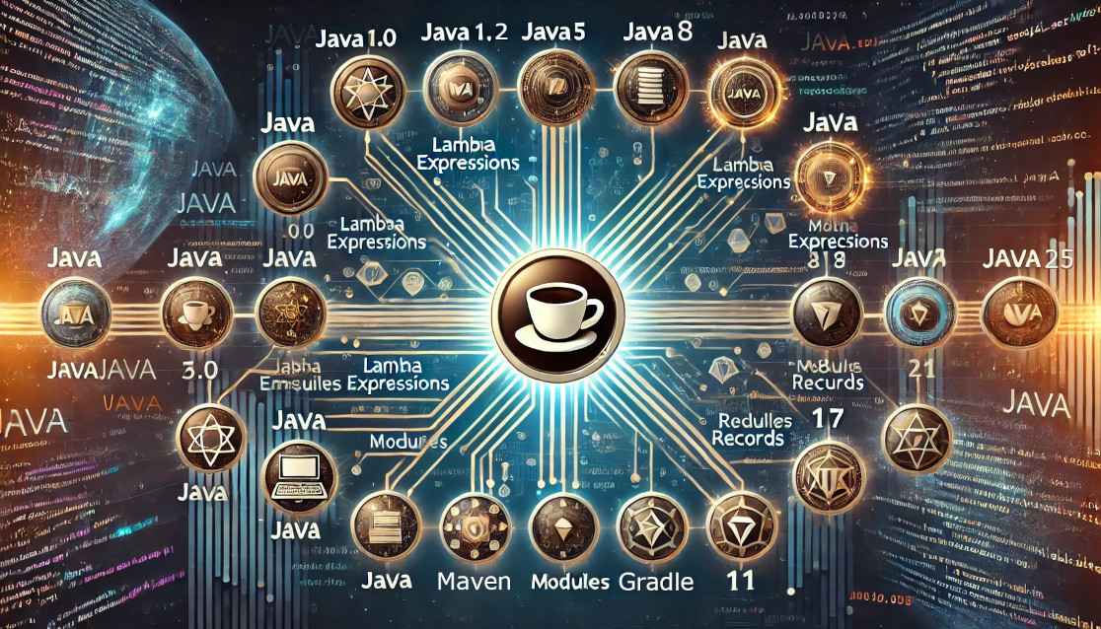

JAVA Version API
Miami JVM Group (MJUG)
https://www.meetup.com/miami-java-user-group/
Thursday, October 17, 2024
Notes:
Java Version API
A presentation for the Miami Java User Group. Thursday, October 17, 2024

Slide 2
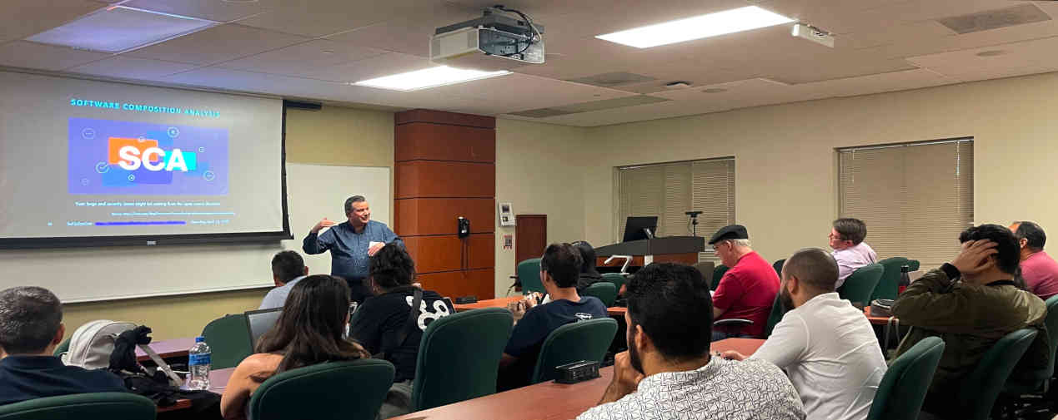
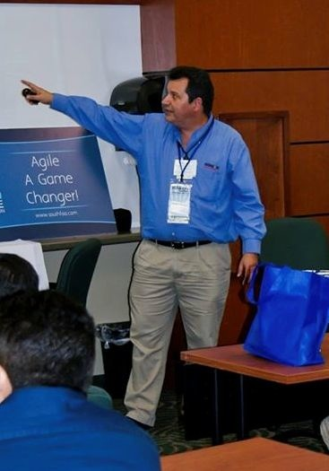








Eugenio Alvarez
A South Florida software engineering professional. Experienced in organizational design, software design, construction, and deployment. Extensive knowledge of Java. Proponent of Unit testing. An advocate for Agile Software Engineering methods using Kanban and Scrum.
www.linkedin.com/in/ealvarez
Miami JVM Group https://www.meetup.com/miami-java-user-group/ Thursday, October 17, 2024
Notes:
Organizer of Miami JVM Group (Miami Java User Group)

Slide 3
What this Meeting is ABOUT
The Java Version API (java.lang.Runtime.Version) was introduced in version 9. The API allows numeric runtime version information to be retrieved inside a running Java application. We will cover use cases and introduce a Runtime Version backport for older versions of Java (8, 7, & 6) that illustrates one use case.
Miami JVM Group https://www.meetup.com/miami-java-user-group/ Thursday, October 17, 2024

Slide 4
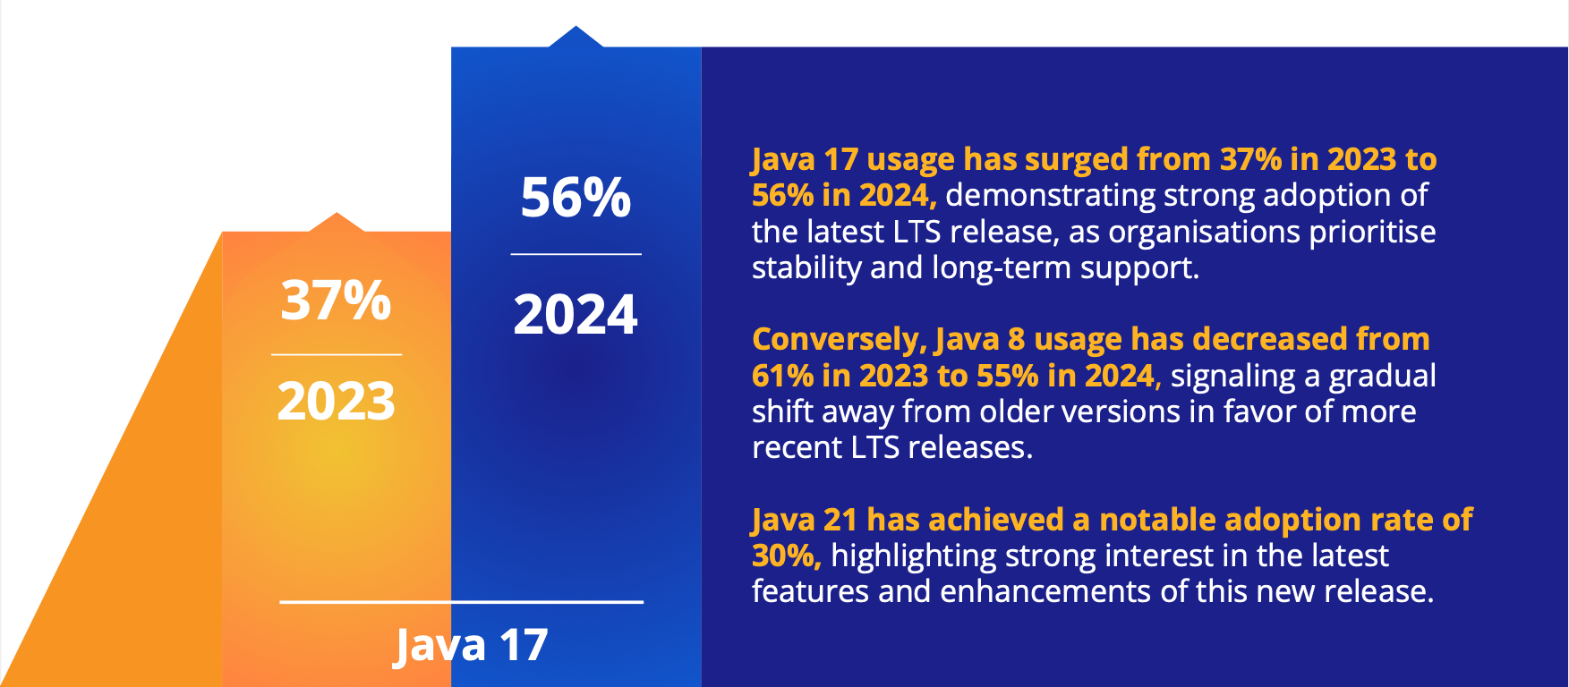
Java Version miGration
Source: 2024 Jakarta EE Developer Survey Report, October 2024 https://outreach.eclipse.foundation/jakarta-ee-developer-survey-2024
Miami JVM Group https://www.meetup.com/miami-java-user-group/ Thursday, October 17, 2024
Notes:
Constant changing of Java versions

Slide 5
Agenda
Compatibility (bytecode versus source code)
Quickly switching between different Java versions
Review Java Version API
What are the use cases for using the Version API
Backported Java Version API to older versions (8, 7 & 6)
Testing between versions
Continuous version updates versus a finish line mentality
Miami JVM Group https://www.meetup.com/miami-java-user-group/ Thursday, October 17, 2024

Slide 6
Compatibility between Java versions
bytecode versus Source Code
Bytecode compatibility
Source code compatibility
Miami JVM Group https://www.meetup.com/miami-java-user-group/ Thursday, October 17, 2024

Slide 7
BYTECODE Compatibility
Miami JVM Group https://www.meetup.com/miami-java-user-group/ Thursday, October 17, 2024
Notes:
Java bytecode / class file version compatibility between versions

Slide 8
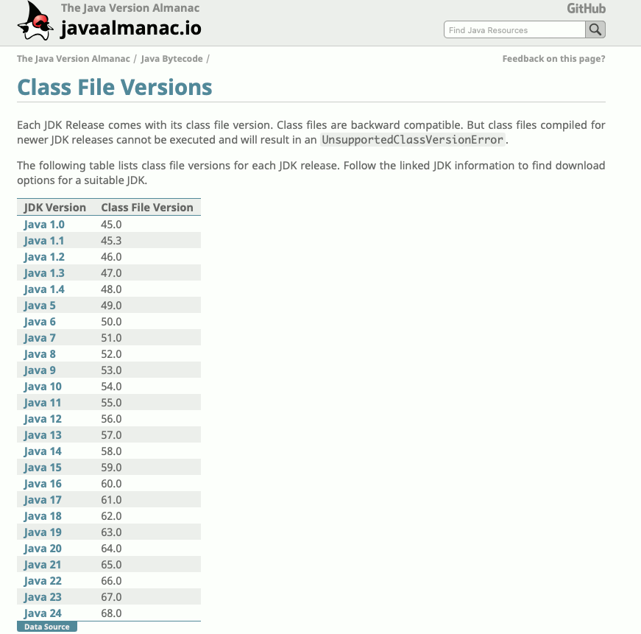
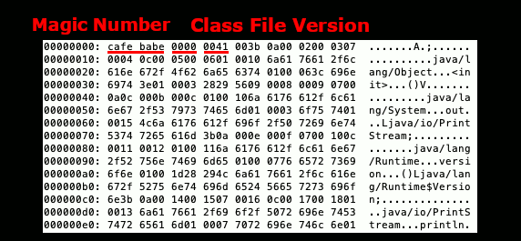
Java Class File / bytecode Versions
Class File Version is two 16-bit numbers 0041 0000 or 65.0
Above example: Hex 0041 is 65
65 - 44 = 21
Example Bytecode for Java Version 21
Source: Java Almanac https://javaalmanac.io/bytecode/versions/
Miami JVM Group https://www.meetup.com/miami-java-user-group/ Thursday, October 17, 2024
Notes:
JDK 1.1 was released February 19, 1997
That is 27 years, 7 months, 28 days ago

Slide 9
Java bytecode Compatibility
Bytecode compatibility refers to the ability of bytecode compiled in an older Java version (e.g., JDK 8) to run on a newer Java runtime (e.g., JDK 11).
Older runtimes do not support newer class file bytecode features
java.lang.UnsupportedClassVersionError if you try running a newer class with older runtime.
Miami JVM Group https://www.meetup.com/miami-java-user-group/ Thursday, October 17, 2024

Slide 10
Java bytecode Compatibility
Bytecode backward compatibility historically much better than source code compatibility.
Biggest issue:
Java runtime may have missing or changed APIs
Miami JVM Group https://www.meetup.com/miami-java-user-group/ Thursday, October 17, 2024

Slide 11
Source Compatibility
Miami JVM Group https://www.meetup.com/miami-java-user-group/ Thursday, October 17, 2024
Notes:
Java source compatibility between versions

Slide 12
Java Source Code Version Compatibility
Source compatibility is generally more work than byte code compatibility
First deploy byte code compiled with previous version
Compiled Java 8 code deployed Java 11, 17, 21 runtimes
Miami JVM Group https://www.meetup.com/miami-java-user-group/ Thursday, October 17, 2024

Slide 13
Compile TIME SOURCE Compatibility
Since Java 1.4 compiler introduced source code and byte code options for backward compatibility
javac -bootclasspath jdk8/jre/lib/rt.jar -source 8 -target 8 Foo.java
Miami JVM Group https://www.meetup.com/miami-java-user-group/ Thursday, October 17, 2024

Slide 14
SOURCE Code Example
String _ = “Hello World”;
Above compiles with Java 7 and older.
Java 7 bytecode works with Java 23
Does not compile with Java 8 or newer
Miami JVM Group https://www.meetup.com/miami-java-user-group/ Thursday, October 17, 2024

Slide 15
Deployment StrategIes
Miami JVM Group https://www.meetup.com/miami-java-user-group/ Thursday, October 17, 2024
Notes:
Deployment strategies

Slide 16
Deployment Version Compatibility
Critical to be able to rollback very quickly in all environments
Blue-green deployments ideal
Load balancer running new and older runtimes
At a minimum, enable quick runtime switching in all environments
Miami JVM Group https://www.meetup.com/miami-java-user-group/ Thursday, October 17, 2024

Slide 17
Quick Java Deployment Options
update-alternatives (Linux / WSL)
sdkman (Linux / WSL / macOS)
jEnv (Linux / WSL / macOS)
Custom scripts
Miami JVM Group https://www.meetup.com/miami-java-user-group/ Thursday, October 17, 2024

Slide 18
alternatives (linux / WSL)
Install java versions using favorite package manager
update-alternatives —list java
sudo update-alternatives —config java
java -version
Source: update-alternatives man page https://man7.org/linux/man-pages/man1/update-alternatives.1.html
Miami JVM Group https://www.meetup.com/miami-java-user-group/ Thursday, October 17, 2024

Slide 19
SDKMAN (linux / WSL / macos)
sdk install java 21.0.4
sdk list
sdk use java 21.0.4
sdk default java 21.0.4
Source: SdkMan website https://sdkman.io/
Miami JVM Group https://www.meetup.com/miami-java-user-group/ Thursday, October 17, 2024

Slide 20
JENV (Linux / WSL /macos)
jenv add /path/to/jdk
jenv versions
jenv global jdkversion
jenv local jdkversion
Source: jEnv website https://www.jenv.be/
Miami JVM Group https://www.meetup.com/miami-java-user-group/ Thursday, October 17, 2024

Slide 21
Custom SCRIPT (Linux / WSL / macos)
Options include:
JAVA_HOME environment variable method along with changing user path
Symbolic links to globally change which java version is in the path
Miami JVM Group https://www.meetup.com/miami-java-user-group/ Thursday, October 17, 2024

Slide 22
Version API
Miami JVM Group https://www.meetup.com/miami-java-user-group/ Thursday, October 17, 2024
Notes:
Review Java version API

Slide 23
REVIEW Java Version API
Introduced in Java 9
Runtime.version().major()
Runtime.version().minor()
Runtime.version().security()
Replaced in Java 10
Runtime.version().feature()
Runtime.version().interim()
Runtime.version().update()
Source: Java 10 JavaDoc https://docs.oracle.com/javase/10/docs/api/java/lang/Runtime.Version.html
Miami JVM Group https://www.meetup.com/miami-java-user-group/ Thursday, October 17, 2024

Slide 24
use cases for the Version API
Prevent execution in wrong runtime
Access new feature runtime
Work around bug
Miami JVM Group https://www.meetup.com/miami-java-user-group/ Thursday, October 17, 2024

Slide 25
Java Version Check Use Case
Prevent execution in wrong runtime
When bytecode is deployed separately from Java runtime.
Miami JVM Group https://www.meetup.com/miami-java-user-group/ Thursday, October 17, 2024

Slide 26
use cases for the Version API
Access new runtime features
Introspection is used to access newer features than the source code.
Miami JVM Group https://www.meetup.com/miami-java-user-group/ Thursday, October 17, 2024

Slide 27
use cases for the Version API
Work around bug(s)
System level feature may be used based on version to work around a behavior in a specific version
Miami JVM Group https://www.meetup.com/miami-java-user-group/ Thursday, October 17, 2024

Slide 28
Version API backport
Miami JVM Group https://www.meetup.com/miami-java-user-group/ Thursday, October 17, 2024
Notes:
Java version API backport

Slide 29
VERSION API Backport Details
Reimplements API in versions 8, 7, 6
Uses introspection in version 9 and newer
RuntimeVersion.version().feature()
RuntimeVersion.version().interim()
RuntimeVersion.version().update()
RuntimeVersion.version().version()
RuntimeVersion.version().parse()
Source: GitHub Repository: https://github.com/MiamiJUG
Miami JVM Group https://www.meetup.com/miami-java-user-group/ Thursday, October 17, 2024

Slide 30
TESTing between VERSIONs
Ability to switch between versions is key to developer testing
Integration test environment must test multiple Java version when migrating
Miami JVM Group https://www.meetup.com/miami-java-user-group/ Thursday, October 17, 2024

Slide 31
Continuous VERSION updates
Java version X or Y is not the finish line
Continuous updating is necessary to keep up
“To improve is to change; to be perfect is to change often”
Winston Churchill
Source: Churchill By Himself: The Definitive Collection of Quotations https://www.amazon.com/Churchill-Himself-Definitive-Collection-Quotations/dp/1586489577
Miami JVM Group https://www.meetup.com/miami-java-user-group/ Thursday, October 17, 2024

Slide 32

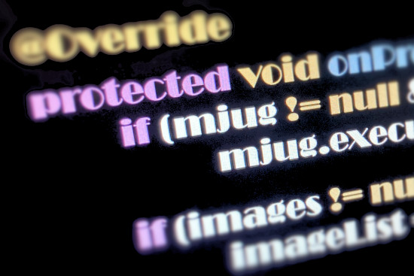

Thank You
Miami JVM Group (MJUG)
https://www.meetup.com/miami-java-user-group/
www.linkedin.com/in/ealvarez
Miami JVM Group https://www.meetup.com/miami-java-user-group/ Thursday, October 17, 2024
Notes:
Thank You

Slide 33
REFERENCES
Oracle JDK Migration Guide (Java 11)
https://docs.oracle.com/en/java/javase/11/migrate/index.html
2024 Jakarta EE Developer Survey Report, October 2024
https://outreach.eclipse.foundation/jakarta-ee-developer-survey-2024
Java System Properties (Java 17)
https://docs.oracle.com/en/java/javase/17/docs/api/system-properties.html
Java Class File Versions
https://javaalmanac.io/bytecode/versions/
Java 10 Runtime.Version JavaDoc
https://docs.oracle.com/javase/10/docs/api/java/lang/Runtime.Version.html
Miami JVM Group https://www.meetup.com/miami-java-user-group/ Thursday, October 17, 2024
Notes:
References

Slide 34
REFERENCES
Update-alternatives man page
https://man7.org/linux/man-pages/man1/update-alternatives.1.html
SDKMAN website
https://sdkman.io/
jEnv website
https://www.jenv.be/
Churchill By Himself: The Definitive Collection of Quotations
https://www.amazon.com/Churchill-Himself-Definitive-Collection-Quotations/dp/1586489577
Miami JVM Group https://www.meetup.com/miami-java-user-group/ Thursday, October 17, 2024
Notes:
References

