Slide 1
KanBAn
看板
Discovering
ITPalooza 2014
http://itpalooza.com
December 4, 2014

Slide 2
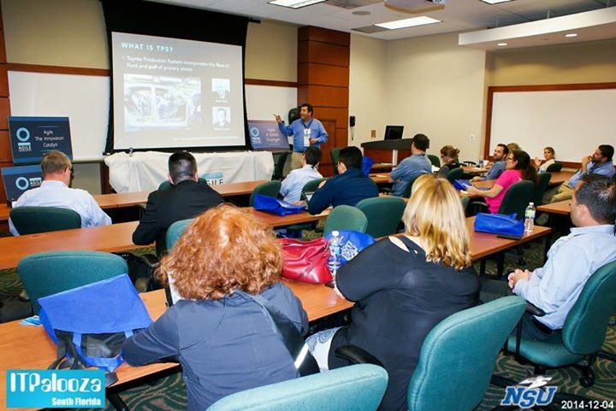
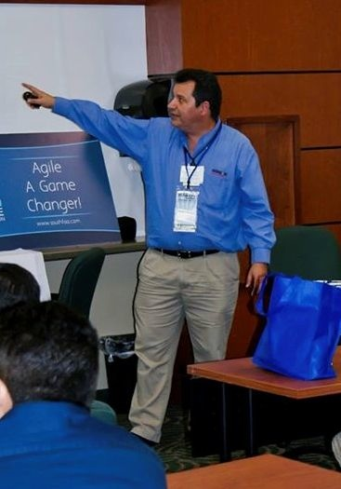





Eugenio Alvarez
A South Florida software development professional with 20 plus years of experience in the design, construction and deployment of software. The bulk of my experience is as a software developer. Unit test infected since 1999. I have been working as a Software Development Manager and Development Director for the last 6 years. Focusing on agile software development methods since 2013.
www.linkedin.com/in/ealvarez

Slide 3
INTRODUCTION (SomETHING NEW)
You have heard that agile software development is the way to go. You probably have heard of Scrum and XP, but there is a relatively newer form of agile development called “Kanban” that has been gaining market share in the last few years.

Slide 4
INTRODUCTION (WHY USE IT?)
Kanban’s recent popularity stems from its ease of implementation, use of visual cues, ability to handle a wide variety of software development and operations teams. Some groups have turned to Kanban when popular methods did not generate the desired results.

Slide 5
INTRODUCTION (questions)
So, what exactly is Kanban?
How is it related to other agile methods?
When would you use Kanban versus other methods?
Is Kanban is right for my group?
How do I get started?

Slide 6
WHAT AGILE METHOD TO USE?
Backstory
September 2013
We are going Agile with a Scrum team
What about the other teams with just one or two developers?
The journey to find the appropriate Agile method

Slide 7
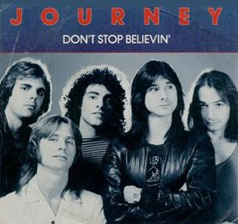
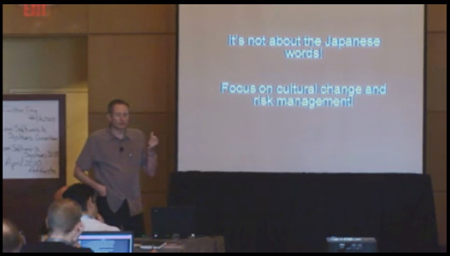
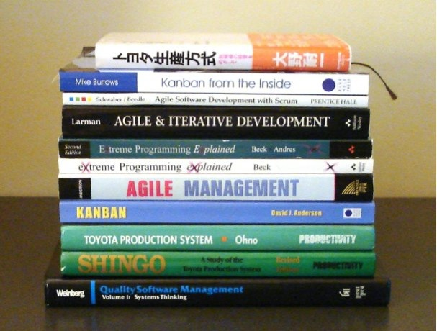
The JOURNEY, DON’t STOP BELIEVIN'
Training Classes
Audiobooks
Certified ScrumMaster, Oct 2013
Certified Product Owner, Mar 2014
Scrumban Workshop, July 2014
Scaled Agile, Nov 2014
Videos
Books
Source: http://en.wikipedia.org/wiki/File:Don%27t_Stop_Believin%27.jpg

Slide 8
What Agile approach is Your Organization USING (Select all that Apply)?
8
Source: The State of Scrum Report, ScrumAlliance, June 2013

Slide 9
“.. KANBAN CONTINUES TO GAIN POPULARITY AMONG TEAMS (7% INCREASE).”
“.. Scrum and Scrum
variants (73%) remain the
most popular agile
methodologies being used.”
Source: State of Agile Development Survey, VersionOne, 2014

Slide 10
FRAMEWORK Versus methodology
A framework is an incomplete set of practices needed for software construction. Gaps are filled with additional methods and/or tools to make a working methodology.
A methodology includes a full set of practices and tools needed for software construction. It is common to omit parts of a full methodology that are not appropriate for a given environment.

Slide 11
AGILE METHODS are becoming MORE ADAPTIVE and LESS PRESCRIPTIVE
Counting method roles, activities and artifacts
Source: Henrik Kniberg & Mattias Skarin (2010), Kanban and Scrum, making the most of both.
Notes:
Source: Henrik Kniberg & Mattias Skarin (2010), Kanban and Scrum, making the most of both.

Slide 12
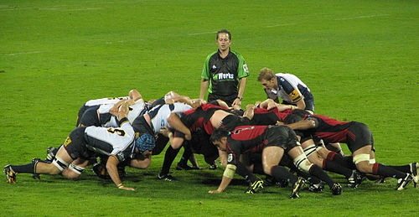
SCRUM
An agile software development framework
Scrum name originates from Rugby term “scrummage”
Inspired by “The New New Product Development Game”, Takeuchi and Nonaka, 1986 Harvard Business Review
Source: http://en.wikipedia.org/wiki/File:Scrum-1.JPG
Notes:
Jeff Sutherland & Ken Schwaber

Slide 13
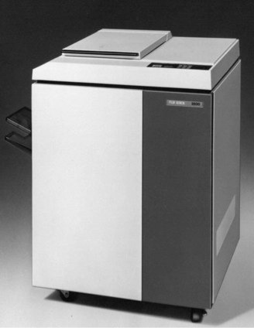

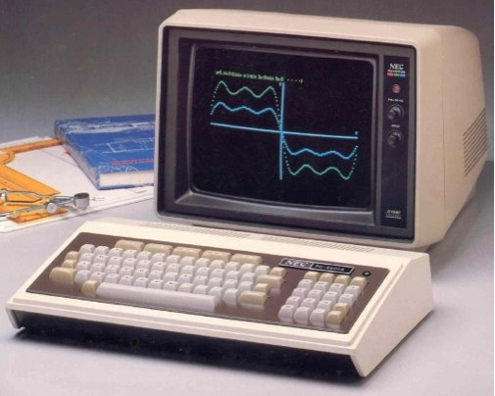
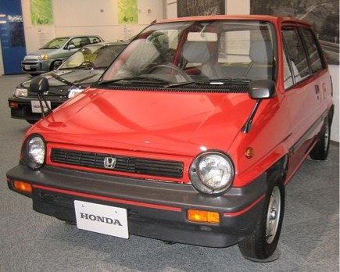
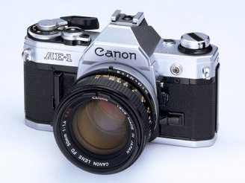
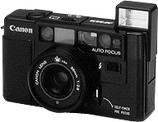
SCRUM Inspiration
“The New New Product Development Game”, Takeuchi and Nonaka, 1986 Harvard Business Review
PC-10 Canon 1982
FX-3500 Fuji-Xerox 1978
PC 8000 NEC 1979
AE-1 Canon 1976
City car Honda 1981
Auto Boy Canon 1979
Source: http://hbr.org/1986/01/the-new-new-product-development-game/
Notes:
Hirotaka Takeuchi & Ikujiro Nonaka. Analyzed the development process of six specific products Fuji-Xerox: Two years to come up with a machine a half the cost but still perform as well a the current high-end machines.
IBM PC (Boca example) AE-1 30% lower prices compared with existing single lens camara.

Slide 14
TO SCRUMBUT or NOT to SCRUMBUT?
That is the question
Scrum requirements
Team size 5 to 9
Cross-functional team
Specified roles: Scrum Master, Product Owner, Team
Sprint without interruptions (Timeboxed 2-4 weeks)
Source: http://en.wikipedia.org/wiki/File:Scrum-1.JPG
Notes:
Jeff Sutherland & Ken Schwaber

Slide 15
SCRUMBAN
Combination of Scrum and Kanban
Coined and described by Corey Ladas
Evolving of Scrum to Kanban
Scrum
Kanban
Kanban
Scrum
Source: http://leansoftwareengineering.com/ksse/scrum-ban/
Notes:
Ladas worked with David Anderson.

Slide 16
Scrum / XP Hybrid
Combination of Scrum Framework with XP practices
SCRUM
eXtreme
Programming
(XP)
Notes:
Kent Beck, Ward Cunningham

Slide 17
SCRUM and EXTREME PROGRAMMING
SCRUM | XP
Sprint | Iteration
SpRINT planning | Planning Game
Product Owner | CUSTOMER
RETROSPECTIVE | REFLECTION
Scrum Master | Project Manager
Daily Scrum | Daily Standup

Slide 18
THE KANBAN METHOD
看板
KanBAn
An Agile software development method
Kanban originates from Japanese [看板] where kan means “visual” and ban means “card” or “board”
Influenced by Lean Manufacturing, the Toyota Production System (TPS) and Eliyahu Goldratt’s Theory of Constraints (TOC)
Developed by David J. Anderson

Slide 19
WHY KANBAN?
Ease of implementation
Accelerate time to market
More easily manage changing priorities
Better align IT and business objectives
Increase productivity
Enhance software quality
Project visibility

Slide 20
FIRST a little background
Let’s step back and discuss a few terms
Flow
Push
Pull
TPS
Lean

Slide 21
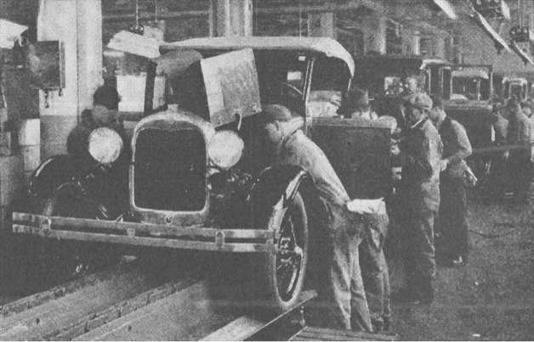
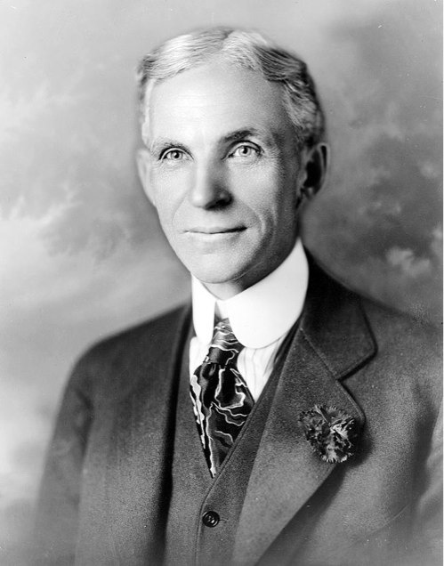
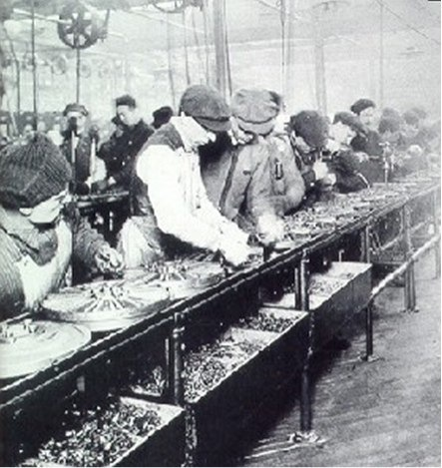
WHAT IS FLOW?
Henry Ford pioneered the assembly line aka “flow lines”
Notes:
Different from “mental state” of flow defined by Mihály Csíkszentmihályi (aka in the Zone).
Pronunciation guide: Me-high Cheek-sent-me-high

Slide 22
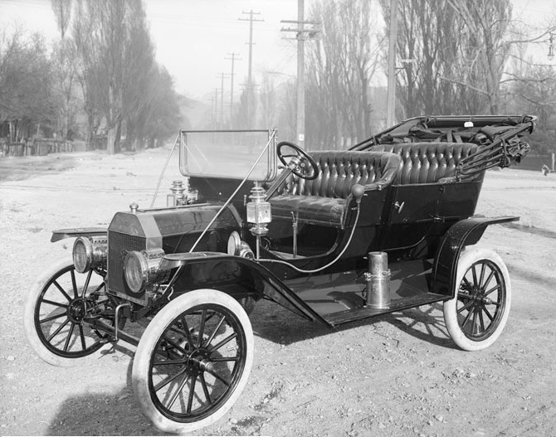
What is a PUSH?
“Any customer can have a car painted any colour that he wants so long as it is black” Henry Ford
Ford Model T
Source: Henry Ford (1922), My Life and Work

Slide 23
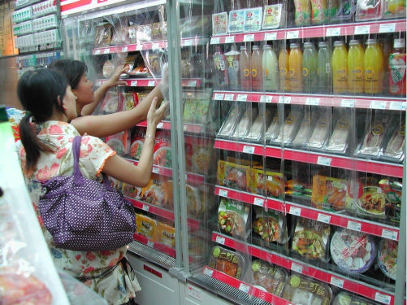
What is Pull?
Grocery store refills items based on customer “pulling” inventory
Source: http://en.wikipedia.org/wiki/File:Frozen_dimsum.JPG

Slide 24
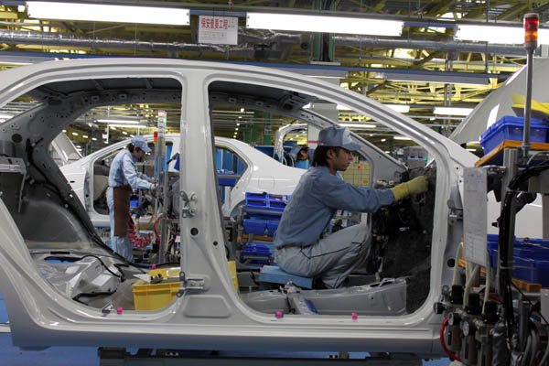
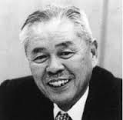
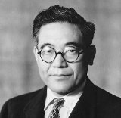
What is TPS?
Toyota Production System incorporates the flow of Ford and pull of grocery stores.
Taiichi Ohno
Kiichiro Toyoda
Source: http://en.wikipedia.org/wiki/File:Toyota_Plant_Ohira_Sendai.jpg

Slide 25
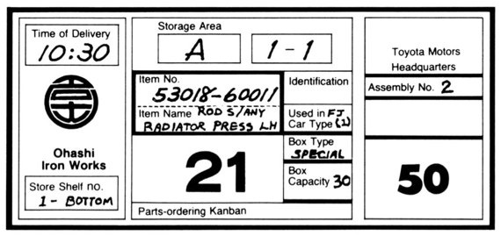
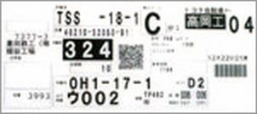
KANBAN and TPS
kanban card, circa 1978
e-kanban card, Today
What is kanban?
“The operating method of the Toyota production system is kanban. Its most frequently used form is a piece of paper contained in a rectangular vinyl envelope.”
Taiichi Ohno (1978). Toyota production System

Slide 26
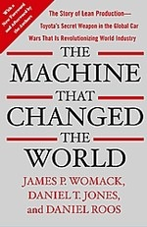
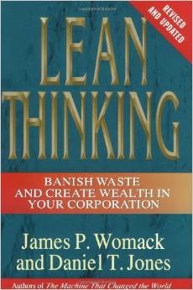
WHAT IS LEAN?
Womack, Jones and Roos provide a comprehensive description of the entire [Toyota] lean system…Indeed, they argued that it would triumph not just in manufacturing but in every value-creating activity from health care to retail distribution.
The Kanban Method includes many Lean principles and practices
Source: http://en.wikipedia.org/wiki/Lean_manufacturing
Notes:
Book: The Lean Startup, Eric Ries

Slide 27
FINISHING WITH background
Quick review of discussed terms
Flow
Push
Pull
TPS
Lean

Slide 28
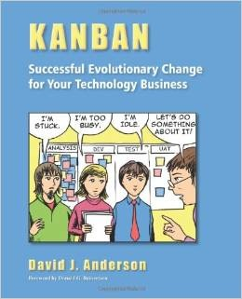
WHAT is the KANBAN METHOD?
“… I describe Kanban (capital K) as the evolutionary change method that utilizes a kanban (small k) pull system, visualization, and other tools to catalyze the introduction of Lean ideas into technology development and IT operations.”
David J. Anderson (2010).
Kanban
Successful Evolutionary Change
for Your Technology Business
Notes:
Mike Burrows. (2014). Kanban from the Inside

Slide 29
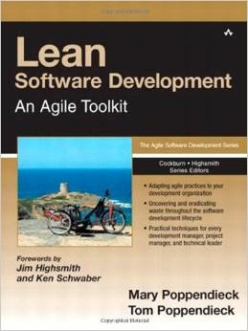
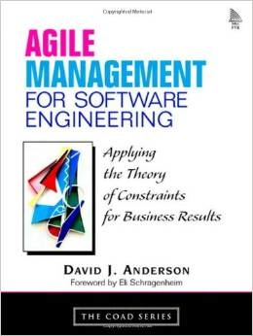
ThE ROAD to KANBAN
The Kanban Method is not a immediate descendant from TPS and Lean.
Mary and Tom Poppendieck’s (2003). Lean Software Development
David J. Anderson’s (2003). Agile Management Applying the Theory of Constraints
This explains among other things the lack of Japanese terms in the Kanban Method
Source: http://en.wikipedia.org/wiki/Lean_software_development
Notes:
Eliyahu M. Goldratt. (1984). The Goal: A Process of Ongoing Improvement
DBR (Drum-Buffer-Rope)
CCR (Capacity constraint resource)

Slide 30
THE KANBAN METHOD
看板
KanBAn
Four guiding Principles
Six core Practices
Notes:
Not including Mike Burrows’ 9 values.

Slide 31
Kanban Method principles
Start with what you know
Agree to pursue evolutionary change
Initially, respect roles, responsibilities and job titles
Encourage acts of leadership at all levels
Source: Mike Burrows (2014), Kanban from the Inside.

Slide 32
Kanban Method PRACTICES
Visualize
Limit work-in-progress (WIP)
Manage flow
Make policies explicit
Implement feedback loops
Improve collaboratively, evolve experimentally (using models and the scientific method)
Source: Mike Burrows (2014), Kanban from the Inside.

Slide 33
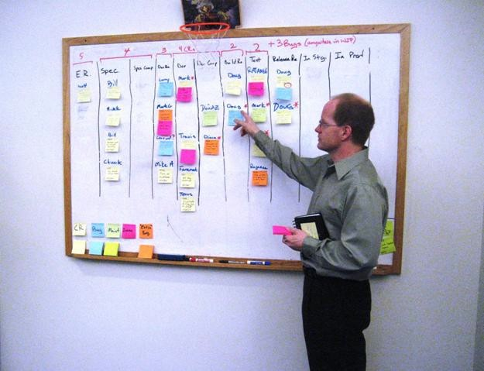
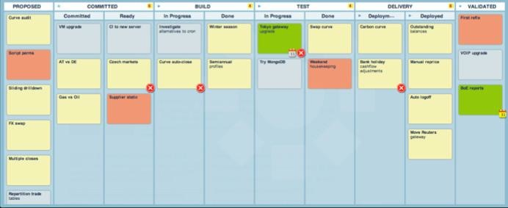
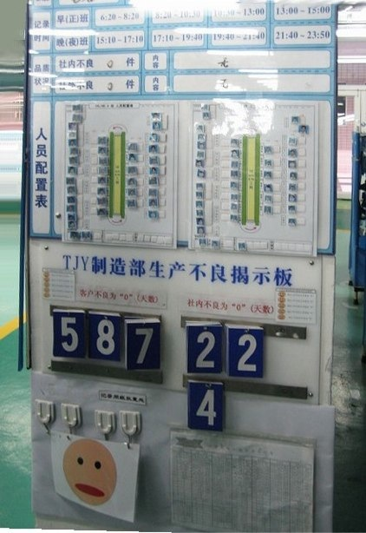
VISUALIZE
Kanban boards
Visual work management
heijunka board

Slide 34

LIMIT WORK IN PROGRESS (WIP)
“Do you realize what impact multi-tasking has on lead time?”
A
B
C
10
10
10
A
B
C
A
B
C
20
20
20
Source: Eliyahu M. Goldratt (1997), Critical Chain
Notes:
Eliyahu M. Goldratt. (1984). The Goal: A Process of Ongoing Improvement

Slide 35
MANAGE FLOW
Cumulative Flow Diagrams (CFD)

Slide 36
Make Policies EXPLICIT
Explicit policies are on the board.
Board rules

Slide 37
IMPLEMENT FEEDBACK LOOPS
Daily standup meetings
Weekly replenishment meetings
Monthly operations review meetings
Notes:
Daily Scrum
Sprint Planning
Scrum Sprint Retrospective

Slide 38
IMPROVE, EVOLVE
Improve collaboratively, evolve experimentally (using models and the scientific method).
Notes:
Finishing Kanban principles and practices.

Slide 39
TO SCRUM, KANBAN OR BOTH?
Do you have separate teams for new development and maintenance?
Do have a enough people for a cross-functional Scrum team?
Can your team focus for 2-4 weeks with minimal interruption?
Is the company culture against Agile?

Slide 40
GETTING STARTED WITH KANBAN
Proto-Kanban
Get a whiteboard
Map your value stream (Todo, WIP, Done)
Limit WIP to 2 cards per person
Start a daily standup

Slide 41
Conclusion
看板
KanBAn
Kanban provides an agile method that works along with other software development methods or by itself.
Kanban’s ease of implementation allows for its deployment in a wide variety of environments.
Kanban is a significant improvement over “ad hoc” software development
Kanban is a method that can be considered for all aspects of IT include portfolio management, software development and operations.

Slide 42
REFERENCES
VersionOne. (2014). State of Agile Development Survey
http://www.versionone.com/pdf/2013-state-of-agile-survey.pdf
ScrumAlliance, (June 2013). The State of Scrum Report
https://www.scrumalliance.org/why-scrum/state-of-scrum-report
Henrik Kniberg & Mattias Skarin. (2010). Kanban and Scrum, making the most of both.
http://www.infoq.com/minibooks/kanban-scrum-minibook
Jeff Sutherland & Ken Schwaber. (2013). The Scrum Guide™
http://www.scrumguides.org/

Slide 43
REFERENCES
Hirotaka Takeuchi & Ikujiro Nonaka. (1986). The New New Product Development Game. Harvard Business Review
http://hbr.org/1986/01/the-new-new-product-development-game/
Jeff Sutherland. (2010). Roots of Scrum: Takeuchi and Self-Organizing Teams
http://www.scruminc.com/roots-of-scrum-takeuchi-and-nonaka/
Corey Ladas. (2008). Scrum-ban
http://leansoftwareengineering.com/ksse/scrum-ban/
Extreme Programming (XP)
http://en.wikipedia.org/wiki/Extreme_programming
Henry Ford. (1922). My Life and Work
http://www.amazon.com/My-Life-Work-Autobiography-Henry/dp/149428300X/

Slide 44
REFERENCES
Taiichi Ohno. (1978). Toyota production System
http://www.amazon.com/Toyota-Production-System-Beyond-Large-Scale/dp/0915299143/
Lean Manufacturing
http://en.wikipedia.org/wiki/Lean_manufacturing
Lean software development
http://en.wikipedia.org/wiki/Lean_software_development
David J. Anderson. (2010). Kanban Successful Evolutionary Change
http://www.djaa.com/kanban-successful-evolutionary-change-your-technology-business-0
Mary and Tom Poppendieck. (2003). Lean Software Development
http://www.amazon.com/Lean-Software-Development-Agile-Toolkit/dp/0321150783/

Slide 45
REFERENCES
David J. Anderson. (2003). Agile Management Applying the Theory of Constraints
http://www.amazon.com/Agile-Management-Software-Engineering-Constraints/dp/0131424602/
David J. Anderson. (2009) Lean Kanban Conference (Miami), keynote presentation, slide 13, “It’s not about the Japanese words!”
http://www.sep.com/lk2009/david-anderson-kanban-applying-principles-and-evolving-process-solutions/
Mike Burrows. (2014). Kanban from the Inside
http://www.djaa.com/kanban-inside
Eliyahu M. Goldratt. (1984). The Goal: A Process of Ongoing Improvement
http://www.amazon.com/Goal-Process-Ongoing-Improvement/dp/0884271951/
Eliyahu M. Goldratt. (1997). Critical Chain
http://www.amazon.com/Critical-Chain-Eliyahu-M-Goldratt/dp/0884271536/

