Slide 1
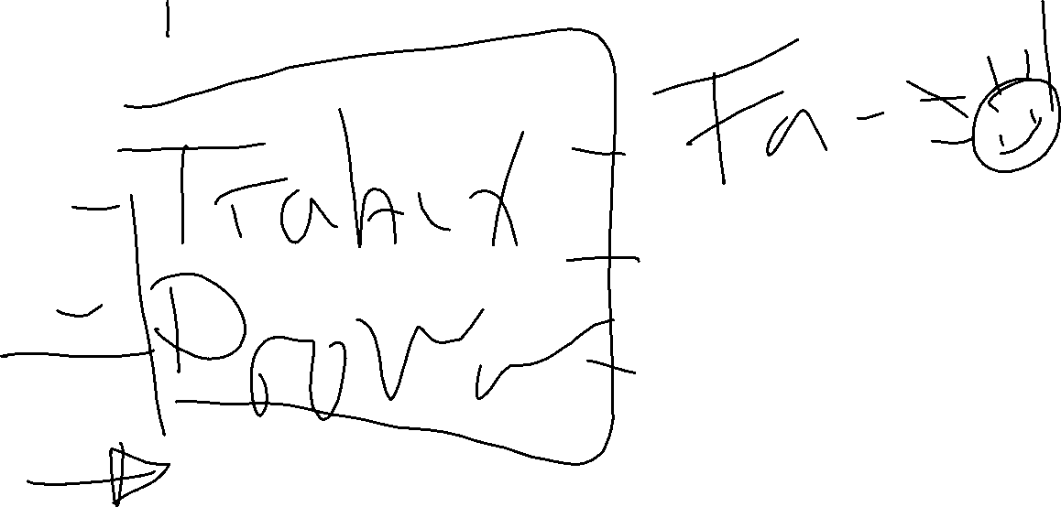
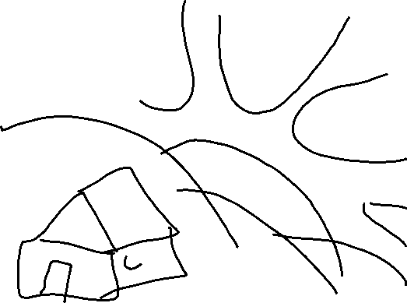
Agrofam
eco fam
Kampo
Sunny farm
Yapu solutions
Yuuuupyyyy
Yapu innovations
Happy communities
Leaders

Slide 2

Drop solutions
Thrive
Life rescue
Cacahuate
Spin solutions
Life drops

Slide 3
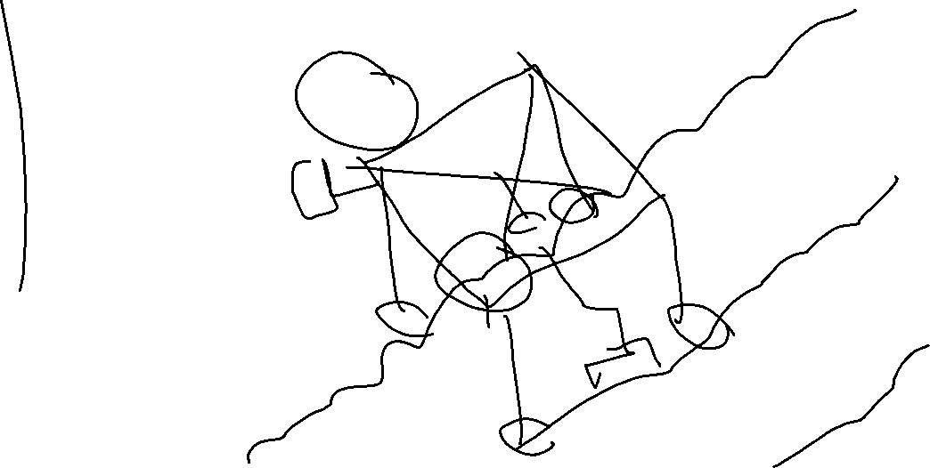

Slide 4
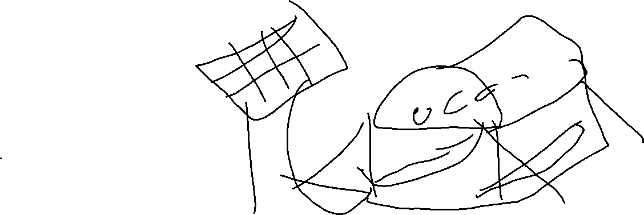
`

Slide 5

AGRO UP

