Slide 1

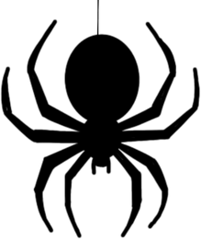
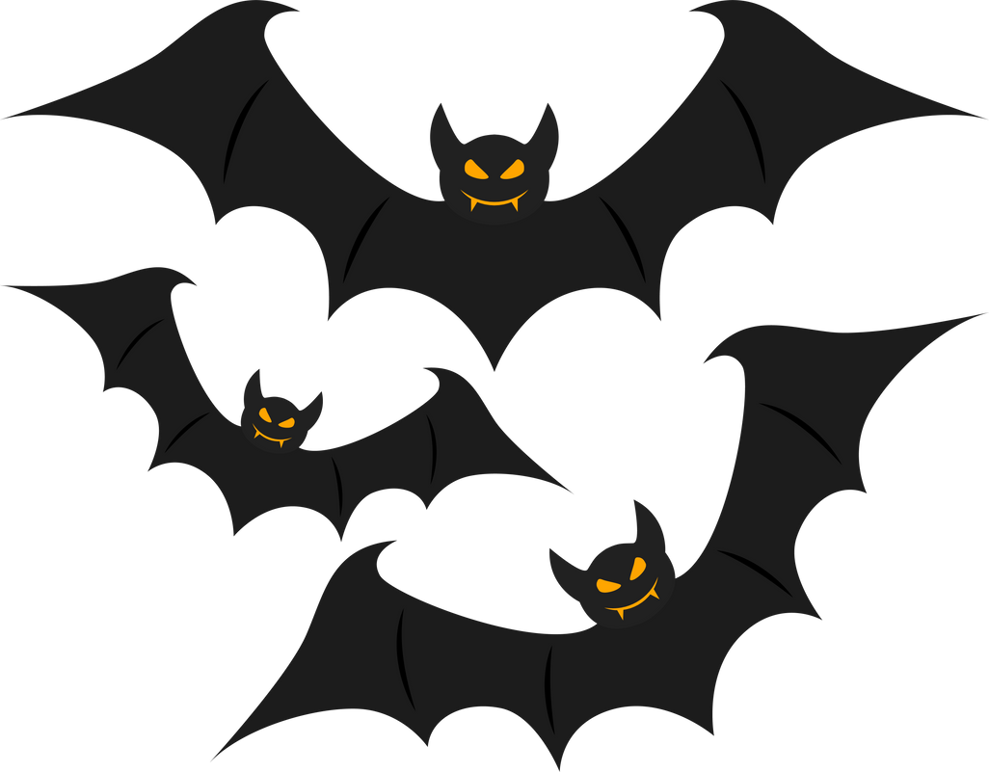
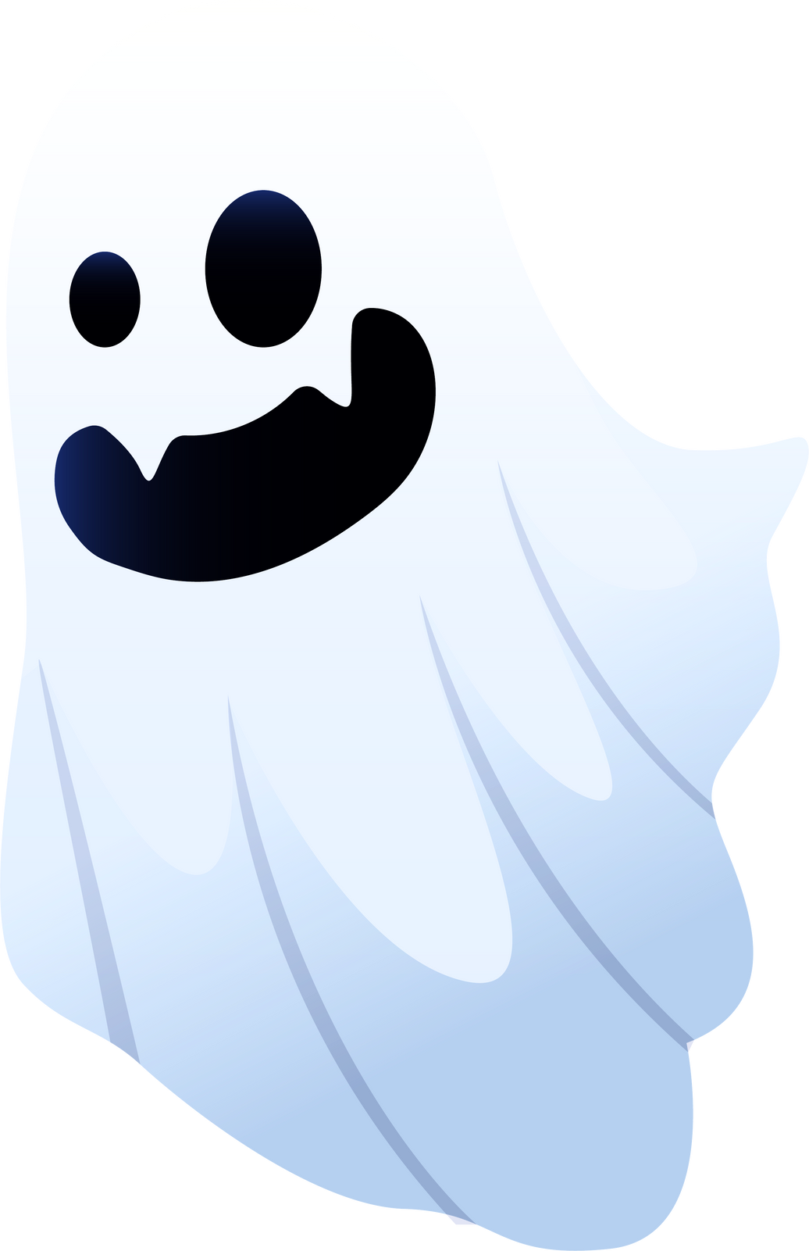
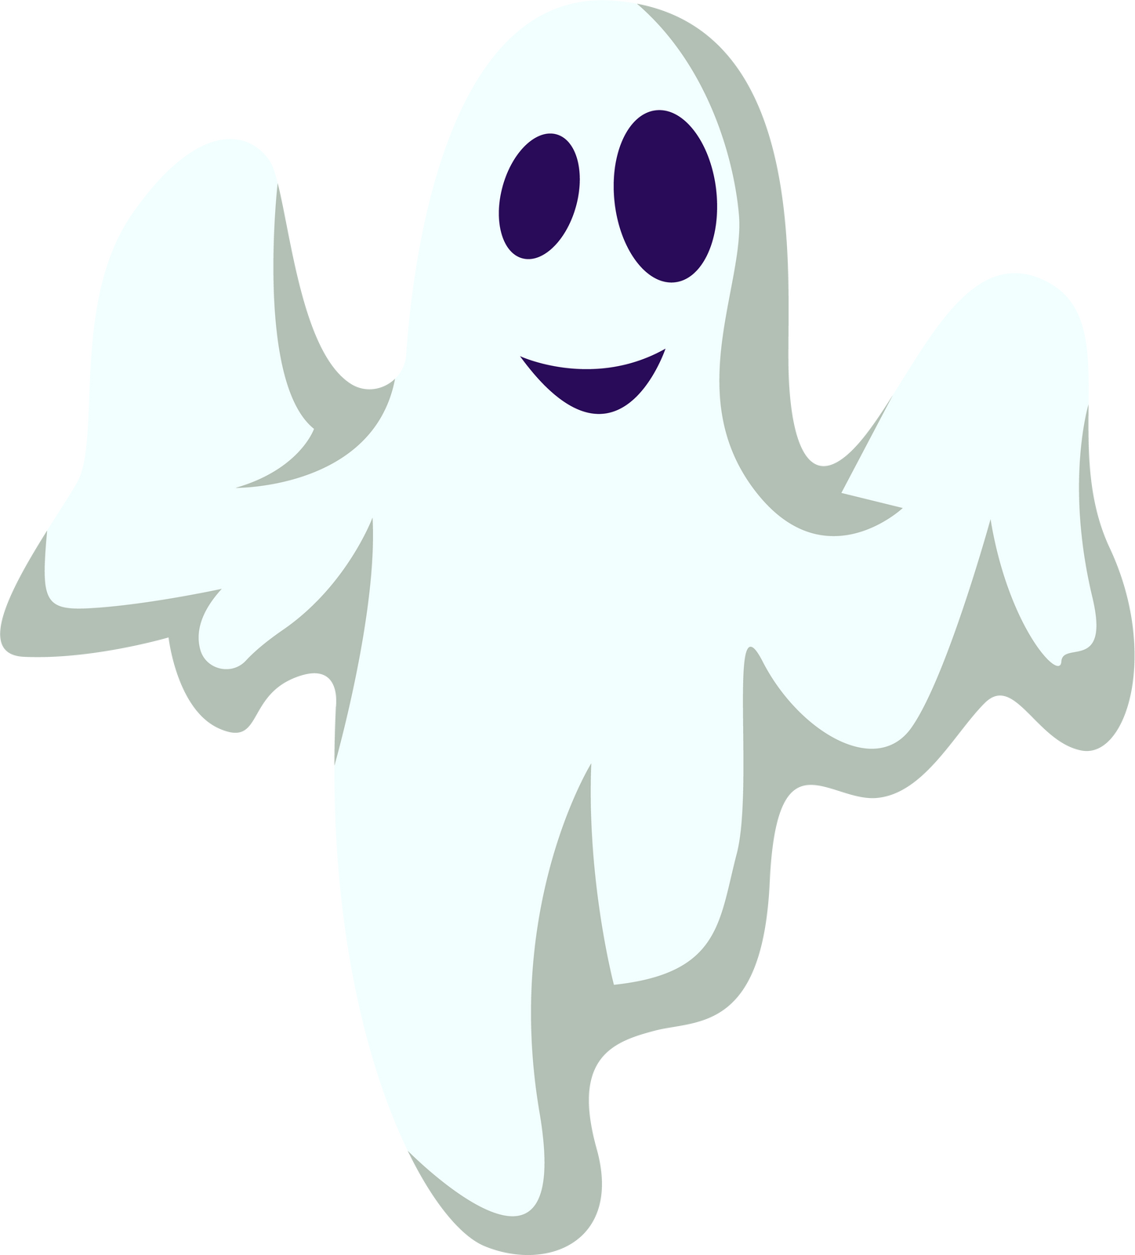

Happy

Slide 2
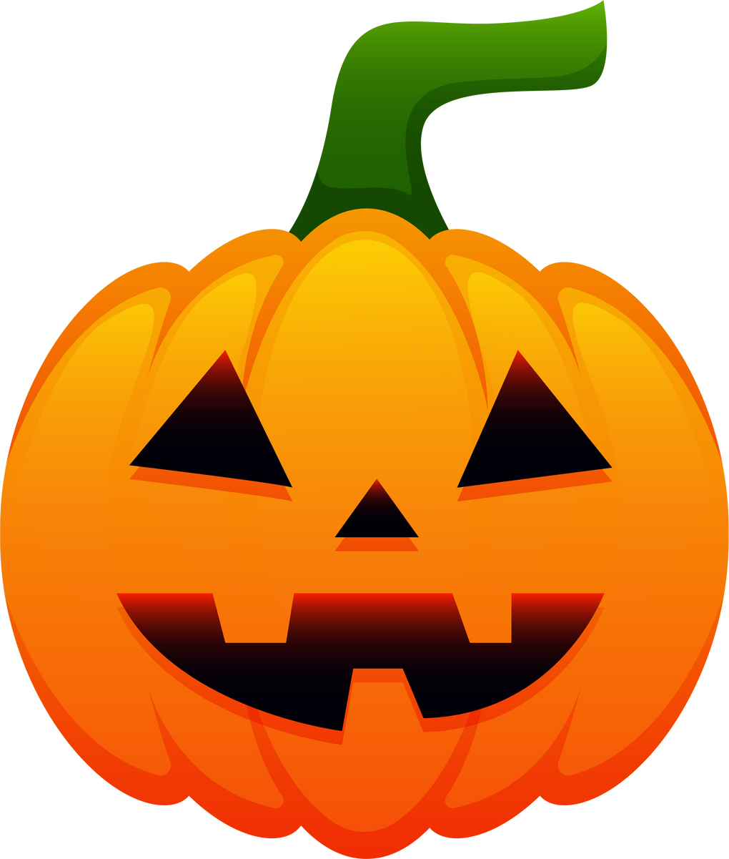
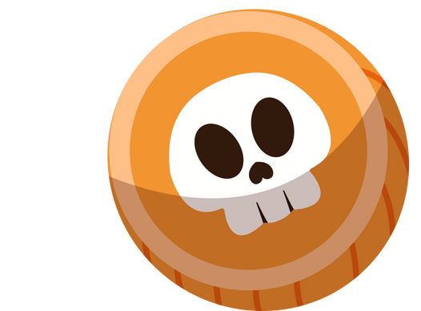
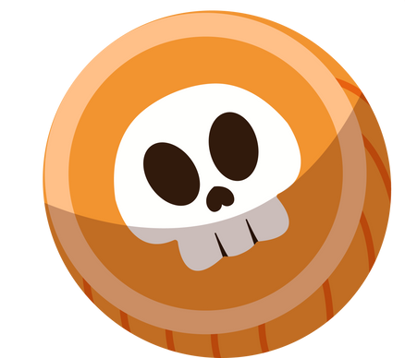
Origin of Halloween
Samhain (pronounced "so-in") is an ancient Celtic festival that marks the end of the harvest and the start of winter. It originated around 2,500 years ago, and was celebrated from sunset on the 31st October to sunset on the 1st November in places like Ireland and Scotland.

Slide 3
Origin of Halloween
The Celts believed that during Samhain, the line between the worlds of the living and the dead was thinner, so spirits could come back to Earth. People lit big fires and wore costumes to scare away bad spirits. They also left food and drink for gods and ancestors and tried to predict the future.

Slide 4
Origin of Halloween
When Christianity spread, Samhain mixed with Christian holidays like All Saints' Day, and eventually, it influenced Halloween. Today, some people still celebrate Samhain as a spiritual festival.

Slide 5
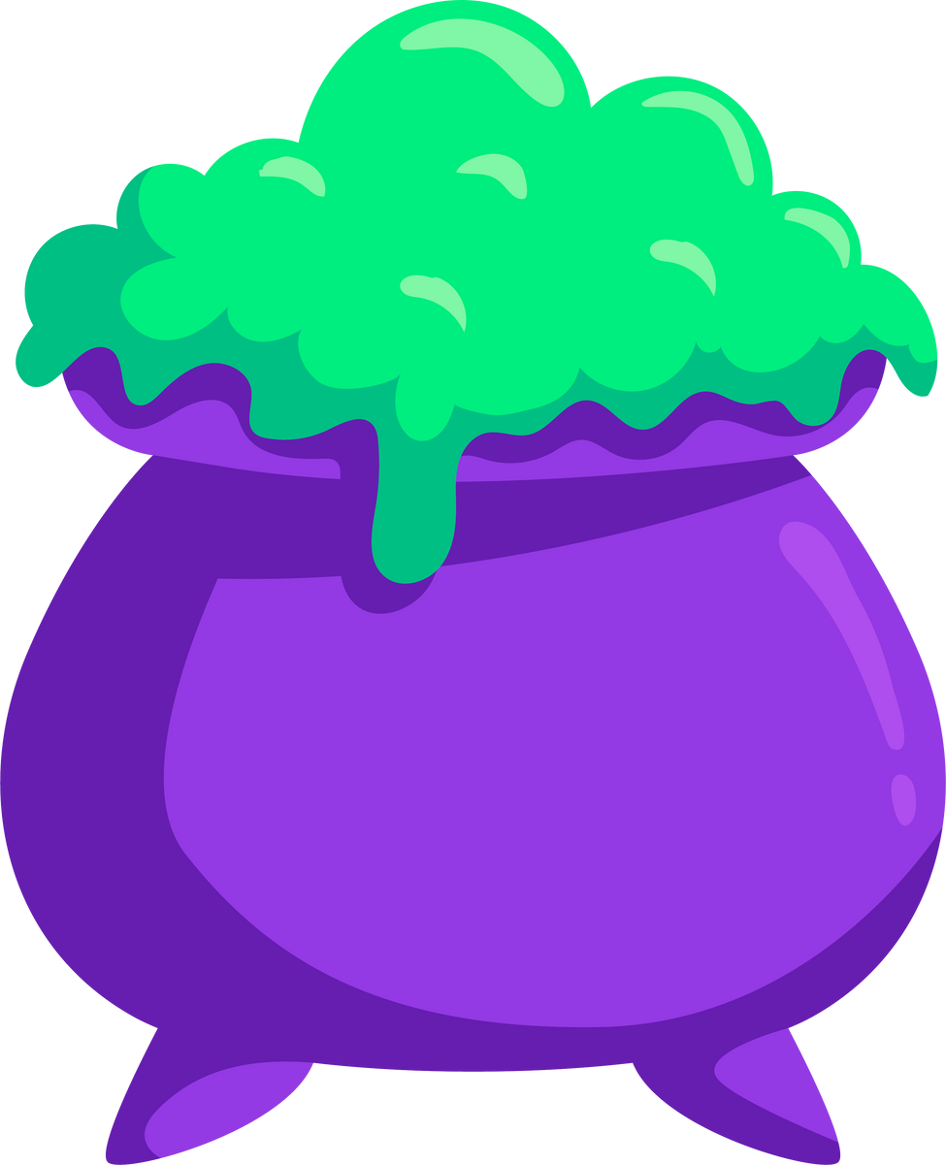
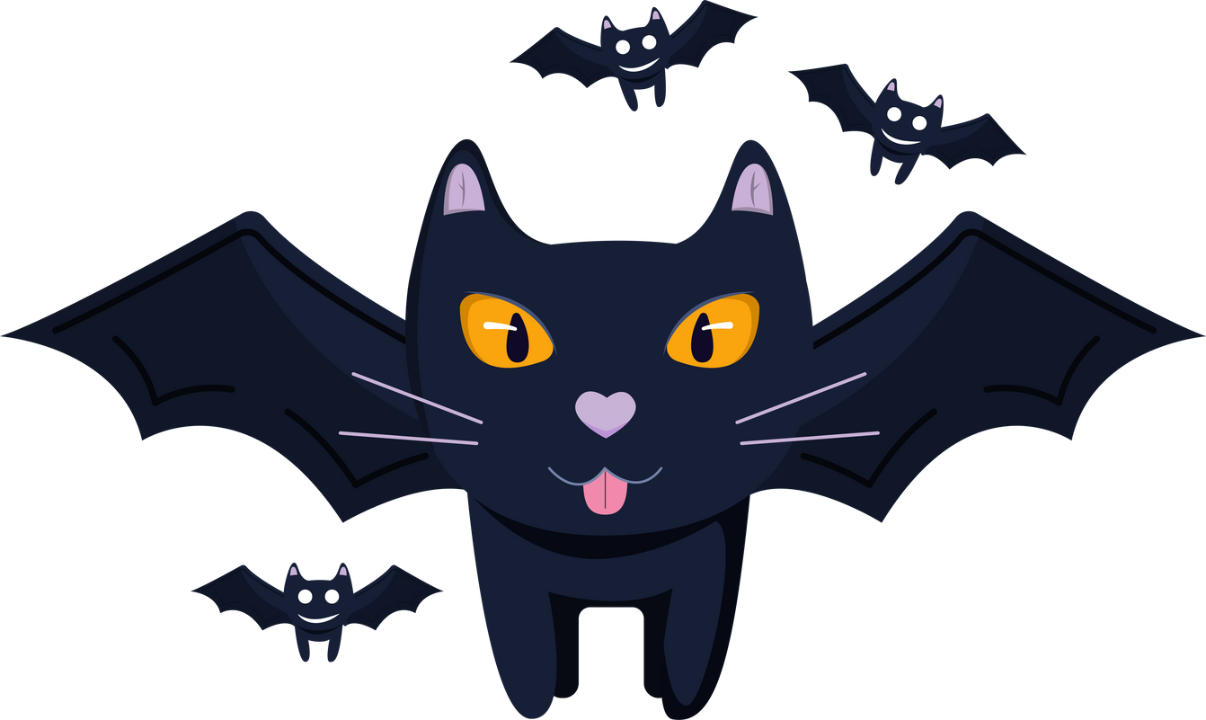
Now to you:
  Do you like Halloween, and what is your favourite tradition? Not really
  What do you usually do for Halloween? Nothing
  Do you like to dress up for Halloween, and what have you dressed up as before?
  Not really
  Do you believe in ghosts or other supernatural beings?
  Do you think Halloween should be more about fun or more about its original meaning?

Slide 6
Match the words with the pictures

Slide 7
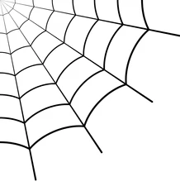
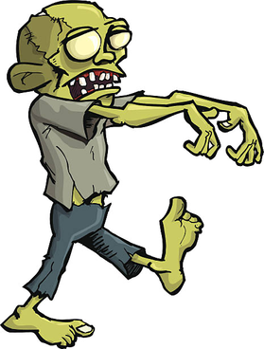
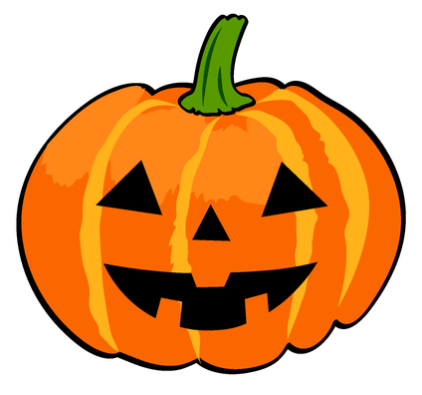
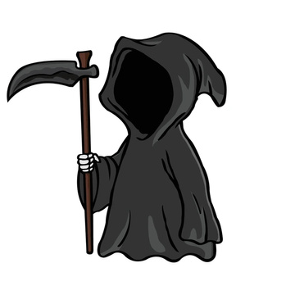
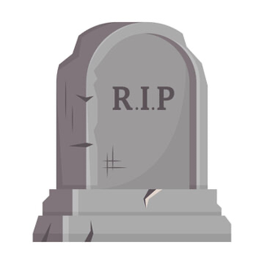
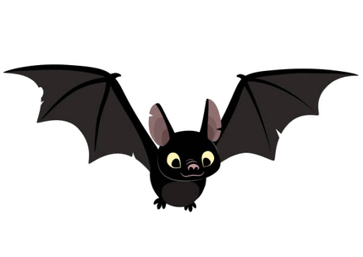
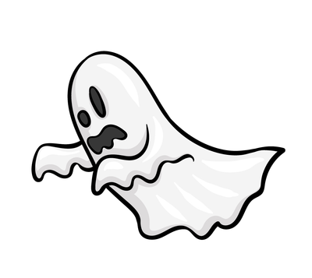
cobweb
pumpkin
zombie
grim reaper
headstone
ghost
bat

Slide 8
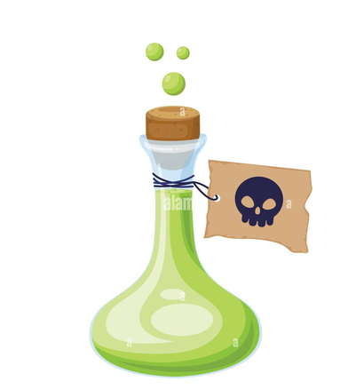
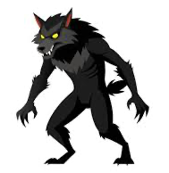
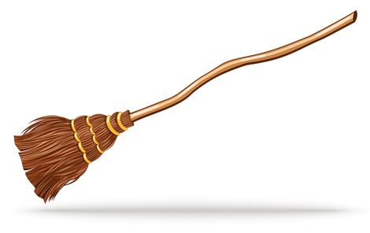
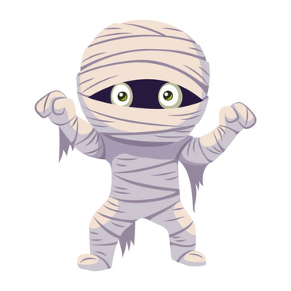
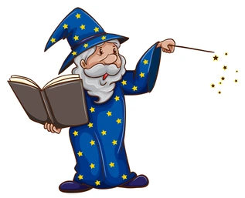
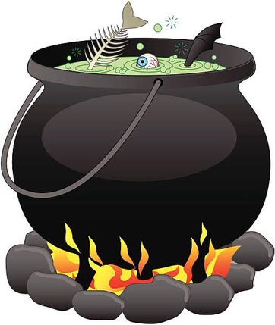
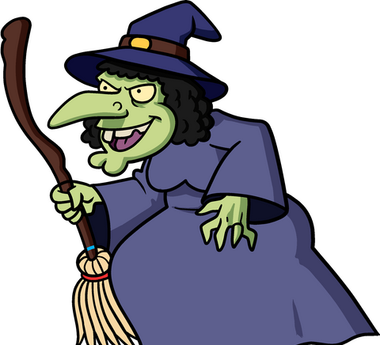
potion
werewolf
broomstick
mummy
wizard
witch
cauldron

Slide 9
u
u
u
u
u
u
u
thank you

