Slide 1

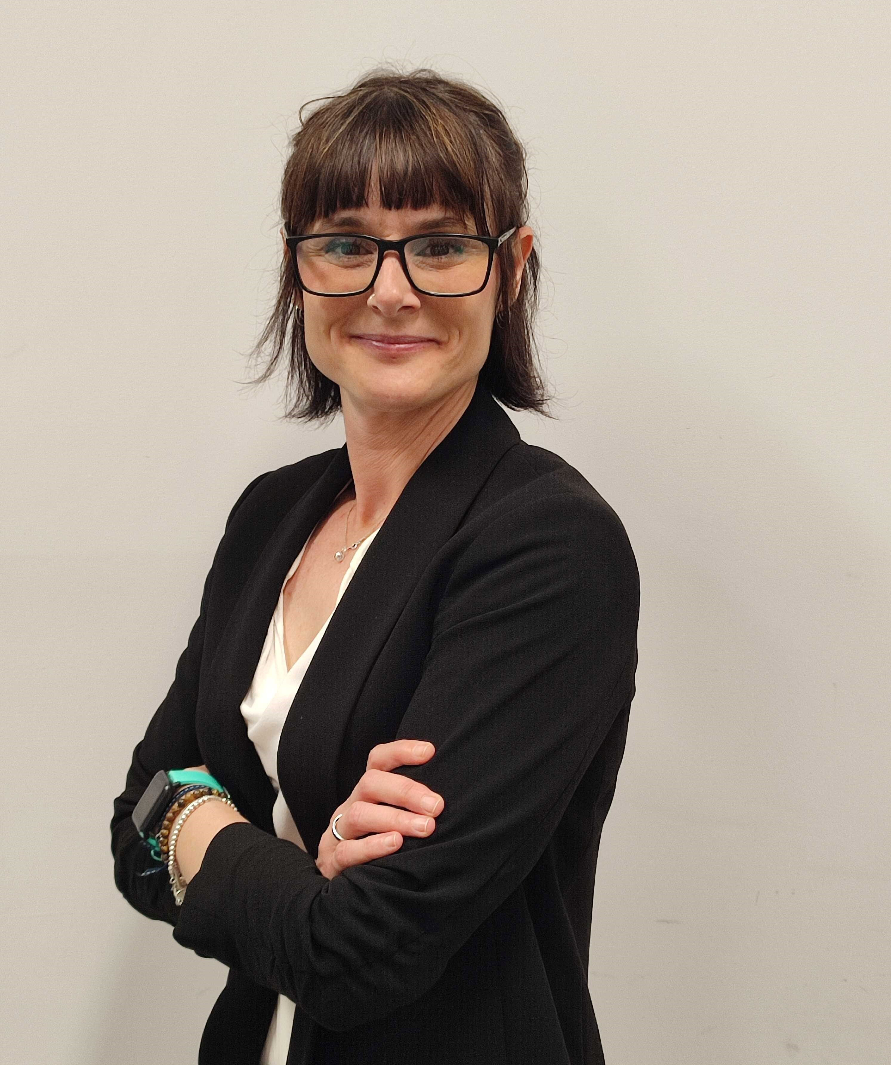
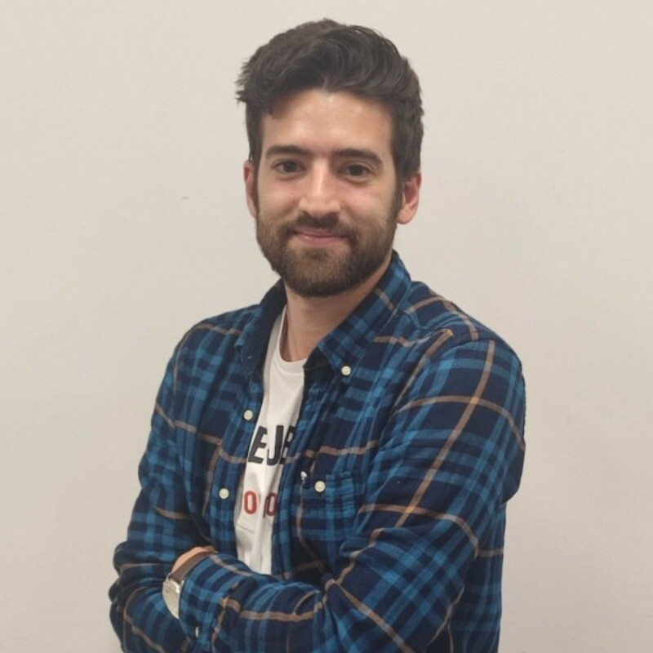
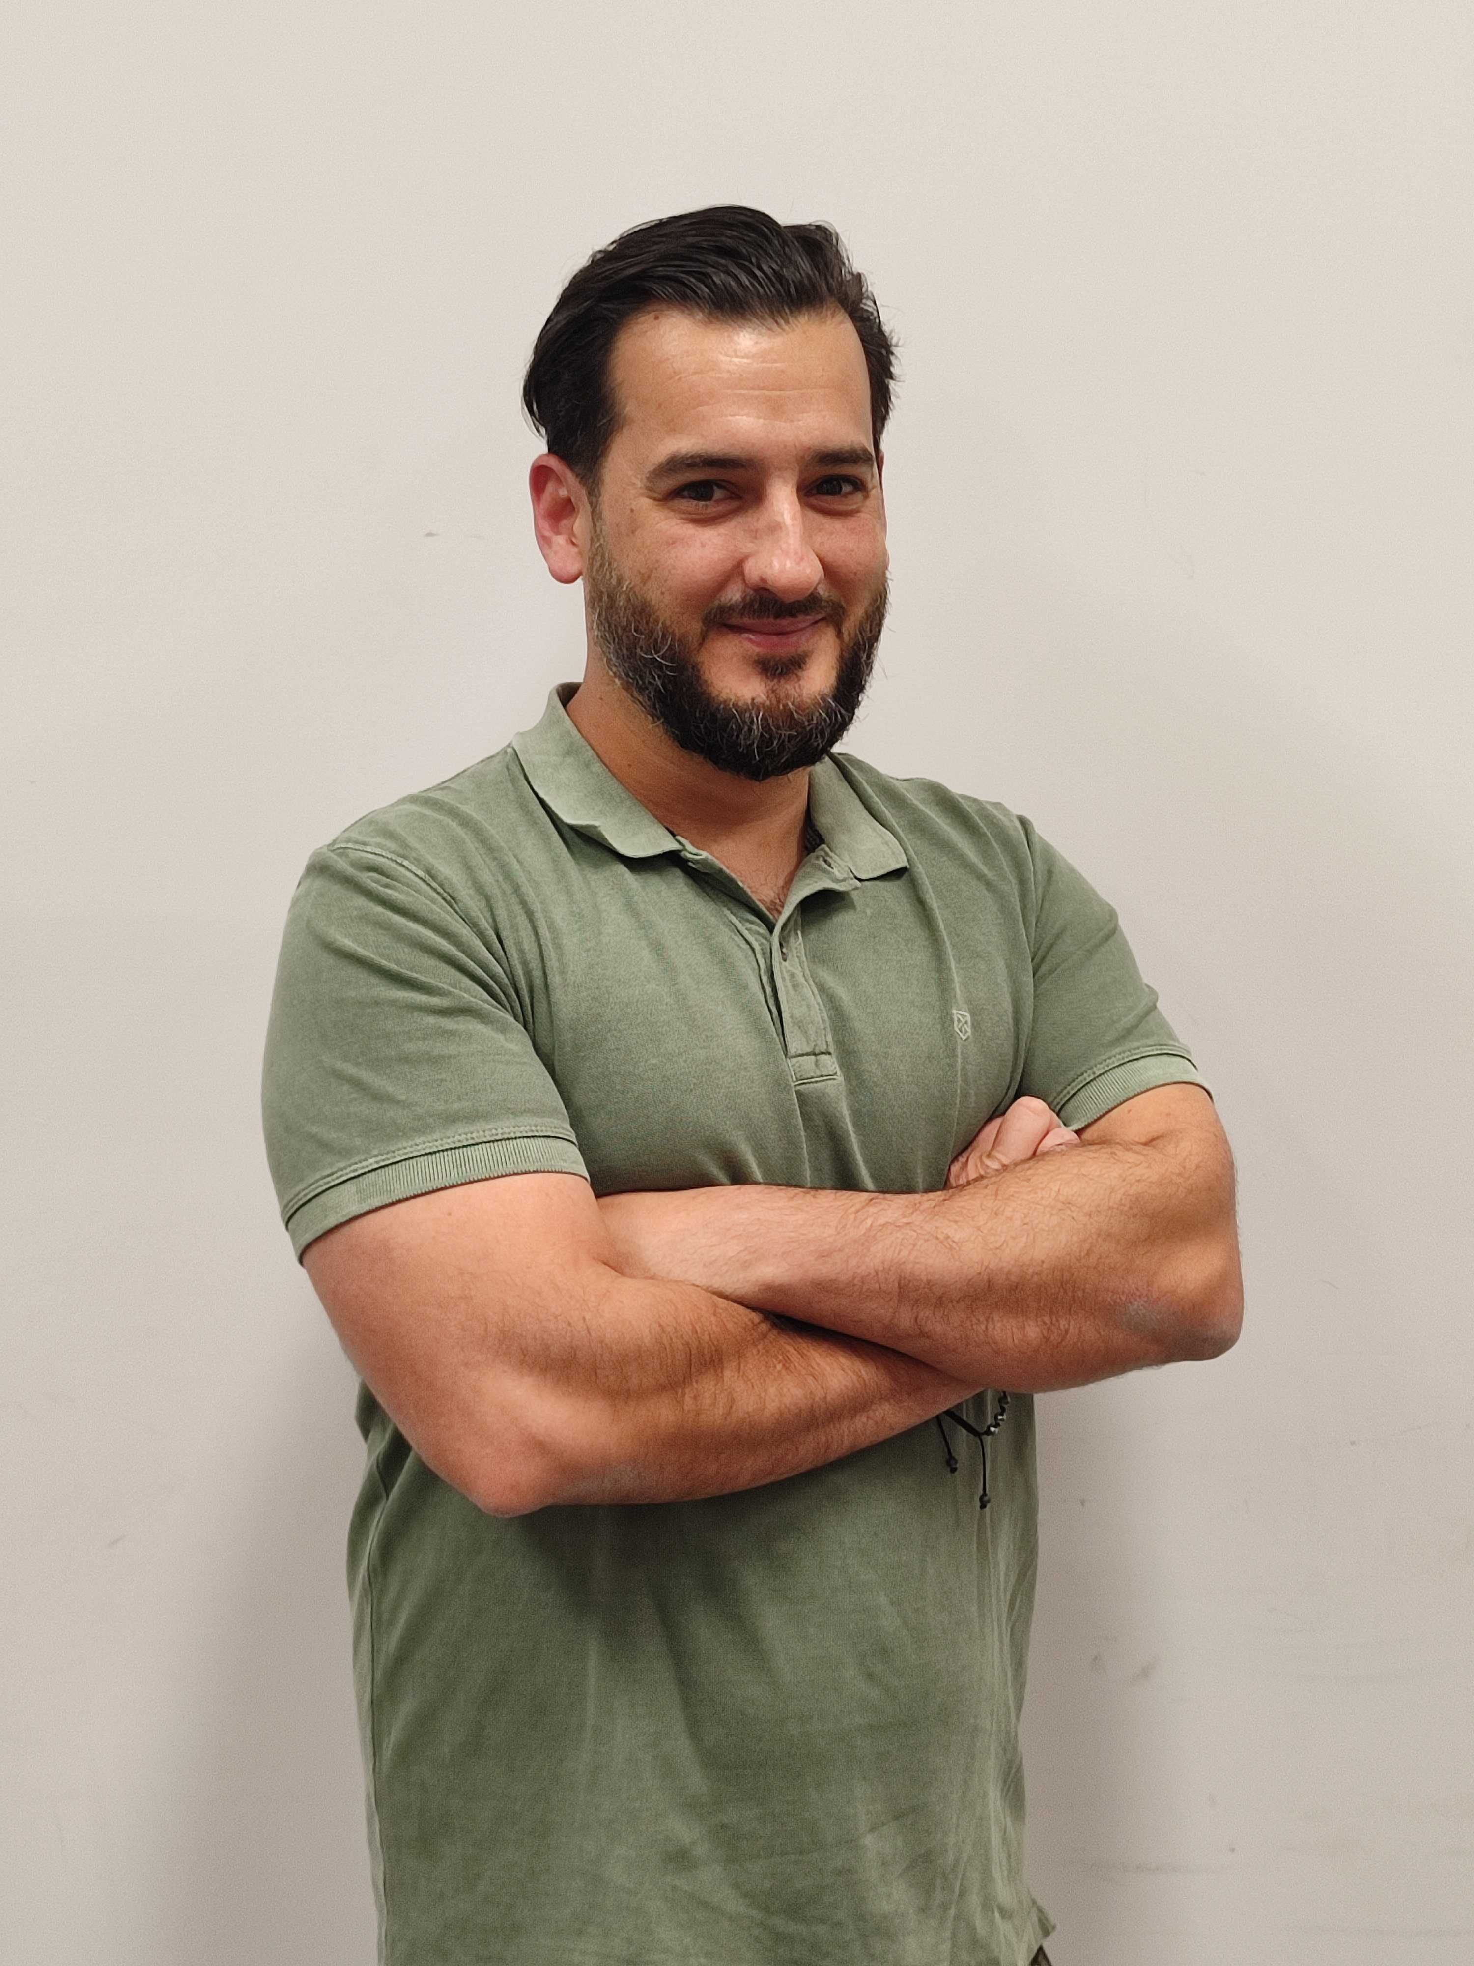

Estela Extremera
Álvaro Rodríguez
Francis Del Río

Slide 2














Slide 3
Francis Del Río
Estela Extremera
Álvaro Rodríguez
f.delrio.velarde@gmail.com
estelaextremeracampos@gmail.com
alvaros.rodriguez92@gmail.com
www.linkedin.com/in/fj-del-rio
www.linkedin.com/in/estela-extremera
www.linkedin.com/in/alvaro-rodriguez-fullstackdeveloper/
https://github.com/Foxxhaund
https://github.com/Estela-Ex
https://github.com/alvaroRodriguez92
+34 625 376 988
+34 647 027 681
+34 666 841 398

