Slide 1
DATA PROCESSING Final project
Rubén Fernández Rodrigo & Álvaro Fernández Gómez

Slide 2
INDEX
Introduction and project statement
Dataset analysis and preprocessing
Vector representation
Training and evaluation
Comparison of the results

Slide 3

Introduction and project statement
Our dataset consists of 20130 entries corresponding to recipes from www.epicurious.com
Variables:
Numerical | Text
+ Fat + Protein + Calories + Sodium + Date + Ratings | + Directions + Desc + Categories + Title + Ingredients

Slide 4
Introduction and project statement 2.0
Steps to follow:
3. Vectorization of the documents
4. Training and evaluating the models
1. Variables analysis
2. Text preprocessing
5. Comparison of the results

Slide 5
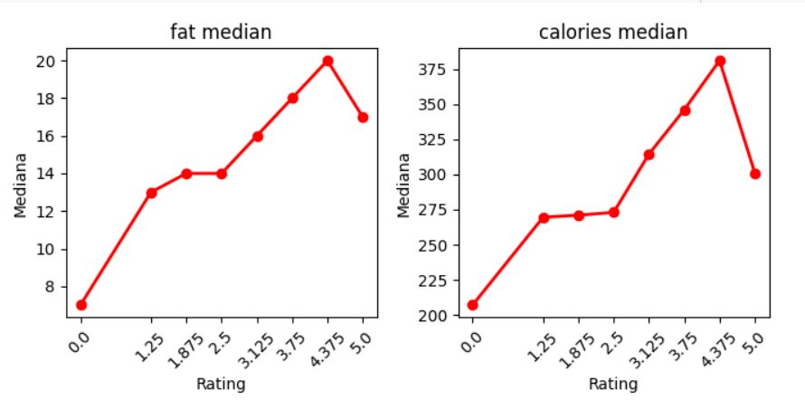
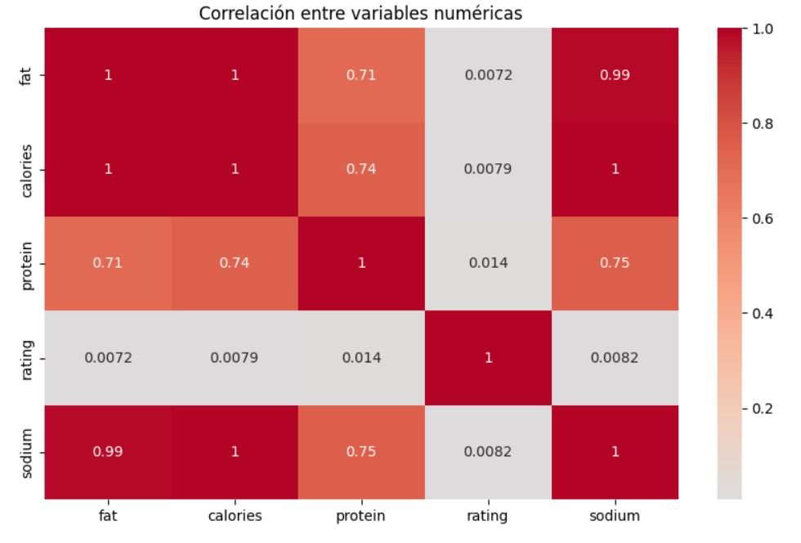
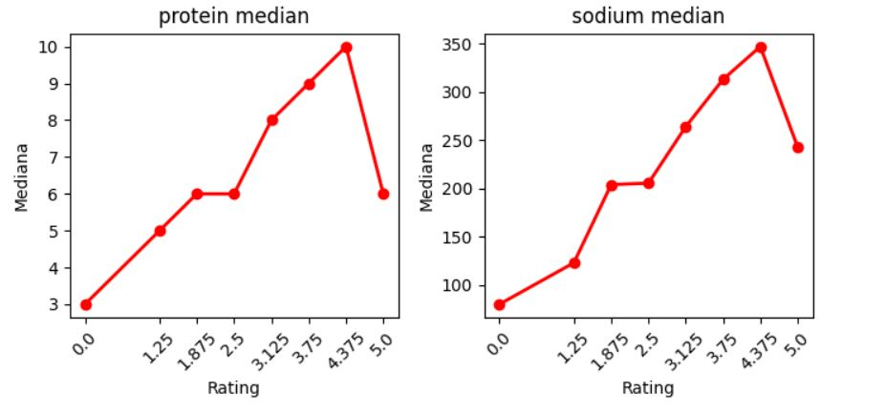
Dataset analysis and preprocessing
Variables analysis:
Rating relation
Variables correlation
Notes:
As the rating increases, the variables fat, calories, protein, and sodium tend to rise as well, suggesting that products with higher ratings generally contain more fat, calories, protein, and sodium. This could indicate that higher-rated products have a greater amount of nutrients or ingredients, though they may also be more caloric and contain more sodium and fat.

Slide 6
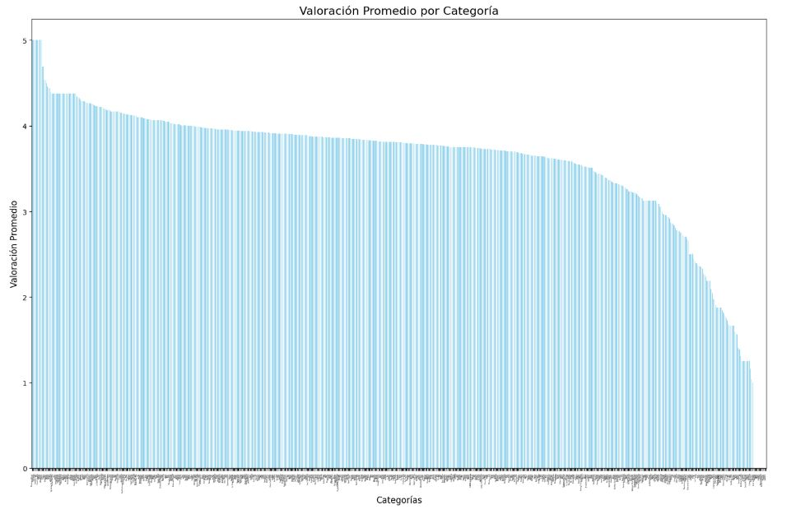
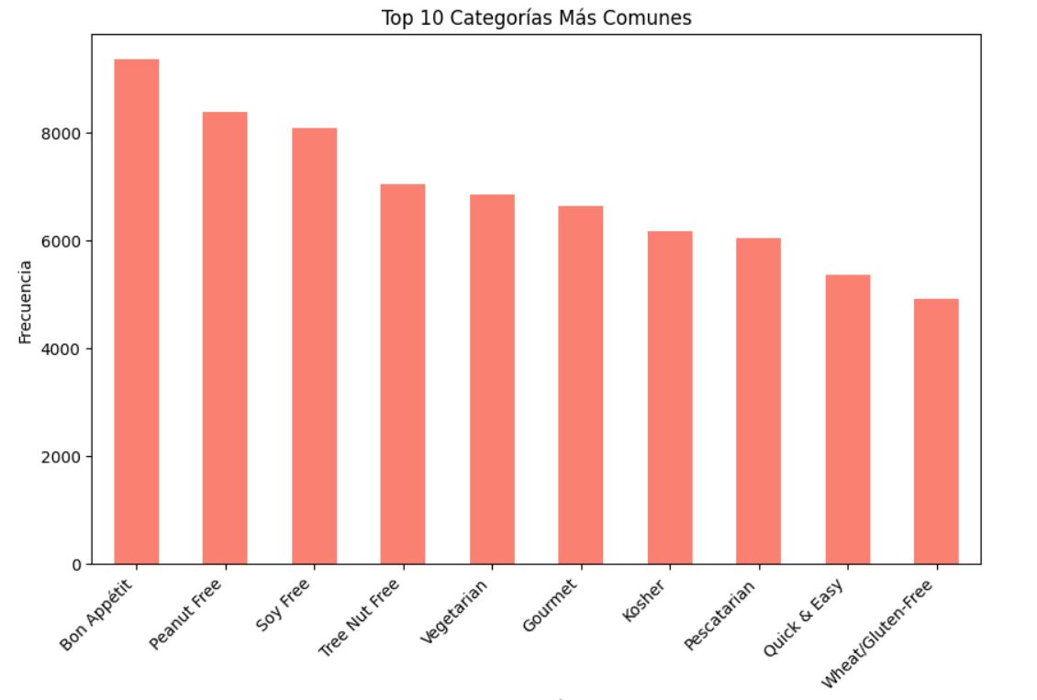
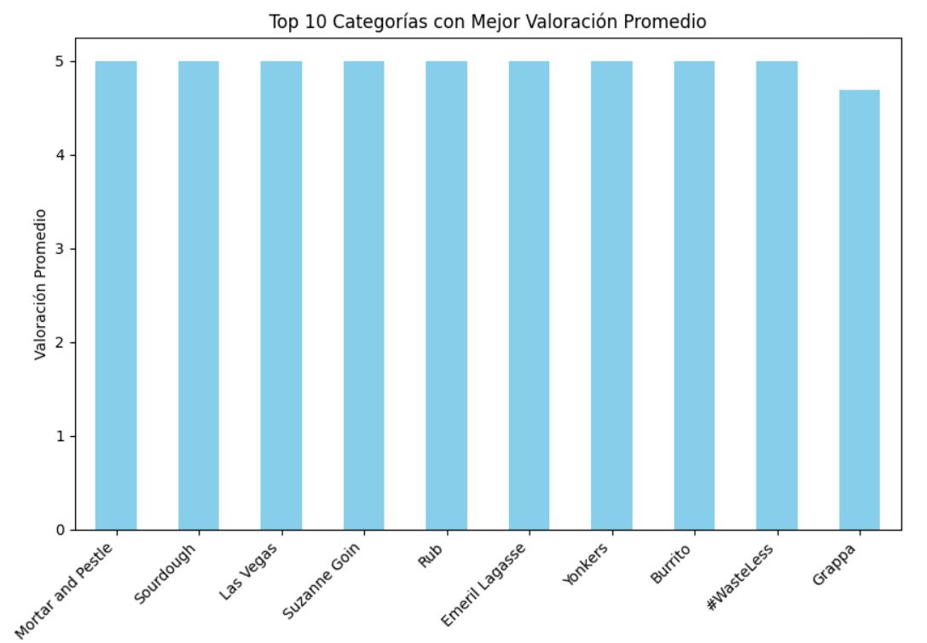
Dataset analysis and preprocessing 2.0
Variables analysis 2.0:
Notes:
The first graph shows that the top 10 categories with the highest average ratings consistently achieve scores between 4.5 and 5. This indicates that certain categories are strongly associated with higher ratings, making them a valuable feature for the predictive model. Including these categories as variables can help the model identify patterns linked to high ratings.
The second graph highlights the most frequent categories in the dataset, with some, such as Bon Appetit and Peanut Free, appearing significantly more often than others. These frequent categories are likely to have a greater influence on the model simply due to their volume of data. However, this also raises the risk of bias, as the model could be disproportionately influenced by these common categories at the expense of less frequent ones
The third graph shows the complete distribution of average ratings by category, where most categories tend to have lower ratings, while only a few achieve consistently high averages. This variability highlights the importance of the inclusion of this categories in the model.

Slide 7
Dataset analysis and preprocessing 3.0
Text preprocessing:
Transform all the text variables to string (because we have lists)
Merge all text variables into one variable called “text”
Splits the data into training (80%) and testing (20%) sets
Convert text to lowercase, remove punctuation, tokenize, and filter out stopwords using NLTK
Size of X_train: 16080 Size of X_test: 4020
"Add 2 cups of flour and mix with 1 cup of sugar and a pinch of salt."
["add", "2", "cups", "flour", "mix", "with", "1", "cup", "sugar", "pinch", "salt"]
"add 2 cups flour mix with 1 cup sugar pinch salt"
Notes:
The first graph shows that the top 10 categories with the highest average ratings consistently achieve scores between 4.5 and 5. This indicates that certain categories are strongly associated with higher ratings, making them a valuable feature for the predictive model. Including these categories as variables can help the model identify patterns linked to high ratings.
The second graph highlights the most frequent categories in the dataset, with some, such as Bon Appetit and Peanut Free, appearing significantly more often than others. These frequent categories are likely to have a greater influence on the model simply due to their volume of data. However, this also raises the risk of bias, as the model could be disproportionately influenced by these common categories at the expense of less frequent ones
The third graph shows the complete distribution of average ratings by category, where most categories tend to have lower ratings, while only a few achieve consistently high averages. This variability highlights the importance of the inclusion of this categories in the model.

Slide 8
Vector representation
Three different procedures:
Word2Vec
TF-IDF (Term Frequency - Inverse Document Frequency)
BERT (Bidirectional Encoder Representations from Transformers)

Slide 9
Vector representation 2.0
TF-IDF:
Two components:
-Term Frequency (TF): This is the frequency of a word in a specific document
-Inverse Document Frequency (IDF): This is a measure of how important a word is across all documents
It does not consider the semantics of the words
We obtain:
Size of X_train_tfidf: (16080, 28811) Size of X_test_tfidf: (4020, 28811)

Slide 10
Vector representation 3.0
Word2vec:
Words with similar meanings or contexts are
close to each other in the vector space
Key Parameters:
+ vector_size=512: Dimension of the word vectors
+ window=5: Context window size
+ min_count=1: Words that occur fewer than 1 time are ignored
+ workers=4: Number of CPU threads used during training for parallelism.
We obtain:
Similar words = Similar embeddings WORD EMBBEDINGS
CONTEXTUAL EMBBEDINGS
Size of X_train_word2vec: (16080, 512) Size of X_test_word2vec: (4020, 512)
Notes:
5 words before and after a target

Slide 11
Vector representation 4.0
BERT:
Contextual embedding is more complex Transformers
Key Parameters:
+ padding=True: Ensures all sentences have the same length by padding shorter ones.
+ truncation=True: Truncates sentences longer than the maximum token limit (512).
+ max_length=512: Maximum length of the input sequence.
We obtain:
Size of X_train_bert: (16080, 768)
Size of X_test_bert: (4020, 768)
Notes:
5 words before and after a target
768?-> predetermined for Bert=12 Transformer layers (blocks)* Each layer has 12 attention heads.

Slide 12
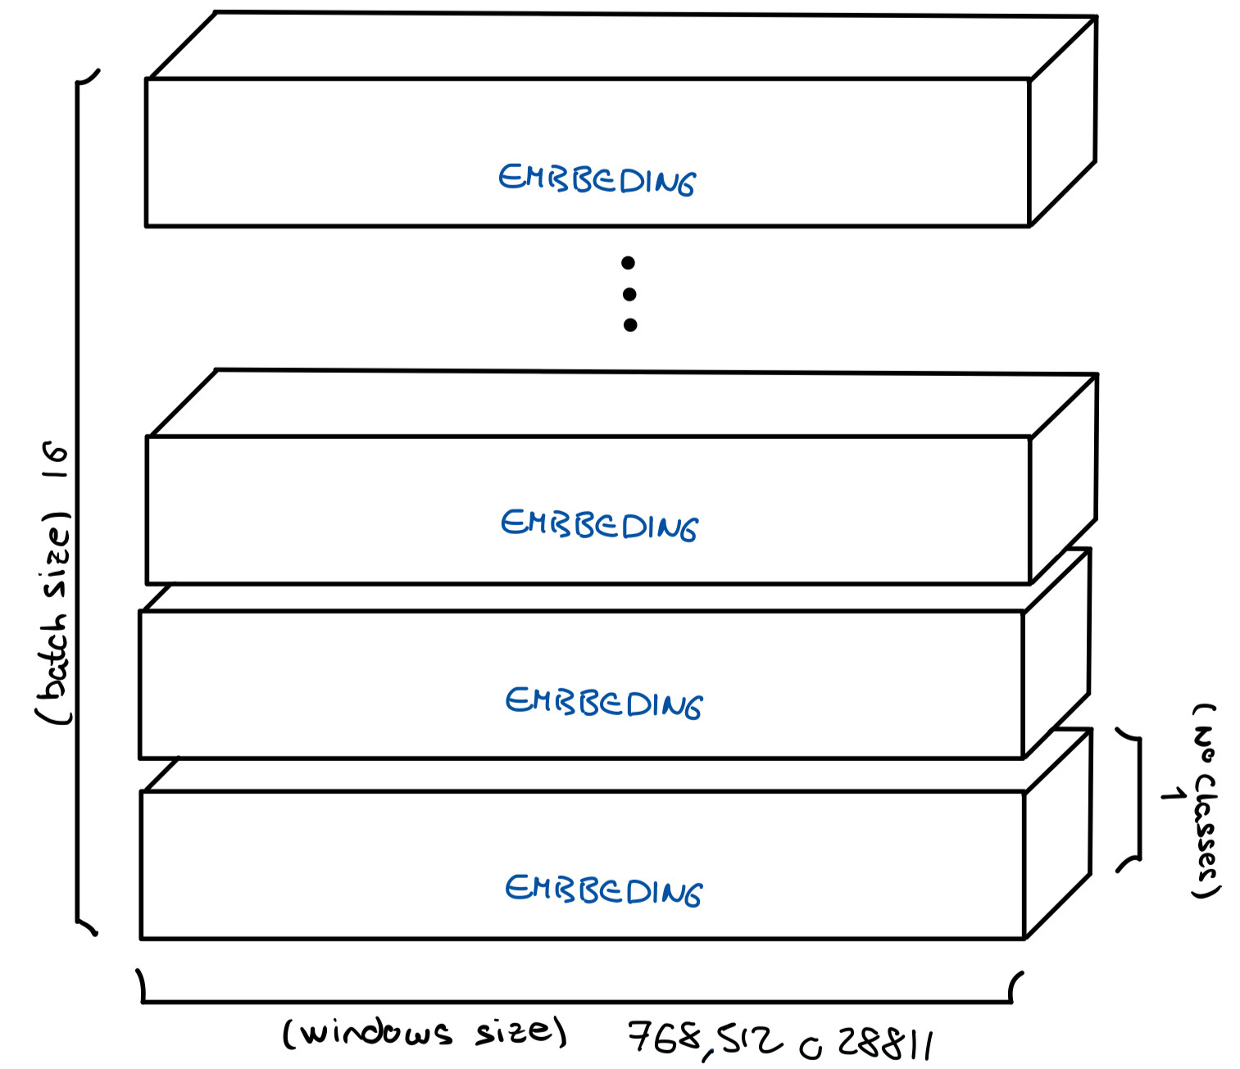
Vector representation 5.0
Notes:
5 words before and after a target
768?-> predetermined for Bert=12 Transformer layers (blocks)* Each layer has 12 attention heads.

Slide 13

Training and evaluation
We use the word2vec vectors
Random Forest:
Algorithm that builds multiple decision trees during training
and averages their predictions
We calculate the MSE (Minimum Square Error) and $R^{2}$score
Results:
MSE = prediction
Random Forest:
+ mse: 1.3173477825715174
+ R^2: 0.28153012825595913
R² = 1: Perfect fit.
R² = 0: Model predicts no better than the mean of the data.
R² < 0: Model performs worse than predicting the mean.
Notes:
R^2 measures how well the model explains the variability of the target variable

Slide 14

Training and evaluation 2.0
We use the word2vec vectors
SVM (Support Vector Machine):
Algorithm that tries to fit a hyperplane (a line in 2D, a plane in 3D) to predict the target values
We calculate the MSE (Minimum Square Error) and $R^{2}$score
Results:
MSE = prediction
SVM:
+ mse: 1.6480520676705548
+ R^2: 0.10116692542997263
R² = 1: Perfect fit.
R² = 0: Model predicts no better than the mean of the data.
R² < 0: Model performs worse than predicting the mean.
Notes:
R^2 measures how well the model explains the variability of the target variable

Slide 15
Training and evaluation 3.0
Neural networks:
LSTM (Long Short-Term Memory) model
We will use two different neural networks:
+ The first one will be trained with the concatenated text variables
+ The second will be trained with the separated text variables that will merge inside the network
We will train each network with the three type of vectors
-Word2vec
-BERT
Notes:
5 words before and after a target

Slide 16
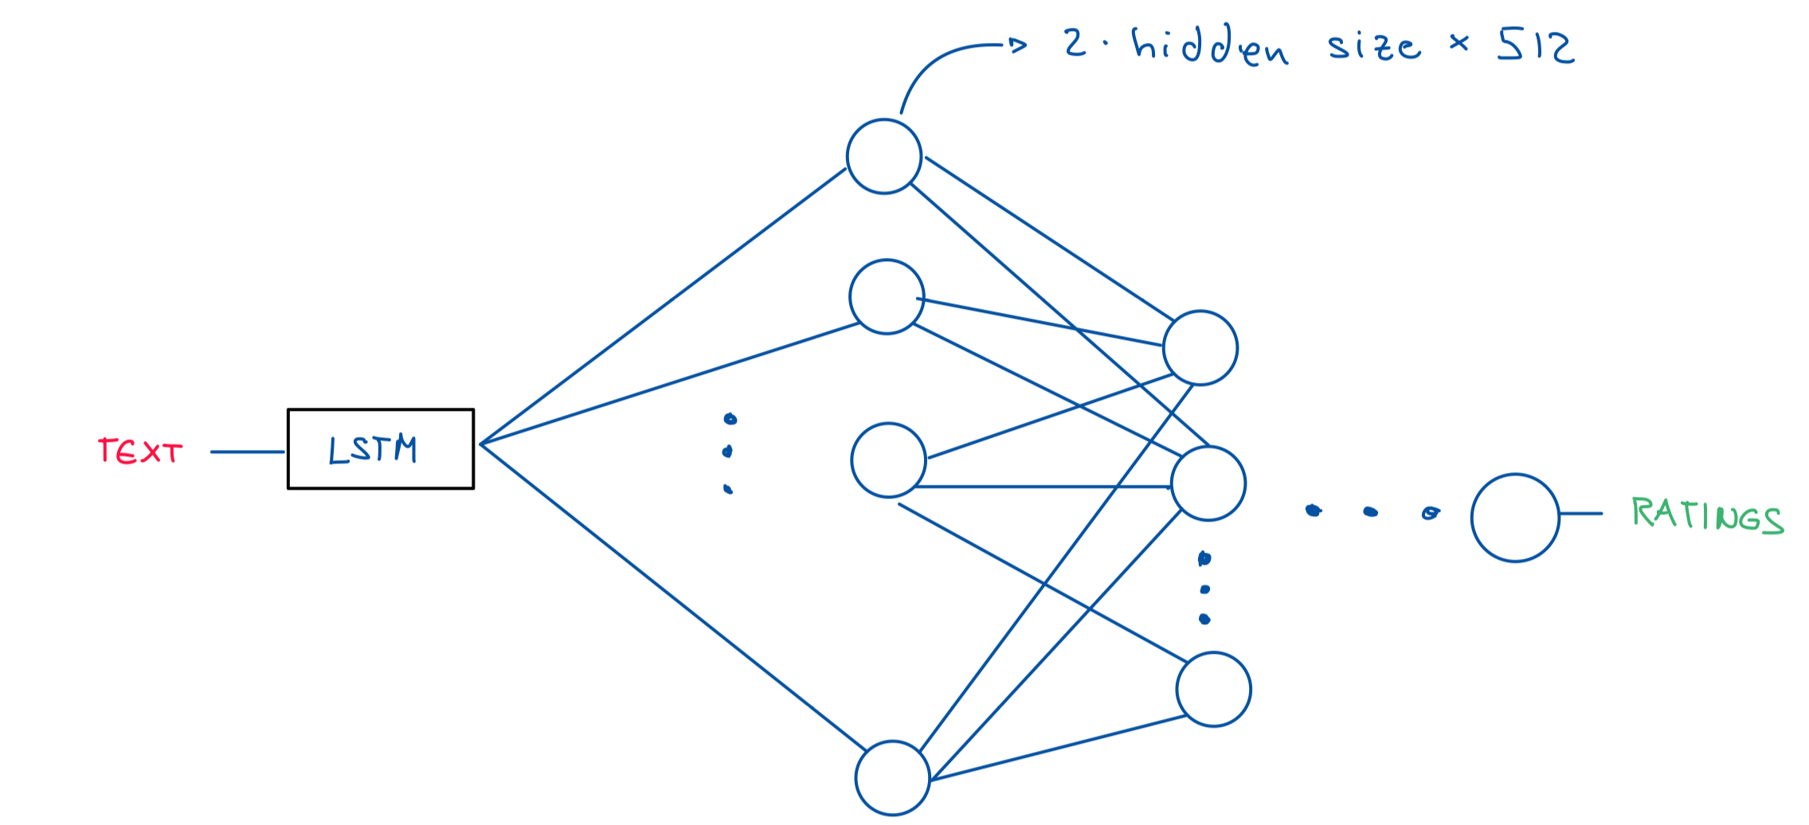
Training and evaluation 4.0
Neural networks:
Notes:
5 words before and after a target

Slide 17
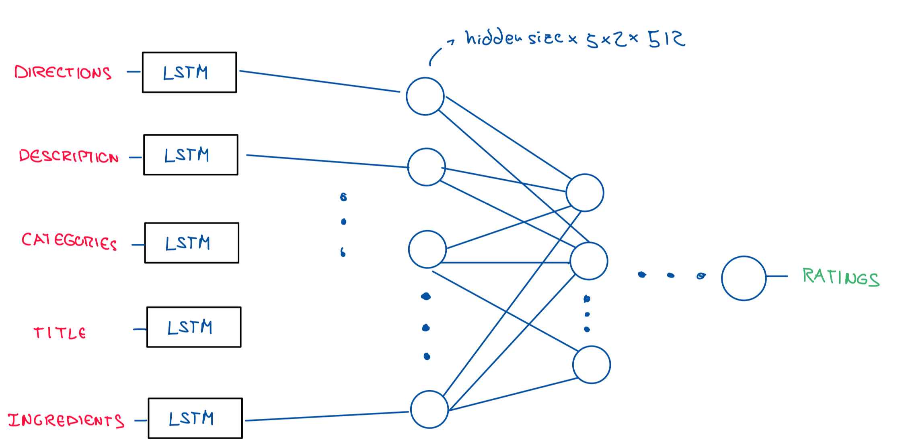
Training and evaluation 5.0
Neural networks:
Notes:
5 words before and after a target

Slide 18
Training and evaluation 6.0
Neural network for the concatenated text:
Each epoch consists of:
+ Training Phase:
-Batches of data are passed through the model.
-Predictions are compared to ground truth
using MSE loss.
-Gradients are computed and weights updated.
+ Validation Phase:
-Performance is evaluated on unseen test data.
Notes:
5 words before and after a target

Slide 19
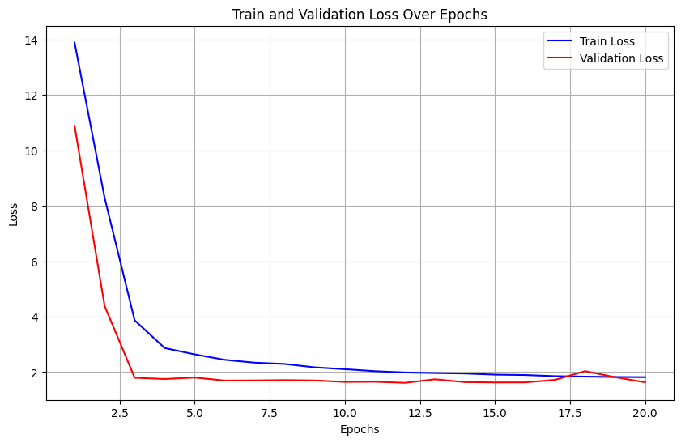
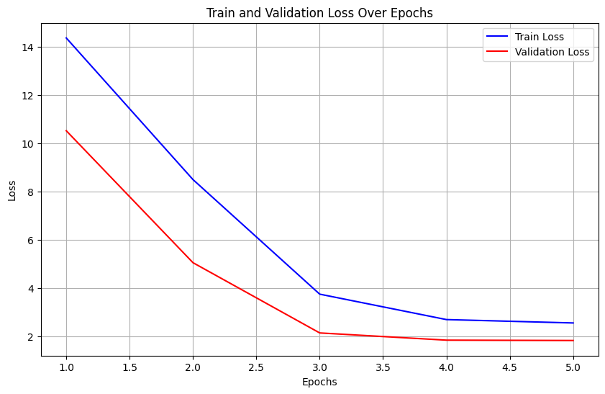
Training and evaluation 7.0
Neural network for the concatenated text 2.0:
Results:
BERT vectors
word2vec vectors
INITIAL PARAMETERS:
BATCH_SIZE = 16
EPOCHS = 20
LEARNING_RATE = 1e-4
EMBEDDING_SIZE =
512 (word2vec)
768 (Bert)
HIDDEN_SIZE = 512
NUM_LAYERS = 4
OUTPUT_SIZE = 1
Test Loss: 1.5678
Test MSE: 1.5706 Test R²: 0.1434 Test Metrics: MSE: 1.5706,
R²: 0.1434
Test Loss: 1.7639 Test MSE: 1.7676 Test R²: 0.0359 Test Metrics: MSE: 1.7676,
R²: 0.0359
Notes:
5 words before and after a target

Slide 20
Training and evaluation 8.0
Neural network for the separated variables:
Each epoch consists of:
+ Training Phase:
-Batches of data are passed through the model.
-Predictions are compared to ground truth
using MSE loss.
-Gradients are computed and weights updated.
+ Validation Phase:
-Performance is evaluated on unseen test data.
Notes:
5 words before and after a target

Slide 21
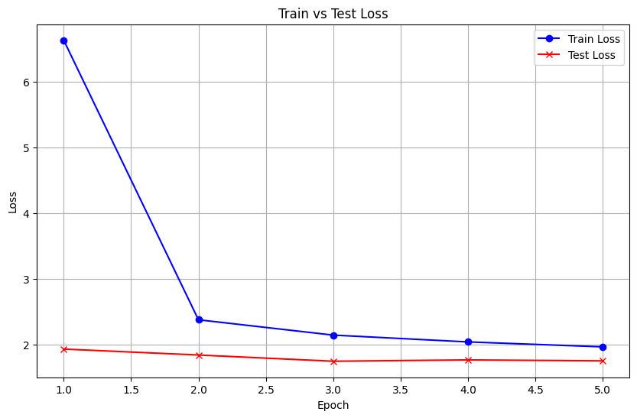
Training and evaluation 9.0
Neural network for the separated variables 2.0:
Results:
word2vec vectors
INITIAL PARAMETERS:
BATCH_SIZE = 16
EPOCHS = 20
LEARNING_RATE = 1e-4
EMBEDDING_SIZE = 512 (word2vec)
HIDDEN_SIZE = 512
NUM_LAYERS = 4
OUTPUT_SIZE = 1
Test loss: 1.7698
Test MSE: 1.7722
rmse: 1.3313
Test R²: -0.0032
Notes:
5 words before and after a target

Slide 22
Pretrained model (Hugging Face)
Transformer:
Steps:
-Charge a transformer which has been traind with big amount of data (bert-base-uncased).
-Fine-tuning the net by our data with a few iterations.
Notes:
5 words before and after a target

Slide 23
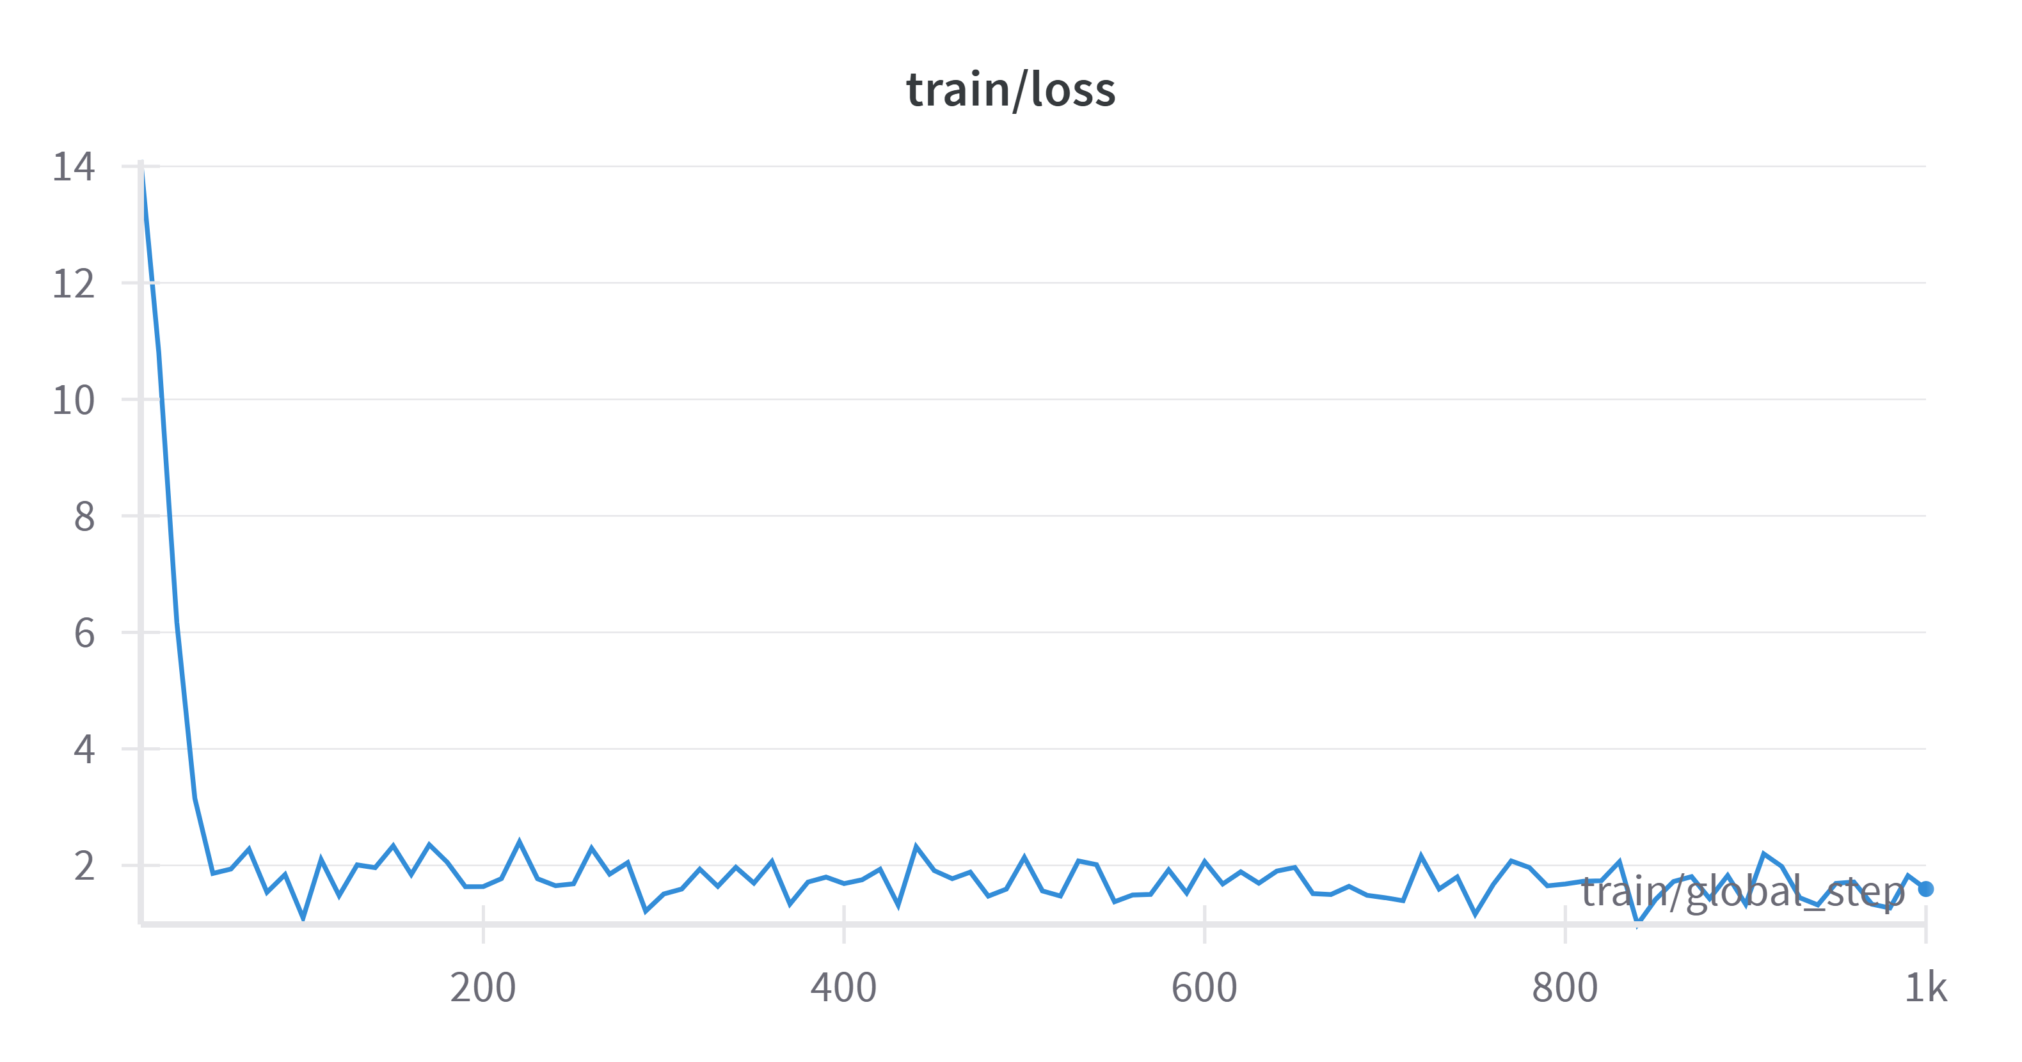
Pretrained model (Hugging Face) 2.0
INITIAL PARAMETERS:
BATCH_SIZE = 16
EPOCHS = 1
LEARNING_RATE = 5e-5
EMBEDDING_SIZE = 768 (Bert)
Warmup_steps = 100
Notes:
5 words before and after a target

Slide 24
Comparison of the results
MSE and R^2 score results
 | Vectorization | MSE (Minimun Square Error) | R^2 score
Random Forest | word2vec | 1,3173 | 0,2815
SVM | word2vec | 1,6481 | 0,1011
Concatenated Neural Network | word2vec | 1,7676 | 0,0359
 | Bert | 1,5706 | 0,1434
Separated Neural Network | word2vec | 1,7698 | -0,0032

Slide 25
Questions

