Slide 1
Angular JS + Backend connection
2015-04-30
Alvaro García
@alvarobiz

Slide 2


Slide 3
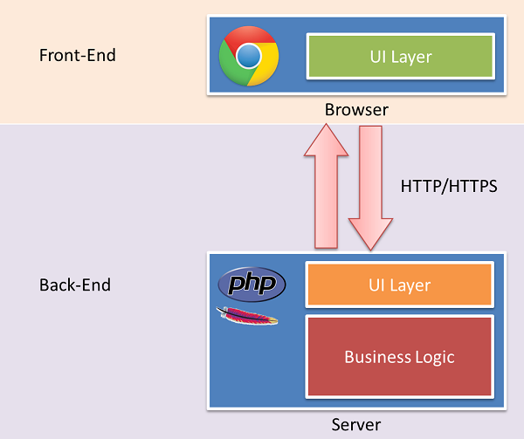
Front-end & Back-end separation: the past

Slide 4
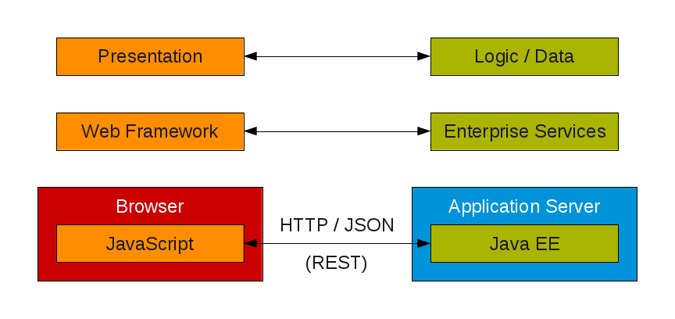
Front-end & Back-end separation: now
AngularJS

Slide 5
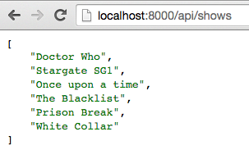
REST Back-end separation: example

Slide 6

Enter AngularJS
https://angularjs.org/

Slide 7
AngularJS: Characteristics
What is it?
Framework for applications that run in the browser
Written in javascript

Slide 8

Javascript
http://www.amazon.com/JavaScript-Good-Parts-Douglas-Crockford/dp/0596517742

Slide 9
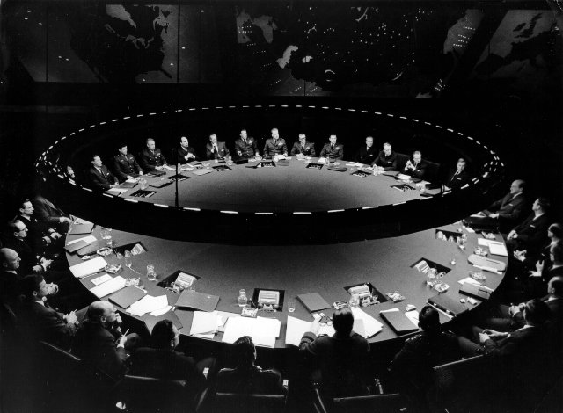
Javascript
Dr. Strangelove or: How I Learned to Stop Worrying and Love the Javascript

Slide 10
AngularJS: how to learn it
angular.codeschool.com
https://angularjs.org/

Slide 11
AngularJS: how to use it
How can I use this?
Read a bit
See the examples
See the demo

Slide 12
AngularJS: tools
Npm: node package manager for javascript (~: ivy, maven)
Grunt: a javascript task runner (~: ant, maven)
Bower: another package management system

Slide 13

Show me the code

Slide 14
AngularJS: useful links - introduction
http://www.w3schools.com/angular/angular_intro.asp
https://www.youtube.com/watch?v=8ILQOFAgaXE
http://www.codeproject.com/Articles/803294/Part-Introduction-to-AngularJS

Slide 15
AngularJS: useful links – TDD + testing
http://www.smashingmagazine.com/2014/10/07/introduction-to-unit-testing-in-angularjs/
https://www.airpair.com/angularjs/posts/testing-angular-with-karma http://private-42e7d-monitoring4.apiary-mock.com/app
and, finally, the link for TDD By Example in UI (javascript) is here: https://www.youtube.com/watch?v=2b1vcg_XSR8&feature=youtu.be​

