Slide 1

Final Project – Startup valuation estimator
Alvaro Garcia Blazquez

Slide 2

Project Summary
Purpose: Provide an estimated valuation for a startup based on key parameters inputted by the user (investor, VC, founder, individual)
Problem to support: When determining pre-money valuations in startups financing rounds, several conflicts tend to appear between founders and investors. Goal is to provide an objective / neutral approach based purely on data
Dataset source: Kaggle
Key tools used:
Pandas: Data exploration and cleaning
Web scraping: Dataset enrichment
ML: Model training, selection, and prediction
Streamlit: App/Web creation

Slide 3




Key steps
Dataset selection
Extracted from Kaggle obtaining over 50k rows and 39 columns
Data cleaning
Involving: NaN’s, irrelevant columns, fixing data types, and adding new columns
Web scraping
Extracted valuation figures from Deal Room via Beautiful Soup. Challenging with Selenium as bot was detected
ML
Trained several models and selected the one with lowest test MSE score

Slide 4
Issues through the process
Dataset selection:
Finding data as recent as possible to take into account new startups and funding rounds
Data cleaning:
Criteria for eliminating rows with NaN’s
Incorrect data types
Web scraping:
Initially to be done with Selenium but bot was detected. Beautiful Soup was time consuming
ML:
Decision of target variable (operating status vs valuation)
Once target decided, avoiding bias towards larger predictions. Use of log(10) worked out

Slide 5
ML
Models tried
Logistic Regression with operating status as target
Simple Linear Regression with absolute valuation as target
Linear Regression, Ridge, Lasso, SGDRegressor, KNeighborsRegressor, and GradientBoostingRegressor with log(10) of absolute valuation as target
Decision Trees and random forest iteration via GridSearch with log(10) of absolute valuation as target
Predictor variables used for training
Total funding
Number of funding rounds
Year founded
Delta between year founded and first financing
Country_ranking (Rank encoding of country variable)
Merket_ranking (Rank encoding of market variable)

Slide 6
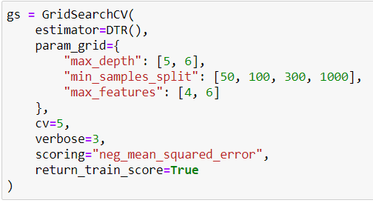
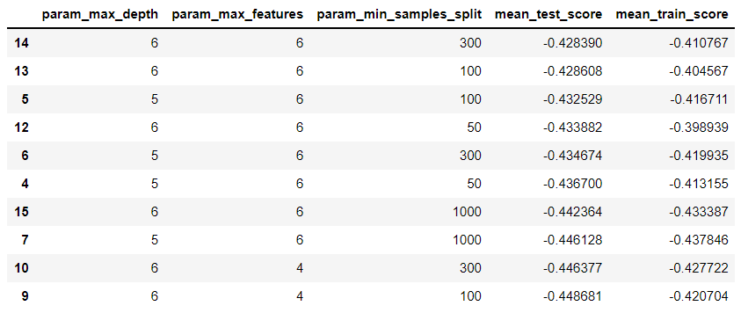
ML – Selection process
Grid Search for Decision Trees:
Decision Trees ranking based on MSE:

Slide 7
Potential next steps
Predicting operating status and then based on that a valuation if the prediction is that the startup will be operating
Different currencies available for total funding, and predicted valuation
Categorize “markets” variable into broader / more general blocks
Further ML training with different variables obtained via web scraping (founders education, employees, users, app downloads…)

Slide 8

Let’s try it!

