Slide 1
Using Linear Programming to Solve Operations Issues

Slide 2
What is Operations Research?
OR is a scientific approach for decision making. It applies mathematics to scenarios to arrive at optimal solutions. In business it’s called “scientific management” or “management science”.
For business, the goal is economic efficiency…optimal use of resources, increasing revenue, decreasing costs. Not necessarily employee, or stakeholder impact beyond economic benefit.

Slide 3
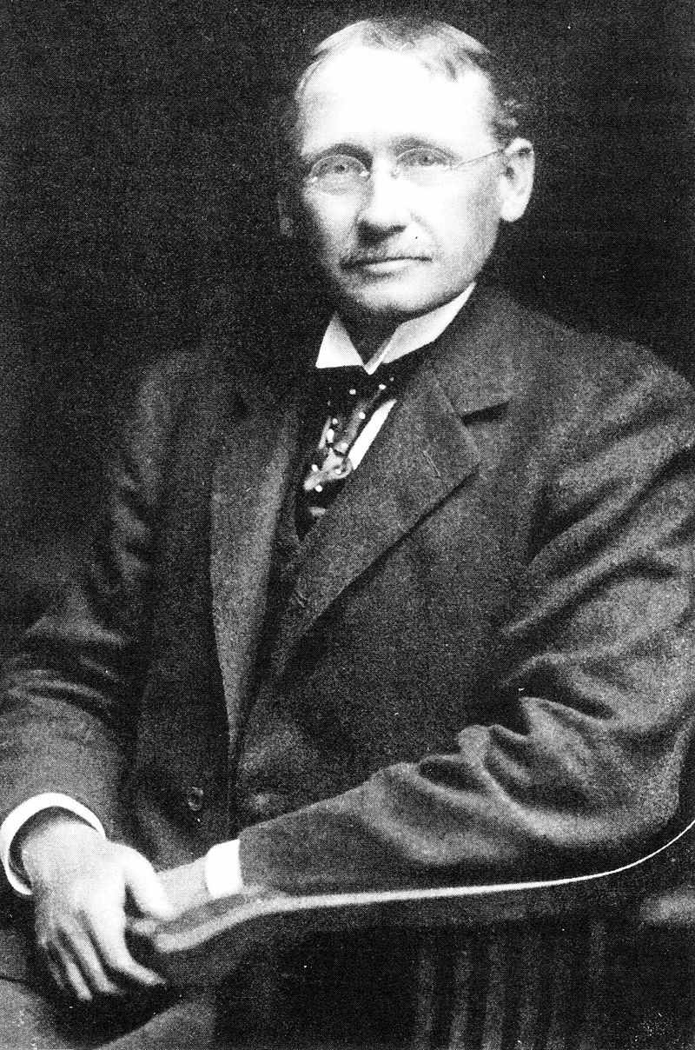
I’m Frederick Winslow Taylor. I am dead but back in my day I pioneered labor productivity in manufacturing using scientific management.

Slide 4


Maybe things got out of hand…but it’s still useful in context.

Slide 5
What is an optimization problem in business?
Linear Regression is an “optimization” problem. The “fit” line optimizes the errors between X-variables & Y. In this case, the optimization is “minimize”.
Remember “minimize ordinary least squared errors”?
https://cran.r-project.org/web/views/Optimization.html

Slide 6
Optimization Problems can be max or min
An optimization problem seeks to find the best solution from among all feasible solutions.
3 Components to Optimization Problems
Objective Function: the function to be maximized or minimized.
Minimize the errors of a regression fit
Decision Variables: the inputs to the function that influence (either increase or decrease) the objective function
x-variables represent the inputs
No y-variable/target! Only inputs
Constraints: A set of restrictions for the decision variables
Examples would be spend <=$5000, spend > 0, Use supplier A twice (supplierA=2)
For regression, the input relationships (coefficients) are not really constrained but can be made (monotonic constraints) & we did constrain the beta-naught in class examples with “+0”

Slide 7
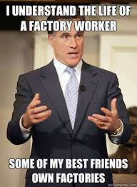

Let’s help Dale with “optimization” problems.
Yeah, a new job at a factory, we make chairs but stink at planning.
Let’s apply lpSolve to identify the structure of these business problems and their solutions.

Slide 8
We’ll work through A,B & C lpSolve scripts
C_max_lpSolve.R
D_min_lpSolve.R
E_lpSolve_sportsLineup.R
Simple “max” optimization
Complex “max” profit mix example
Simple cost “min” optimization meeting factory production requirements
Fun, fantasy football selection example

Slide 9
Summary
Optimization problems seek to maximize or minimize a single function.
LP-Solve is a linear approach with three components
Function to optimize
Inputs
constraints are linear i.e. <,<=, >,>=, =
Linear programming & other optimizations are used in various business situations
Arbitrage (though it gets more complicated & faster)
Product & Marketing mix
Procurement & supply chain/logistics
Production
…
Operations Research & Scientific Management are huge disciplines.
Many more techniques than a “linear” approach but it’s the easiest.

