Slide 1
Guest Speakers

Slide 2
Agenda
Start | End | Item
 |  | Ross Leav Presidio Ventures
 |  | Rachel Switchenko Plymouth Rock Assurance
 |  | James Liu Amazon Web Services

Slide 3
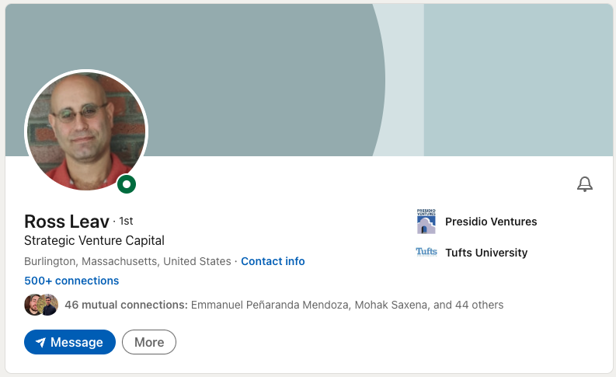
Notes:
Ross has been a strategic investor on behalf of Sumitomo Corporation for 13yrs. In that role Ross navigates emerging tech to be applied to one of the largest company portfolios in the world from cattle to mining to data and banking Ross has to have a keen eye for applied technologies. In addition, he sits on the MIT Sandbox Innovation fund’s board helping improve student’s startup ideas.

Slide 4
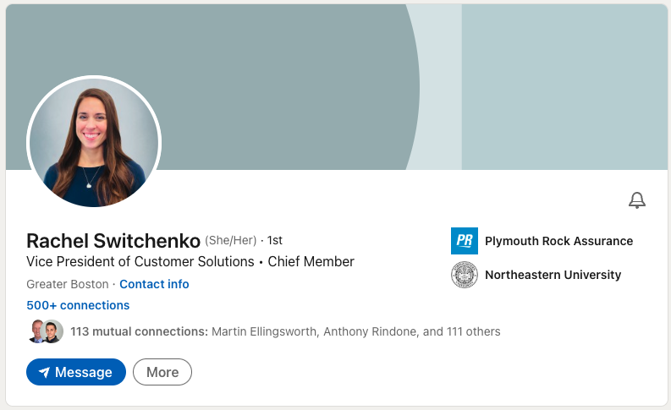
Notes:
Rachel Switchenko has built a data driven career thoughtfully applying data to business operations. She was recently promoted to VP at Plymouth Rock Assurance where she drives innovation in customer solutions understanding the intersection of data and operations.

Slide 5
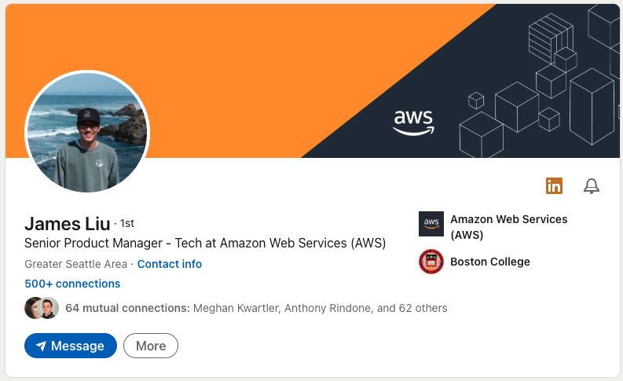
Notes:
James Liu is a Senior Product Manager within AWS. He has worked on a multitude of projects within amazon including dedicated cloud solutions, amazon devices (alexa), amazon go – cashier-less checkout and also within the customer service organization. As a PM James helps articulate user needs in functional specifications for the engineering team to execute upon. In all these roles he advocates for user experience and when possible supports his requirements with data.

