Slide 1

Thanksgiving break is ruined…thanks Prof K!
di·dac·tic
/dīˈdaktik/
in the manner of a teacher, particularly so as to treat someone in a patronizing way.
"slow-paced, didactic lecturing”
“if it feels like the teaching is just telling you what to think explicitly, that's didactic in a bad way.”
Case 3
This is a regression case, rf, dt, lm and others can be applied
RMSE and MAPE are appropriate
EDA is still important!
Code consistency, logical flow, avoiding redundant objects are important
Tone, volume, cadence and limited use of filler words are important
Agenda, problem statement, data description, EDA, Assessment are all important
Essay
You don’t have to cover the essays from class at all, but if you do no more than 25% of your material should review it. I don’t want book reports
State your position “Generative AI is bad”, “AI Recommendations help the world”
Support your position with article quotes
Support your position with at least 1 philosophical paradigm
Identify an objection someone may have to your position and why “Generative AI adds to creativity because…”
Space permitting overcome the objection identified
No need for APA etc. Just add a link to the footer or end and have it start with “According to Wikipedia…”
If it is slightly longer, or shorter, don’t fret
https://i.pinimg.com/736x/3a/38/19/3a38195c96de241560714610f32b8532.jpg
This course is not didactic. The real world is not slow-paced, or tells you expectations explicitly. Bosses rarely if ever say I want A. They give you an ambiguous problem statement, you must apply judgment, learn and try. As you become an executive, this is more important.

Slide 2
Text Mining

Slide 3
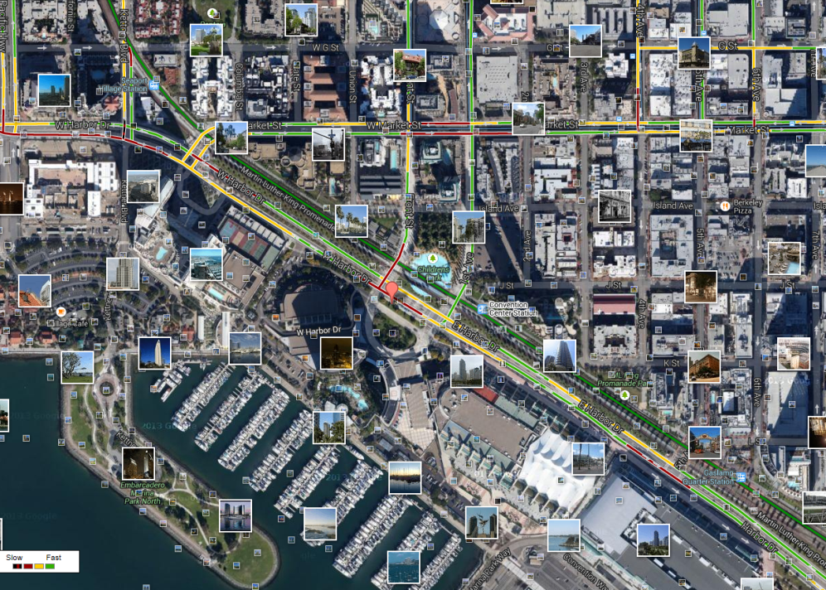
What is Text Mining?
Before Text Mining
Extract new insights from text
Let’s you drink from a fire hose of information
Language is hard; many unsolved problems
Unstructured
Expression is individualistic
Multi-language/cultural implications

Slide 4
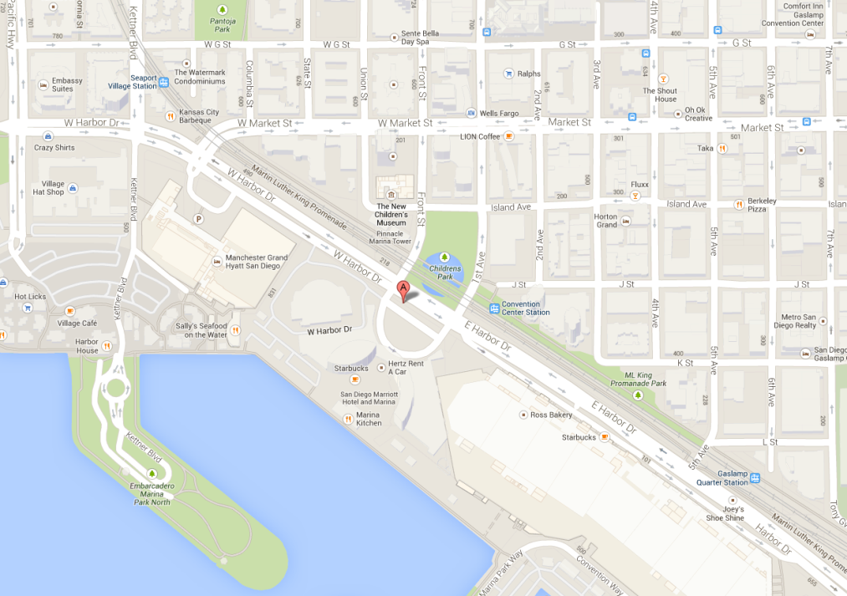
What is Text Mining?
After Text Mining
Extract new insights from text
Let’s you drink from a fire hose of information
Language is hard; many unsolved problems
Unstructured
Expression is individualistic
Multi-language/cultural implications

Slide 5
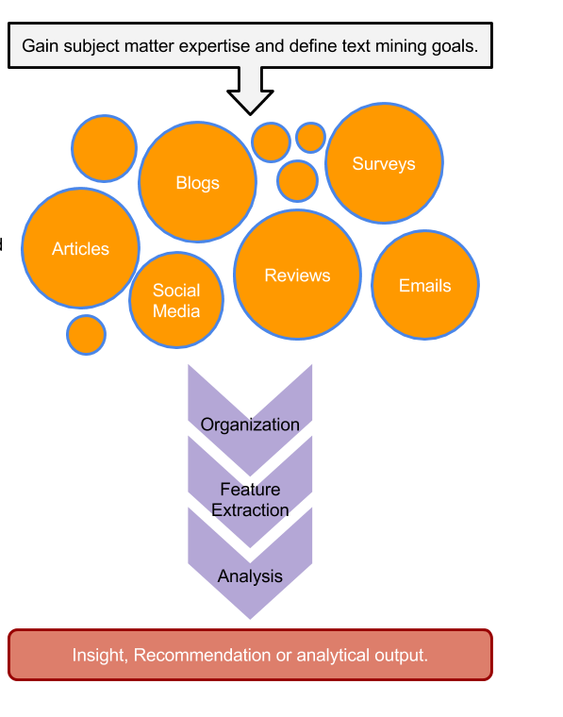
TM Project Workflow
Unorganized State
Natural Language Processing & Analysis
Organized State

Slide 6


R for Cleaning Steps
Tomorrow I’m going to have a nice glass of Chardonnay and wind down with a good book in the corner of the county :-)
Remove Punctuation
Remove extra white space
Remove Numbers
Make Lower Case
Remove “stop” words
blogs
reviews
articles
tomorrow going nice glass chardonnay wind down good book corner county

Slide 7
For Bag of Words, how is data organized?
Term Document Matrix
Document Term Matrix
 | Tweet1 | Tweet2 | Tweet3 | Tweet4 | … | Tweet_n
Term1 | 0 | 0 | 0 | 0 | 0 | 0
Term2 | 1 | 1 | 0 | 0 | 0 | 0
Term3 | 1 | 0 | 0 | 2 | 0 | 0
… | 0 | 0 | 3 | 0 | 1 | 1
Term_n | 0 | 0 | 0 | 1 | 1 | 0
 | Term1 | Term2 | Term3 | … | Term_n
Tweet1 | 0 | 1 | 1 | 0 | 0
Tweet2 | 0 | 1 | 0 | 0 | 0
Tweet3 | 0 | 0 | 0 | 3 | 0
… | 0 | 0 | 0 | 1 | 1
Tweet_n | 0 | 0 | 0 | 1 | 0
Code to Create the DTM/TDM and change to a matrix
Why are DTM & TDM Sparse? What do they represent?
txtDtm<-DocumentTermMatrix(txtCorpus)
txtTdm<-TermDocumentMatrix(txtCorpus)
txtDtmM<-as.matrix(txtDtm)
txtTdmM<-as.matrix(txtTdm)
??
The matrices are sparse (many 0’s) so additional steps may be needed to extract information.

Slide 8
A safe/supportive learning environment
This text has never been read. “Keyboard Courage” is rampant which may entail some less than ideal topics.
Twitter is a realistic Natural Language Channel
It is a great place to get topics, and messy challenging data.
As a safe learning environment, no offense is intended, merely exposure to a real data set. If offended, please reach out and I will get you additional data sets.
#%@*!!!

Slide 9
Let’s Practice Review!
A_text_organization.R

