Slide 1
Credit Risk Modeling

Slide 2

Consumer Credit - Lending Club
Consumers apply for loans & instead of bank funding, other consumers fund the loan by purchasing “notes” to receive the interest.
Peer to Peer funding for
Personal Loans
Auto Loans
Small Business Loans
Medical Loans
Everyday investors can accept the loan risk – making it a new banking distribution model
Consumer credit is a traditional market. There are defined inputs (credit score), consumer protections (usury laws), and established distribution (credit applications).

Slide 3
What’s the Risk?
Risk
Mitigation
Over exposure in a single loan
Diversify – Do not fund more than $25 on a single loan
Early payment reduces interest received
Monitor & re-invest monthly
Illiquid – notes are 36-60 months
Buy notes with 36m horizons
Default – debtors that stop paying
Model the probability of default

Slide 4
What’s the Reward?
Reward
Result
Interest is imposed by LC
Investors have no input to the % amount
Usually lower rates for the applicant
Lower capital cost for debtor
LC takes 1% of interest
Reduces reward incentive for investor
Remaining interest is paid monthly to note holders.
Investors act as banks & receive consistent returns

Slide 5

Example
Erin decides to buy a car. Instead of a traditional loan she applies at LC.
Erin applies for a $10k car loan
LC assesses her creditworthiness & posts a $10k loan @ 6% interest on the investor site.
Trish & hundreds of other LC investors fund the loan in $25 increments called “notes”
Each month Erin pays her loan, LC takes 1% and the investors make 5% on their outstanding notes.

Slide 6
Example
12+ yrs of historical performance – Over 1M notes publicly available
Some platform changes in that time
Datasets are updated monthly
Sampled to 20k – either in fully paid of charged off state; when doing it for real use more data
Loan Origination
36 or 60 Monthly Payments
Fully Paid
1 = Success Class
Transitional States of Nature:
Grace Period, late 30-60,60-90 days
Charged Off
0 = Failure Class
https://www.lendingclub.com/info/download-data.action

Slide 7
What is cross – validation?
This is a typical partitioning schema to avoid overfitting.
All Data
Training Data
Test Data
Notes:
No Cross Validation
No Feature Engineering

Slide 8
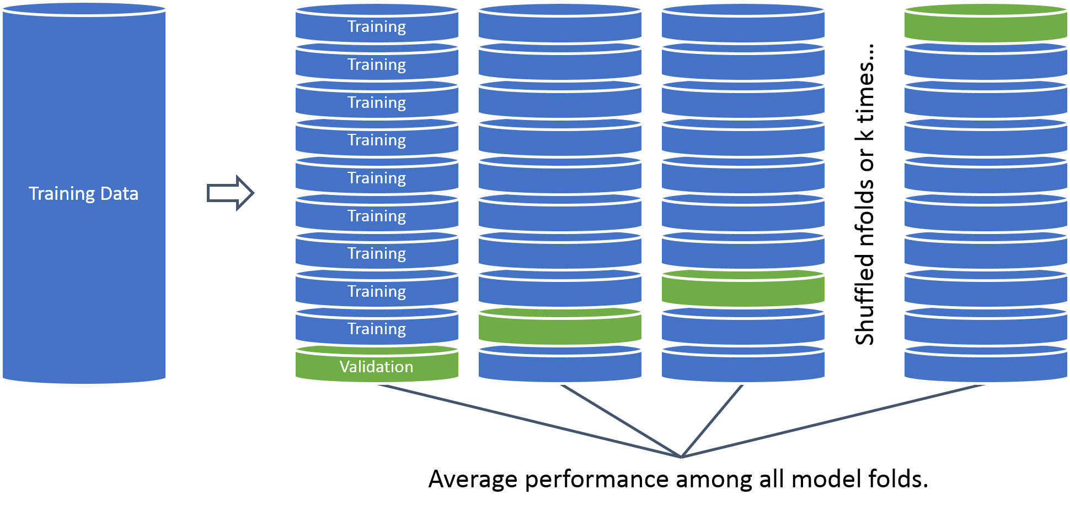
What is cross – validation?
In this example we will perform cross validation because the data set is only 20k records.

Slide 9
Cutoff Threshold
Is 0.50 the optimal cutoff?
Should we be equal weighted?
Do we care equally about picking paying notes and charged off loans?

Slide 10
Open F_ConsumerCreditTraining.R
Learning Objective:
Load in real lending club data
Treat the variables for modeling
Build a cross validated logistic regression with caret
Save model object & variable treatment plan

Slide 11
Agenda
Topic VI
Predicting Loan Defaults Lending Club Information Fit a model to the loan data & save as an example Fit a more validated model with new loans Visualize the loans in a dynamic plot Q & A

Slide 12
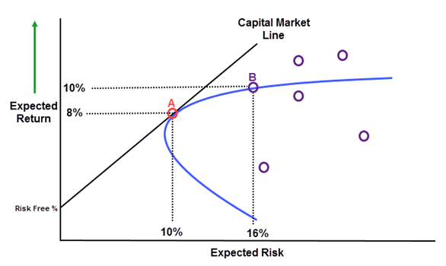
Making a CAPM style plot to understand risk/reward relationship & optimize choice.
T-Bill: usually 3 month

Slide 13
Open G_ConsumerCreditScoring.R
Learning Objective:
Score notes
Make a plot similar to CAPM & identify top loans to fund

Slide 14
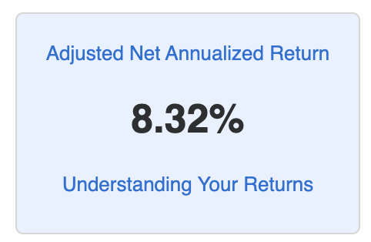
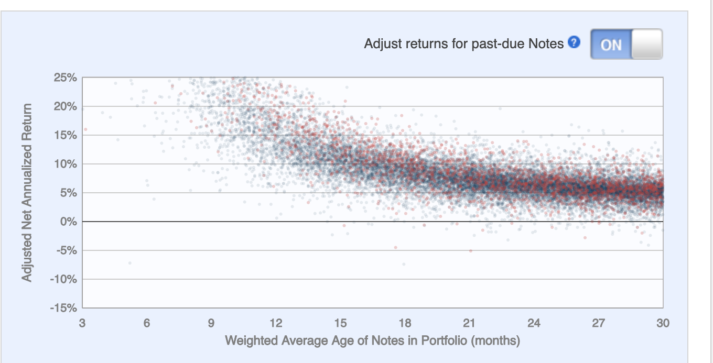
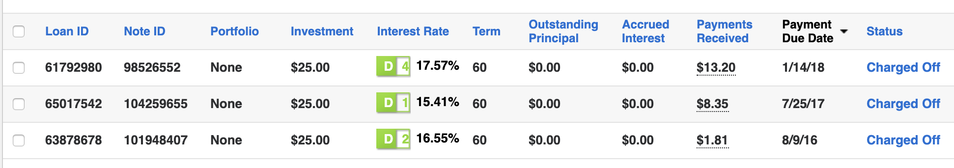
Actual Results using models.

