Slide 1
Agenda
Start | End | Item
 |  | Core Concepts in Data Mining
 |  | Break
 |  | More R learning & EDA

Slide 2
Slow down!
Before jumping into a problem think
The temptation is to accept data as valid
The temptation is to assume you understand the context and what good looks like
The temptation is to use a cool modeling technique
Slow down, think, understand, get diverse opinions, then perform EDA….after all that start modeling and hopefully you will deliver value.

Slide 3
“We want to sell insurance for delayed flights.”
Let’s make a model to predict late flights so we know how to price our insurance.
Get all the data you can about flights and whether or not they are delayed
Airline
Route
Flight cancellation
Aircraft type
Aircraft maintenance
Weather at specific airports
Seats sold vs empty
…
WRONG. Most often, flights are cancelled after they have been delayed. So modeling with cancellation is out of order to what you’re trying to predict.

Slide 4
“We want to predict hospital readmission to improve patient quality of life.”
Let’s make a model to predict late probability of readmission.
Get all the data you can about patients and whether or not had to come back within 30days.
Race
Age
Weight
Gender
Has the person expired
Height
Different drugs they may be on
Number of tests
Number of diagnoses
…
WRONG. People that have expired are not coming back to the hospital.

Slide 5
“Let’s predict if an employee is likely to be fired to help our HR ops make better hiring decisions.”
Let’s make a model to predict late probability of being fired.
Get all the data you can about employees and figure out the probability for getting fired.
Distance to work
Transportation Type
Transportation Reliability
Last review score
Were they on a performance plan
Education
Pay
Current role
…
WRONG. People that are on a performance plan know they will be fired at a specific date, as that date draws near they will quit. Since they quit, they will not be considered “FIRED” in most HR systems.

Slide 6
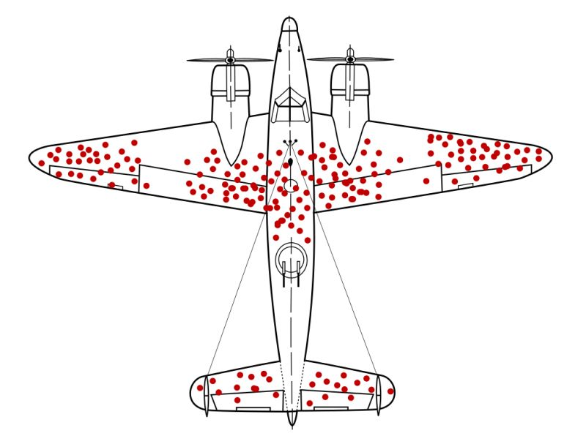
Where should we put extra structural reinforcements?
Pattern of damage among returning plans from bombing runs in WW2.
Returning is success. So this is the damage pattern for success.

Slide 7
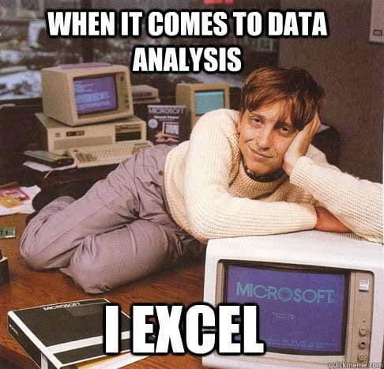
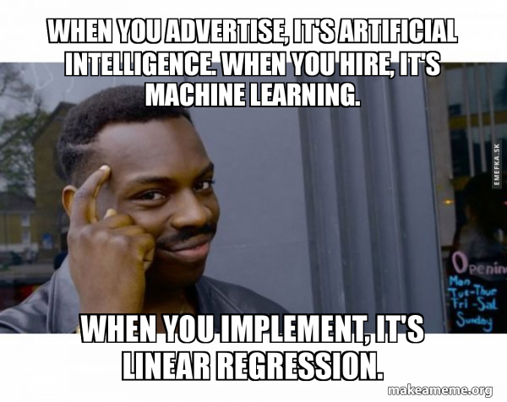
After you have a good grasp of the problem then comes choosing data.

Slide 8
Data Exploration (EDA)
Data sets are typically large, complex & messy
Need to review the data to help refine the task
Use techniques of Reduction/Sampling and Visualization

Slide 9
Exploring Data: Sampling to Save Time
Data mining typically deals with huge databases
For piloting/prototyping, algorithms and models are typically applied to a sample from a database, to produce statistically-valid results
Once you develop and select a final model, you use it to “score” (predict values or classes for) the observations in the larger database
Caveats – unbalanced data needs “over sampling”
Insurance no claim (99%) vs claim (1%)
Credit Card Transactions (99+% no fraud) vs (<1% fraud)
If your modeling is unbalanced, the book has an example of oversampling

Slide 10
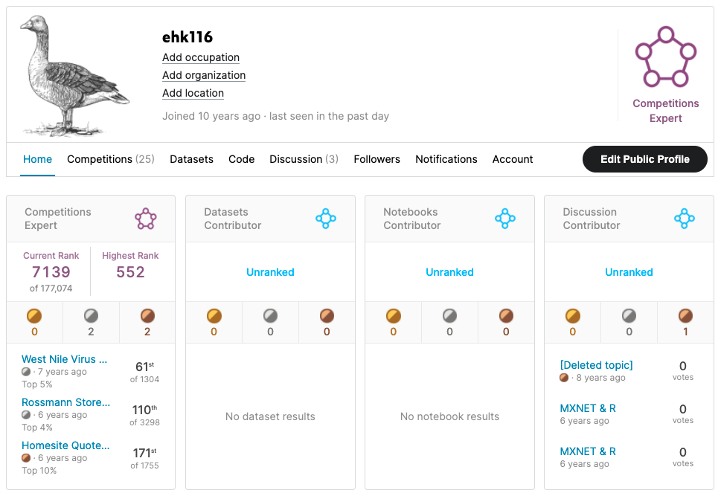
What’s the value of good EDA?
Asked to predict the presence of West Nile Virus in Chicago mosquito traps.

Slide 11
The task to predict West Nile Virus in Traps
Date | Temperature | Humidity | … | Presence of Virus
6/1/2012 | 82 | 50 | … | 1
5/15/2011 | 84 | 60 | … | 0
5/30/2011 | 76 | 35 | … | 0
7/4/2012 | 97 | 85 | … | 1
7/15/2010 | 89 | 75 | … | 1
6/12/2010 | 78 | 75 | … | 0
8/3/2012 | 84 | 45 | … | 1
Date | Temperature | Humidity | … | Presence of Virus
6/1/2012 | 82 | 50 | … | 1
7/4/2012 | 97 | 85 | … | 1
7/15/2010 | 89 | 75 | … | 1
8/3/2012 | 84 | 45 | … | 1

Slide 12

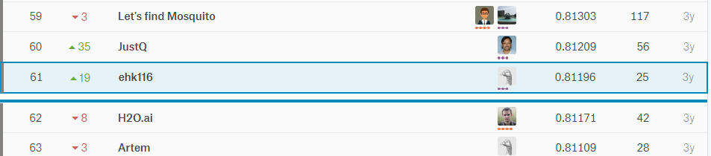
EDA let me realize a flaw!
Simple EDA by year would show that West Nile was 2x in 2012
After fitting an algorithm, I merely doubled predictions if they were within 2012 for the test set. Not great DS but an easy way to move up the leaderboard.

Slide 13
Let’s Practice
Open B_EDA work.R:
Lots of basic R options
str()
dim()
class()
head()
nlevels()
summary()
cor()
unique()
mean()
colSums()
is.na()
Specific packages make life easier
library(DataExplorer)
plot_str()
plot_missing()
plot_histogram()
plot_density()
plot_scatterplot()
library(radiant.data)
On this script you will fill in the object, vector and information into the code scaffold. Then spend 5-10min exploring the data with radiant.data

Slide 14
Housekeeping , Reading & Homework
Start Case I in code or with Radiant.Data!
Read Chapter 3
Ask questions publicly on the class forum or use www.llmaid.com (beta)

