Slide 1
Exploring Data: Sampling to Save Time
Data mining typically deals with huge databases
For piloting/prototyping, algorithms and models are typically applied to a sample from a database, to produce statistically-valid results
Once you develop and select a final model, you use it to “score” (predict values or classes for) the observations in the larger database
Caveats – unbalanced data needs “over sampling”
Insurance no claim (99%) vs claim (1%)
Credit Card Transactions (99+% no fraud) vs (<1% fraud)
If your modeling is unbalanced, the book has an example of oversampling

Slide 2
The task to predict West Nile Virus in Traps
Date | Temperature | Humidity | … | Presence of Virus
6/1/2012 | 82 | 50 | … | 1
5/15/2011 | 84 | 60 | … | 0
5/30/2011 | 76 | 35 | … | 0
7/4/2012 | 97 | 85 | … | 1
7/15/2010 | 89 | 75 | … | 1
6/12/2010 | 78 | 75 | … | 0
8/3/2012 | 84 | 45 | … | 1
Date | Temperature | Humidity | … | Presence of Virus
6/1/2012 | 82 | 50 | … | 1
7/4/2012 | 97 | 85 | … | 1
7/15/2010 | 89 | 75 | … | 1
8/3/2012 | 84 | 45 | … | 1

Slide 3
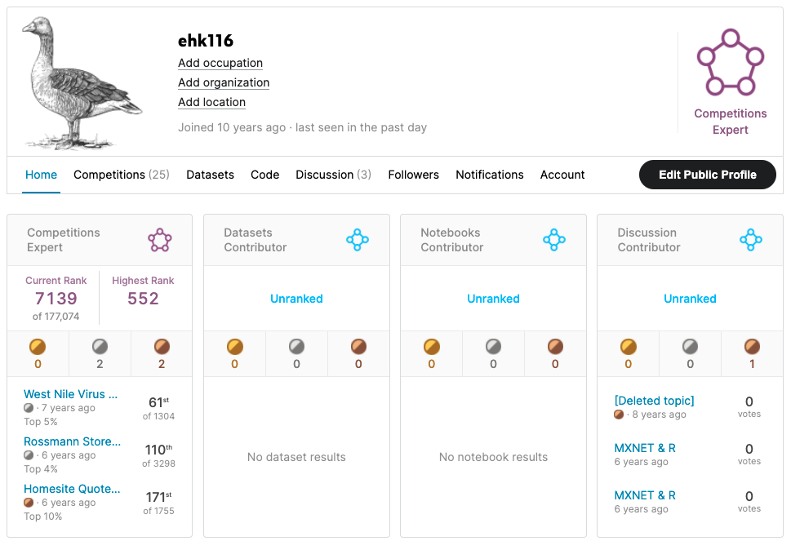
What’s the value of good EDA?
Asked to predict the presence of West Nile Virus in Chicago mosquito traps.

Slide 4

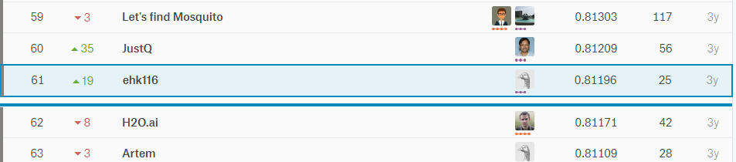
EDA let me realize a flaw!
Simple EDA by year would show that West Nile was 2x in 2012
After fitting an algorithm, I merely doubled predictions if they were within 2012 for the test set. Not great DS but an easy way to move up the leaderboard.

Slide 5
Let’s Practice
Open B_EDA work.R:
Lots of basic R options
str()
dim()
class()
head()
nlevels()
summary()
cor()
unique()
mean()
colSums()
is.na()
Specific packages make life easier
library(DataExplorer)
plot_str()
plot_missing()
plot_histogram()
plot_density()
plot_scatterplot()
library(radiant.data)
On this script you will fill in the object, vector and information into the code scaffold. Then spend 5-10min exploring the data with radiant.data

