Slide 1
Unsupervised Learning
Ted Kwartler

Slide 2
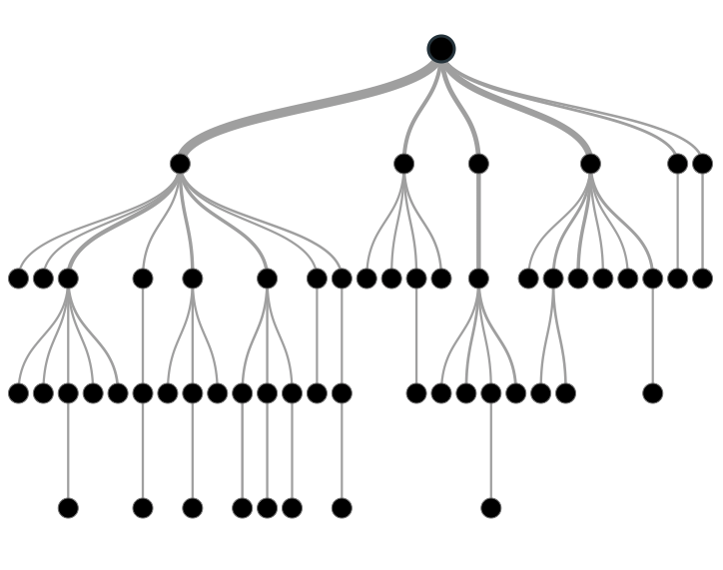

Supervised Learning: Classification & Prediction
Inferring a function from labeled data.
“Learn from telling”, “Look at my data and I will tell you what to predict”
Data Setup
Method
Business Examples
Application
Marketing-Will a customer buy yes or no? How much will a customer spend?
Operations- Will an applicant default? When will a machine break?
Flat “Excel” file. Each row is a record or observation. Each column is an attribute of the record.
One column is the outcome, y or target attribute.
Modeling e.g. K-NN, linear regression, decision tree, random forest etc.
Use the model to make predictions for the target label on the new data.

Slide 3
Unsupervised Learning: Find meaningful groups
Trying to find hidden structure in unlabelled data.
“Learn from observing”, “Look at my data and tell me about it”
Data Setup
Method
Business Examples
Application
Marketing-Find customer segments for specific marketing campaigns.
Operations-Identify locations for cell towers based on population density and area characteristics.
Text Analysis- Topic modeling of articles
Flat “Excel” file. Each row is a record or observation. Each column is an attribute of the record.
Clustering e.g. K-Means, Hierarchical Clustering, Cosine Similarity etc
In new data find the customers/observations that most likely are part of a particular cluster.

Slide 4
Benefits of Unsupervised Learning
Unsupervised learning is a type of machine learning dealing with unlabeled data. It explores the underlying structure in the data to form groups (clusters) without a specific guided outcome.
Patterns and relationships can be complex and hard to uncover, unsupervised learning helps identify patterns that may have gone unnoticed.
Challenges: best often depends on specifics of the data and business problem, hard to make meaningful sense for a business person, traditionally harder to calculate ROI for an unsupervised project.

Slide 5
Business Applications
Market Segmentation
Recommendation Systems
Examining customer databases and features to identify groups/personas for targeted messaging and promotions
User-based, or collaborative filtering help identify next ideal suggestion for a customer’s habits
Feature Reduction
Anomaly Detection
Add a cluster assignment to an observation as a form of feature engineering within a supervised learning workflow.
Identify a small and unusual cohort within data i.e. transaction, network traffic etc.
NLP
Topic modeling such as LDA to extract subjects from customer reviews, support tickets etc.

Slide 6
ID 3 Clusters
Select US State Fuel Cost (x) vs Sales (y)
Sales
Price

Slide 7
K-Means Clustering*: Intuition for 3 clusters…
low price &
high sales
Mid price &
Mid sales
Sales
High price &
Low sales
Price
*remember there are MANY types of unsupervised algorithm choices; this is just one

Slide 8

K-Means Unsupervised
Previous slide clustering was done by “eye”
“K” clusters are defined by practitioner
Need a defined distance measure between record
Euclidean Distance (common but not great for text)
Scale each vector to so one unit of measure doesn’t dominate ie # of rooms in a house vs sq-Meter of house

Slide 9
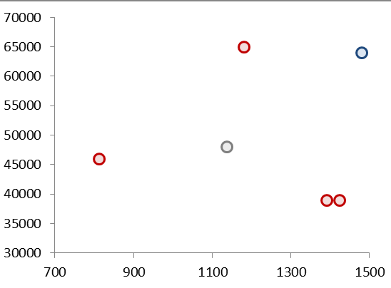
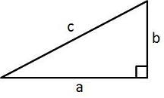
Quick Refresher
Remember Pythagorean Theorem?
Example Data
A²+B²=C²
b
c
a

Slide 10
K Means
Select US State Fuel Cost (x) vs Sales (y)
2
1
3
Random centroid placement

Slide 11
K Means
Select US State Fuel Cost (x) vs Sales (y)
2
1
3
Calculate the distance from each point to each centroid

Slide 12
K Means
Select US State Fuel Cost (x) vs Sales (y)
2
1
Cluster “2”
Cluster “3”
3
Cluster “1”
Pts assigned to closest centroid.

Slide 13
K Means
Select US State Fuel Cost (x) vs Sales (y)
2
1
Cluster “2”
Cluster “2”
Cluster “2”
3
Calculate the MEAN AVERAGE distance among assigned pts to centroid

Slide 14
K Means
Select US State Fuel Cost (x) vs Sales (y)
2
2
1
3
3
1
Move the centroid to the average distance among all assigned points

Slide 15
K Means
Select US State Fuel Cost (x) vs Sales (y)
2
Since “3” moved, this pt is assigned to “2”
3
1
Pt reassignment affects the avg distances so the process repeats…

Slide 16
K Means
Select US State Fuel Cost (x) vs Sales (y)
2
2
1
2
3
3
1
1
The new pt assignments again moves the centroid. The process repeats until no reassignments occur after moving the centroids (convergence).

Slide 17
K Means
Select US State Fuel Cost (x) vs Sales (y)
2
3
1
The new pt assignments again moves the centroid. The process repeats until no reassignments occur after moving the centroids (convergence).

Slide 18
K-Means Unsupervised
Previous slide clustering was done by “eye”
“K” clusters are defined by practitioner; multiple analytical methods can help
Need a defined distance measure between record
Euclidean Distance (common but not always great)
Scale each vector to so one unit of measure doesn’t dominate ie # of rooms in a house vs sq-Meter of house
Because it is the mean average all data attributes must be numeric (non factor ie what is the average of “blue eyes” or “medium” or “first”.

Slide 19
Choosing the optimal clusters
WSS
Within Cluster Sum of Squares
- value to be minimized measures the “compactness” of the cluster
Small WSS
2 clusters
Higher WSS
less compact
Small WSS
more compact
But you could keep adding clusters to reduce WSS which overfits. The elbow method lets you examine the tradeoff of WSS by number of clusters.

Slide 20
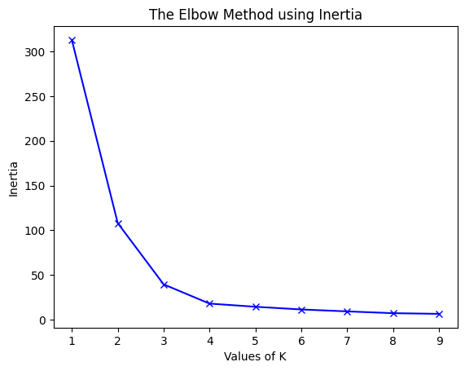
Choosing K with the Elbow Method
Big decease in WSS
“cluster compactness”
Decreasing rate of WSS decrease
Very little WSS change for each new cluster
Each new cluster decreases the WSS but at some point the changes in WSS decreases.

Slide 21
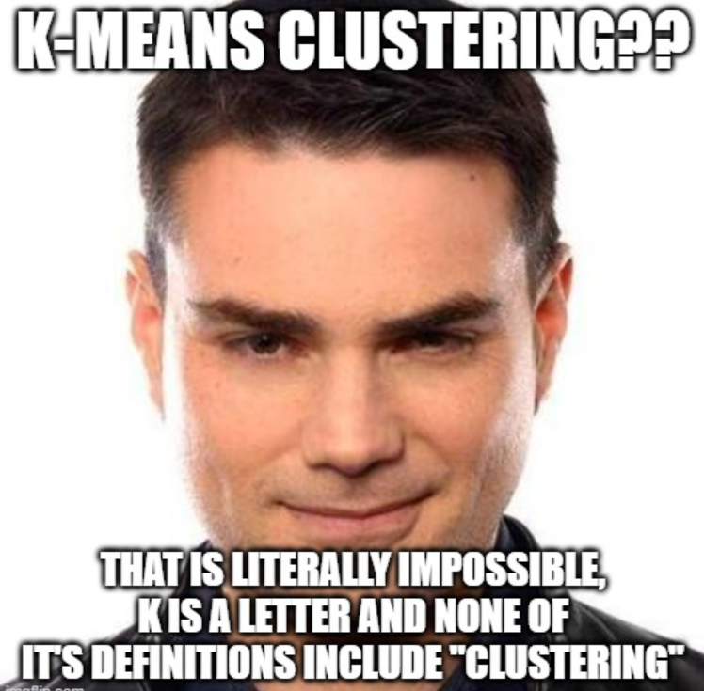
Open C_kmean_clustering.R
Use K-Means for customer segmentation
Use Elbow Method to choose the optimal K
Apply the cluster identities to new records by measuring new record distances to the identified cluster centroids.

