Slide 1
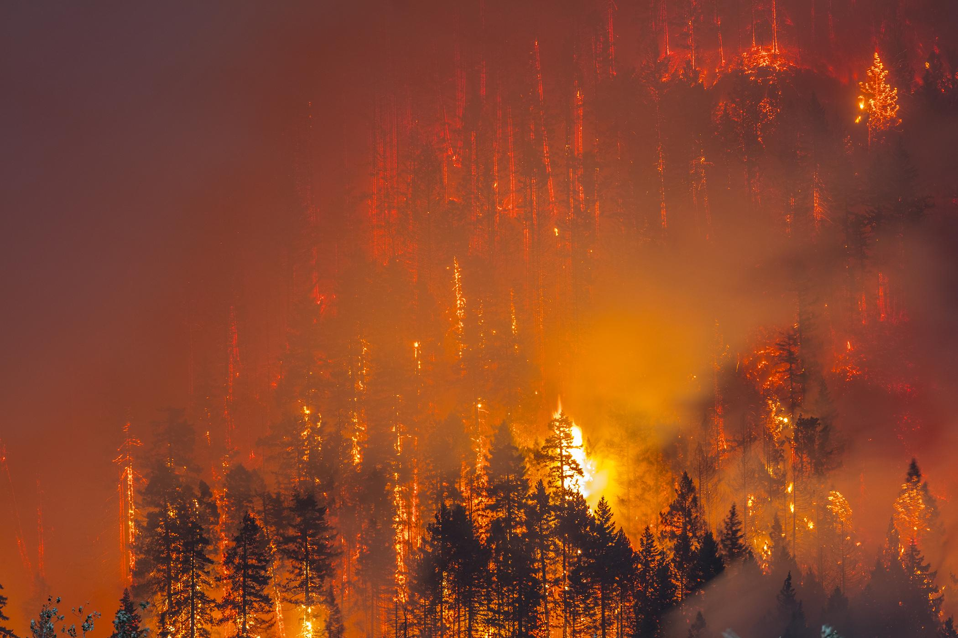
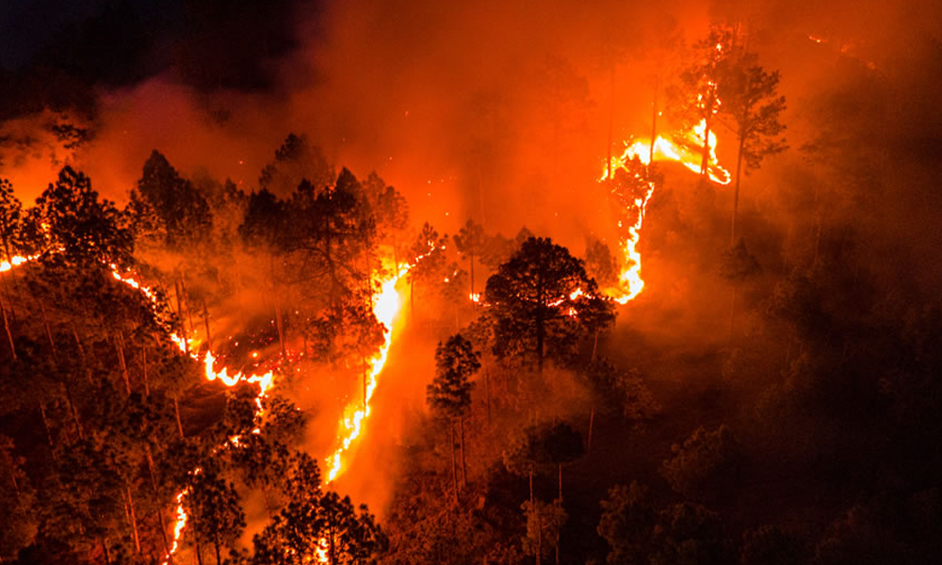
Predicting Wildfires
in California
Using Machine Learning
Alvaro Laham · Ruchi T. Bhanot
Jake Klein · Phillip Dundas
UC Berkeley MIDS - DATASCI 207 · April 2026
Notes:
Welcome everyone. Our project tackles one of the most pressing environmental challenges in California: predicting wildfire ignition before it happens. We focused on daily weather data to tell us whether a wildfire will start on a given day?
Why? Because it can serve as an early warning signal for emergency services and potentially save lives and property. Our team of four – Ruchi, Alvaro, Jake and Phil - tackled this as a supervised binary classification problem - fire day or not -We built and compared four machine learning models to find the best approach.

Slide 2
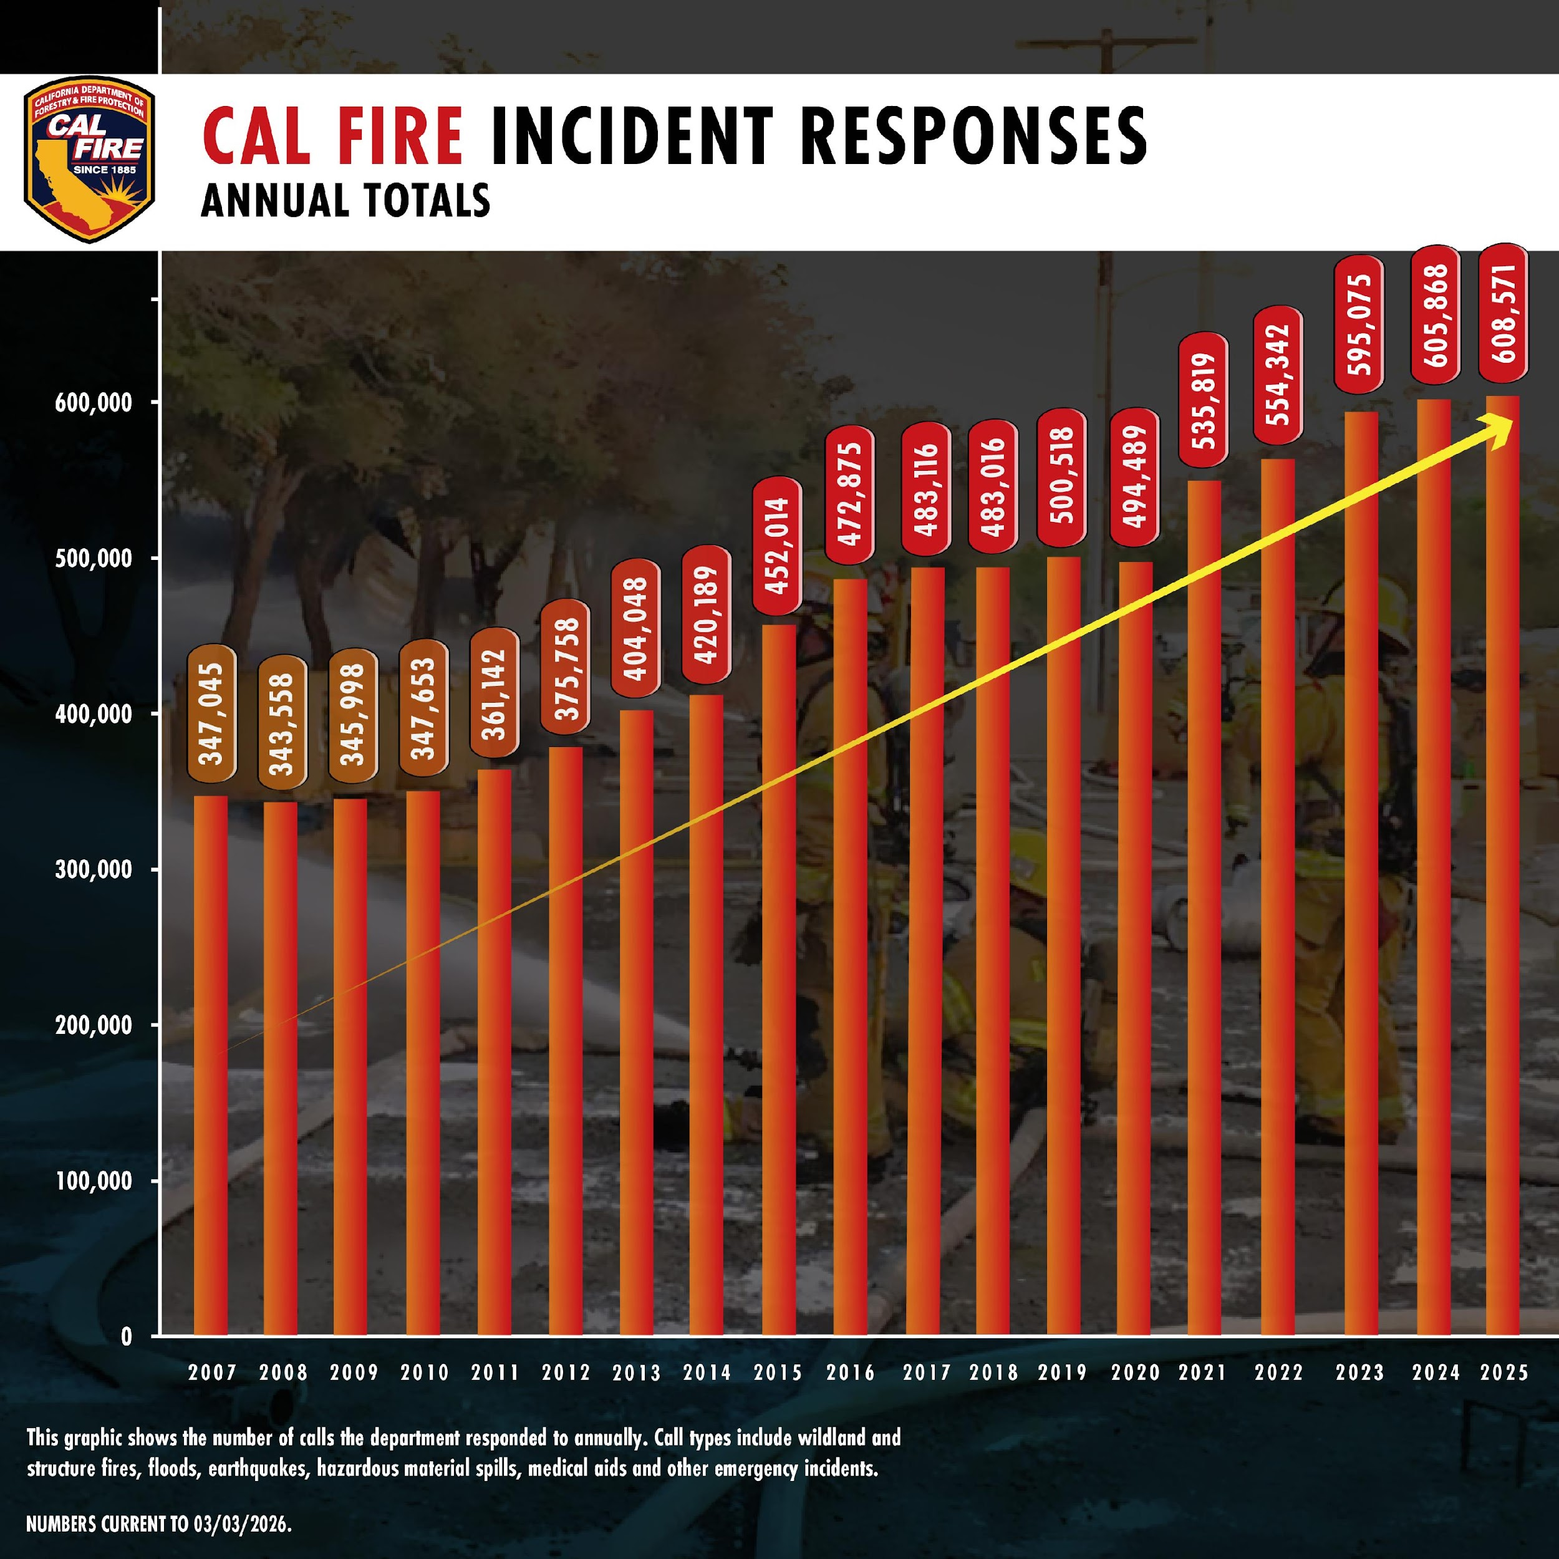
Problem & Motivation
California wildfires have increased dramatically in frequency and severity over the past four decades
Literature review suggests detection systems focused on predicting fire expansion - too late for proactive resource deployment (Khennou et al., 2023; Radke et al., 2019)
Weather conditions (temperature, drought, wind, precipitation) are known precursors to fire ignition (Aurora et al., 2021)
Our goal: predict whether a wildfire will start on a given day from day-of weather data alone
Practical use case: fire agencies can pre-position crews and equipment on forecasted high-risk days
We treat this as a binary classification problem — fire day (1) or no-fire day (0)
Notes:
[Ruchi]
California has experienced a dramatic increase in wildfire activity as you can see from the graph showing
Year-on-year incident responses
Current early warning systems are largely reactive, rely on satellite imagery or fire lookout towers after ignition has already occurred. At that point, the response is containment, not prevention. Our hypothesis is that weather conditions create predictable windows of elevated fire risk.
Identifying those windows reliably enables agencies to take preemptive action - think of it as a 'weather forecast for fire risk' rather than a post-ignition alert.
[We're not trying to predict where a fire will start or how large it will grow. The question is simply: given today's weather conditions in California, should we be on high alert?]

Slide 3
Our Dataset, Preprocessing & Features
Data source: The California Weather & Fire Prediction Dataset (http://zenodo.org/records/14712845)
14,976
41 yrs
23
Daily Observations
1984 – 2025
Predictive Features
Weather (4)
Engineered (3)
precipitation · max_temp · min_temp · avg_wind_speed
lagged_precipitation · lagged_wind_speed · days_without_rain*
Temporal (16)
Target (1)
Month & season : one-hot encoded
fire_start_day [0 = No Fire | 1 = Fire]
* Team-engineered feature: consecutive days without precipitation
Notes:
[Ruchi]
Our dataset comes from the California Weather and Fire Prediction Dataset on Zenodo.org that combines NOAA Climate Data with fire incident data from CAL FIRE. It covers roughly 15,000 daily observations 41 years of data (across 1984 to 2025) The raw dataset had 14,989 rows. We removed only 13 rows with missing values - representing just 0.09% of the data - leaving us 14,976 clean observations. We split these into 8,985 training, 2,995 validation, and 2,996 test observations using stratified 60/20/20 sampling to preserve the class balance across all three sets. the original data had features across 3 categories: weather, temporal, target. The four weather variables are raw daily measurements. The three engineered features capture temporal patterns - particularly drought buildup. e.g., days_without_rain, which counts consecutive dry days as a proxy for vegetation dryness. The 16 temporal features are one-hot encoded month and season columns, leaving us with a total of 23 predictive features
One important preprocessing decision: the dataset has a 67/33 class imbalance - two thirds of days have no fire. We addressed this through class weighting in each model rather than resampling. And to next talk about our EDA, I’ll pass it on to Jake.

Slide 4
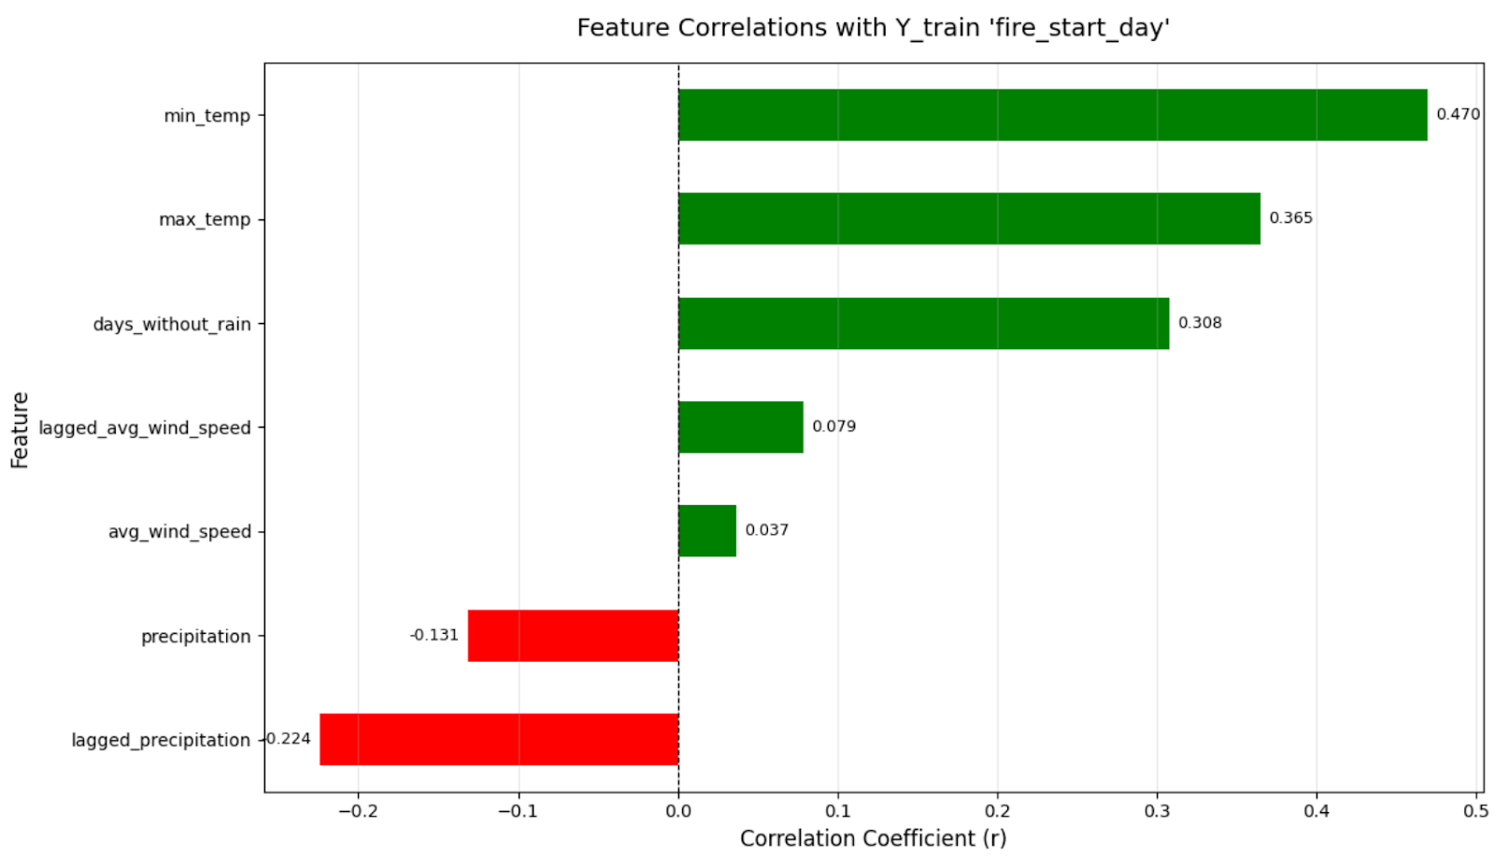
Exploratory Data Analysis - Key Findings
min_temp has the strongest correlation to fire ignition (r = 0.47) - warm overnight temperatures signal elevated risk
max_temp shows strong positive correlation (r = 0.37) - daytime heat compounds moisture stress
days_without_rain captures cumulative drought effect (r = 0.31) - vegetation dryness builds over time
lagged_precipitation - 7-day prior rainfall - acts as a protective signal (r = -0.22)
Wind speed shows very weak correlation with ignition (r = 0.04 to 0.08) - more relevant to spread than start
📷 IMAGE SUGGESTION
Notes:
[JAKE]
We conducted EDA. Findings:
Min temp (often the overnight low) strongest positive correlation to fire binary variable
Research shows that plants and trees cannot recover overnight when temperatures stay high, which increases stress on plants and decresaes moisture content, which can lead to wildfires
Max temp was more weakly correlated but still moderately correlated
Days without rain also positively correlated
This captures the cumulative drying effect that standard precipitation variables miss: a single dry day is not dangerous, but 30 consecutive dry days are.
Wind speed has very little correlation with ignition
May contribute to spread but didn’t show strong positive correlation to yes or no ignition
These EDA findings directly informed our model evaluation - when we later look at feature importance from the Random Forest, we see these same three features at the top, validating our EDA.

Slide 5
Methodology — Baseline + Four Models
Baseline
Logistic
Regression
XGBoost
Random
Forest
FFNN
Majority class
(always no fire)
Linear boundary
TensorFlow
Gradient boosting
1,000-config search
Bagging ensemble
Manual grid search
0 to 3 hidden layers
Keras Tuner
Class imbalance (67/33): adjusted for by using class_weight='balanced' for Random Forest, scale_pos_weight=2.01 for XGBoost, class weights {0:1, 1:2} for FFNN
Feature scaling: Z-score normalization for logistic regression & FFNN; raw features for XGBoost & Random Forest (tree models are scale-invariant)
Tuning: Keras Tuner Hyperband for logistic regression/FFNN; RandomizedSearchCV (1,000 configs) for XGBoost; manual grid for Random Forest
Evaluation: F1-score is primary metric; recall is tiebreaker - operationally, missing a fire is worse than a false alarm
Train/val/test: 60/20/20 stratified split; hyperparameters tuned on validation only; test set used once for final evaluation
Notes:
[JAKE]
We implemented five models including the baseline, progressing from simplest to most complex.
Baseline
Majority classifier, no fires every day, 67% accuracy but 0 recall
Logistic regression
a single-layer neural network in TensorFlow taking features, passing through a sigmoid function to get 0 or 1
XGBoost
Gradient boosting algorithm which builds sequential trees each correcting the prior, built using the XGboost library in Python
Random Forest
builds independent trees in parallel on bootstrapped subsets of the training data and votes by majority vote to make a determination
FFNN
Same input features, a set of hidden layers with activation functions, culminating in a sigmoid layer
A few things we did across all models:
First, handling class imbalance - we didn't resample, instead using class weights to penalize fire misses more heavily (as we had fewer fire days in our dataset)
Second, feature scaling - only gradient-descent models need it; tree models are scale-invariant so we used raw features there.
Third, hyperparameter tuning was done exclusively on the validation set – per best practice the test set was held out until final evaluation.
Our selection criteria used F1-score primarilyy, with recall as tiebreaker. We chose recall as tiebreaker because from a public safety perspective, missing a real fire day is worse than a false alarm.

Slide 6
Results — Model Comparison
Key Takeaways
Model | Test Accuracy | Fire F1 | Fire Recall | Fire Precision
Baseline | 66.82% | 0.00 | 0.00 | 0.00
Logistic Regression | 75.47% | 68.03% | 78.67% | 59.92%
XGBoost ★ | 76.47% | 68.79% | 78.17% | 61.42%
Random Forest | 75.60% | 68.00% | 77.00% | 60.00%
FFNN | 74.50% | 67.00% | 78.00% | 59.00%
XGBoost wins on F1 (68.79%) and highest precision (61.42%) - selected as best model
All models beat 66.82% baseline by ~8-10% accuracy
All four models converge near the same F1 (~67-69%)
Logistic Regression best on recall (78.67%)
This suggests the bottleneck is the data, not the model.
Notes:
PHIL
Displayed here are the results across all five models. The yellow-highlighted row is XGBoost, our best model under the F1-primary selection criteria. A few things stand out:
First, the baseline catches zero fires - it just predicts no fire every day. Every real model substantially outperforms it on fire recall and F1, which validates that our weather features carry genuine predictive signal. XGBoost edges out with the highest fire F1 of 0.69. Logistic regression, XGBoost, and Random Forest all land near 76% accuracy and similar F1 scores - they’ve largely converged.
This is an important finding: the additional complexity of tree ensembles and gradient boosting didn't significantly beat a simple linear model. This suggests the bottleneck is the data, not the model. (model complexity does not help) F1 - balances the recall and precision -
why? precision + recall/precision * recall The logistic regression fire shows with highest recall of 78.67% is themodel but barely 2/10th of a point - if recall was the top criteria, logistic regression wins. This is why selection criteria matter.

Slide 7
Seasonal Subgroup Analysis — Random Forest
Summer: An Illusion of Performance
Season | Count (n) | Fire Days % | Fire Recall | Fire F1
☀️ Summer | 791 | 69.2% | 0.995 | 0.816
🍂 Fall | 710 | 33.0% | 0.709 | 0.552
🌱 Spring | 720 | 22.9% | 0.358 | 0.418
❄️ Winter | 775 | 7.0% | 0.000 | 0.000
99.5% recall - but 69% of summer days ARE fire days. Model predicts fire constantly.
Spring: Most Dangerous Gap
Model misses 64% of spring fires. Low base rate (23%) makes model overly conservative.
Winter: Complete Failure
Zero fires detected. 7% base rate overwhelms class weighting entirely.
Notes:
PHIL
This is arguably the most analytically interesting slide in the deck - and the most honest one. When we break the Random Forest results down by season, a very different picture emerges from the overall 76% accuracy. Summer looks spectacular - 99.5% recall. But look at the fire day percentage: 69% of summer days are fire days. The model has essentially learned to predict fire for almost every summer day, which trivially produces near-perfect recall. This isn't discrimination - it's following the base rate. Spring is operationally the most concerning finding. The model misses nearly two thirds of spring fires. Spring has a lower fire base rate of 23%, and the model hasn't learned what distinguishes the fire days from the non-fire days within the season. Winter is a complete failure. Zero fires detected in the test set despite 54 actual winter fire days. The 7% base rate is so low that even with class weighting, the model defaults to always predicting no fire in winter. Importantly - XGBoost shows a similar seasonal pattern in its monthly subgroup analysis. This is a consistent finding across models, not a Random Forest-specific issue. The implication is clear: our models have learned California's seasonal fire calendar. Next, let’s look at what XGBoost identified as important features but they haven't learned what makes any specific day within a season a fire risk day. Better features - vegetation dryness, regional weather stations - could close this gap.

Slide 8
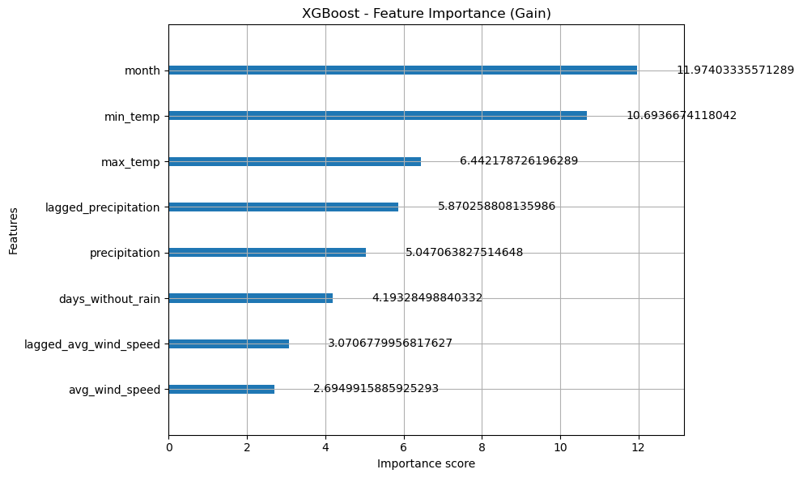
Discussion — What the Models Learned
Models converge near 76% accuracy across logistic regression, XGBoost, and RF suggests a data ceiling, not a model complexity ceiling
Feature importance: month followed by weather (min_temp, max_temp and lagged participation) to refine prediction - most efficient way to reduce loss
Feature min_temp is the highest-ranked numerical feature, suggesting fire risk is associated with higher daily low temperatures
Geographic blindness: no location identifiers in dataset - models represent statewide averages, not regional risk
Wind not driving ignition: average and lagged wind speed are not effective at separating data into classes (Fire vs No fire)
Notes:
[ALVARO]
Looking across all models, a consistent picture emerges about what the data can and cannot tell us. The top three features - month, min_temp, max_temp, followed by precipitation - so model is predicting “No Fire” in winter months and “Fire” in summer months.
Month and overnight lows or night time temperatures are key, as the vegetation does not get time to recover its moisture.
The model splits the data into risky or Fire months vs safe or No-Fire months, and then within those risky months, the days when night-time temperatures are high, increases the risk of fire-ignition the most compared to cooler nights which decreases the next day’s risk risk.
Peak heat in the afternoon - or Max temp is less predictive than night-time temperatures.
This is consistent with the Correlations where min_temp had the strongest relationship with ‘Fire_start_day’ (0.47)
The most important high-level finding is what the model convergence tells us. When a simple logistic regression and a complex gradient boosting model achieve essentially identical F1 scores, that's a signal that we have extracted most of the available signal from the features. Adding model complexity and depth didn't help - you need better data. The geographic limitation is fundamental. California has dozens of distinct climate zones. A heat wave in the Central Valley is very different from one in the coastal ranges, but our dataset treats them identically. Station-level weather data with coordinates would unlock regional modeling.

Slide 9
Conclusions & Future Work
★ Best Model: XGBoost | 76.5% Test Accuracy | Fire F1 = 0.69 | Fire Recall = 78.2%
Key Conclusions
Future Work
Monthly and Night time weather data can predict California fire ignition meaningfully above a naive baseline
All models converged near 76% accuracy - data quality is the limiting factor, not model complexity
Seasonal patterns are learnable
Winter and spring fire detection remains an unsolved problem - and challenge - across all models
Add location-specific weather station data to enable regional modeling across California's diverse climate zones
Incorporate fuel moisture indices and vegetation dryness satellite data as direct physical precursors to ignition
Collect multi-day weather sequence data to move beyond the IID assumption - fire risk builds over consecutive days and single-day snapshots miss that accumulation
Investigate season-specific prediction thresholds to improve winter and spring fire detection without sacrificing summer performance
Notes:
[ALVARO]
To close, I will summarize what we found and where this work could go. Our best model is XGBoost with a test accuracy of 76.5%, fire F1 of 0.69, and fire recall of 78.2%. It achieves this by building 6,938 sequential decision trees, each correcting the residual errors of the previous. The headline conclusion is that tabular weather data carries real predictive signal for wildfire ignition.
Our models beat the naive baseline by roughly 9 percentage points in accuracy and go from zero fire detection to 78% recall - a meaningful improvement.
But: all three of our serious models - logistic regression, XGBoost, and Random Forest - converge to nearly identical performance. This tells us we've extracted most of the available signal from these features. The most important limitation is geographic. Our dataset has no location identifiers. California encompasses dramatically different fire environments - the Central Valley, the Sierra Nevada, the coastal ranges, Southern California - and our model can't distinguish between them. The most actionable future improvement would be adding fuel moisture data. Fuel moisture content - how dry the vegetation is - a direct physical precursor to ignition that our weather-based proxy features only approximate. The USDA Forest Service publishes daily fuel moisture readings at station level that could be integrated. Thank you. Happy to take any questions.

Slide 10
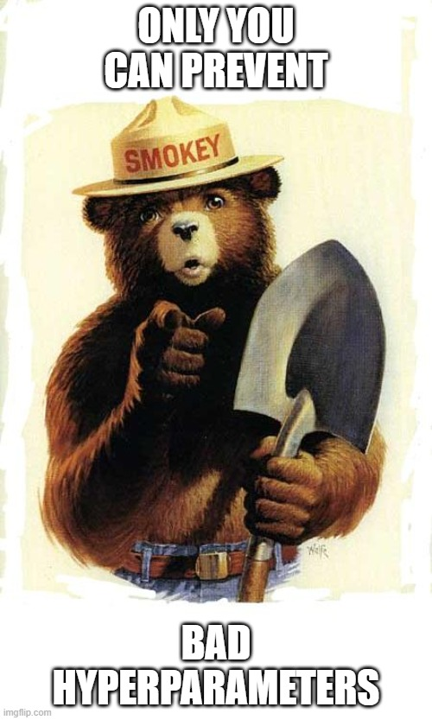
Thank you!
Questions?
Notes:
To close, I will summarize what we found and where this work could go. Our best model is XGBoost with a test accuracy of 76.5%, fire F1 of 0.69, and fire recall of 78.2%. It achieves this by building 6,938 sequential decision trees, each correcting the residual errors of the previous. The headline conclusion is that tabular weather data carries real predictive signal for wildfire ignition.
Our models beat the naive baseline by roughly 9 percentage points in accuracy and go from zero fire detection to 78% recall - a meaningful improvement.
But: all three of our serious models - logistic regression, XGBoost, and Random Forest - converge to nearly identical performance. This tells us we've extracted most of the available signal from these features. The most important limitation is geographic. Our dataset has no location identifiers. California encompasses dramatically different fire environments - the Central Valley, the Sierra Nevada, the coastal ranges, Southern California - and our model can't distinguish between them. The most actionable future improvement would be adding fuel moisture data. Fuel moisture content — how dry the vegetation is - a direct physical precursor to ignition that our weather-based proxy features only approximate. The USDA Forest Service publishes daily fuel moisture readings at station level that could be integrated. Thank you. Happy to take any questions.

Slide 11
References
Aurora A. Gutierrez et al. “Wildfire response to changing daily temperature extremes in California’s Sierra Nevada.” Science Advances 7.47 (2021).
Khennou, Fadoua, and Moulay A. Akhloufi. “Improving wildland fire spread prediction using deep U-Nets.” Science of Remote Sensing 8 (2023): 100101.
Radke, David, et al. “FireCast: Leveraging deep learning to predict wildfire spread.” Proceedings of the Twenty-Eighth International Joint Conference on Artificial Intelligence (IJCAI-19) (2019): 4575-4581.
Notes:
To close, I will summarize what we found and where this work could go. Our best model is XGBoost with a test accuracy of 76.5%, fire F1 of 0.69, and fire recall of 78.2%. It achieves this by building 6,938 sequential decision trees, each correcting the residual errors of the previous. The headline conclusion is that tabular weather data carries real predictive signal for wildfire ignition.
Our models beat the naive baseline by roughly 9 percentage points in accuracy and go from zero fire detection to 78% recall - a meaningful improvement.
But: all three of our serious models - logistic regression, XGBoost, and Random Forest - converge to nearly identical performance. This tells us we've extracted most of the available signal from these features. The most important limitation is geographic. Our dataset has no location identifiers. California encompasses dramatically different fire environments - the Central Valley, the Sierra Nevada, the coastal ranges, Southern California - and our model can't distinguish between them. The most actionable future improvement would be adding fuel moisture data. Fuel moisture content — how dry the vegetation is - a direct physical precursor to ignition that our weather-based proxy features only approximate. The USDA Forest Service publishes daily fuel moisture readings at station level that could be integrated. Thank you. Happy to take any questions.

