Slide 1
NBA Game Predictor
ID10T & Let’s Ride Consulting Group
Alvaro Mendizabal

Slide 2
NBA Data
2021-2022
2016 - 17
Golden State Warriors
Golden State Warriors
2020-21
2017 - 18
Milwaukee Bucks
Golden State Warriors
2019-20
2018 - 19
Los Angeles Lakers
Toronto Raptors

Slide 3
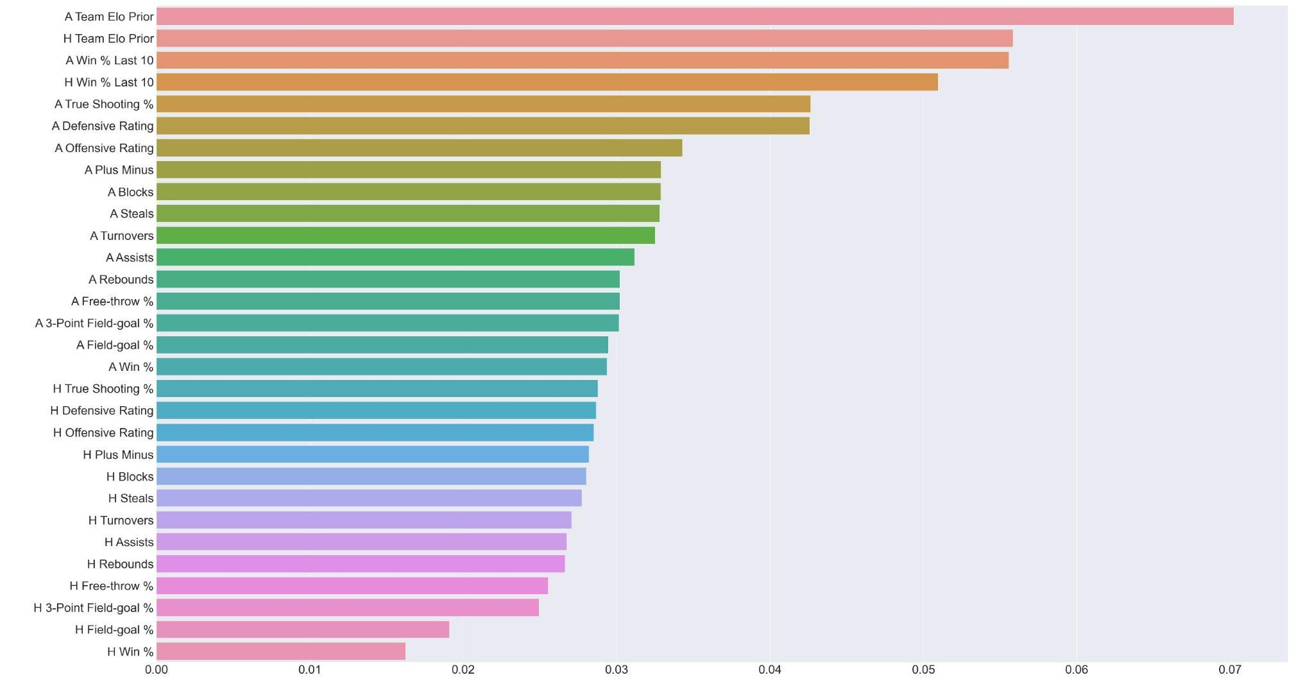
Feature Importance

Slide 4
Offensive vs Defensive Rating
Offensive
Defensive
Points produced by a team per 100 possessions
Points allowed by a team per 100 possessions

Slide 5
True Shooting Percentage
3-pointers
2-pointers
2-pointers
Free-throws
Free-throws
3-pointers

Slide 6
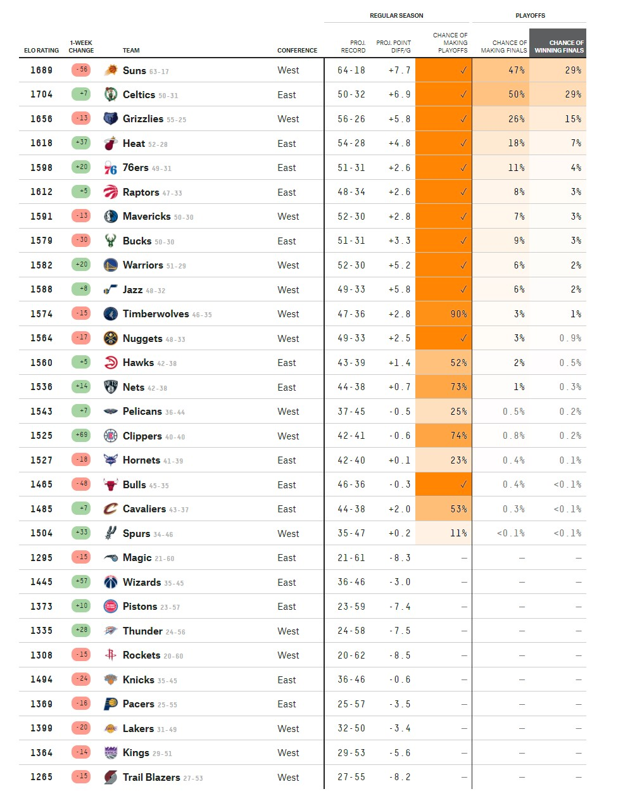
Elo
Rating

Slide 7
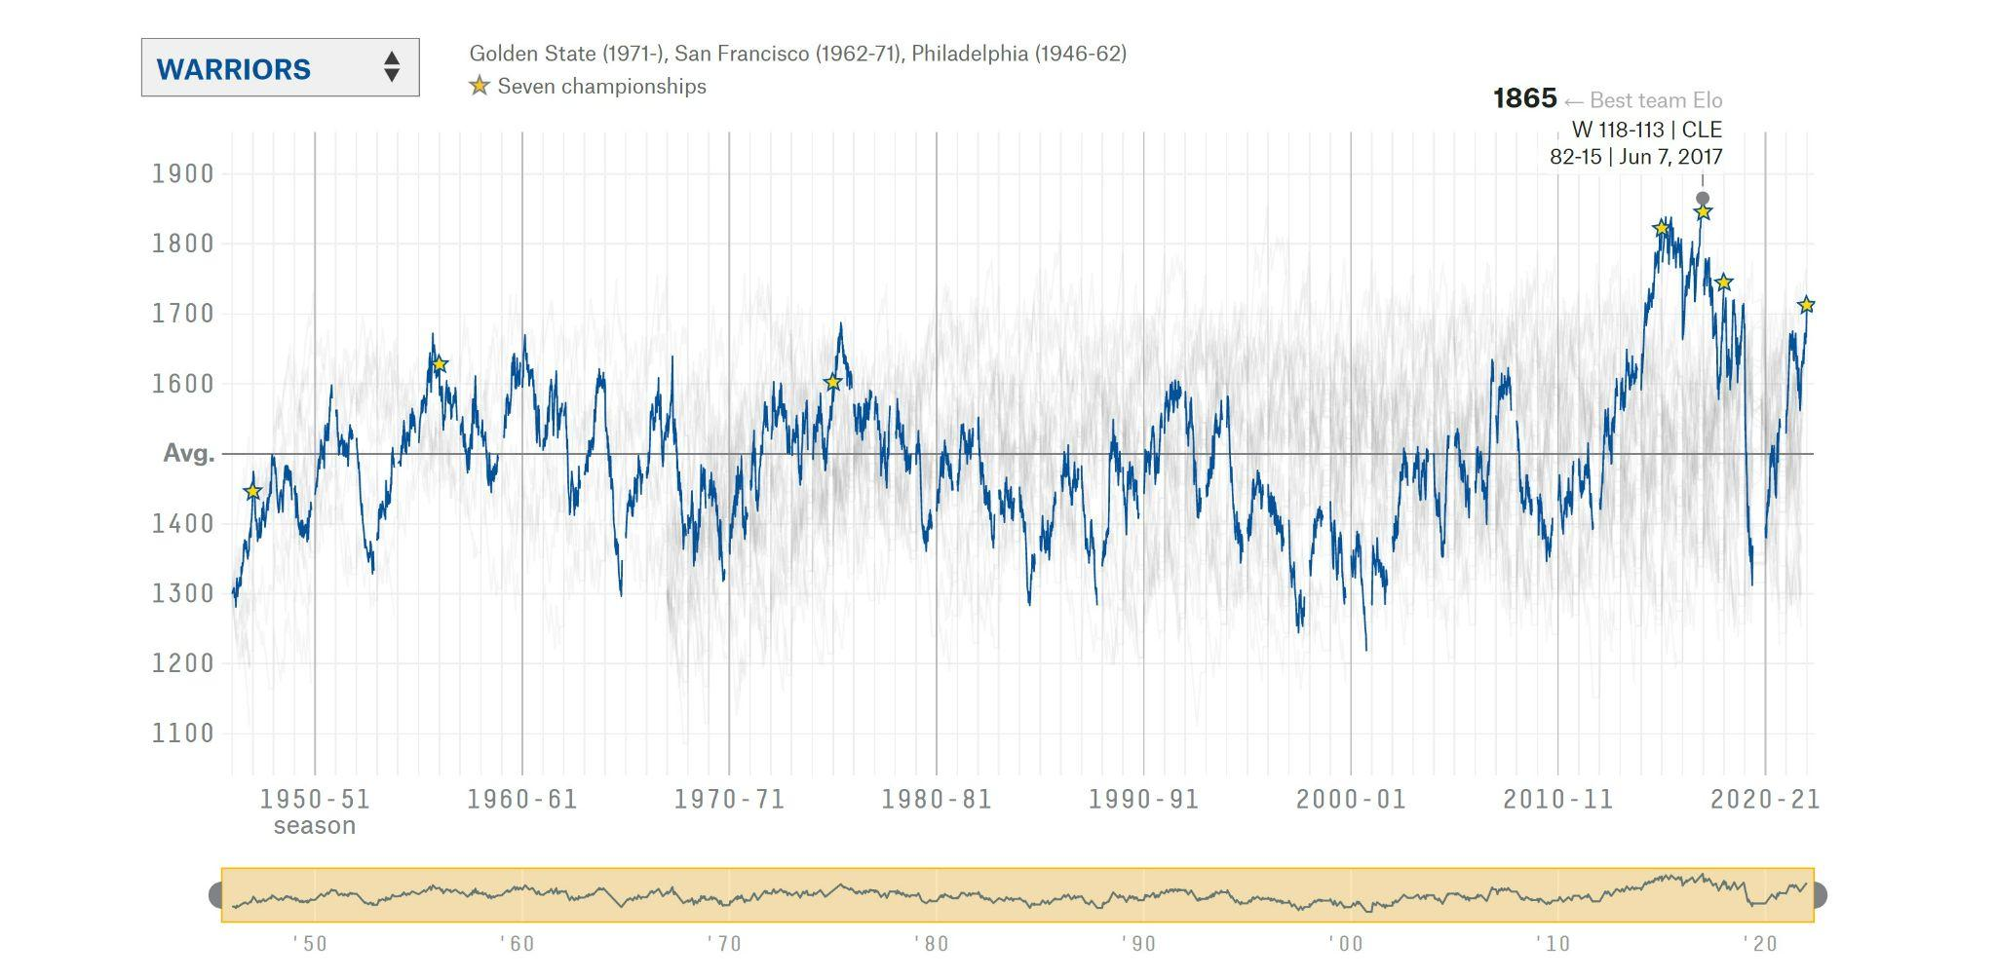
Elo Rating - Golden State Warriors

Slide 8

Predictive Model
67.39%
Accuracy

Slide 9
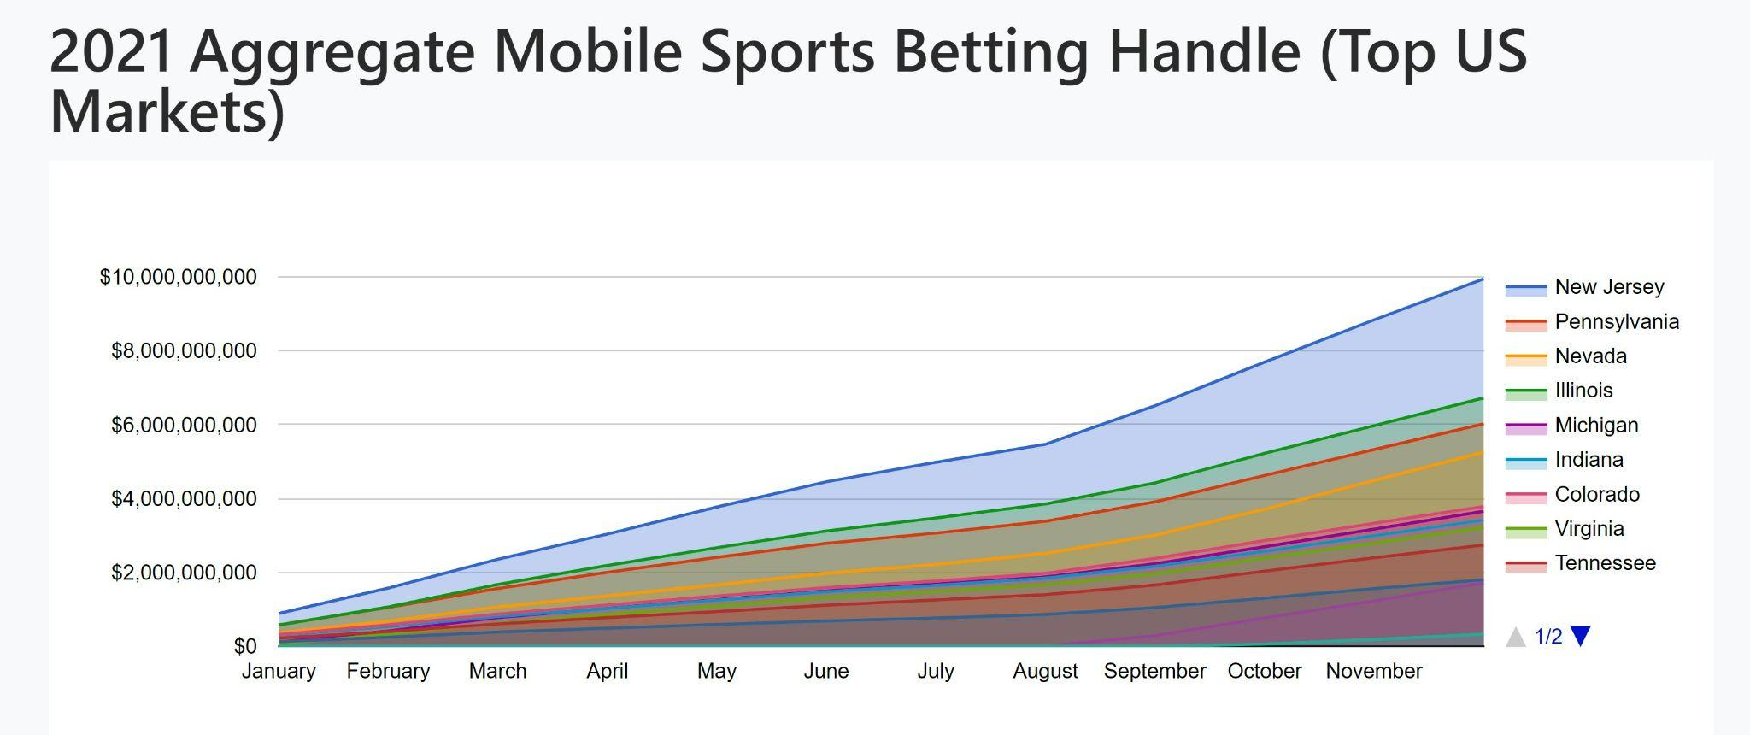

Slide 10
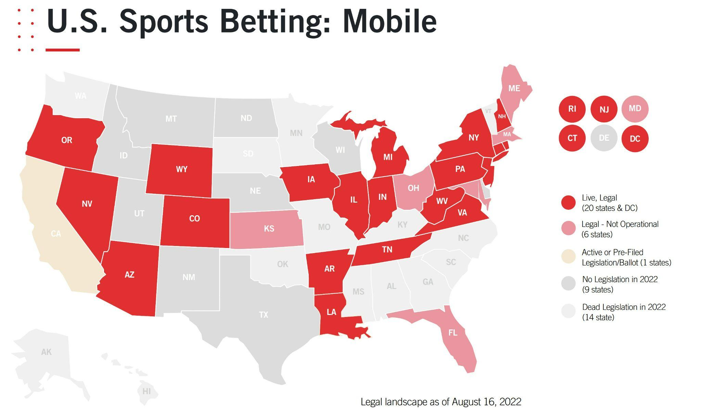

Slide 11
NBA Game Prediction
Alvaro Mendizabal
LinkedIn
Medium

Slide 12
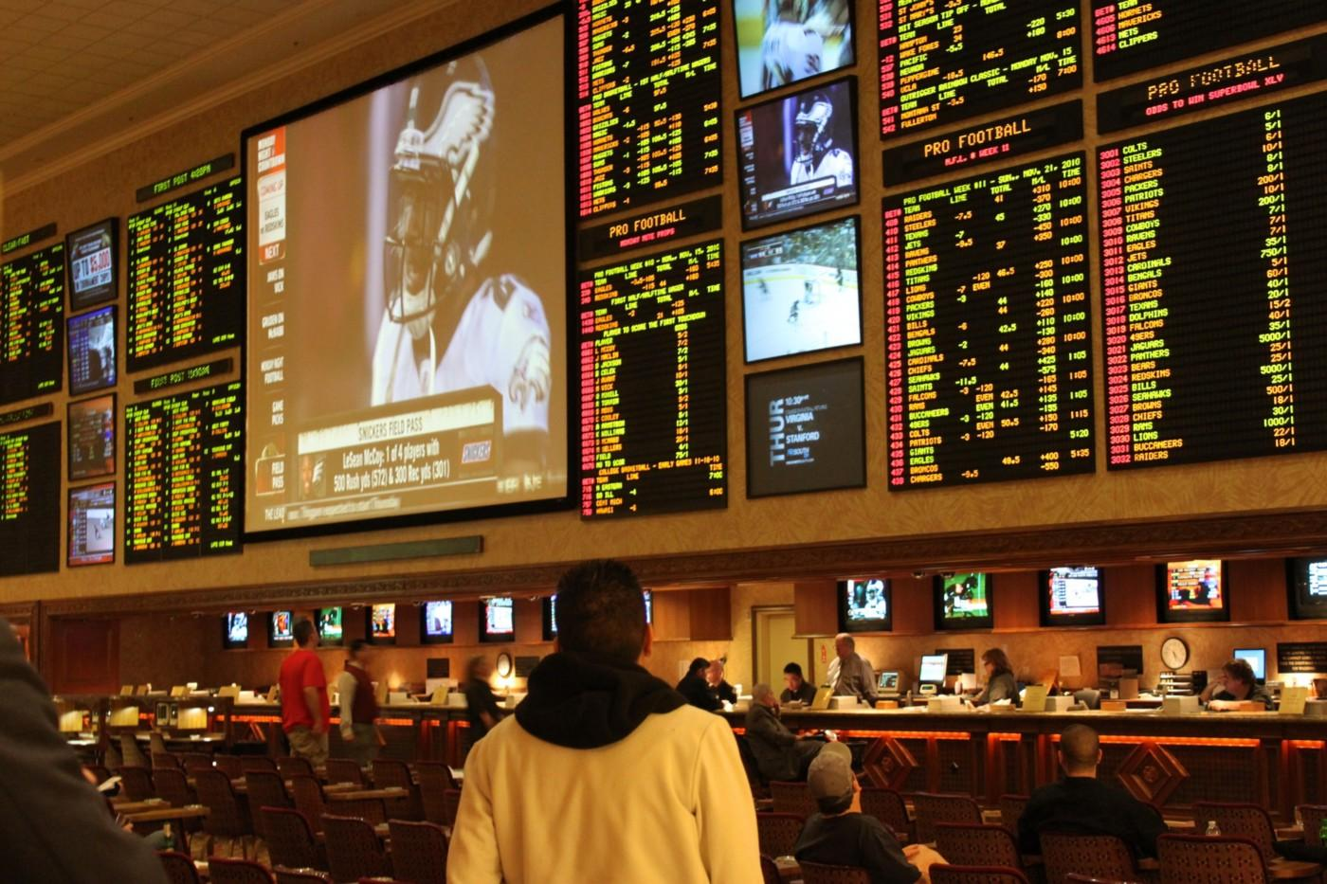

Slide 13
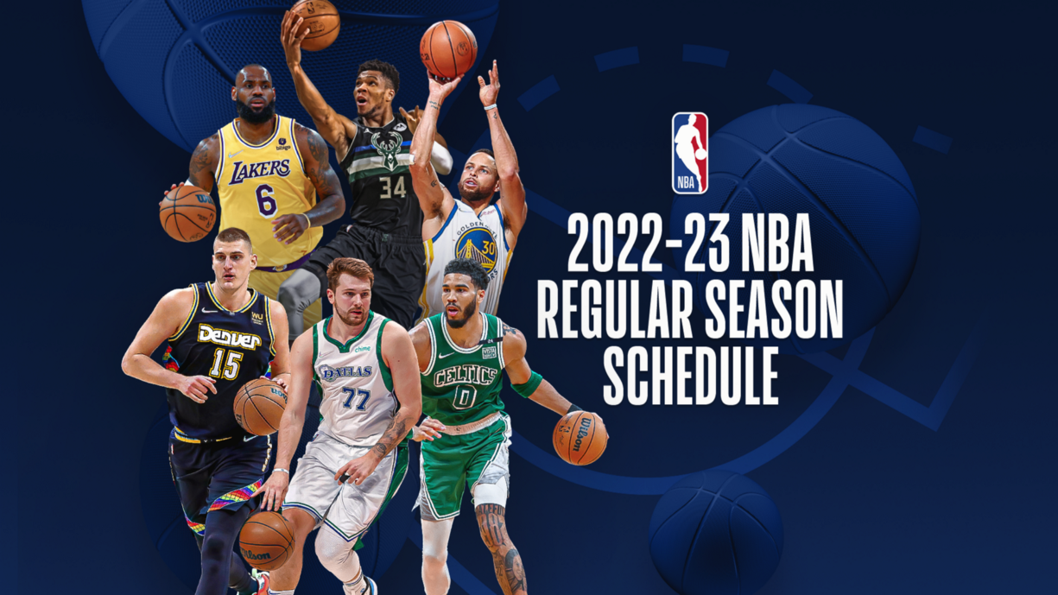

Slide 14
True Shooting Percentage
Free-throws
2-pointers
3-pointers

Slide 15
Basketball Infographics
Saturn
Earth
Uranus
Mars
Saturn is a gas giant and has several rings
The Earth is the beautiful planet where we all live
Uranus is the seventh planet from the sun
Despite being red, Mars is actually a cold place
Jupiter
Mercury
Neptune
Venus
Jupiter is the biggest planet in the Solar System
Mercury is the smallest planet in the Solar System
Neptune is the farthest planet from the Sun
Venus is terribly hot, even hotter than Mercury

Slide 16
Basketball Infographics
Basketball Tournament
Group A
Jupiter is the biggest one
Mars is made of rock
Saturn is a gas giant
Mars is a cold place
Group B
Saturn is a gas giant
Mars has iron oxide dust
Mercury is very small
Jupiter is the biggest one
Group C
Jupiter is the biggest one
The Earth is where we live
Mars is a cold place
Neptune is an ice giant
Group D
Venus is toxic
Mars is actually cold
Jupiter is a gas giant
Mercury is the smallest

Slide 17
Basketball Infographics
1
2
3
4
Mars
Earth
Jupiter
Mercury
Despite being red, it’s actually a cold place full of iron oxide dust
It’s the only planet that harbors life in the Solar System
Jupiter is a gas giant and the biggest planet in the Solar System
Mercury is the closest planet to the Sun and the smallest one

Slide 18
Basketball Infographics
Venus
Venus has a beautiful name and is the second planet from the Sun
Mercury
Mercury is the closest planet to the Sun and the smallest one
Jupiter
Jupiter is a gas giant and the biggest planet in the Solar System
Mars
Despite being red, Mars is actually a cold place full of iron oxide dust

Slide 19
Basketball Infographics
Mercury
Mars
Mercury is the closest planet to the Sun and the smallest one
Despite being red, Mars is actually a cold place full of iron oxide dust
Jupiter
Venus
Jupiter is a gas giant and the biggest planet in the Solar System
Venus has a beautiful name and is the second planet from the Sun

Slide 20
Basketball Infographics
Saturn
Mercury
Mars
Venus
Saturn is a gas giant and has several rings
It’s the smallest planet in the Solar System
Despite being red, Mars is actually a cold place
It’s terribly hot, even hotter than Mercury
Basketball Tournament

Slide 21
Basketball Infographics
Jupiter
Saturn
Earth
Mars
It’s the biggest planet in the Solar System
Saturn is a gas giant and has several rings
The Earth is the planet where we live
Despite being red, Mars is actually a cold place

Slide 22
Basketball Infographics
Saturn
1
2
Venus
Saturn is a gas giant and has several rings
It is terribly hot, even hotter than Mercury
Jupiter
3
4
Earth
It’s the biggest planet in the Solar System
The Earth is the planet where we all live
Mars
5
6
Mercury
Despite being red, Mars is actually a cold place
It’s the smallest planet in the Solar System

Slide 23
Basketball Infographics
1 | 2 | 3 | 4
Saturn | Jupiter | Mercury | Earth
Saturn is a gas giant and has several rings | Jupiter is the biggest planet in the Solar System | Mercury is the smallest planet in the Solar System | The Earth is the planet where we all live

Slide 24
Basketball Infographics
Mars
Saturn
Mercury
Earth
Jupiter
Mars is actually a cold place
It’s a gas giant and has several rings
It’s the closest planet to the Sun
The Earth is the planet where we live
It’s a gas giant and the biggest planet

Slide 25
Basketball Infographics
Venus
Saturn
Venus is terribly hot, even hotter than Mercury
Saturn is a gas giant and has several rings
Mars
Earth
Despite being red, Mars is actually a cold place
The Earth is the beautiful planet where we all live

Slide 26
Basketball Infographics
1 | 2 | 3 | 4 | 5 | 6
Mercury | Saturn | Jupiter | Earth | Mars | Venus
It’s the smallest planet in the Solar System | Saturn is a gas giant and has several rings | Jupiter is the biggest planet in the Solar System | The Earth is the planet where we all live | Despite being red, it’s actually a cold place | Venus is terribly hot, even hotter than Mercury

Slide 27
Basketball Infographics
The best-selling basketball equipment in the world
Venus
Venus has a beautiful name and is the second planet from the Sun
Mercury
Mercury is the closest planet to the Sun and the smallest one
Mars
Despite being red, it’s actually a cold place full of iron oxide dust
Jupiter
It’s a gas giant and the biggest planet in the Solar System

Slide 28
Basketball Infographics
Mercury
Earth
Saturn
Earth
Saturn
Mars
Saturn
Earth
Jupiter
Uranus
Neptune
Venus
Neptune
Venus

Slide 29
Basketball Infographics
A
A
Mercury
C
Mercury is the closest planet to the Sun
B
Mars
Despite being red, it’s actually a cold place
C
Jupiter
It’s the biggest planet in the Solar System
D
Earth
D
The Earth is the planet where we all live

Slide 30
Basketball Infographics
1
2
3
4
Earth
Mars
Mercury
Saturn
The Earth is the beautiful planet where we all live
Despite being red, Mars is actually a cold place
Mercury is the smallest planet in the Solar System
Saturn is composed mostly of hydrogen and helium

Slide 31
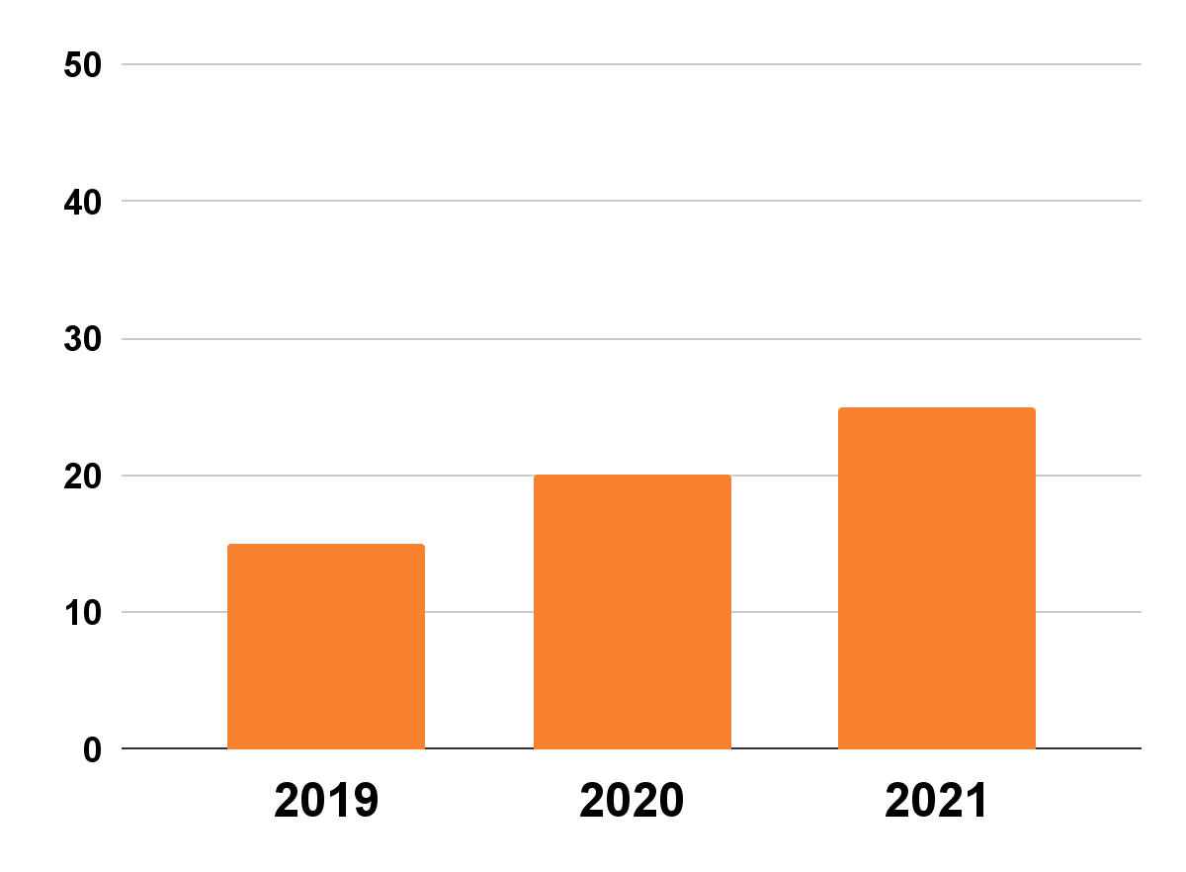
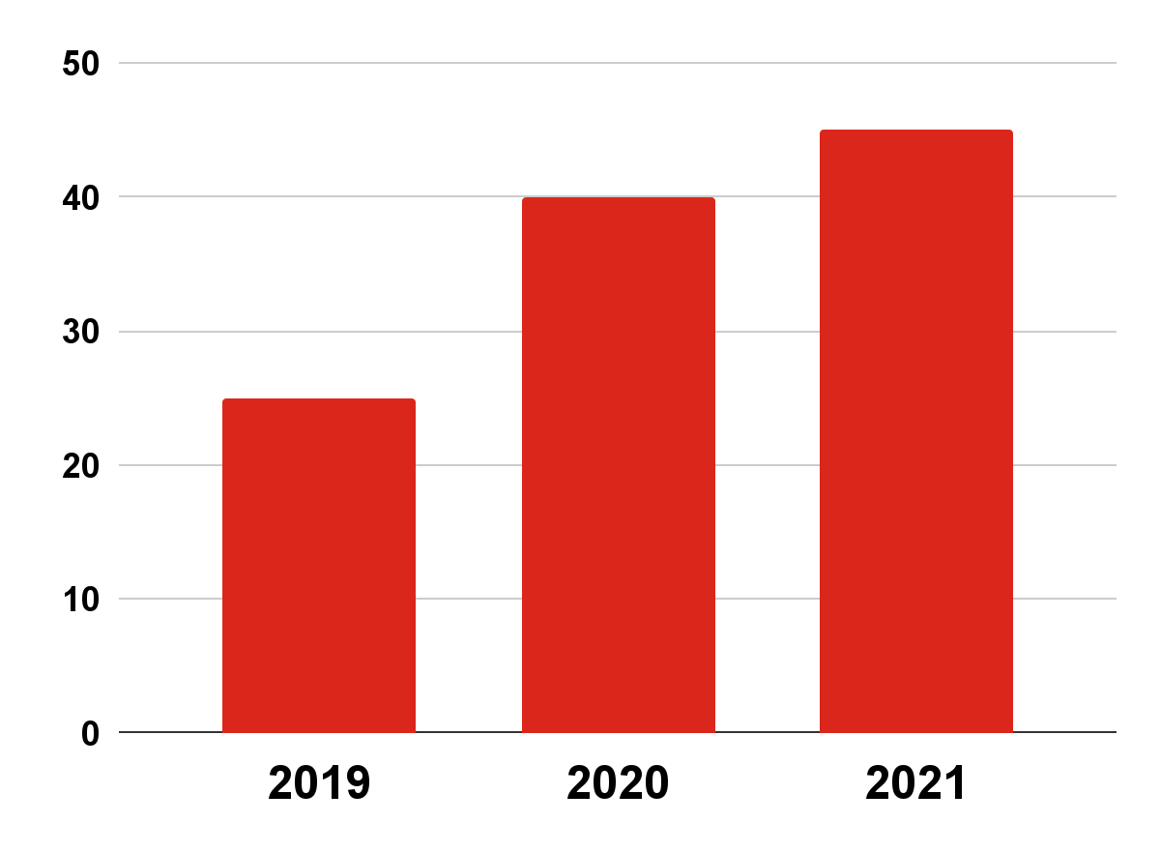
Basketball Infographics
The evolution of professional basketball players
15M
20M
25M
25M
40M
45M
Women
Men
Mercury is the smallest planet in the Solar System
The Earth is the beautiful planet where we all live
Follow the link in the graph to modify its data and then paste the new one here. For more info, click here

Slide 32
Basketball Infographics
The importance of basketball in disabled people
1
Mercury
2
Jupiter
Mercury is the closest planet to the Sun
It’s the biggest planet in the Solar System
3
Saturn
4
Mars
Saturn is a gas giant and has several rings
Despite being red, it’s actually a cold place
5
Venus
6
Earth
Venus is the second planet from the Sun
The Earth is the planet we all live on

Slide 33
Basketball Infographics
Mercury
Venus
Mercury is the closest planet to the Sun and the smallest one
Venus has a beautiful name and is the second planet from the Sun
Jupiter
Mars
Jupiter is a gas giant and the biggest planet in the Solar System
Despite being red, Mars is actually a cold place full of iron oxide dust

Slide 34
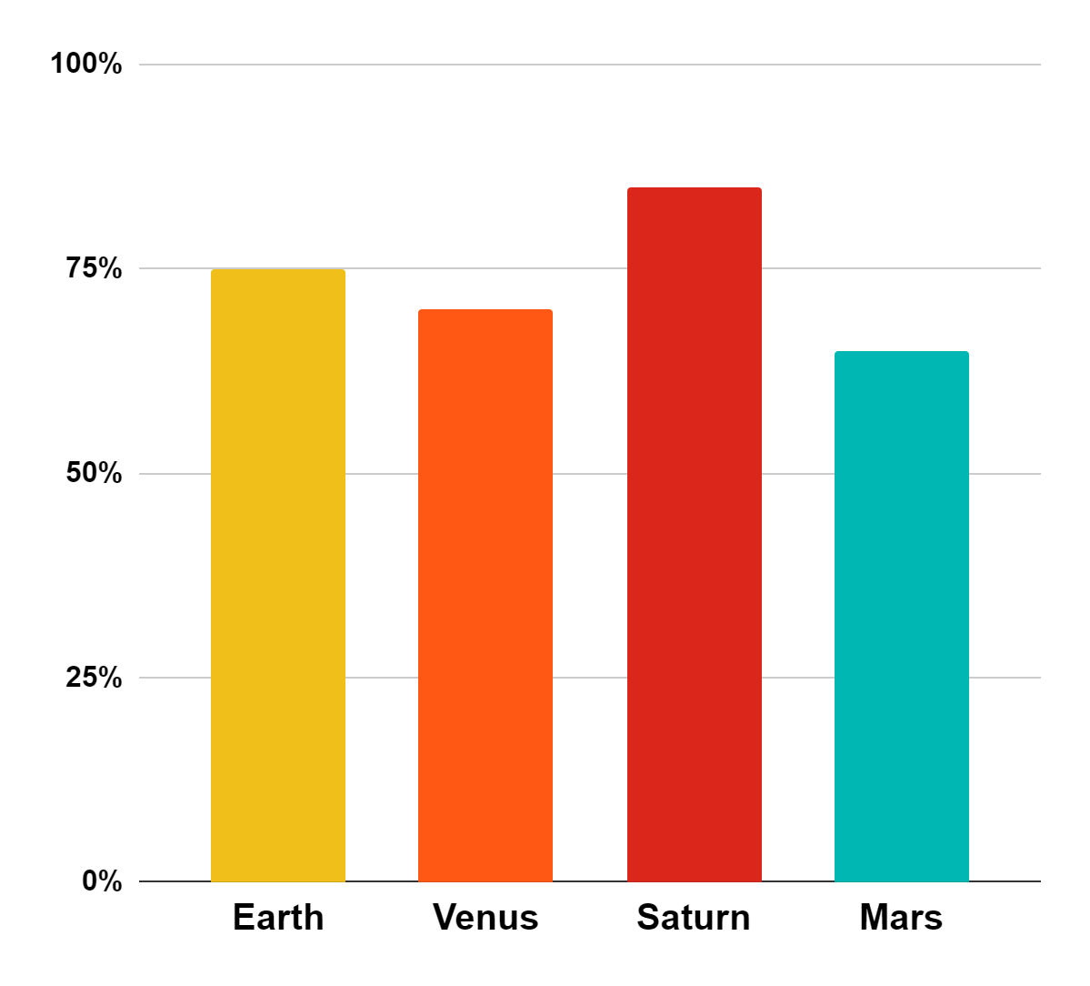
Basketball Infographics
75%
70%
Earth
Venus
The Earth is the beautiful planet where we all live
Venus is terribly hot, even hotter than Mercury
85%
65%
Saturn
Mars
Saturn is a gas giant and has several rings
Despite being red, Mars is actually a cold place
Follow the link in the graph to modify its data and then paste the new one here. For more info, click here

Slide 35
Basketball Infographics
Mars
01
Despite being red, Mars is actually a cold place full of iron oxide dust
Mercury
02
Mercury is the closest planet to the Sun and the smallest one
Jupiter
03
Jupiter is a gas giant and the biggest planet in the Solar System

Slide 36
Basketball Infographics
Jupiter
Earth
Mercury
Mars
Venus
Jupiter is a gas giant and the biggest planet in the Solar System
The Earth is “the Blue Planet” and it’s the only planet that harbors life
Mercury is the closest planet to the Sun and the smallest one
Despite being red, Mars is actually a cold place full of iron oxide dust
Venus has a beautiful name and is the second planet from the Sun
1
2
3
4
5

Slide 37
Instructions for use
In order to use this template, you must credit Slidesgo in your final presentation.
You are allowed to:
- Modify this template.
- Use it for both personal and commercial projects.
You are not allowed to:
- Sublicense, sell or rent any of Slidesgo Content (or a modified version of Slidesgo Content).
- Distribute Slidesgo Content unless it has been expressly authorized by Slidesgo.
- Include Slidesgo Content in an online or offline database or file.
- Offer Slidesgo templates (or modified versions of Slidesgo templates) for download.
- Acquire the copyright of Slidesgo Content.
For more information about editing slides, please read our FAQs or visit Slidesgo School:
https://slidesgo.com/faqs and https://slidesgo.com/slidesgo-school

Slide 38
Instructions for use (premium users)
In order to use this template, you must be a Premium user on Slidesgo.
You are allowed to:
Modify this template.
Use it for both personal and commercial purposes.
Hide or delete the “Thanks” slide and the mention to Slidesgo in the credits.
Share this template in an editable format with people who are not part of your team.
You are not allowed to:
Sublicense, sell or rent this Slidesgo Template (or a modified version of this Slidesgo Template).
Distribute this Slidesgo Template (or a modified version of this Slidesgo Template) or include it in a database or in any other product or service that offers downloadable images, icons or presentations that may be subject to distribution or resale.
Use any of the elements that are part of this Slidesgo Template in an isolated and separated way from this Template.
Register any of the elements that are part of this template as a trademark or logo, or register it as a work in an intellectual property registry or similar.
For more information about editing slides, please read our FAQs or visit Slidesgo School:
https://slidesgo.com/faqs and https://slidesgo.com/slidesgo-school

Slide 39
Infographics
You can add and edit some infographics to your presentation to present your data in a visual way.
Choose your favourite infographic and insert it in your presentation using Ctrl C + Ctrl V or Cmd C + Cmd V in Mac.
Select one of the parts and ungroup it by right-clicking and choosing “Ungroup”.
Change the color by clicking on the paint bucket.
Then resize the element by clicking and dragging one of the square-shaped points of its bounding box (the cursor should look like a double-headed arrow). Remember to hold Shift while dragging to keep the proportions.
Group the elements again by selecting them, right-clicking and choosing “Group”.
Repeat the steps above with the other parts and when you’re done editing, copy the end result and paste it into your presentation.
Remember to choose the “Keep source formatting” option so that it keeps the design. For more info, please visit Slidesgo School.

