Slide 1
Body Area Network Platform Utilizing Energy-Efficient Routing of Physiological Data
Alvaro Prieto
Masters Thesis
BS/MS Electrical Engineering
Electrical and Microelectronic Engineering Department
Rochester Institute of Technology
Rochester, NY
axp8664@rit.edu

Slide 2
Previous Work
WBAN Software Libraries
Wireless ECG Platform
Algorithm Development Platform
Specialized Cost Function
Results
Conclusion

Slide 3
Previous Work
Time Synchronization
Synchronized Sampling
Routing and Relaying

Slide 4
Time Synchronization

Slide 5
Synchronized Sampling

Slide 6
Routing and Relaying

Slide 7
Software Libraries

Slide 8
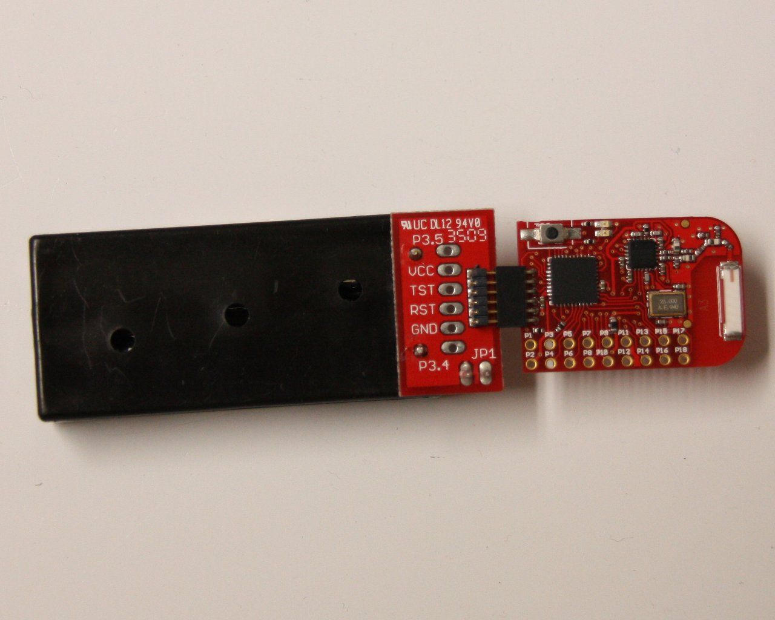

Slide 9
Wireless ECG Platform

Slide 10
Algorithm Development Platform

Slide 11
Specialized Cost Function

Slide 12
Results

Slide 13
Conclusions

Slide 14
Contributions

