Slide 1
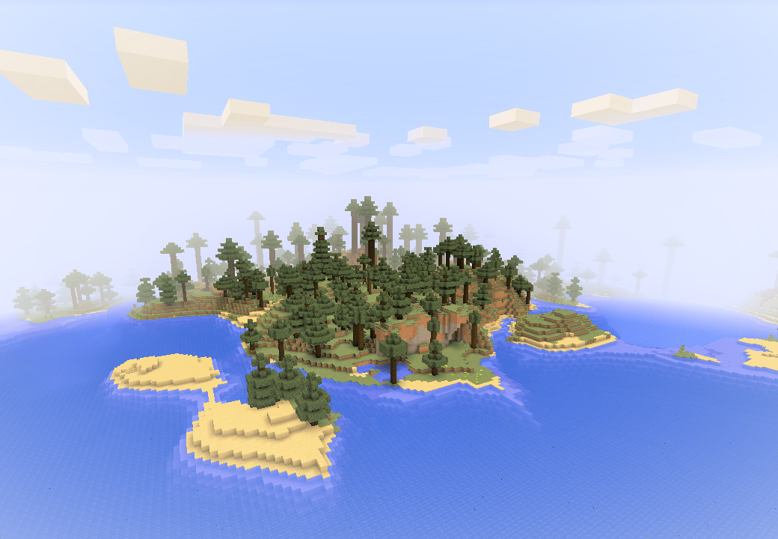
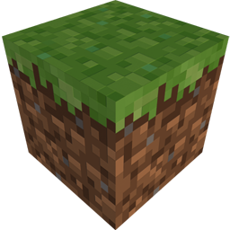


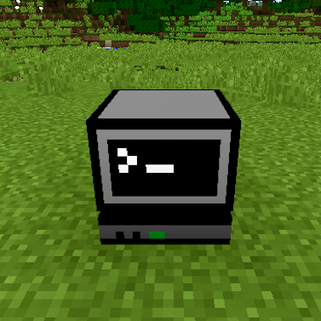
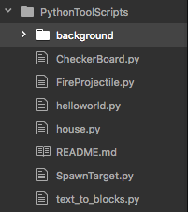
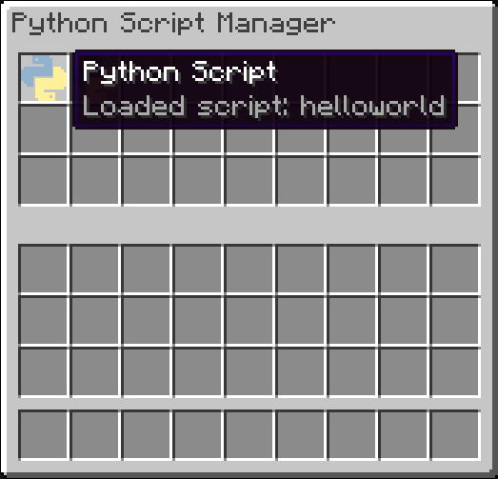
10 min programming challenge!
How many programming tasks can you complete in 10 minutes?
TASK 1
Let’s get started…
Load World1 then find and right-click the computer block
Next, we’ll look at the script itself, first pause the game by pressing Esc
Now look on the right hand side of your screen and click the file called helloworld.py (this is the same script as before, except now we can see the code!)
Find the line that says mc.postToChat(“Hello World!”) (this is called a FUNCTION, functions tell the computer what to do)
Change “World” to “your name” and then save the file by holding the ctrl key and pressing s
Repeat steps 1, 2, 3, and 4. What changed?
Drag the yellow and blue item called helloworld to your inventory (this is called a SCRIPT, scripts contain lines of code)
Close the computer by pressing E
Right-click with the script in your hand, what happens?

Slide 2
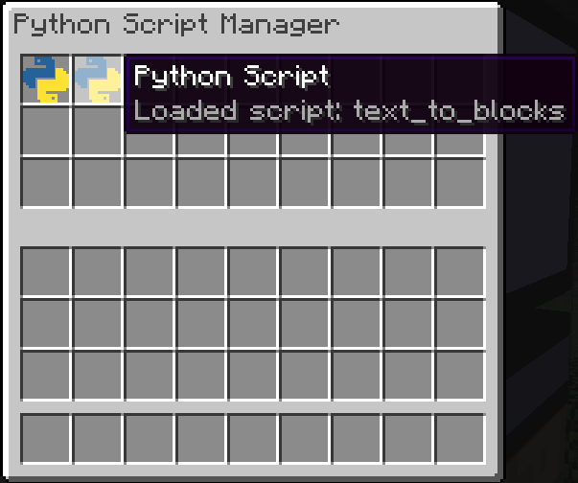
TASK 2
Now we’ll try something a bit BIGGER…
From the computer block, take the script called text_to_blocks, and drag it to your inventory
Press E to exit and with the script in your hand, right-click and see what happens…
Pause the game by pressing Esc and load the file on the right side called text_to_blocks.py
Now find the lines that say:
word = “NGCM”
colour = ”black”
and change them to your name and favourite colour from below (these are called variables and give the computer important information)
Colours to choose from:
Red Cyan Pink
Orange Blue Black
Yellow Light Blue Gray
Green Magenta Light Gray
Lime Purple White
Brown
After saving the file, repeat steps 1 and 2 again, what changed this time?

Slide 3
TASK 3
How about building a shelter?
In Minecraft, one of the first things to do is to build a house, but what if you could build one with a single click?
This time we’ll look at the code first, open the file house.py on the right hand side of your screen
This time you’ll notice the variables are whole numbers (we call these integers, and are a type of data in programming)
Change the length and height variables to how many blocks long, and how many blocks tall you want your house
Use the script house in the Minecraft world and see what happens…
Now change the numbers in the script to be bigger than 30
When you use the script this time, what happens?

Slide 4
TASK 4
Now that we’ve built something, let’s blow something up…
From the computer block, take and use the SpawnTarget script
Now take the FireProjectile script, and aiming at the target, use the script…
In this piece of code, we can change how fast we want the TNT to go, and how much gravity (the force pulling the TNT down) we want...
Open the FireProjectile.py script on the right, and notice now how we can change the variables within the brackets
Change the first number to anything between 1 – 100, and then pick a body from the list below to replace “earth” and repeat steps 1, 2, and 3
“sun”
“mercury”
“venus”
“moon”
“mars”
“jupiter”
“saturn”
“uranus”
“neptune”
“pluto”
Once you’ve completed the tasks, if you haven’t run out of time, feel free to have a play with any of the scripts in the computer block…

