Slide 1
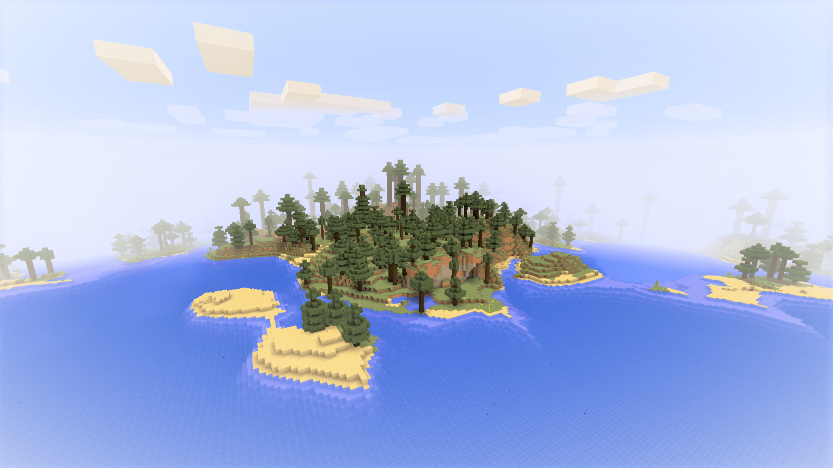
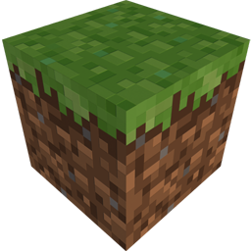


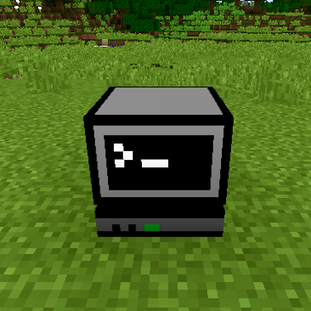
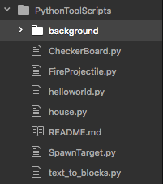
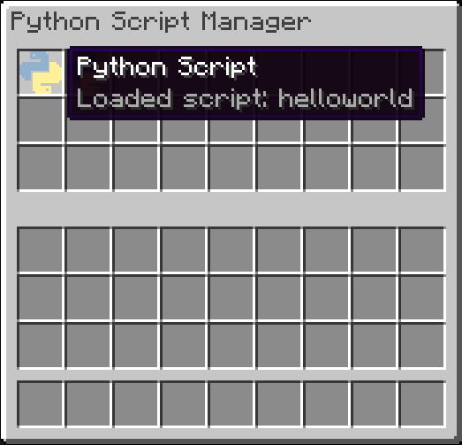
10 min programming challenge!
How many programming tasks can you complete in 10 minutes?
TASK 1
Next, we’ll look at the script itself, first pause the game by pressing Esc
Now look on the right hand side of your screen and click the file called helloworld.py (this is the same script as before, except now we can see the code!)
Find the line that says mc.postToChat(“Hello World!”) (this is called a FUNCTION, functions tell the computer what to do)
Change “World” to “your name” and then save the file
Repeat steps 1, 2, 3, and 4. What changed?
Find and right-click the computer block
Drag the yellow and blue item called helloworld to your inventory (this is called a SCRIPT, scripts contain lines of code)
Close the computer by pressing E
Right-click with the script in your hand, what happens?

Slide 2
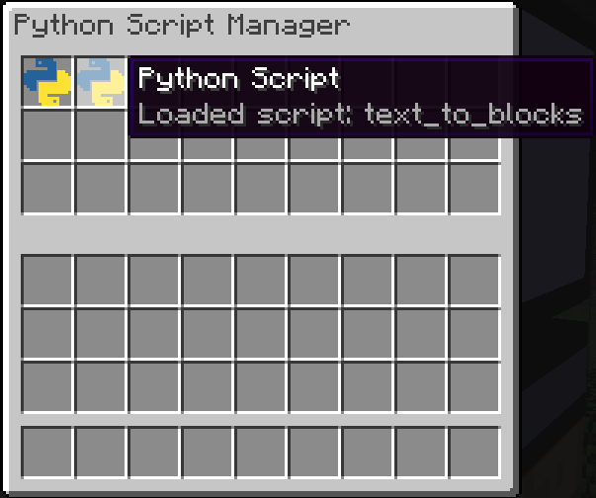
Now we’ll try something a bit BIGGER…
Now find the lines that say:
word = “NGCM”
colour = ”black”
and change them to your name and favourite colour (these are called variables and give the computer important information)
After saving the file, repeat steps 1 and 2 again, what changed this time?
TASK 2
From the computer block, take the script called “text_to_blocks”, and drag it to your inventory
Press E to exit and with the script in your hand, right-click and see what happens…
Pause the game by pressing Esc and load the file called text_to_blocks.py

Slide 3
TASK 3
Now let’s try building a shelter…

