Slide 1
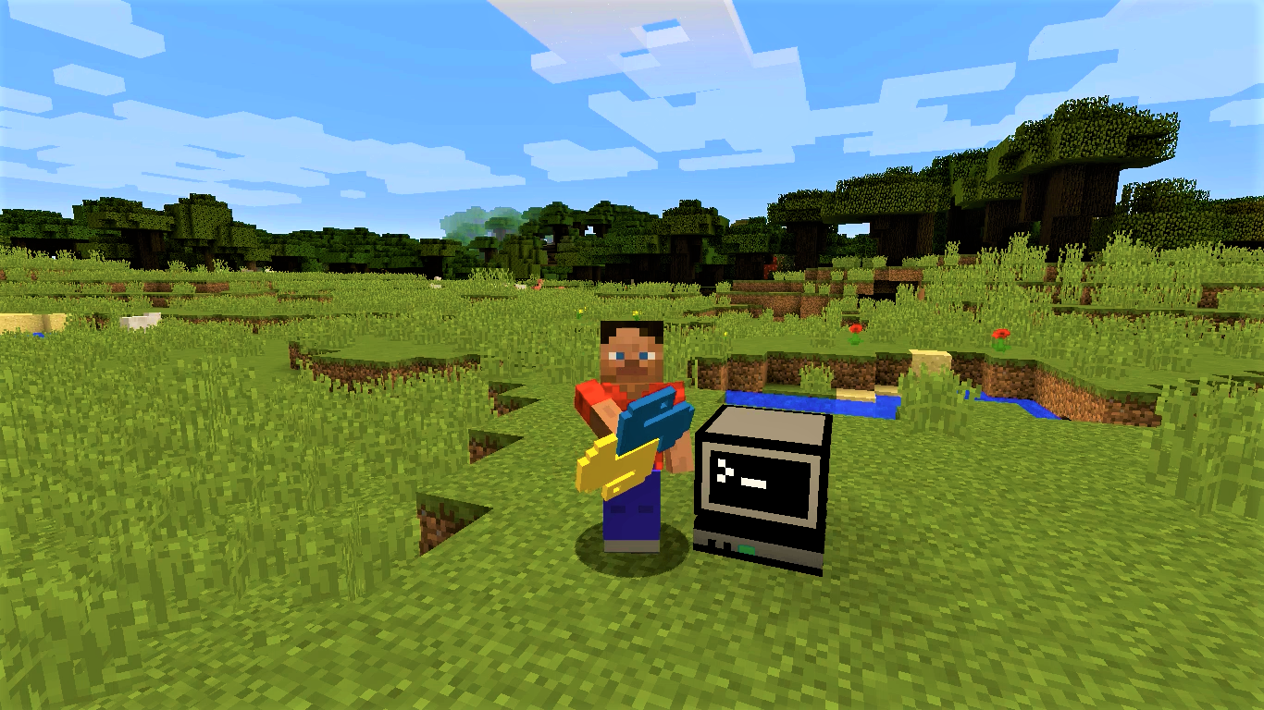
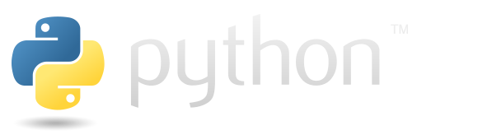
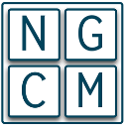

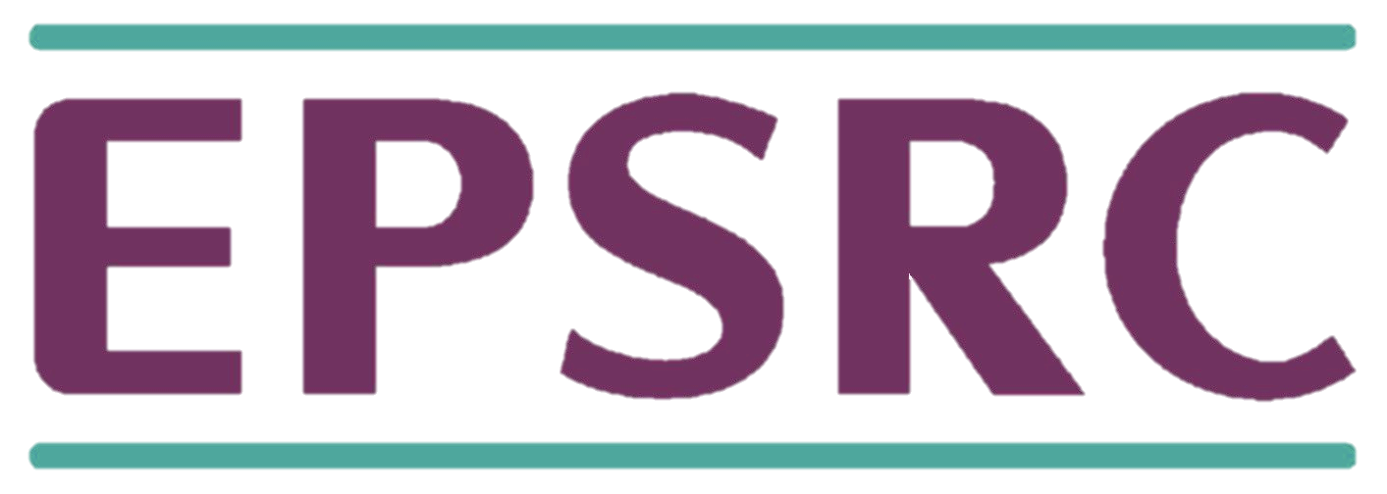
What is Minecraft?
Minecraft is a best-selling sandbox type video game set in a world where everything is made of blocks.
What is Python?
Python is a very common and powerful -yet simple- programming language that can be used to modify your Minecraft worlds in real time.
PythonTool Mod:
PythonTool Mod provides an interactive way to get started with Python programming inside your own Minecraft adventures.
Build amazing things, turn blocks into bombs, or create interactive games, just with one click!
PythonTool Mod
Learning programming with Python and Minecraft
Learn more:
https://ngcm.github.io/PythonTool-Mod/

Slide 2
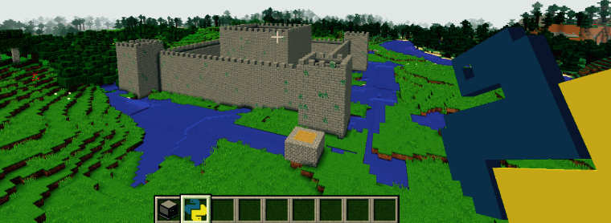
Ever wanted to learn how to program?
Write your own scripts or get plenty of examples online, and use them inside the game with the mighty Computer Block and Python Script items.
Why should you use PythonTool?
PythonTool is a fun way to start learning incredible
programming skills that are highly sought after around the world!
Get more examples and start coding at:
https://ngcm.github.io/PythonTool-Mod/
PythonTool Mod for Minecraft interactively alters your Minecraft world in real time, using Python!
Get in touch:
PythonTool Mod
ngcm@soton.ac.uk
MIT License Copyright (c) 2016
Alvaro Perez-Diaz &
Hans Fangohr,
NGCM, University of Southampton, UK

