Slide 1
Language Identification for the World's Languages
SU
GA
LI

Slide 2
How are Languages born?
“Language are unlike organisms in the way they born or die ... Languages as communal phenomena cannot be issued birth or death certificates …”

Slide 3
How are Languages born?
“At no particular point in time can be associated with the emergence of creoles as separate vernaculars from the languages from which they evolved ...”

Slide 4
How are Languages born?
“The recognition of separateness is made possible by a cumulative accretion of divergence features relative to an ancestor language ...” – Mufwene, 2004

Slide 5
How do Languages
die?
“Language death is a protracted change of state ... [It's a] process that does not affect all speakers at the same time nor to the same extent.”

Slide 6
How do Languages
die?
“Total death is declared
when no speakers are left of a particular language variety in a population that had
used it.” – Mufwene, 2004

Slide 7
What has birth and death got to do with Language Identification?
The constant change in language evolution presents a challenge to build language identification models that can rapidly adapt to ‘cumulative accretion’ of linguistic divergence.

Slide 8
What has birth and death got to do with Language Identification?
The remnants of the ancestral languages permeates the modern written languages today, especially when the descendent languages shares similar orthography.

Slide 9
How many Languages are there in the World?

Slide 10
How many spoken Languages are there in the World?
7105

Slide 11
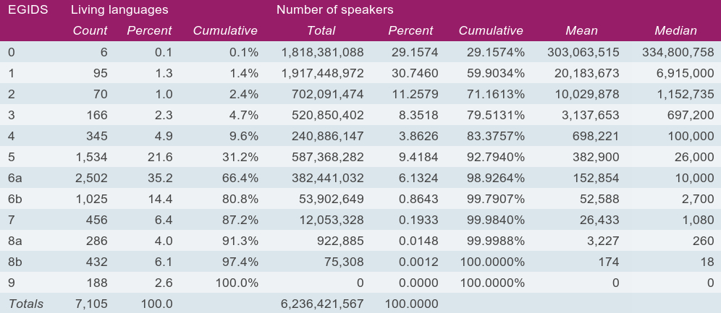

Slide 12
How many sign Languages are there in the World?
Wiki: > 200
In ISO: 144

Slide 13
What are
IS0 language codes?

Slide 14
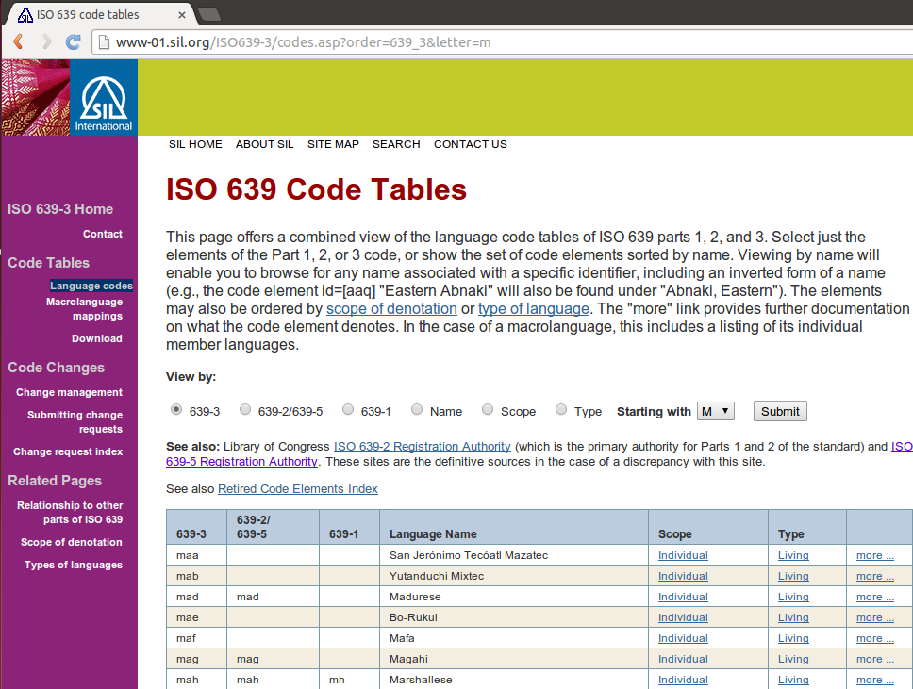

Slide 15
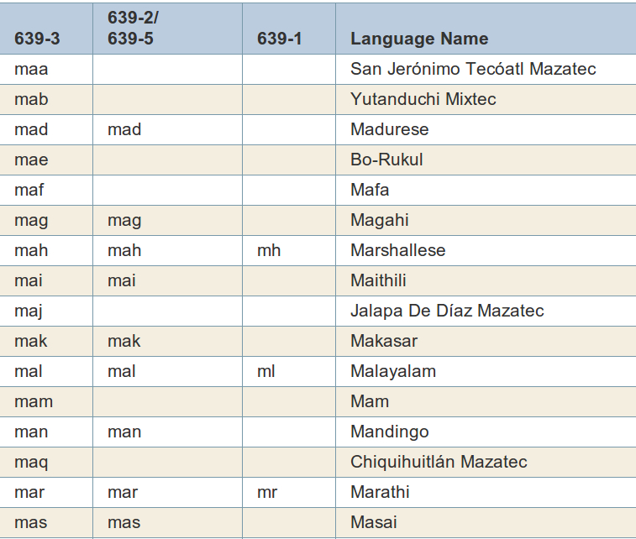

Slide 16
How many
IS0 693-3 codes are there?

Slide 17
How many
IS0 693-3 codes are there?
8129

Slide 18
What’s the Tag?
Possible Tagsets | Number
Languages | 7,105
ISO 693-3 (spoken, signs, ‘dialects’) | 8,129
Language Families | 147
ISO 693-5 (macrolanguages) | 60
See Xia, Lewis and Lewis (2010)

Slide 19
What’s the Tag?
Possible Tagsets | Number
Languages | 7,105
ISO 693-3 (spoken, signs, ‘dialects’) | 8,129
Language Families | 147
ISO 693-5 (macrolanguages) | 60

Slide 20
Who’s the Competitor?
Language ID Systems | #Tags
Polygot 3000 | 474
Chromium Language Detector | 156
LexTex | 260
ODIN Language ID | 1,750
Sugarlike | 1,046

Slide 21
Where’s the Data?
Data Source | Original | Cleaning | Universality
ODIN | 1750 | 1046 | 14.72 %
Omniglot | 180 | 134 | 1.88%
UDHR | 388 | 360 | 5.07%
Wikipedia | - | -
Plaintext
Utf8
ISO639-3 filenames
.tar balls

Slide 22
でも

Slide 23
How’s the Result?
Tests | Original
Pregnancy | 28.57%
UDHR_pick 10 | takes too long, 1 min/query BTW, it scored 0.0% for 3 random runs…

Slide 24
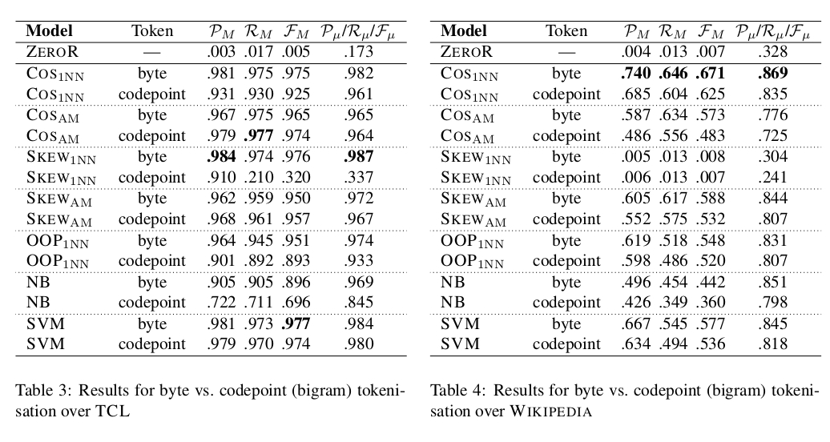
From Baldwin and Lui (2010)

Slide 25
What to do now?
Add more data source to the system
Build a scalable model (for universality) that deals with unbalanced data
Choose a tagset
Develop add-ons to map more data to the ISO 693-3/5 tagset (with language families)
Engineer features

Slide 26
Preliminary Conclusions
Language ID is hard for ALL languages in the world
One reason why Language ID for ALL languages is tough because of language evolution

Slide 27
References
Simon Ager. 2011. Omniglot - writing systems and languages of the world. Retrieved from www.omniglot.com.
William Lewis and Fei Xia, 2010. Developing ODIN: A Multilingual Repository of Annotated Language Data for Hundreds of the World's Languages. In Journal of Literary and Linguistic Computing (LLC), 25(3):303-319.
Lewis, M. Paul, Gary F. Simons, and Charles D. Fennig (eds.). 2013. Ethnologue: Languages of the World, Seventeenth edition. Dallas, Texas: SIL International. Online version: http://www.ethnologue.com.
Fei Xia, Carrie Lewis and William D. Lewis, 2010. The Problems of Language Identification within Hugely Multilingual Data Sets, Proceedings of the 7th International Conference on Language Resources and Evaluation (LREC 2010), pages 2790-2797, Valletta, Malta, May 19-21, 2010.
Salikoko Mufwene. 2004. Language birth and death.In Annual Review of Anthropology 33.201-222.
Baldwin, Timothy and Marco Lui (2010) Language Identification: The Long and the Short of the Matter, In Proceedings of Human Language Technologies: The 11th Annual Conference of the North American Chapter of the Association for Computational Linguistics (NAACL HLT 2010), Los Angeles, USA, pp. 229—237.

Slide 28


