Slide 1
ClimbCode
Notes:
Welcome to ClimbCode’s exposition. Here we’ll see the results of the development’s third sprint of this project.

Slide 2

Our Path Today
Idea & Business
Workgroup & Weekly Progress
Pilot Plan’s Results
Marketing Plan
Lessons Learnt
2
Notes:
This is the path we’re going to follow during the presentation. First we’ll introduce the idea behind ClimbCode, next we’ll see the technologies we’re using to develop ClimbCode, after that, we’ll talk about the things we’ve done, the results of our pilot plan and the current status of the project.

Slide 3
Idea & Business
Notes:
We’ll start seeing which idea lies behind ClimbCode. But first, let’s travel a bit back in time:

Slide 4

4
Notes:
We’re sure everyone remembers those days at high school in which they had a lot of homework to do, copying the questions and doing them to show them in class. A bit boring and tiring, wasn’t it? And also for the teacher, because he/she also needed to search in the books the exercises he/she wanted us to do.

Slide 5

5
Notes:
Then… What if there was back in those days a way to do both things easier and faster? A way to do those tasks in our computers?

Slide 6


Idea
+
=
ClimbCode
6
Notes:
The answer to this is ClimbCode, our web platform, which acts as a supporting tool for teaching subjects at schools with the help of software.

Slide 7


Idea
Interactive
7
Notes:
How do we grant this support? Simple, by interactive exercises, a better version of the original paper exercises made by independent programmers. Those exercises are bought by schools in order to increase their content catalog they have for supporting their subjects.

Slide 8
Idea
NEGOCIO
7
Notes:
How do we grant this support? Simple, by interactive exercises, a better version of the original paper exercises made by independent programmers. Those exercises are bought by schools in order to increase their content catalog they have for supporting their subjects.

Slide 9
Workgroup & Weekly Progress
Notes:
Now we’ll see the things we’ve already done in our project.

Slide 10
Idea
PRESENTAR A LOS MIEMBROS
7
Notes:
How do we grant this support? Simple, by interactive exercises, a better version of the original paper exercises made by independent programmers. Those exercises are bought by schools in order to increase their content catalog they have for supporting their subjects.

Slide 11



Features
Transactions
Interactive
Ordinary Use Cases
19
Notes:
In terms of features, we’ve finished all the ones we had as our MVP: Our interactive exercises’ system, allowing it to create and save them on our platform, our transactions’ system, allowing to buy and sell interactive exercises and letting programmers get their money from the purchases of the exercises, and many other minor use cases of our Django model.

Slide 12



Features
Security
Style
Feedback
20
Notes:
Those features include solving security problems, the preparation and correction of the style of our platform, and the implementation of all the feedback we’ve got during our pilot plan and that we could include in our project.

Slide 13
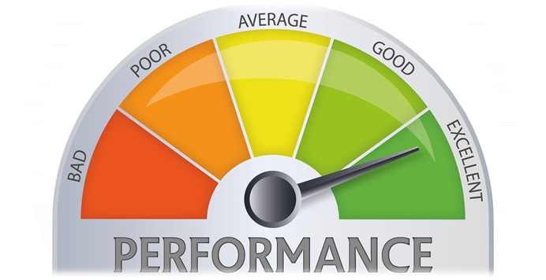
Performance
COMPLETED SP / REAL TOTAL HOURS
17
Notes:
We’ve also updated our metric to measure the performance of our team members in matters of tasks. The new version of the metric uses the current completed story points done by the member in the sprint, and the total amount of hours spent by that member for doing those story points, resulting in a percentage which shows the performance of the team member based on his tasks completed during the week and the hours spent on them.

Slide 14
Idea
Grafiquilla
7
Notes:
How do we grant this support? Simple, by interactive exercises, a better version of the original paper exercises made by independent programmers. Those exercises are bought by schools in order to increase their content catalog they have for supporting their subjects.

Slide 15
Current Costs & Time
50%
936 h
0%
100%
€18K
€29K
1120 h
Current: €63%, 83% h
Budgeted: €57%, 57% h
46
Notes:
Currently we’ve spent a total amount of 936 hours and 18k euros, which is a 83 and a 63 percent from the total, and different from the 57 expected this week.

Slide 16



Costs’ Explanation
Direct Costs: €13,5k
Indirect Costs: €4,6k
47
Notes:
That money investment is divided in direct and indirect costs, having the amount shown in the slide for each one.

Slide 17
Deployment & Demo
Deployment URL: www.climbcode.tk
Demo URL:
https://www.youtube.com/watch?v=_pAyQNXK4IY
36
Notes:
To show how the system works today, we’ve put a link in which everyone can see our project, and also we’ve created a demo, showing our star use case: The creation and buying of an interactive exercise.
Demo: https://www.youtube.com/watch?v=_pAyQNXK4IY
Paypal’s credentials for a school: schoolCC@hotmail.com / climbcodeISPP2018
Admin Account: administrador / climbcode

Slide 18
Pilot Plan’s Results
Notes:
Now we’ll see the results of applying our pilot plan.

Slide 19


Pilot Plan
38
Notes:
We designed a pilot plan based in meetings with programmers and teachers, showing them our platform, how an interactive exercise is and works, and asking them what did they think about our star use case (creation and purchase of interactive exercises), what suggestions did they have for our project, what did they think we could change, and how much would they pay for each thing of our platform (licenses and exercises).

Slide 20



Results: Feedback
39
Notes:
From the feedback we received, we decided to include the automatic registration of teachers and students with a .csv file to save time to schools and to keep safe the student’s personal information.
Also, our school users didn’t seem interested in programming in our platform or learning to do it, so we decided to focus in our interactive exercises.

Slide 21
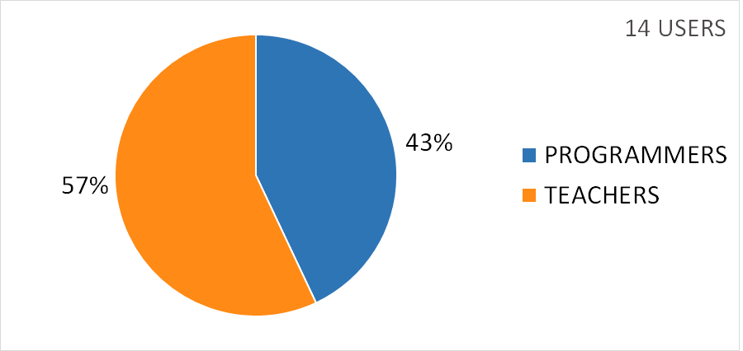
Results: Figures
41
Notes:
As a result of our pilot plan, we’ve got an amount of 14 users for our platform, from the 26 inverviewed, divided bewteen teachers and programmers as we see in the graphic. We’ve also received messages from other users asking to join the platform, so we expect to see an increasing in these numbers as time goes on.

Slide 22
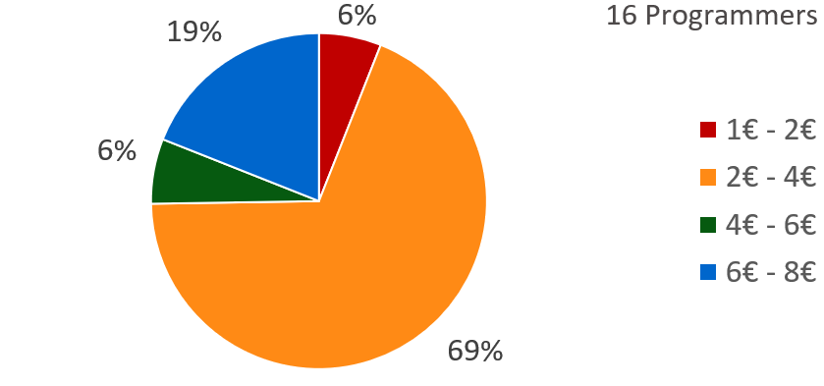
Results: Figures
Exercises’ price (Programmers)
42
Notes:
From all the programmers we’ve interviewed, the 69% finds reasonable a price between 2 and 4 euros for each purchase of an exercise.

Slide 23
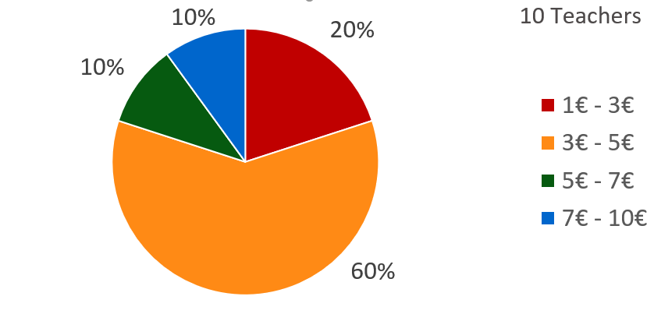
Results: Figures
Exercises’ price (Teachers)
43
Notes:
Also, we’ve asked the schools for those prices, showing that they mostly agree with the programmers, choosing a price which is between 3 and 5 euros per purchase of an exercise.

Slide 24
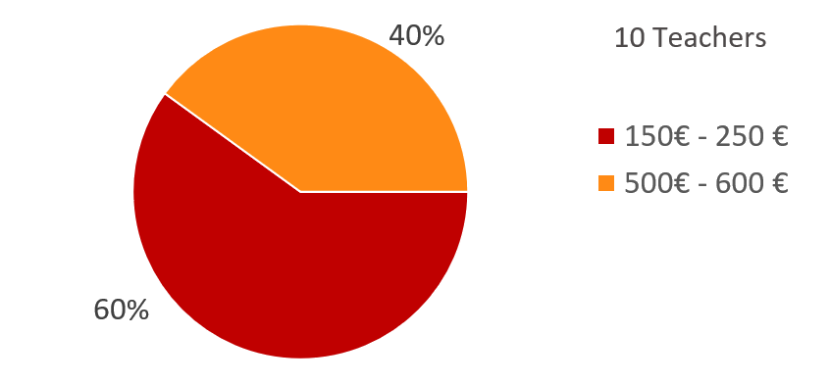
Results: Figures
Licenses’ price (Teachers)
44
Notes:
Finally, we asked the schools about the prices of the annual licenses, and most of them would pay between 150 and 250 euros, which is the price of our smallest annual license with 60 users and 20 free exercises, or between 500 and 600 euros, which is the one of our medium annual license with 200 users and 50 free exercises. Also, we have available in case that our users need it a annual license with 500 users, 75 free exercises and 700 euros.

Slide 25
Marketing Plan
Notes:
Finally, we’ll see the current situation of the project.

Slide 26
Current Project’s Usage
EXPLICARLO
50
Notes:
Seeing those figures makes us think about the viability of our project. In order to measure it, we decided to study the current usage of our platform. We saw that the current number of users is the 53% of the ones inverviewed, with an increase of 4 users per week.

Slide 27
Lessons Learnt
Notes:
Finally, we’ll see the current situation of the project.

Slide 28



Problems’ Status
PROBLEM | SOLUTION | METRIC | RESULT
 |  | TOTAL PROBLEMS (> 0) | Before: 3 After: 3
 | SP & PRIORITIES | ESTIMATION ERROR (< 10%) | Before: 15% After: 13%
15
Notes:
First, we’ve been analysing our problems and the solutions given to them, resulting in this table we see here. The table shows our principal problems: The first is the fact that we found difficult to document the problems we previously found. To solve it we decided to create a document in which we could put all the problems we could find during the development process. As we see, measuring the problems documented per week we can see that the problem has been completely solved, because the number of problems documented has increased, staying above the ratio of 0 we considered as the minimum acceptable level for this metric.
The second problem is that we found hard to estimate our tasks, so we decided to put Story Points on our requirements and relate them to our tasks, measuring the error between the estimations and the real time invested in those tasks. In addition, to increase the efficiency of the tasks’ distribution, we’ve also put a priority for each task in this sprint, allowing them to be distributed better and lowering our metric. The result of this is that the deviation has decreased, but still we need to keep improving this system in order to keep those figures the maximum amount of time that we can.

Slide 29


Problems’ Status
PROBLEM | SOLUTION | METRIC | RESULT
 |  | BIG TASKS (< 10%) | Before: 17% After: 13%
16
Notes:
Finally, the other problem we’ve tried to solve was that there were many big and indivisible tasks, so we decided to find ways to divide them and make them lighter and smaller. To measure the success of this solution we used the percentage of big tasks (more than 3 estimated hours) we have in our project, showing that the solution is working at the moment and the problem seems solved, but still needs to decrease to a 10%, which is the accepted limit for it.

Slide 30

Conclusions
MVP FINISHED
52
Notes:
So, as a conclusion, we can say that we have finished the MVP of our project, and now a new phase begins, more focused in marketing and getting more users for our platform.
This situation is all thanks to our team’s effort in the development phase, and that makes us very positive in our project, becasue if we did this good during development, we can expect a good performance during the next phases of the project, too.

Slide 31

THANKS!
You can find me at
alvdomnun@alum.us.es
53
Notes:
And that’s the end of our presentation! Thank you for watching, and if you have any doubt you can contact me at alvdomnun@alum.us.es.

