Slide 1
ClimbCode

Slide 2

The Crew
Miguel Ángel Baños Carretón
Álvaro Domínguez Núñez
Andrés Fernández Alés
Alejandro Garrido Resina
Alejandro Román Rodríguez
Álvaro Sánchez López
Jesús Sosa Sánchez

Slide 3
Our Path Today
Our Idea
Business Area
Good and Bad facts
Competitors
A bit of technology
Knowledge Management

Slide 4
Our Idea
Let’s start with what we have in mind

Slide 5
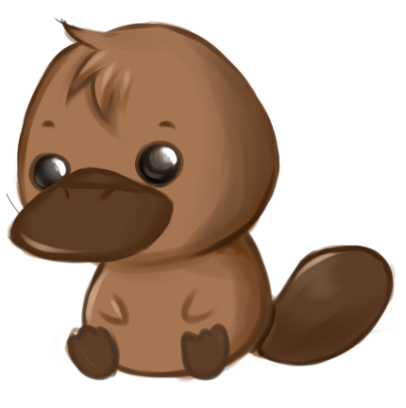
What is ClimbCode?

Slide 6

Our Idea
ClimbCode is a platform in which teachers from academies, schools and high schoools can support their teachings while helping their students to learn programming.
Helpful, isn’t it?

Slide 7

Our Idea
What uses does it have?
Documentation
Management of the documents of the subjects
Competitions
A way to amuse the students
Real-time Coding
You can try to programme live and see the results
Administration
Control of the application

Slide 8
Business Area
Well, where are the clients?

Slide 9

Education
Right here, at every place in which there’s a teacher.

Slide 10
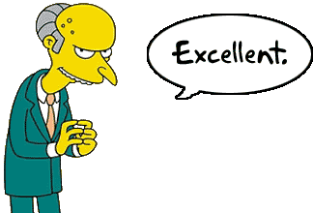
Business Area
Our application will use different kinds of licenses, which are different in the number of users and subjects.
We can have many different kinds of clients like that!

Slide 11

Business Area
Some brief examples:
Yellow
For a license with physics and an amount of 10 stundents
Blue
For a license with maths and 20 stundents
Red
For the license with maths and physics, and 20 students

Slide 12
Good and Bad facts
Time to get realistic

Slide 13
Good and Bad facts
Facts | Good | Bad | ?
Low Competitors | X | - | -
Access to Clients | X | - | -
Increase of services | X | - | -
Technology | - | - | X

Slide 14

Good and Bad facts
Facts | Good | Bad | ?
Specific market | - | X | -
Hard to Explain | - | X | -

Slide 15
A bit of techology
Tools, tools everywhere

Slide 16

A bit of technology
We’re looking forward to use Angular and other technologies that work with it.

Slide 17
Competitors
Other options… Or perhaps not?

Slide 18

Too focused on programming!

Slide 19
Knowledge Management
Petete’s thick book

Slide 20



Knowledge Management
An old friend…

Slide 21

THANKS!
Any questions?
You can find me at
alvdomnun@alum.us.es

