Slide 1
Software design Documentation
TweetDemo
Version : 1.0

Slide 2
Prepared by
Imran Mahmud Sadman 1610940642
Esha Bintee Mahid 1610259042
Sk. Maliha Mehnaz 1610055042
Nazmus Shahadat
Ashraful Islam Alvee 1530376042

Slide 3
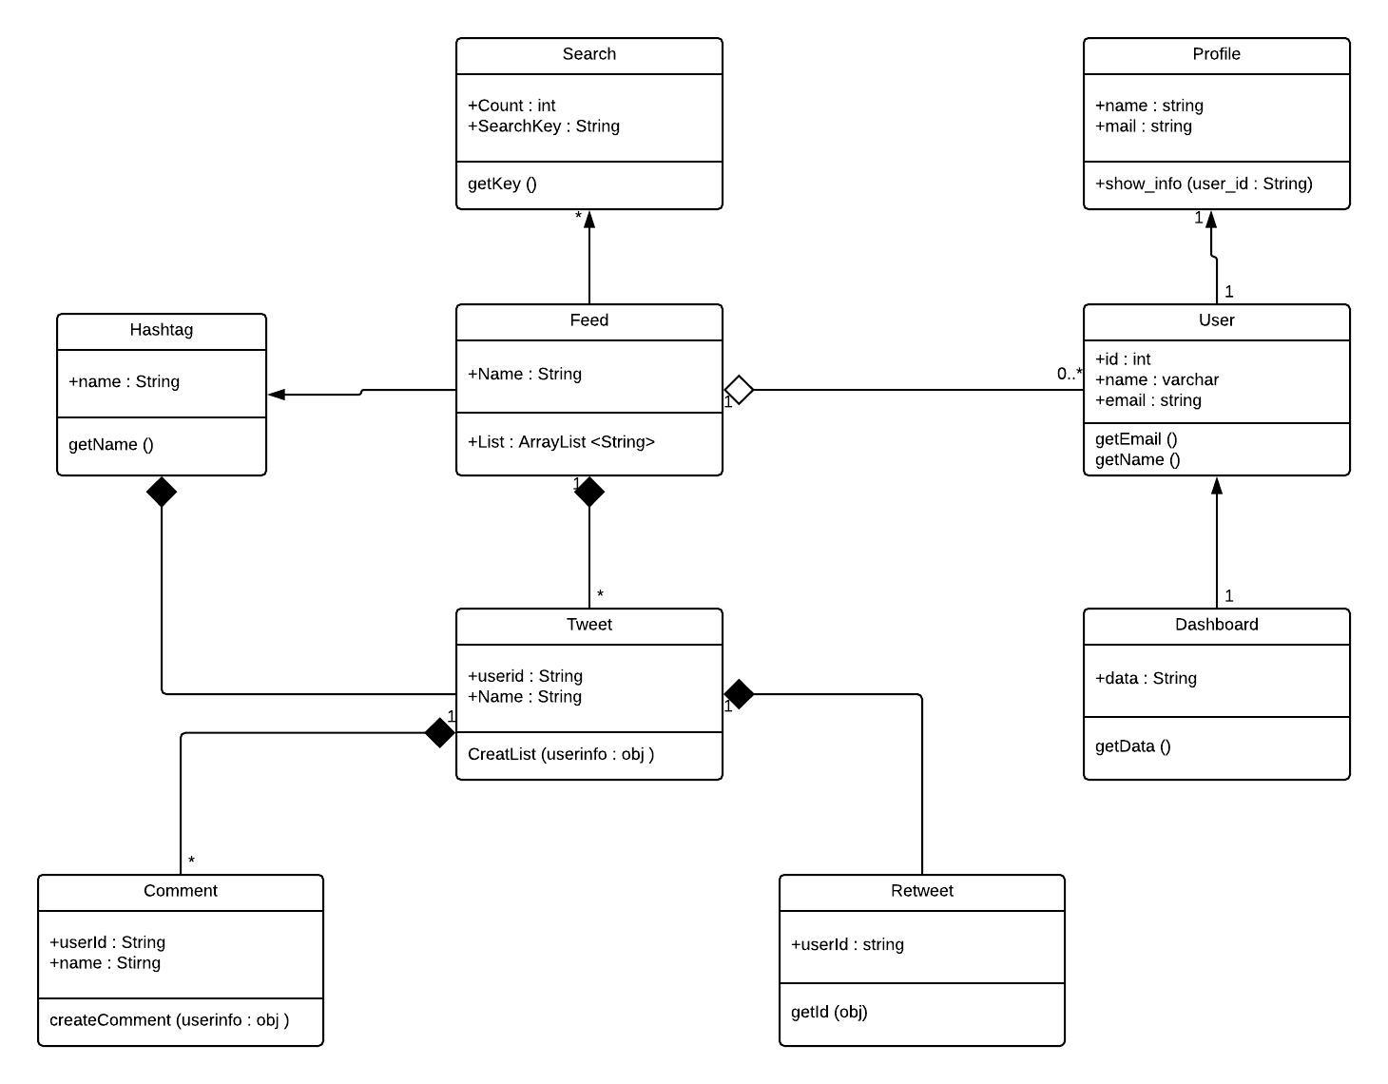
Class Diagram:

Slide 4
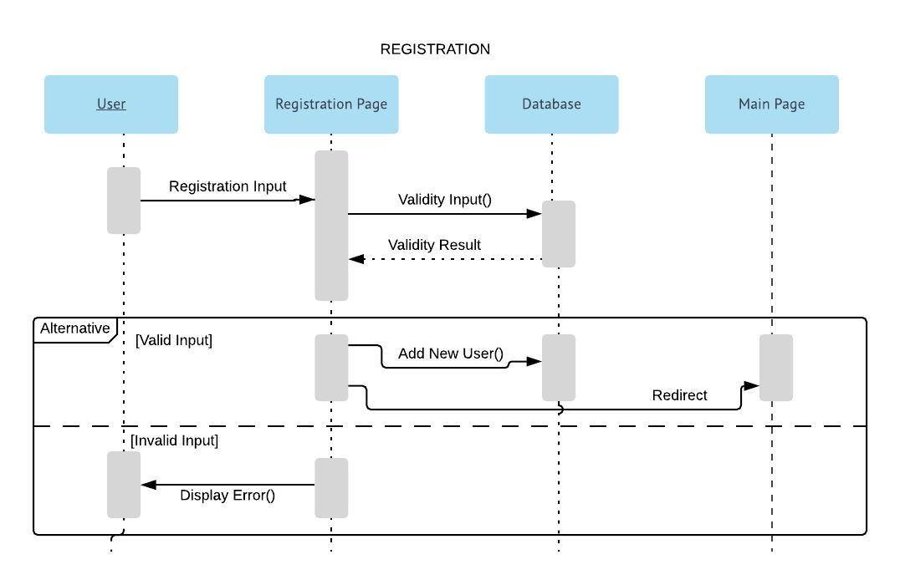
Sequential Diagram 1. Registration :

Slide 5
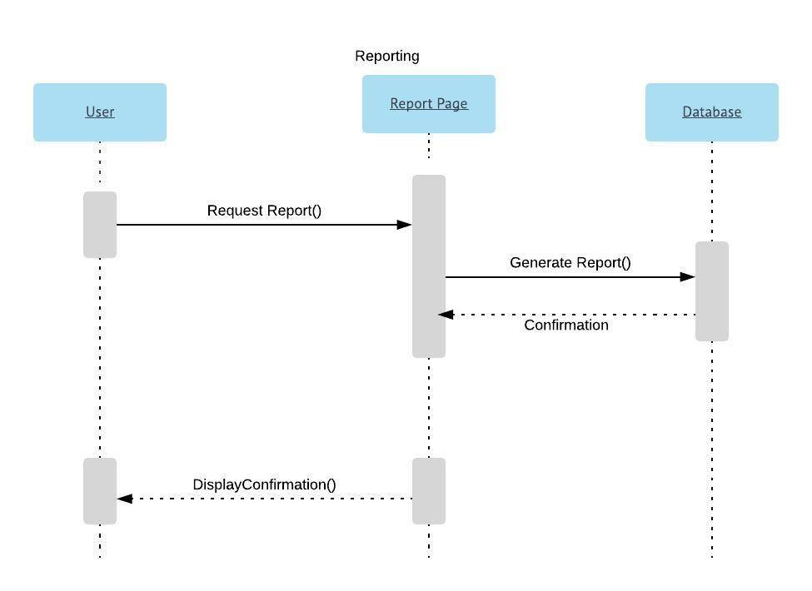
2. Report :

Slide 6
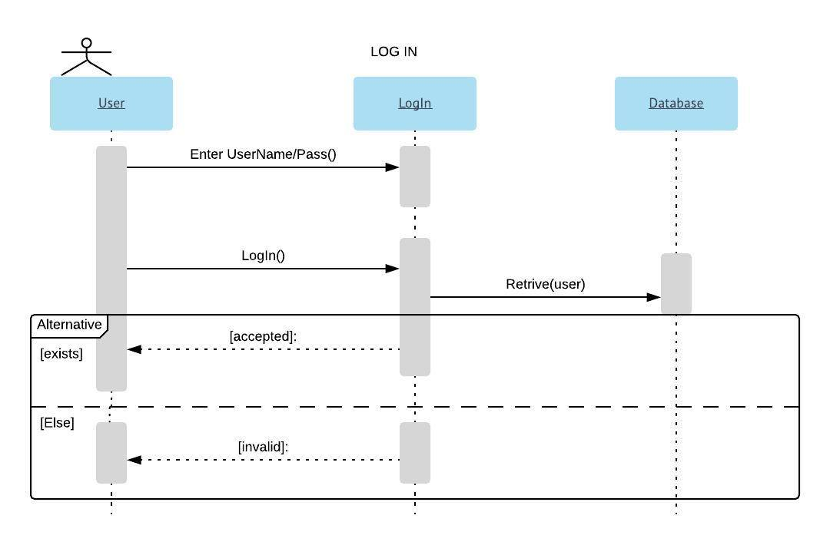
3. Log in :

Slide 7
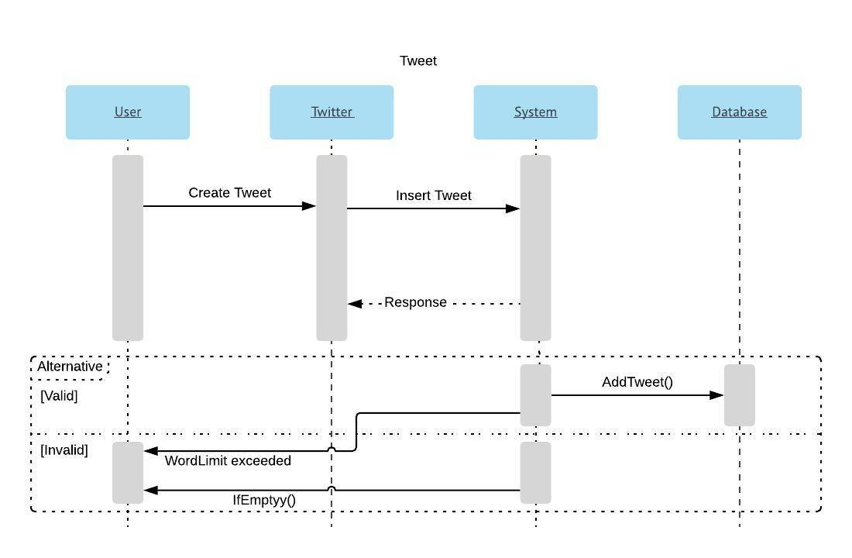
4. Tweet :

Slide 8
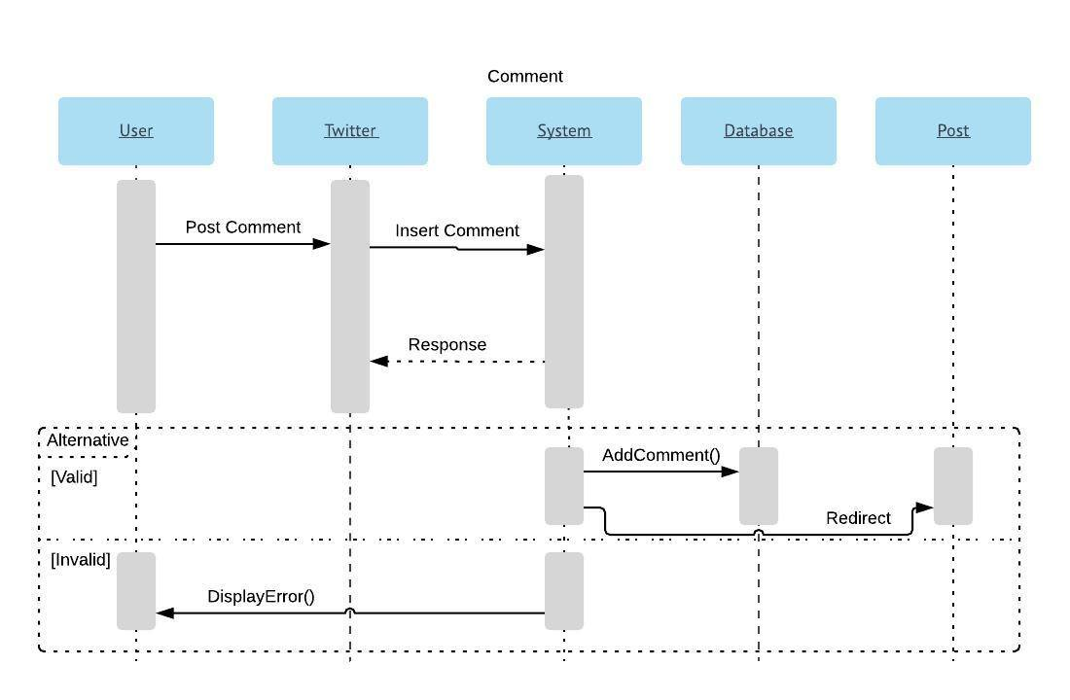
5. Comment :

Slide 9
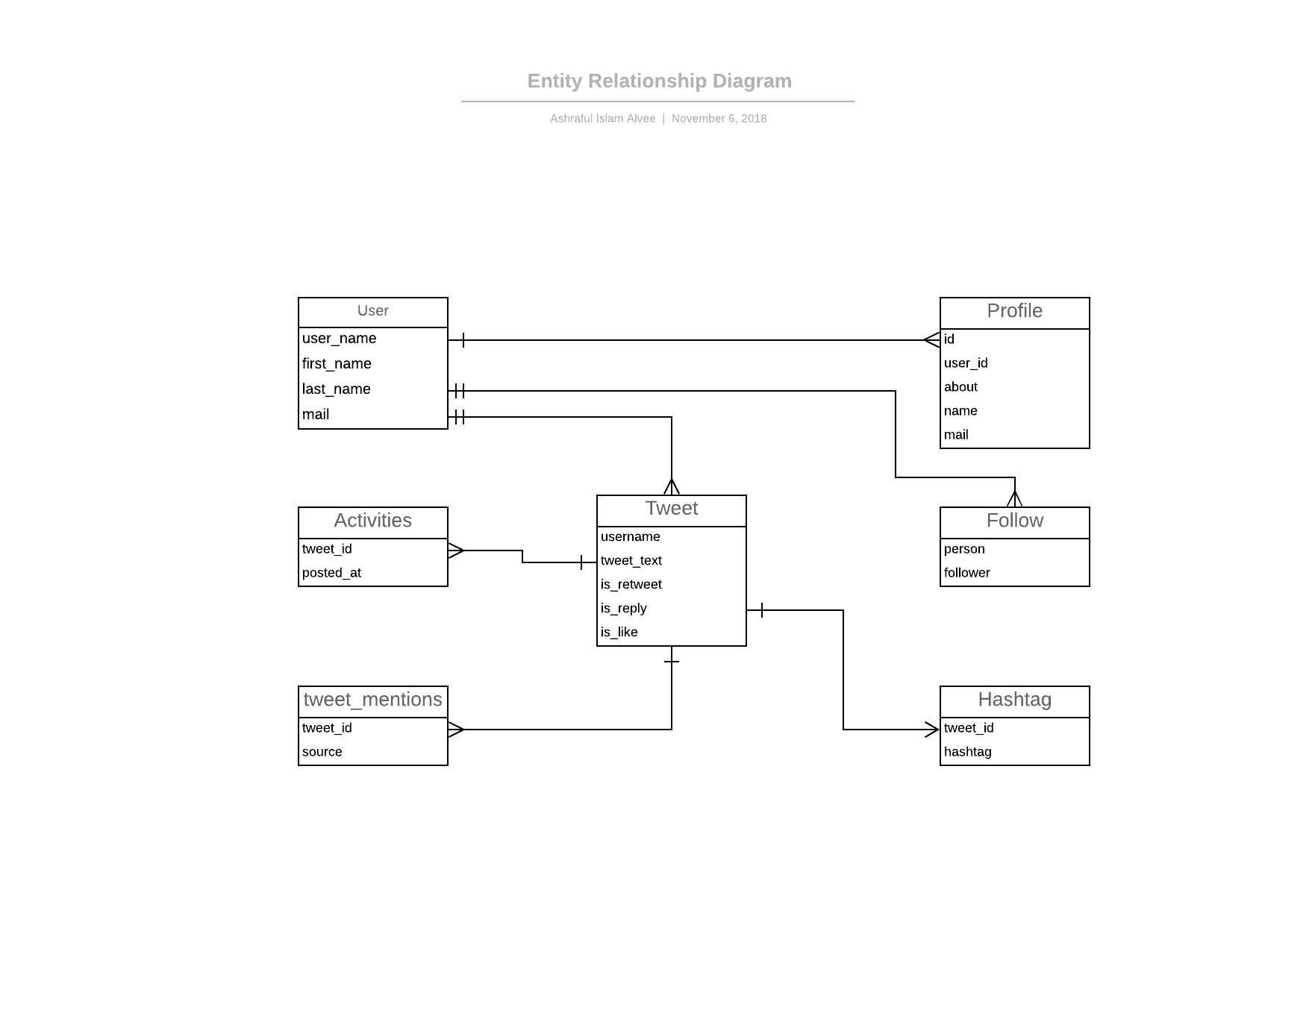
Database Scheme

Slide 10
Mysql
CREATE TABLE `User` (
`user_name` <type>,
`first_name` <type>,
`last_name` <type>,
`mail` <type>
);
CREATE TABLE `Profile` (
`id` <type>,
`user_id` <type>,
`about` <type>,
`name` <type>,
`mail` <type>
);
CREATE TABLE `Follow` (
`person` <type>,
`follower` <type>
);
CREATE TABLE `Tweet` (
`username` <type>,
`tweet_text` <type>,
`is_retweet` <type>,
`is_reply` <type>,
`is_like` <type>
);

Slide 11
CREATE TABLE `tweet_mentions` (
`tweet_id` <type>,
`source` <type>
);
CREATE TABLE `Hashtag` (
`tweet_id` <type>,
`hashtag` <type>
);
CREATE TABLE `Activities` (
`tweet_id` <type>,
`posted_at` <type>
);

Slide 12
Technology stack :
Platform : Linux based OS
Logical language : Python
Framework : Django (backend)
Frontend : html,css,bootstrap
Database : mysql
Webserver : apache
Management containerization : Docker
Version control : git
Web based version control : github using git
API : Restful API
API tool : Postman

