Slide 1













AVDTECHFEST.COM
ONLINE – 18.11.2021
AZURE IMAGE BUILDER OR PACKER FOR AVD
Stein-Erik Alvestad
01:35pm – 02:25pm (CET)
04:35am – 05:25am (PST)

Slide 2

DIAMOND SPONSORS
GOLD SPONSORS
SILVER SPONSORS

Slide 3


LinkedIn
Twitter
Hashtag
#
WVDTechFest
@WVDTechFest
AVDTECHFEST

Slide 4


How am I?
Stein-Erik Alvestad
Cloud Solution Architect @TietoEVRY (MSP)
Twitter @salvestad
Blog @alven.tech
#GirlDad

Slide 5


Slide 6

Session Agenda
Image Creation & Deployment - High Level Design
Comparing AIB vs Packer
Demos with Azure DevOps

Slide 7
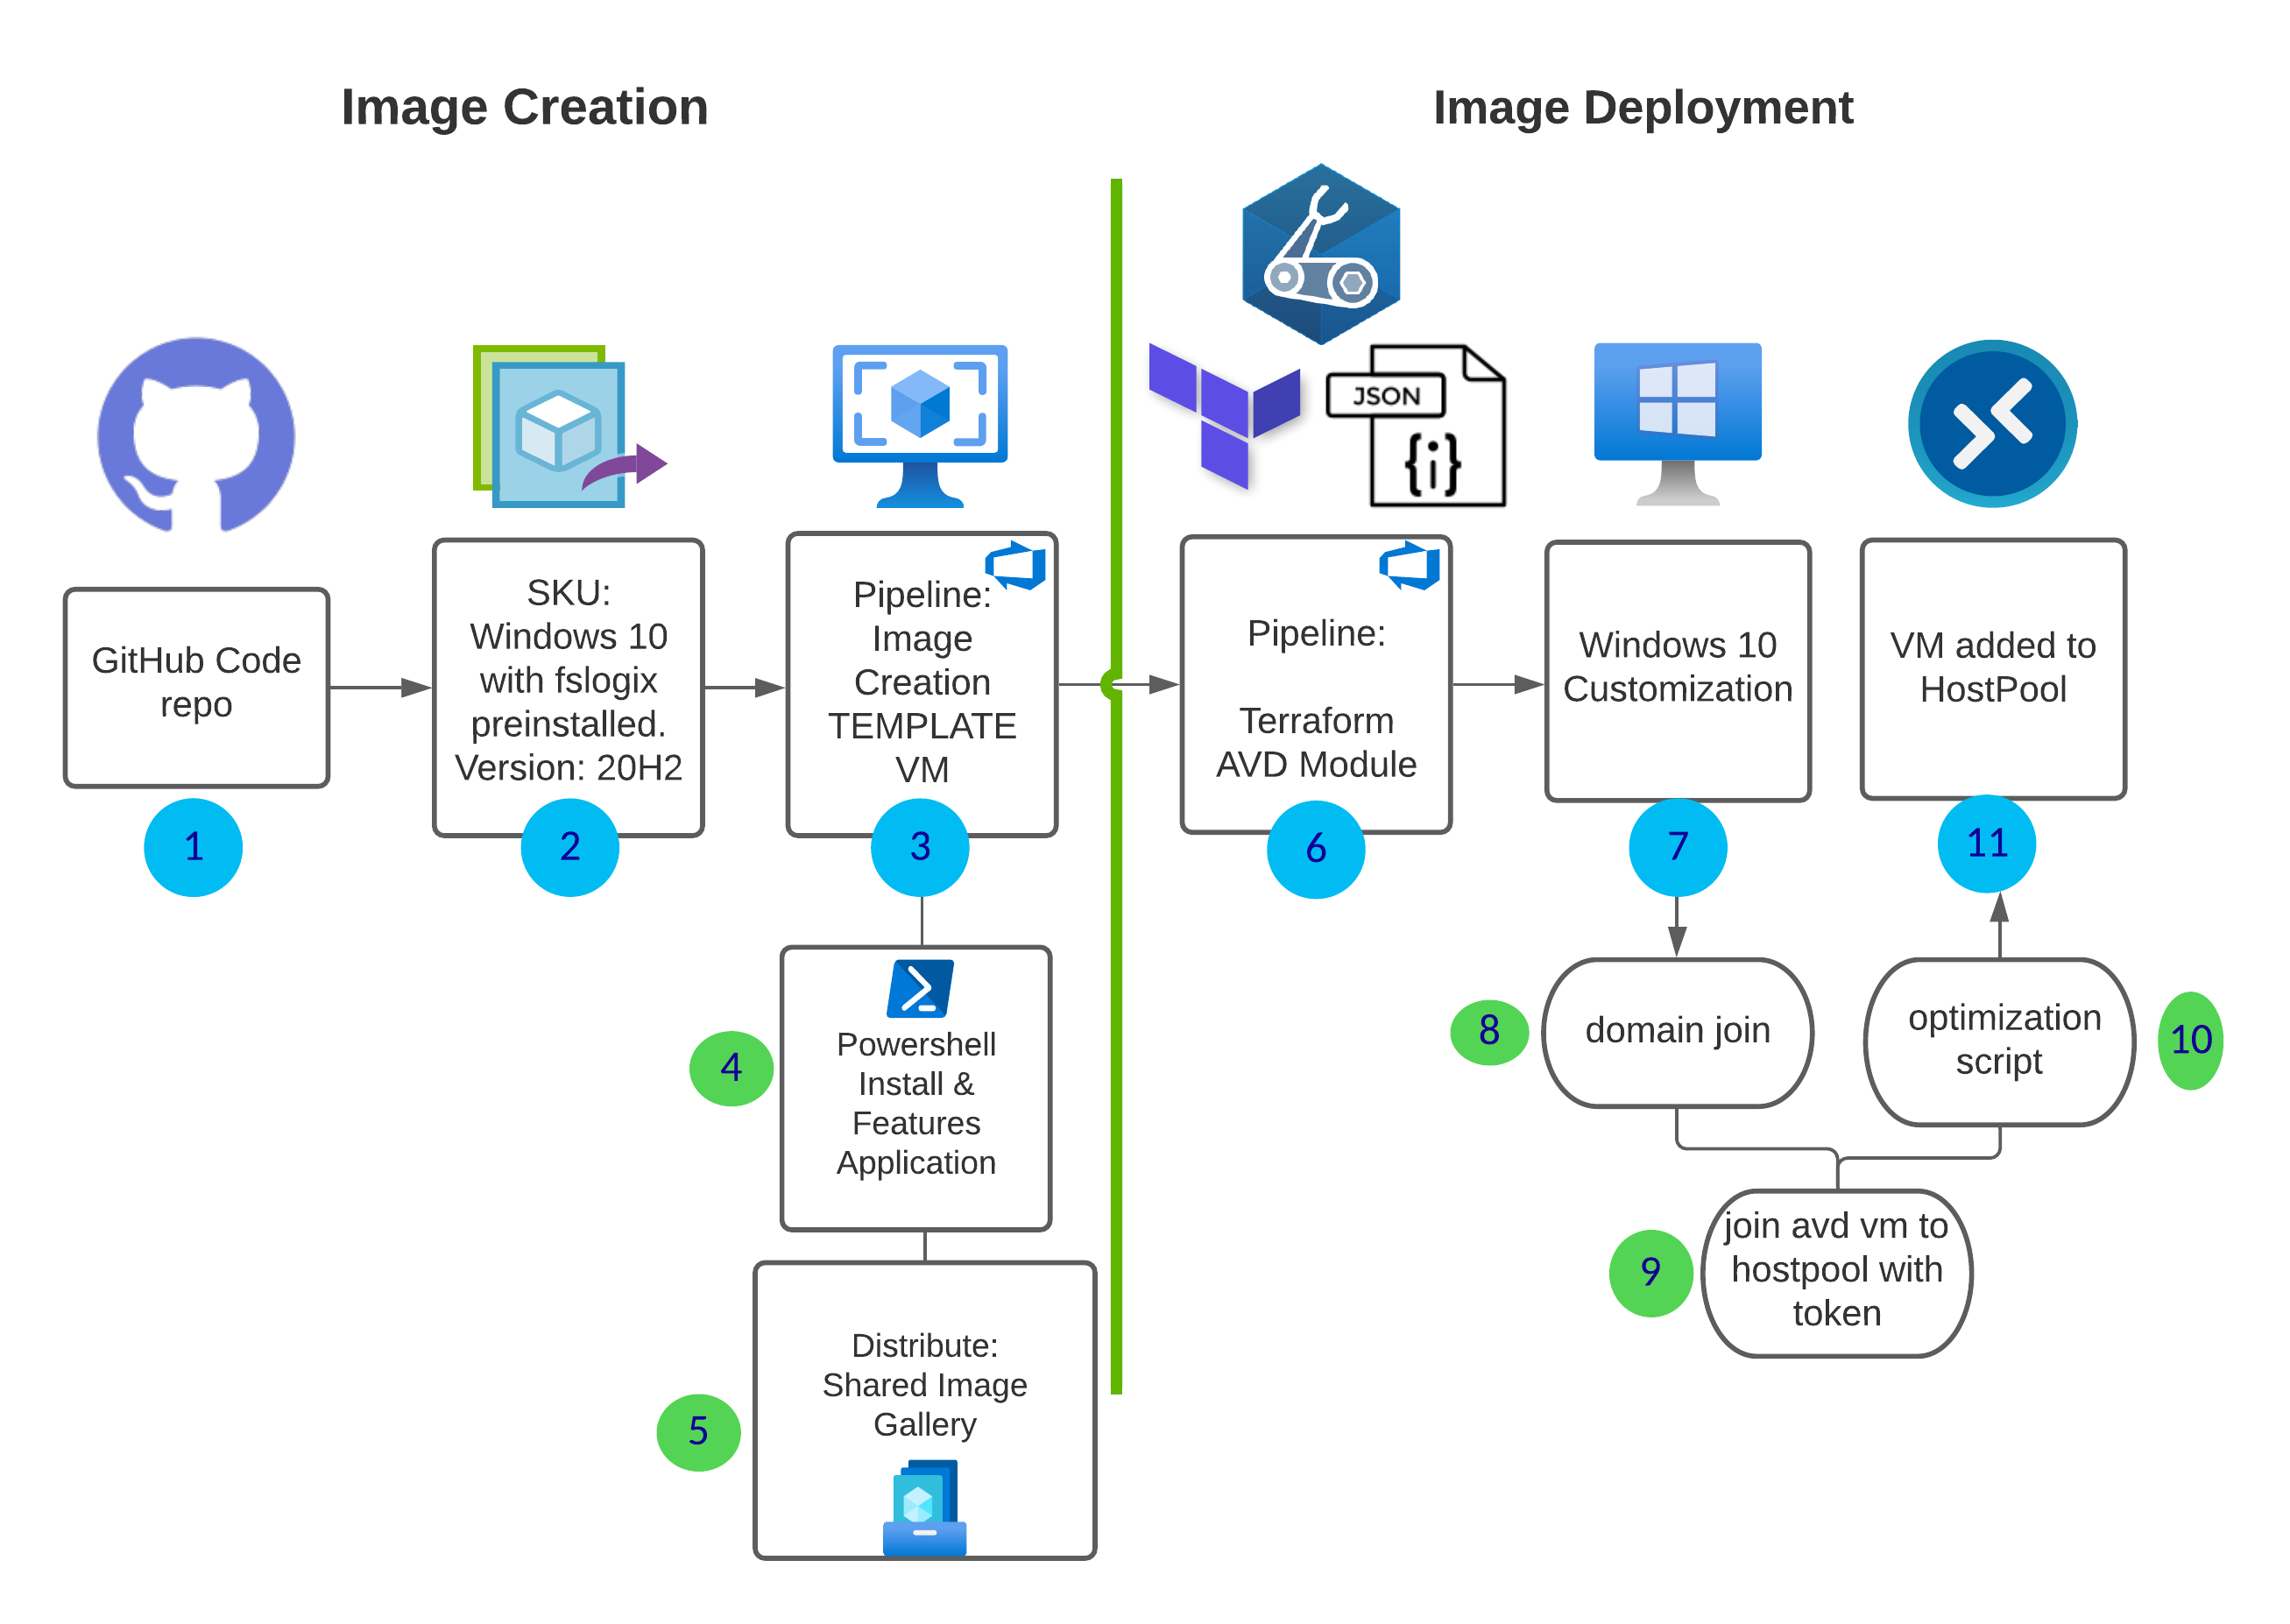

Image Creation & Deployment - High Level Design
Notes:
use marketplace SKU (add this to our code)
choose the latest offer, windows version supported by your organization (add this to code)
build pipeline with AIB or Packer with info from 1 & 2
provisioner – install windows features and custom applications from azure storage/azure files /package manager
distribute the shared image gallery across regions
trigger ARM or TF deployment with the latest release of the ID from SIG.
start windows customization extensions phase
domain join extension
host pool join dsc extension
custom PowerShell extension (example WVD optimization script )
VM added to host pool ready for testing or production.

Slide 8
Session Agenda
Image Creation & Deployment - High Level Design
Comparing AIB vs Packer
Demos with Azure DevOps

Slide 9




DESCRIPTION | PACKER (AZURE-ARM) | AIB (AZURE IMAGE BUILDER)
Managed by | HashiCorp | “Microsoft” ( with HasiCorp Packer under the hood)
Azure RBAC role | Service Principal “Managed Identity” | Managed Identity
Azure Resource Group | Provision resources to the default resource group from packer or existing resource group | Provision resources to the default resource group from packer or existing resource group
Distribute | Shared Image Gallery ManagedImage VHD | Shared Image Gallery ManagedImage VHD

Slide 10




DESCRIPTION | PACKER (AZURE-ARM) | AIB (AZURE IMAGE BUILDER)
Communicators (windows Packer create certificate only valid 24-hours from invocation time. Uploaded to KeyVault. | winrm | winrm
Provisioner | Powershell, chef, ansible, puppet , DSC, etc… | Powershell
Region | All Azure regions | most Azure regions supported
Azure gen images | Gen1 (Boot – PCAT) Gen 2 (Boot – UEFI ) | Gen 1 Gen 2 (Roadmap - tentative q4 or q1 2022)

Slide 11





DESCRIPTION | PACKER (AZURE-ARM) | AIB (AZURE IMAGE BUILDER)
Azure DevOps / Infra as Code | Packer task / Build Image task (1.) / Azure CLI and Powershell (1.7.*) | Azure VM Image Builder Task (preview), Azure CLI and Powershell (1.7.*)
Security | VNET (default or existing) , NSG (restricted ports) , KeyVault (certificate and secrets) | VNET (default or existing) , NSG (restricted ports), KeyVault (certificate and secrets)
Packer.exe | Azure cli has packer preinstalled. Need to download the latest packer version or specify an older version. | Do not have any direct interaction with Packer. Everything goes through the azure image builder service that again uses packer under the hood.
Configuration syntax | JSON HCL (preferred from 1.7.0) | JSON
Logging | Storageaccount | Storageaccount

Slide 12
Session Agenda
Image Creation & Deployment - High Level Design
Comparing AIB vs Packer
Demos with Azure DevOps

Slide 13
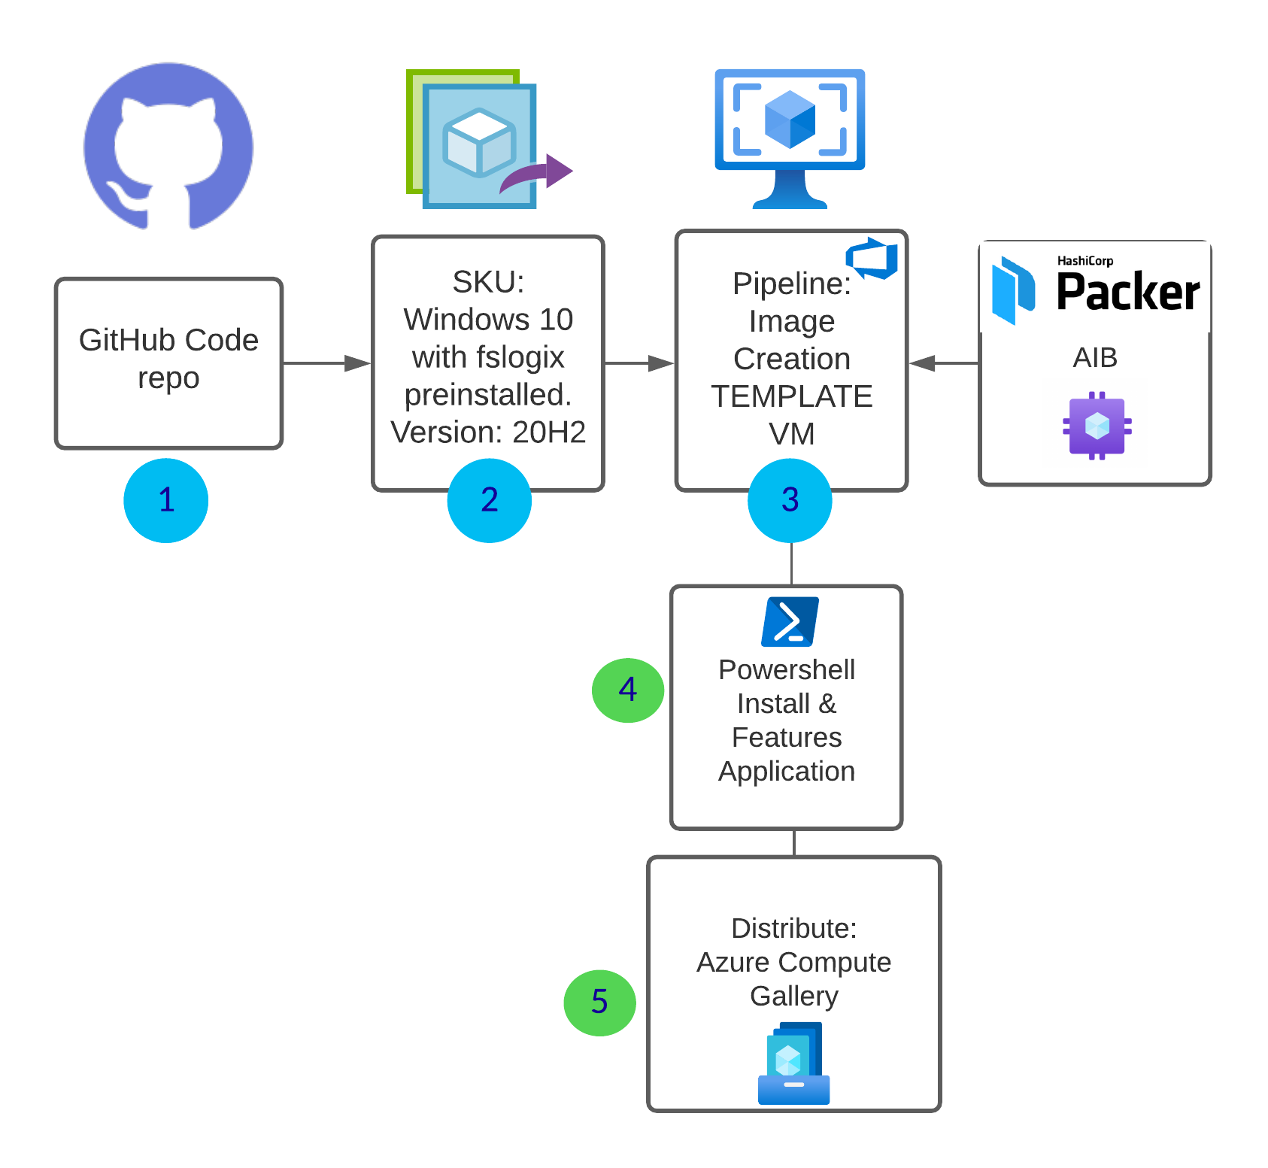
Image Creation
Notes:
use marketplace SKU (add this to our code)
choose the latest offer, windows version supported by your organization (add this to code)
build pipeline with AIB or Packer with info from 1 & 2
provisioner – install windows features and custom applications from azure storage/azure files /package manager
distribute the shared image gallery across regions
trigger ARM or TF deployment with the latest release of the ID from SIG.
start windows customization extensions phase
domain join extension
host pool join dsc extension
custom PowerShell extension (example WVD optimization script )
VM added to host pool ready for testing or production.

Slide 14

Packer Azure DevOps Demo

Slide 15

Azure Image Builder Azure DevOps Demo

Slide 16
Troubleshooting
Packer Logs
Packer logs are stored in the storage account.
Use CMTrace.exe to debug the log file -*.log Identity
azure-arm: Getting tokens using Managed Identity for Azure fails. Check the secrets used by KeyVault and the json tempalte

Slide 17
Summary
It’s not a battle - gets down to current preferences.
Lucky for you it’s no wrong answer, the secret is that you use packer either way
AIB
Packer
Azure DevOps
Checkout - Session from Travis Roberts – Azure Image Builder and Patrick van den Born - Deploying Win10MS with Azure DevOps, Terraform and Packer
Session - https://alven.tech/azure-image-builder-or-packer-for-wvd/

Slide 18
LinkedIn
Twitter
Hashtag
#
WVDTechFest
@WVDTechFest
AVDTECHFEST

