Slide 1
Physical Verification System
Caselet for Advanced Django + DB + REST API
September 2021
Estimated Efforts: 80 hours

Slide 2
Introduction
This caselet will be focusing on creating a web application backend which will be ready to use for any front end to create a Physical Verification System.
What is Physical Verification System?
Physical Verification System is used by Verification Agencies to verify the identity of a loan applicant.
Verification branch/agency is one of the core teams of a NBFC (Non-Banking Financial Institution) moving towards digital system of loan disbursal.
Overall Flow
NBFC looking to disburse a loan assigns the application to one of many verification agencies it has hired.
Verification agency receives this loan application for verification.
‘Manager’ assigns an application for verification to a ‘Verifier’.
The ‘Verifier’ or the field agent goes to the applicant’s address, verifies their identity, submits pictures of their DOB Proof, Address Proof & the candidate.
The application moves to the ‘Reviewer’.
Reviewer reviews the uploaded documents and either approves the documents or rejects them.

Slide 3




Prerequisite knowledge on few techniques and familiarity with domain solicited
Postman
Django Rest Framework
Django Rest Swagger
Postman is used to quicky test the APIs.
It allows you very quickly create a request with the required HTTP method and parameters, submit the request and easily inspect the results.
Django
Django REST framework is a powerful and flexible toolkit for building Web APIs.
Swagger is an Interface Description Language for describing RESTful APIs expressed using JSON. Swagger is used to design, build, document, and use RESTful web services.
Django is a high-level Python web framework that encourages rapid development and clean, pragmatic design.
Overview | Django Simple History
Django Settings | Middleware
Django WSGI | Mixins
Model Manager | Signals
Migrations | Admin Site
Requests | Responses
Status Codes | Routers
Viewsets | Serializers
Validators | Pagination
Tutorial Link 1 | Tutorial Link 2
Tutorial Link 1 | Tutorial Link 2

Slide 4





Application consists of the following
Customer
Loan Application
Verification Agency
Agency Employee
Employee Role

Slide 5
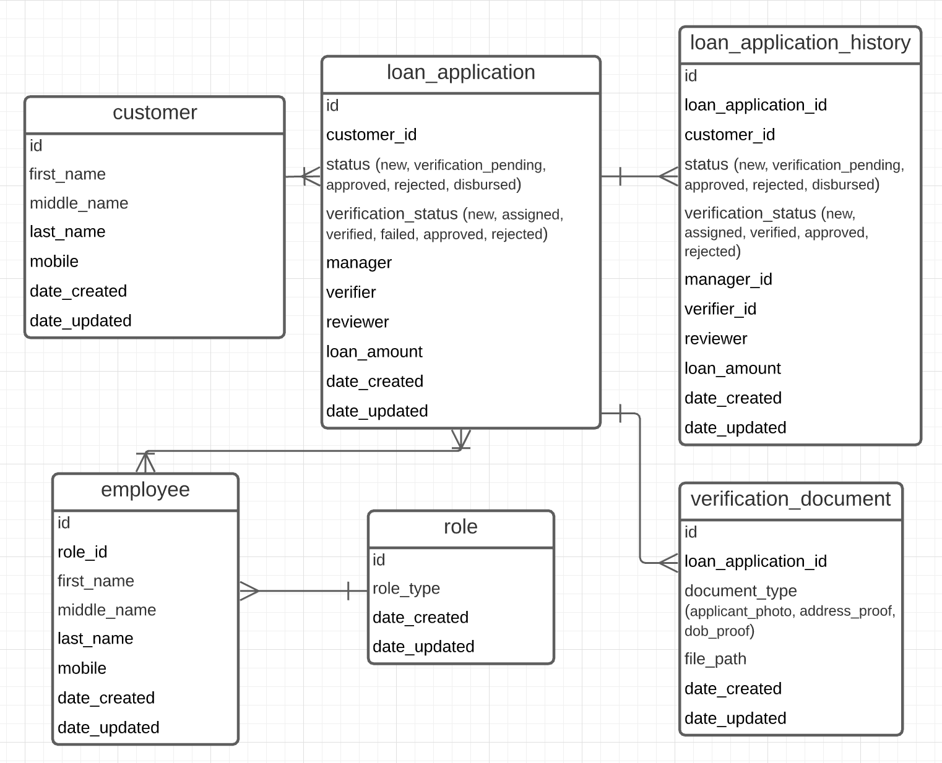
Datasets to be created
Table Name | Table Definition
customer | Personal details of loan applicants
loan_application | Details of the various loan applications
loan_application_history | Every time a loan_application record is updated, a new entry is made in this table to maintain the history
verification_document | Points to the document/image uploaded for verification
employee | Employees of verification agency
role | Various roles that can be assigned to an employee
Database In this exercise, a Postgres database is required to be created keeping in mind the ERD at the right hand side.
Create a database named ‘physical_verification’ and use the ‘physical_verification.tar’ to restore the pre-created datasets.
Link A | Link B | Link C | Link D

Slide 6
Verification Status Flow
The default status of a loan application when created is verification_pending and of verification_status is New.
Manager assigns this application to a Field Agent (Verifier) and the verification_status of application changes to Assigned.
Verifier goes to the applicant’s residence.
If somehow, the agent can’t verify the application, the Verifier moves the verification_status to Failed.
Else if, the agent is able to verify and upload required documents, he/she moves the verification_status to Verified.
Once Verifier is done with changing the status of application, it is assigned to Reviewer.
Reviewer reviews the documents uploaded by Verifier and moves the verification_status to either of:
Approved
Rejected
New
Note: verification_status is not to be confused with status.

Slide 7
Exercises
For overall understanding of the application.
Create a web application backend using Django which will be able to cater the request and send an appropriate response.
For understanding the advanced features of Django:
Add different settings files for different stages (prod.py, dev.py, local.py).
Create Django models for the tables mentioned before.
Integrate with Django-simple-history and connect with the loan_application model, such that a new entry in the table ‘loan_application_history’ is created whenever an update happens on a loan_application record (feel free to create a custom signal on update of loan_application).
Create an abstract BaseModel containing common fields like date_created and date_updated.
Create migration files and apply them.
Enable admin panel and add code to admin.py for each of the models.
Manually insert records in the tables mentioned before and take a backup of the DB.

Slide 8
Exercises…
Create subclasses of ModelViewSet for the entities mentioned before. (Feel free to make use of Mixin along with GenericViewSet instead to open specific APIs only).
Implement pagination
Use corresponding serializers for validations like:
The employee should be allowed to move the verification_status as per their role only refer to the flow in previous slide)
A field agent and a reviewer should only have the permission to upload a verification document.
The records listed should be different for every role. The verifier should see the applications assigned to him/her only (Create model manager for loan_application Model).
Integrate with Swagger for API documentation.
Test out all the application using Swagger, this will enable the understanding of Swagger

Slide 9



Technical Aspects to watchout for
While writing Python Logic always use PEP-8 conventions ( help )
Always use Try-Except-Finally blocks while dealing with any connection related code i.e., While working on File/Database read write related operations. ( help )
Implement Separation of concerns i.e., try to separate the APIs routing logic from business logic and try to group similar types of functionalities like grouping all the database related logic and calling it a 'DataBaseUtils' Class.
Try finding the best fit for various Design Patterns like Abstract Factory, Builder pattern etc. Example – Singleton design pattern comes in handy when a database connection is required to be created. Also, read about Anti-patterns.
Follow best practices for endpoint naming conventions. (help-1, help-2)

Slide 10

Expected Output
1
How to use DRF and create APIs with minimal code.
How to use Serializers for validations.
How to use permission classes.
How to appropriately use of Django signals.
How to build scalable backend application (including class design)
2
3
4
5

Slide 11

Contacts
Topic Experts
Mearaj Ali (Ali.Mearaj@bcg.com)
Saurabh Bhatia (Bhatia.Saurabh2@bcg.com)
Author of Caselet
Saurabh Bhatia (Bhatia.Saurabh2@bcg.com)

Slide 12


Naming convention:
CaseletName_Last_FirstName
Communication:
Use Slack channel
Ensure you have Slack on mobile device
Outputs:
Do version control and share only final version
Typical savings across transformations
Best Practices
Check-in Calls:
Use this as a platform to clear any doubts
Request for call with SPOC/expert if needed
Share:
Use send.bcg>2Mb
Share link on email with explanations as needed
Deadline:
In the unavoidable case of being pulled on case/
any anticipated delay; raise an early alarm
Feel free to reach out in case of confusions.

