Slide 1
Travel Aid
1005017
1005029

Slide 2
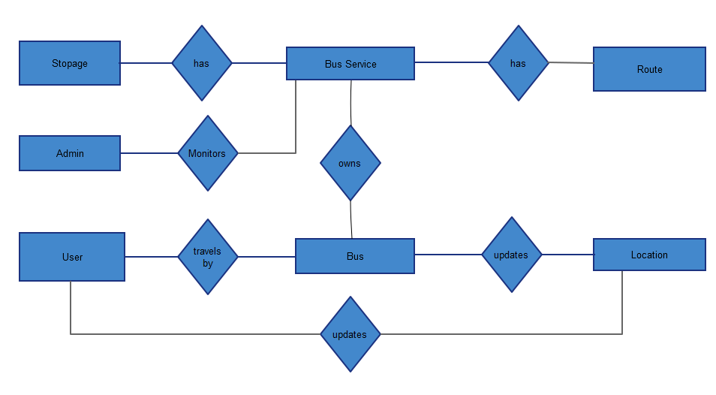
ERD
1
M
M
1
M
1

Slide 3
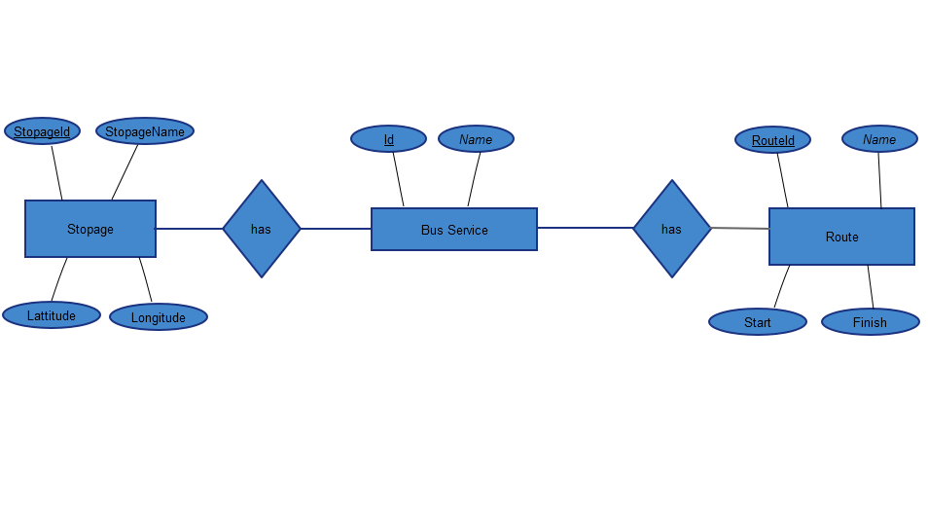
Entity and Relation with attributes

Slide 4
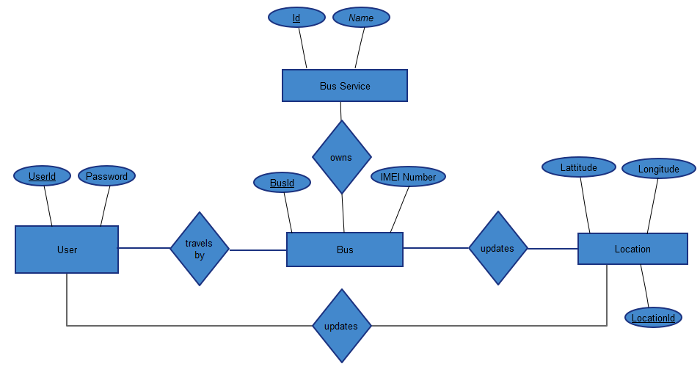
Entity and Relation with attributes
1
M

Slide 5
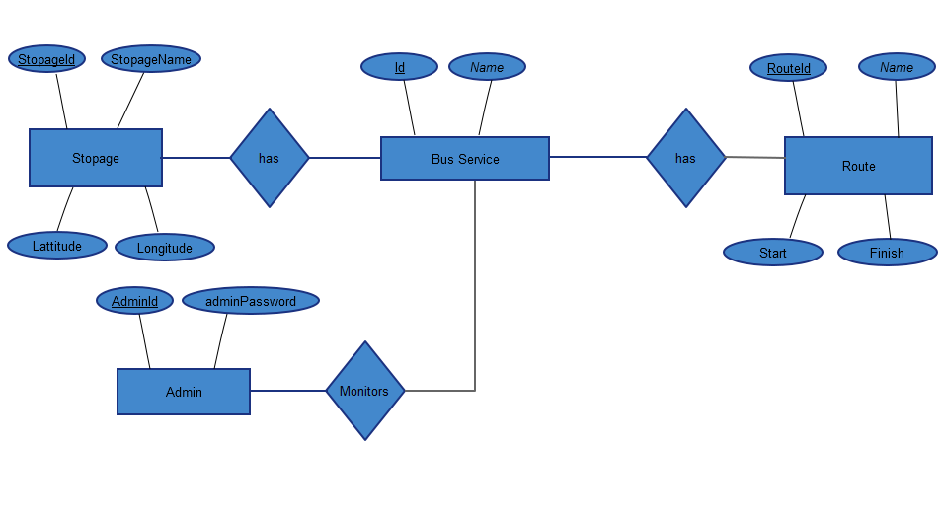
Entity and Relation with attributes

Slide 6
Tables
BusService(ID , Name)
Stopage(ID,Name,Lattitude,Longitude)
Route(ID,Start,Finish)
BusSpotage(StopageID,BusServiceId)
BusRoute(RouteID,BusServiceId)
BusOwner(BusServiceId,BusId)
Bus(Id,IMEI)
Location(LocationId,Lattitude,Longitude,Time,UpdateBy)
User(Id,Password)
User_Travel(UserId,BusId)

