Slide 1

CID: Cow Images Dataset for Regression and Classification
AI
.
https://github.com/bhuiyanmobasshir94/CID

Slide 2
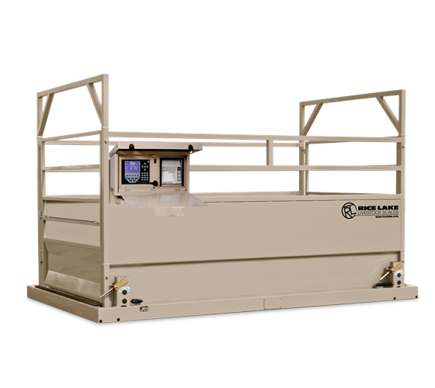
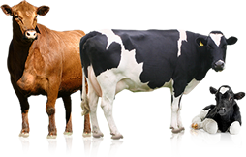
PROBLEM STATEMENT.
Weight & Breed are key drivers in livestock (i.e. cows) trading. Yet, Livestock Weight Measurement is a key challenge during production and procurement because available industrial livestock scales are simply:
Bulky
Expensive
Not Easily Portable
A typical agricultural scale: 13’ x 8’; 15000 LBS

Slide 3



What breed is it?
01
How certain are you of the breed when you are negotiating?
What is the impact of increased speed & accuracy on breed and weight determination when you negotiate?
How much does it weigh?
02
How do you weigh a livestock without a scale?
How accurate is the weighing formula?
How do you ascertain weight tampering on the spot?
How long does the weighing process take?
How confident are you about your guesstimate?

Slide 4

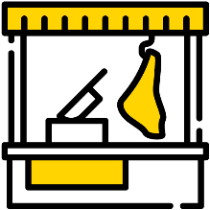



MARKET & END USERS.
FARMERS
INDUSTRIAL BUTCHER SHOPS & MEAT PROCESSORS
LIVESTOCK TRADERS
A low cost alternative to expensive weighing scale for farmers rearing livestock to keep track of the health of their livestock inventory.
Increased productivity and accuracy in procurement decision making for Butcher shops & Meat Processors.
Increased profitability through minimizing errors in weight estimations for spot livestock traders
VETERINARIANS
GENERAL CONSUMERS
Enable better animal care. Accurate weight estimation and breed identification are required for growth tracking and dosage estimation.
Enable better decision making for consumer looking to purchase livestock directly from the farmers or traders.

Slide 5
How AI can add Value?
Increase Speed and Accuracy
Augment your existing knowhow to make better decisions with AI
Low Cost & Portability
AI can augment and scale human expertise and aid solving real-world challenges. Much of the recent progress in AI has relied on data-driven techniques like deep learning and artificial neural networks. Given sufficiently large labeled training data sets and enough computation, these approaches can achieve unprecedented results.
Bulky Weighing scales are not required
Reduce time spent on weighing leading to productivity gain
Low cost device that is easily portable
Maximize Output
Increase overall yield by reducing weighing error

Slide 6
‹#›
‹#›
What is Needed ?
Labeled Data
AI Image recognition solution requires images with known parameters. While small number of images could show promising results, usually 10,000+ images are required for better and consistent results
The core currency of any business will be the ability to convert their data into AI that drives competitive advantage
-Satya Nadella, CEO, Microsoft
Data Accuracy
AI Image recognition solution is dependent upon the accuracy of training data. The more accurate the training data, the more accurate the results
Large Possible Dataset
So that our research community can build their novel models or finetune existing ones without the hassle of data collection.

Slide 7
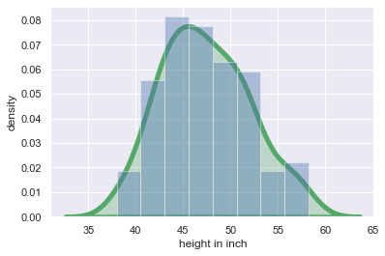
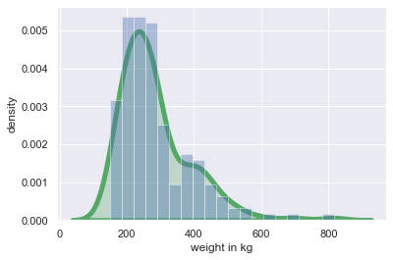
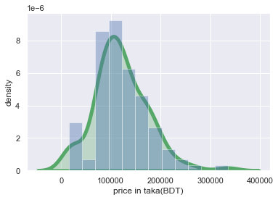
OUR Dataset.
We developed our cow images dataset of 17,899 images with vitals (sex, color, breed, feed, age, teeth, height, weight, price, size) which can be used for both classification and regression.
Figure 1
Figure 2
Figure 3
Height Distribution in Inch of Cow Images Dataset
Weight Distribution in Kg of Cow Images Dataset
Price Distribution in Taka (BDT) of Cow Images Dataset

Slide 8
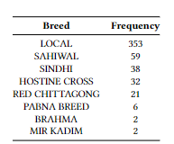


OUR Dataset.
We developed our cow images dataset of 17,899 images with vitals (sex, color, breed, feed, age, teeth, height, weight, price, size) which can be used for both classification and regression.
Table 1
Table 2
Table 3
Breed Distribution of Our Cow Images Dataset
Age (Year) Distribution of Our Cow Images Dataset
Resolution Wise Image Distribution of Cow Images Dataset

Slide 9
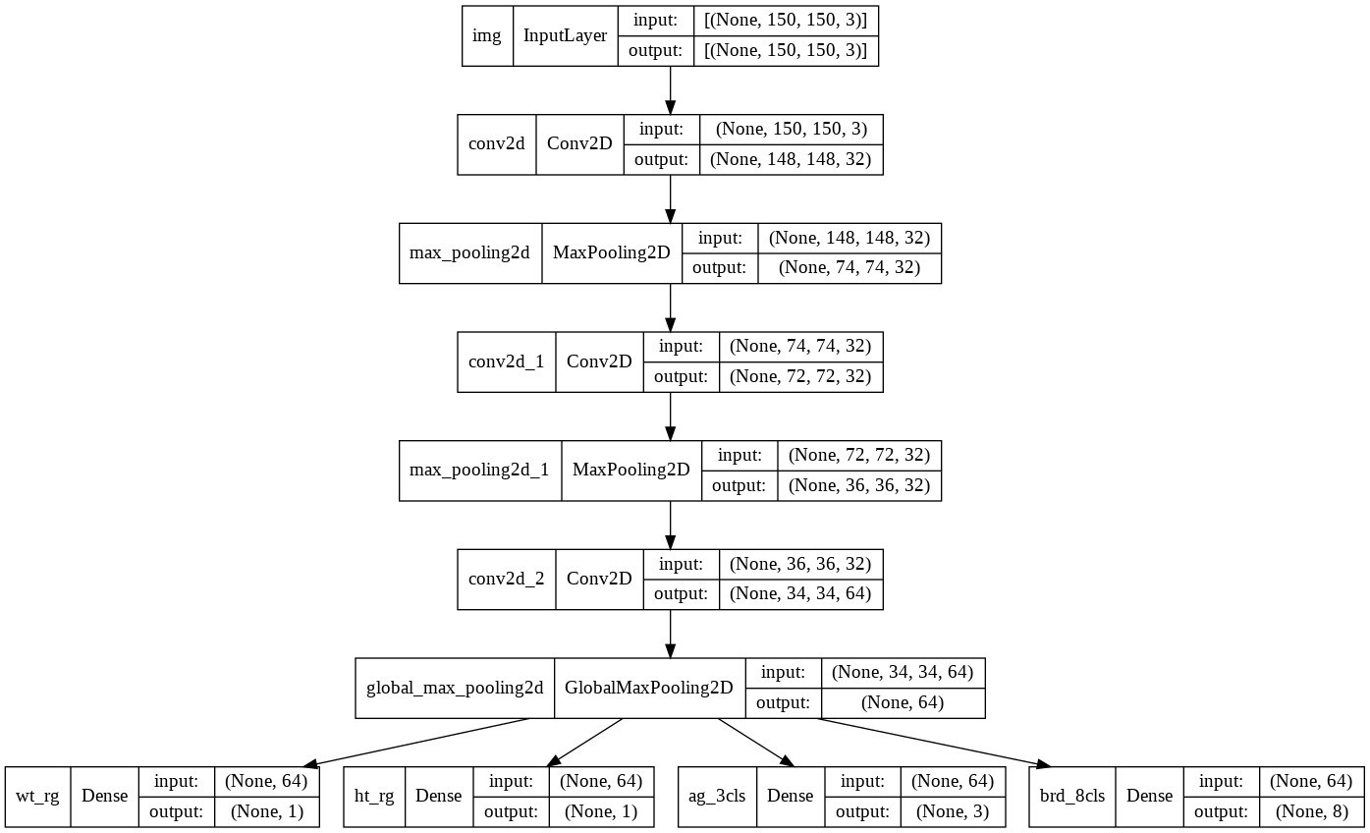
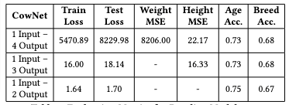
OUR Model & Results.
We are also contributing baseline models demonstrating how this dataset can be used for regression and classification. These baseline models consist of multi input-output network (1 input - 2 outputs; 3 outputs; 4 outputs) to classify and regress cattle livestock vitals among
them (1 input - 2 outputs) have the best accuracy of 75% and 67% respectively for age and breed with the minimum loss.
Figure 4
CowNet Model Architecture for 1 Input - 4 Outputs
Table 4
Evaluation Metrics for Baseline Models.

Slide 10
THANK YOU
Q & A
CID: Cow Images Dataset for Regression and Classification
International Conference on Computing Advancements (ICCA)

