Slide 1



Applying Curriculum Learning to Bug Fixing: Finetuning CodeT5
By: Md Zahidul Haque
CSCI 680 AI for S/W Eng
Antonio Mastropaolo
@AntonioMastro2

Slide 2
CL for Bug Fixing
What is Curriculum Learning (CL)?
@AntonioMastro2
Notes:
is an approach where the model is provided with examples of input-output pairs or task descriptions directly within the input context (the prompt) without altering the model’s weights through traditional training or gradient updates.
• Key Idea: Instead of fine-tuning a pre-trained model for a specific task, you simply provide a set of instructions or demonstrations (examples of inputs and outputs) in the same prompt. The model then generalizes this “on the fly” to perform the given task.
• Example: Suppose you’re automating a bug-fixing task. You can input several examples of buggy code alongside the correct fixes in the prompt, and the model will infer how to fix new, unseen code based on these in-context examples.
• Efficiency: Since the model isn’t updated during this process (no backpropagation or learning in the traditional sense), you can use a pre-trained model across various tasks without the need for task-specific retraining.

Slide 3
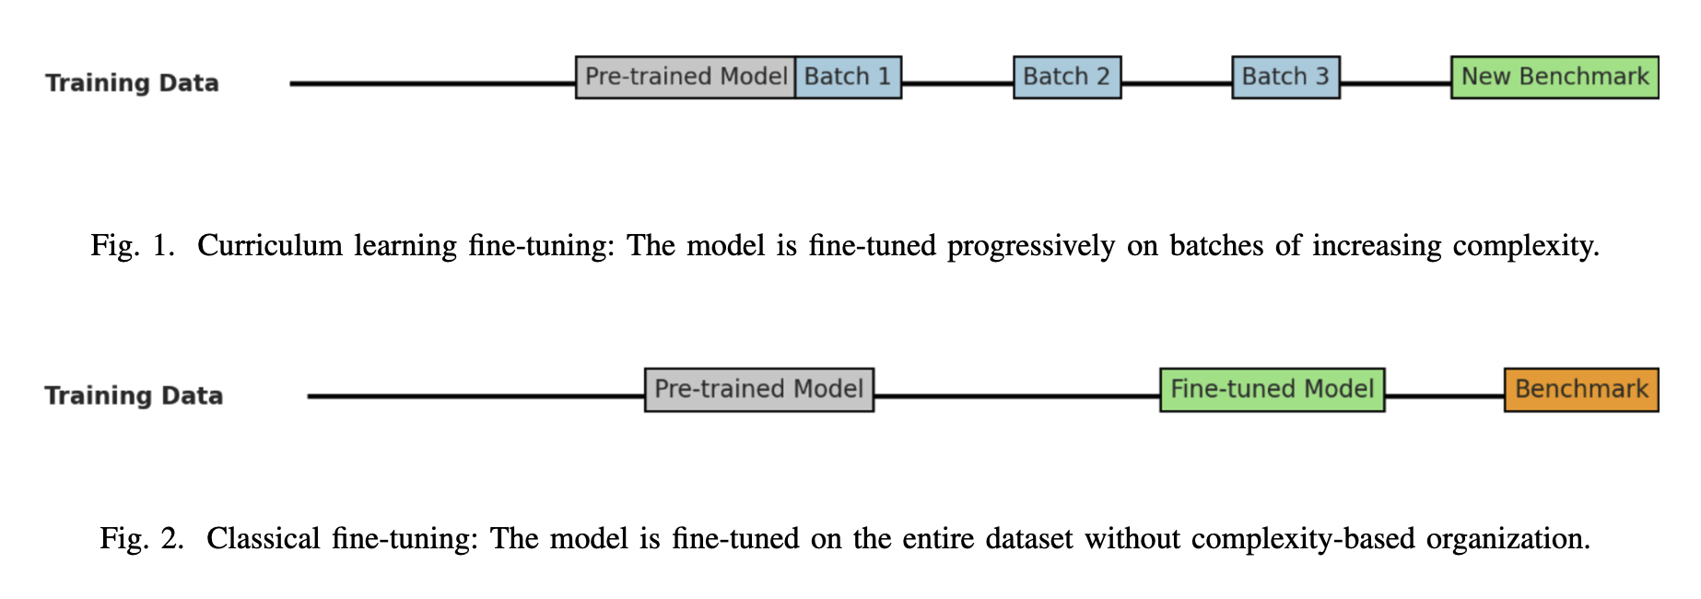
CL for Bug Fixing
What is Curriculum Learning (CL)?
@AntonioMastro2
Notes:
is an approach where the model is provided with examples of input-output pairs or task descriptions directly within the input context (the prompt) without altering the model’s weights through traditional training or gradient updates.
• Key Idea: Instead of fine-tuning a pre-trained model for a specific task, you simply provide a set of instructions or demonstrations (examples of inputs and outputs) in the same prompt. The model then generalizes this “on the fly” to perform the given task.
• Example: Suppose you’re automating a bug-fixing task. You can input several examples of buggy code alongside the correct fixes in the prompt, and the model will infer how to fix new, unseen code based on these in-context examples.
• Efficiency: Since the model isn’t updated during this process (no backpropagation or learning in the traditional sense), you can use a pre-trained model across various tasks without the need for task-specific retraining.

Slide 4
CL for Bug Fixing
What is Curriculum Learning (CL)?
Curriculum Learning
@AntonioMastro2
Notes:
is an approach where the model is provided with examples of input-output pairs or task descriptions directly within the input context (the prompt) without altering the model’s weights through traditional training or gradient updates.
• Key Idea: Instead of fine-tuning a pre-trained model for a specific task, you simply provide a set of instructions or demonstrations (examples of inputs and outputs) in the same prompt. The model then generalizes this “on the fly” to perform the given task.
• Example: Suppose you’re automating a bug-fixing task. You can input several examples of buggy code alongside the correct fixes in the prompt, and the model will infer how to fix new, unseen code based on these in-context examples.
• Efficiency: Since the model isn’t updated during this process (no backpropagation or learning in the traditional sense), you can use a pre-trained model across various tasks without the need for task-specific retraining.

Slide 5
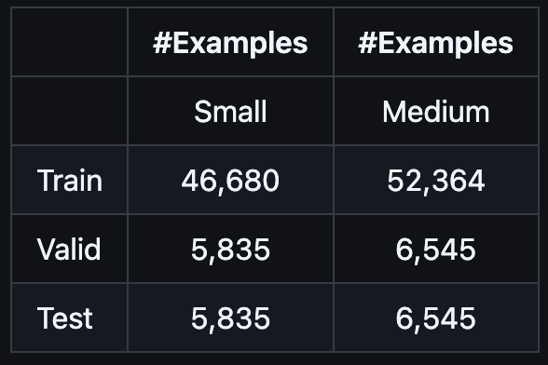

CL for Bug Fixing
Dataset?
Small + Medium
99,044
12,380
12,380
@AntonioMastro2
Notes:
is an approach where the model is provided with examples of input-output pairs or task descriptions directly within the input context (the prompt) without altering the model’s weights through traditional training or gradient updates.
• Key Idea: Instead of fine-tuning a pre-trained model for a specific task, you simply provide a set of instructions or demonstrations (examples of inputs and outputs) in the same prompt. The model then generalizes this “on the fly” to perform the given task.
• Example: Suppose you’re automating a bug-fixing task. You can input several examples of buggy code alongside the correct fixes in the prompt, and the model will infer how to fix new, unseen code based on these in-context examples.
• Efficiency: Since the model isn’t updated during this process (no backpropagation or learning in the traditional sense), you can use a pre-trained model across various tasks without the need for task-specific retraining.

Slide 6
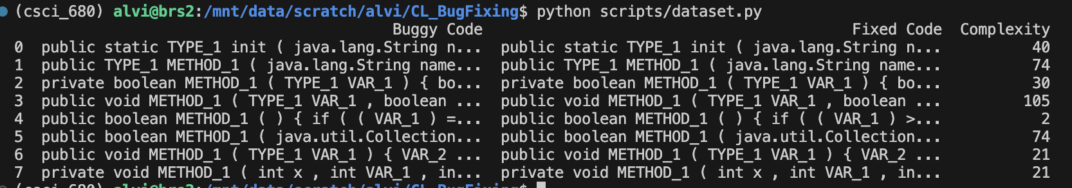
CL for Bug Fixing
Dataset?
Levenshtein Distance
Batch #1
25%
Small + Medium
50%
Batch #2
99,044
12,380
75%
Batch #3
12,380
100%
Batch #4
FOR EACH DATASET (i.e. small)
@AntonioMastro2
Notes:
is an approach where the model is provided with examples of input-output pairs or task descriptions directly within the input context (the prompt) without altering the model’s weights through traditional training or gradient updates.
• Key Idea: Instead of fine-tuning a pre-trained model for a specific task, you simply provide a set of instructions or demonstrations (examples of inputs and outputs) in the same prompt. The model then generalizes this “on the fly” to perform the given task.
• Example: Suppose you’re automating a bug-fixing task. You can input several examples of buggy code alongside the correct fixes in the prompt, and the model will infer how to fix new, unseen code based on these in-context examples.
• Efficiency: Since the model isn’t updated during this process (no backpropagation or learning in the traditional sense), you can use a pre-trained model across various tasks without the need for task-specific retraining.

Slide 7
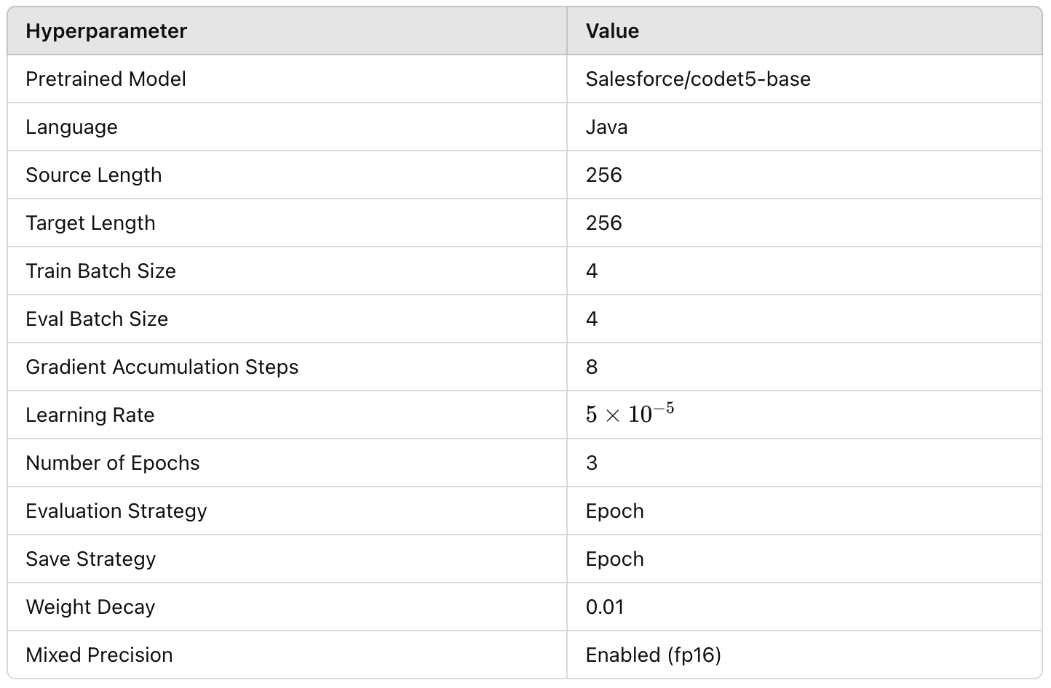


CL for Bug Fixing
Model?
@AntonioMastro2
Notes:
is an approach where the model is provided with examples of input-output pairs or task descriptions directly within the input context (the prompt) without altering the model’s weights through traditional training or gradient updates.
• Key Idea: Instead of fine-tuning a pre-trained model for a specific task, you simply provide a set of instructions or demonstrations (examples of inputs and outputs) in the same prompt. The model then generalizes this “on the fly” to perform the given task.
• Example: Suppose you’re automating a bug-fixing task. You can input several examples of buggy code alongside the correct fixes in the prompt, and the model will infer how to fix new, unseen code based on these in-context examples.
• Efficiency: Since the model isn’t updated during this process (no backpropagation or learning in the traditional sense), you can use a pre-trained model across various tasks without the need for task-specific retraining.

Slide 8
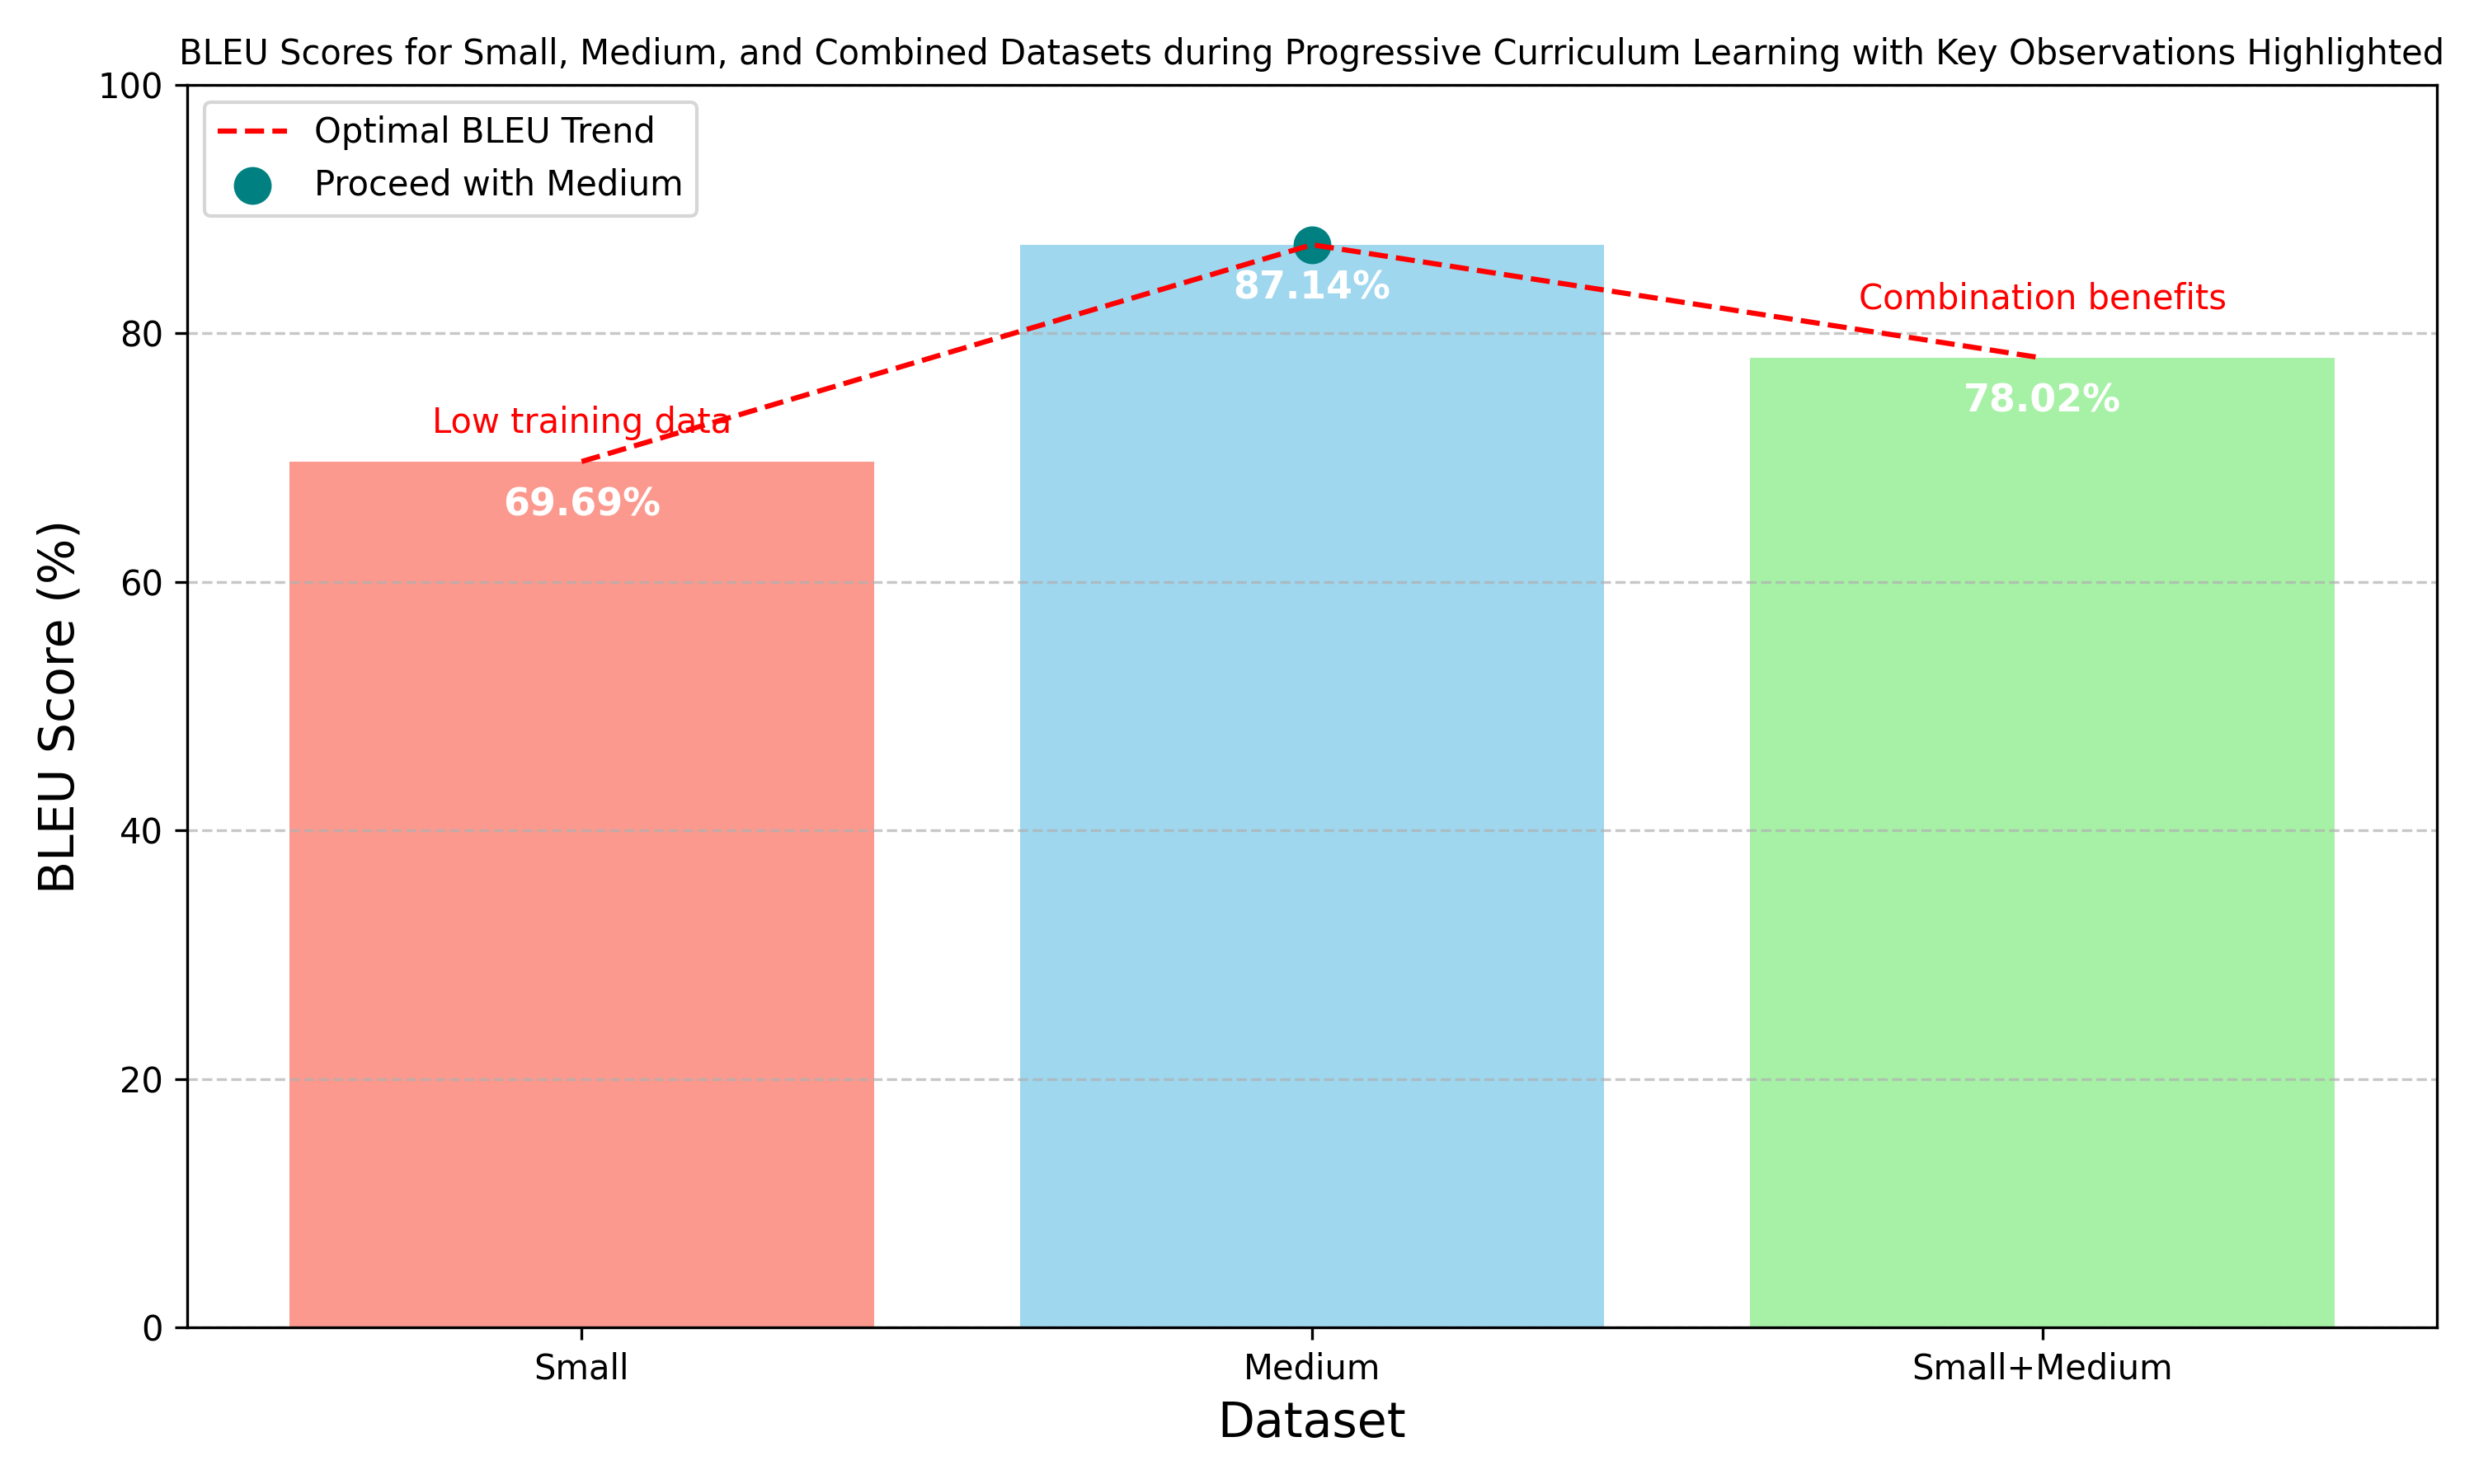
CL for Bug Fixing
BLEU Score
@AntonioMastro2
Notes:
is an approach where the model is provided with examples of input-output pairs or task descriptions directly within the input context (the prompt) without altering the model’s weights through traditional training or gradient updates.
• Key Idea: Instead of fine-tuning a pre-trained model for a specific task, you simply provide a set of instructions or demonstrations (examples of inputs and outputs) in the same prompt. The model then generalizes this “on the fly” to perform the given task.
• Example: Suppose you’re automating a bug-fixing task. You can input several examples of buggy code alongside the correct fixes in the prompt, and the model will infer how to fix new, unseen code based on these in-context examples.
• Efficiency: Since the model isn’t updated during this process (no backpropagation or learning in the traditional sense), you can use a pre-trained model across various tasks without the need for task-specific retraining.

Slide 9
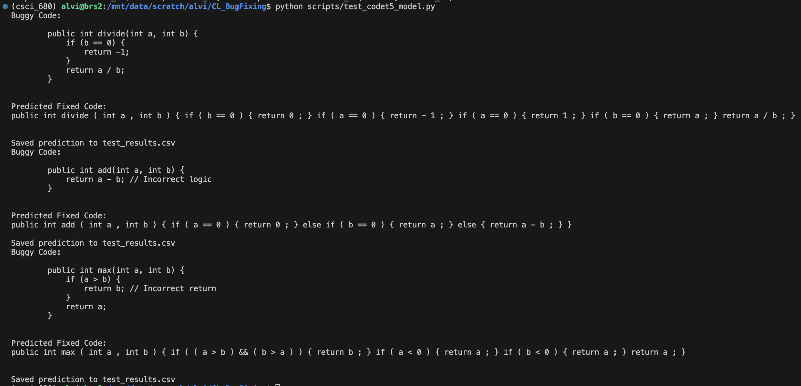
CL for Bug Fixing
BLEU Score
illogical & unnecessary
illogical & unnecessary
@AntonioMastro2
Notes:
is an approach where the model is provided with examples of input-output pairs or task descriptions directly within the input context (the prompt) without altering the model’s weights through traditional training or gradient updates.
• Key Idea: Instead of fine-tuning a pre-trained model for a specific task, you simply provide a set of instructions or demonstrations (examples of inputs and outputs) in the same prompt. The model then generalizes this “on the fly” to perform the given task.
• Example: Suppose you’re automating a bug-fixing task. You can input several examples of buggy code alongside the correct fixes in the prompt, and the model will infer how to fix new, unseen code based on these in-context examples.
• Efficiency: Since the model isn’t updated during this process (no backpropagation or learning in the traditional sense), you can use a pre-trained model across various tasks without the need for task-specific retraining.

Slide 10
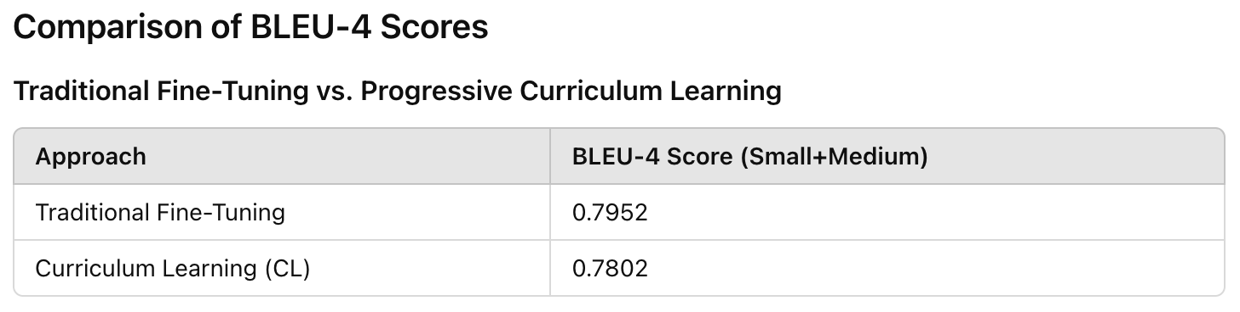
CL for Bug Fixing
BLEU Score
Optimize Batch Structuring
Add Auxiliary Objectives
Experiment with Batch Size
Improve Model Configuration
@AntonioMastro2
Notes:
is an approach where the model is provided with examples of input-output pairs or task descriptions directly within the input context (the prompt) without altering the model’s weights through traditional training or gradient updates.
• Key Idea: Instead of fine-tuning a pre-trained model for a specific task, you simply provide a set of instructions or demonstrations (examples of inputs and outputs) in the same prompt. The model then generalizes this “on the fly” to perform the given task.
• Example: Suppose you’re automating a bug-fixing task. You can input several examples of buggy code alongside the correct fixes in the prompt, and the model will infer how to fix new, unseen code based on these in-context examples.
• Efficiency: Since the model isn’t updated during this process (no backpropagation or learning in the traditional sense), you can use a pre-trained model across various tasks without the need for task-specific retraining.

