Slide 1
Shell Bootcamp 2024 3 Reflections for Week #2
Alvia Hussain
Date : 06-Sep-2024

Slide 2

About Me
If it doesn’t challenge you,
it doesn’t change you
Please share an image / visual that best represents you

Slide 3

My learnings from this week!

Slide 4
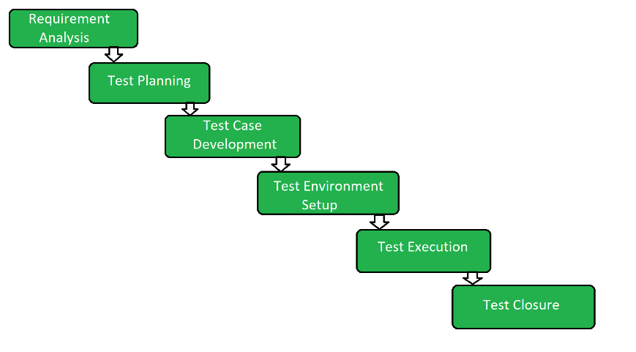
Learning 1 | My takeaways
Key Learnings: Software Testing & DevOps
STLC vs SDLC and its roles
Software failures
Phases of STLC and bug triage
Unit, integration, regression, functional tests
ESM (Enterprise Systems Management)
DevOps lifecycle and its importance
CI vs CD, DevOps Principles
DevOps benefits and tools
[Add a graphic that provides evidence of what you learned]

Slide 5
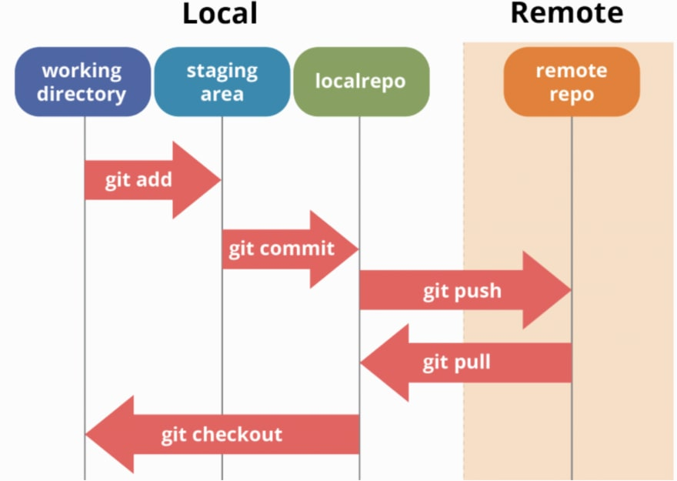
Learning 2 | My takeaways
Key Learnings: GitHub & Cloud
GitHub actions, components and its benefits
GitHub events, jobs, runners, workflow, events
YAML syntax
Secrets and environment variables
Building pipelines and its advantages
Cloud Computing, Architecture & Benefits
SaaS, PaaS, IaaS
Cloud Deployment Models
[Add a graphic that provides evidence of what you learned]

Slide 6

Learning 3 | My takeaways
Key Learnings: Cloud & DBMS
Azure AD, VM and networking
Cloud Scalability and elasticity
IAC approaches: Declarative vs Imperative
DBMS, PostgreSQL vs SQL
Types of databases
DDL, DML, DQL, DCL, TCL
Primary, Secondary and Foreign Key, Joins
Normalization and its types
[Add a graphic that provides evidence of what you learned]

Slide 7

Relevance of learnings for my organization

Slide 8
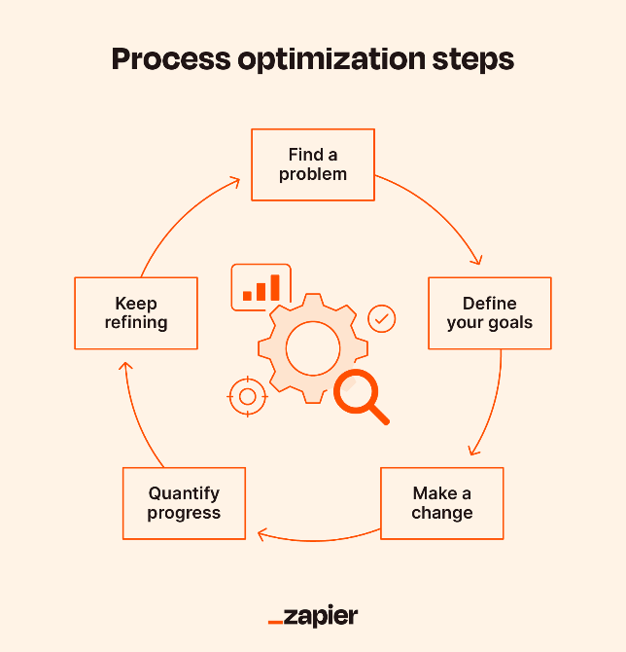
Learning 1 | Relevance for Shell
Enhanced Quality Assurance: Reduces software failures, improves product quality.
Efficient Bug Management: Systematic defect identification and resolution.
Comprehensive Testing: Validates software across different scenarios.
Optimized IT Operations: Enhances efficiency, reduces downtime.
Streamlined Development and Deployment: Accelerates release cycles, fosters team collaboration.

Slide 9
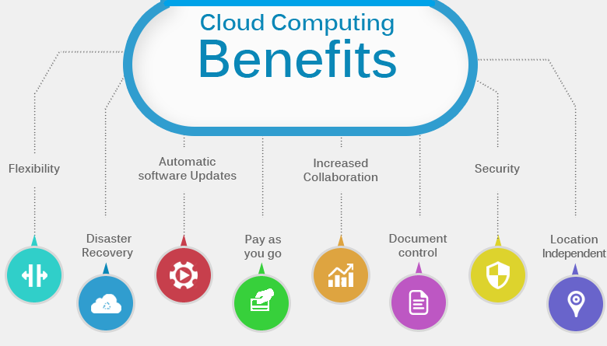
Learning 2 | Relevance for Shell
GitHub Actions: Automates workflows, enhances productivity.
GitHub Events: Triggers actions, manages workflows.
YAML Syntax: Defines workflows, easy configuration.
Secrets and Environment Variables: Secures sensitive data.
Building Pipelines: Streamlines development, improves efficiency.
Cloud Computing: Scalable resources eliminate the need for in house architecture

Slide 10
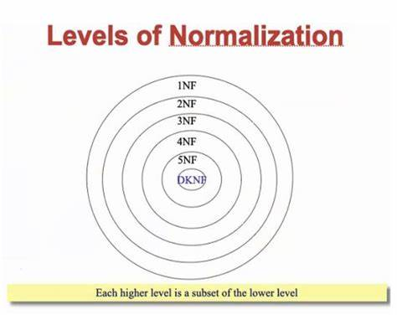
Learning 3 | Relevance for Shell
Azure AD, VM, Networking: Manages identities, virtual machines, and networks.
Cloud Scalability and Elasticity: Adapts resources to demand.
DDL, DML, DQL, DCL, TCL: Database operation commands.
Keys and Joins: Relational database concepts for logical querying
Normalization removes redundancy in databases

Slide 11

Challenges in implementing learning

Slide 12
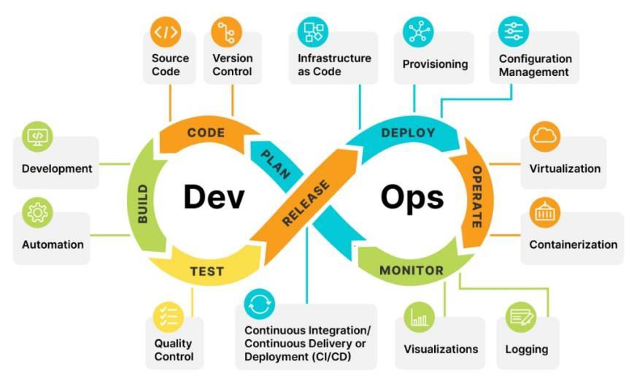
Challenge faced while implementing Learning 1
Complex Integration: Integrating STLC with SDLC can be intricate.
Solution: Use detailed documentation and collaboration tools.
Tool Proficiency: Mastering diverse DevOps tools requires time and practice.
Solution: Provide comprehensive training and hands-on workshops.
Continuous Adaptation: Keeping up with evolving DevOps practices and technologies.
Solution: Encourage continuous learning and regular updates.

Slide 13
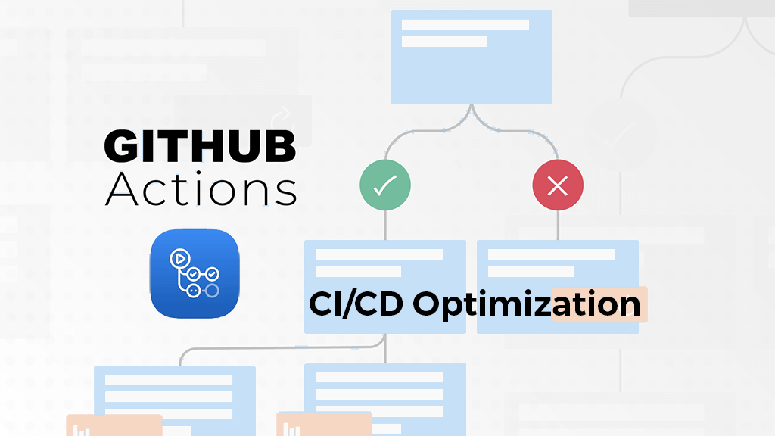
Challenge faced while implementing Learning 2
Configuration Complexity: Setting up GitHub Actions and workflows can be intricate.
Solution: Utilize templates and community resources for guidance.
Security Management: Handling secrets and environment variables securely.
Solution: Implement robust security policies and regular audits.
Cloud Integration: Navigating various cloud services and deployment models.
Solution: Leverage cloud provider documentation and support services.

Slide 14
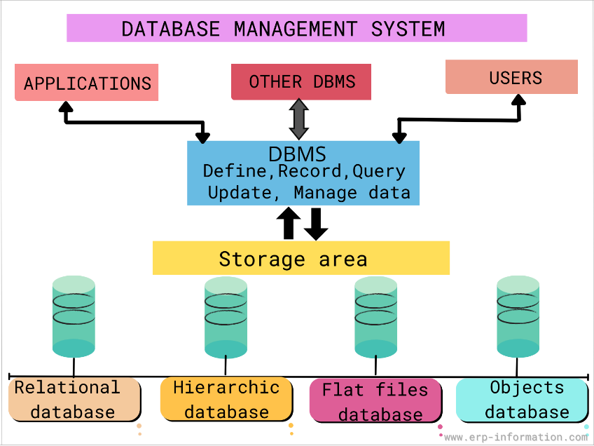
Challenge faced while implementing Learning 3
Complex Configurations: Setting up Azure AD, VMs, and networking.
Solution: Follow best practices and use automation tools.
Database Management: Understanding various database types and operations.
Solution: Provide targeted training and use comprehensive documentation.
Scalability Issues: Implementing cloud scalability and elasticity effectively.
Solution: Use scalable architecture patterns and performance monitoring tools.

Slide 15

Action Plan

Slide 16
My Action Plan for this Week
Actions
Timeline
Status
Keep learning on the given topics and prepare for next week
Brush up on the given topics over the weekend
Status of the same by the end of the week

Slide 17

Learning is also Fun!

Slide 18
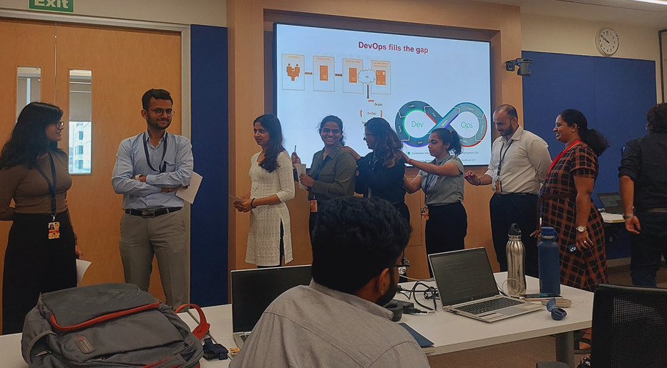
Learning is also Fun!
This activity demonstrates the power of communication and miscommunication.
Message sent from one end is received by multiple people in between to receive the final message which could be distorted due to miscommunication in between.

Slide 19

Summary
Enhanced Efficiency: Streamlined workflows and improved productivity through DevOps, GitHub, and cloud practices.
Improved Quality: Comprehensive testing and effective bug management ensure reliable software.
Scalability and Security: Leveraging cloud services and secure practices enhances scalability and data protection.
Revise core topics like DBMS, OS, etc.

Slide 20
Thank You

