Slide 1
Tuberculosis (TB) Detection from Chest X-ray Images

Slide 2
Introduction
Tuberculosis is a treacherous disease. It is one of the top 10 causes of death. Our goal is to extract the features of the lung and classify them whether they are normal or abnormal.
After showing the result, We will give proper guideline to the patients how they should act.

Slide 3
Methodology
Tuberculosis (TB) is a disease caused when a bacteria called Mycobacterium tuberculosis attack the lungs.
The chest X-ray (CXR) images of a tuberculosis infected patients exhibit unusual characteristics like irregular lung size, shape, structure and complex textures etc.

Slide 4
Problem Overview
Patients do not know the symptoms of Tuberculosis.
For financial reasons some patients don’t go consultants after testing.
Sometimes there are checking errors in observing TB symptoms.
Less awareness about TB and how destroy a Life.
We will take Chest-X-ray from patients, extract the features of the lung and classify them TB or not TB

Slide 5
Key Questions
How the classification of Tb will be done?
What feature will be extracted?
What impact will it have on society?

Slide 6
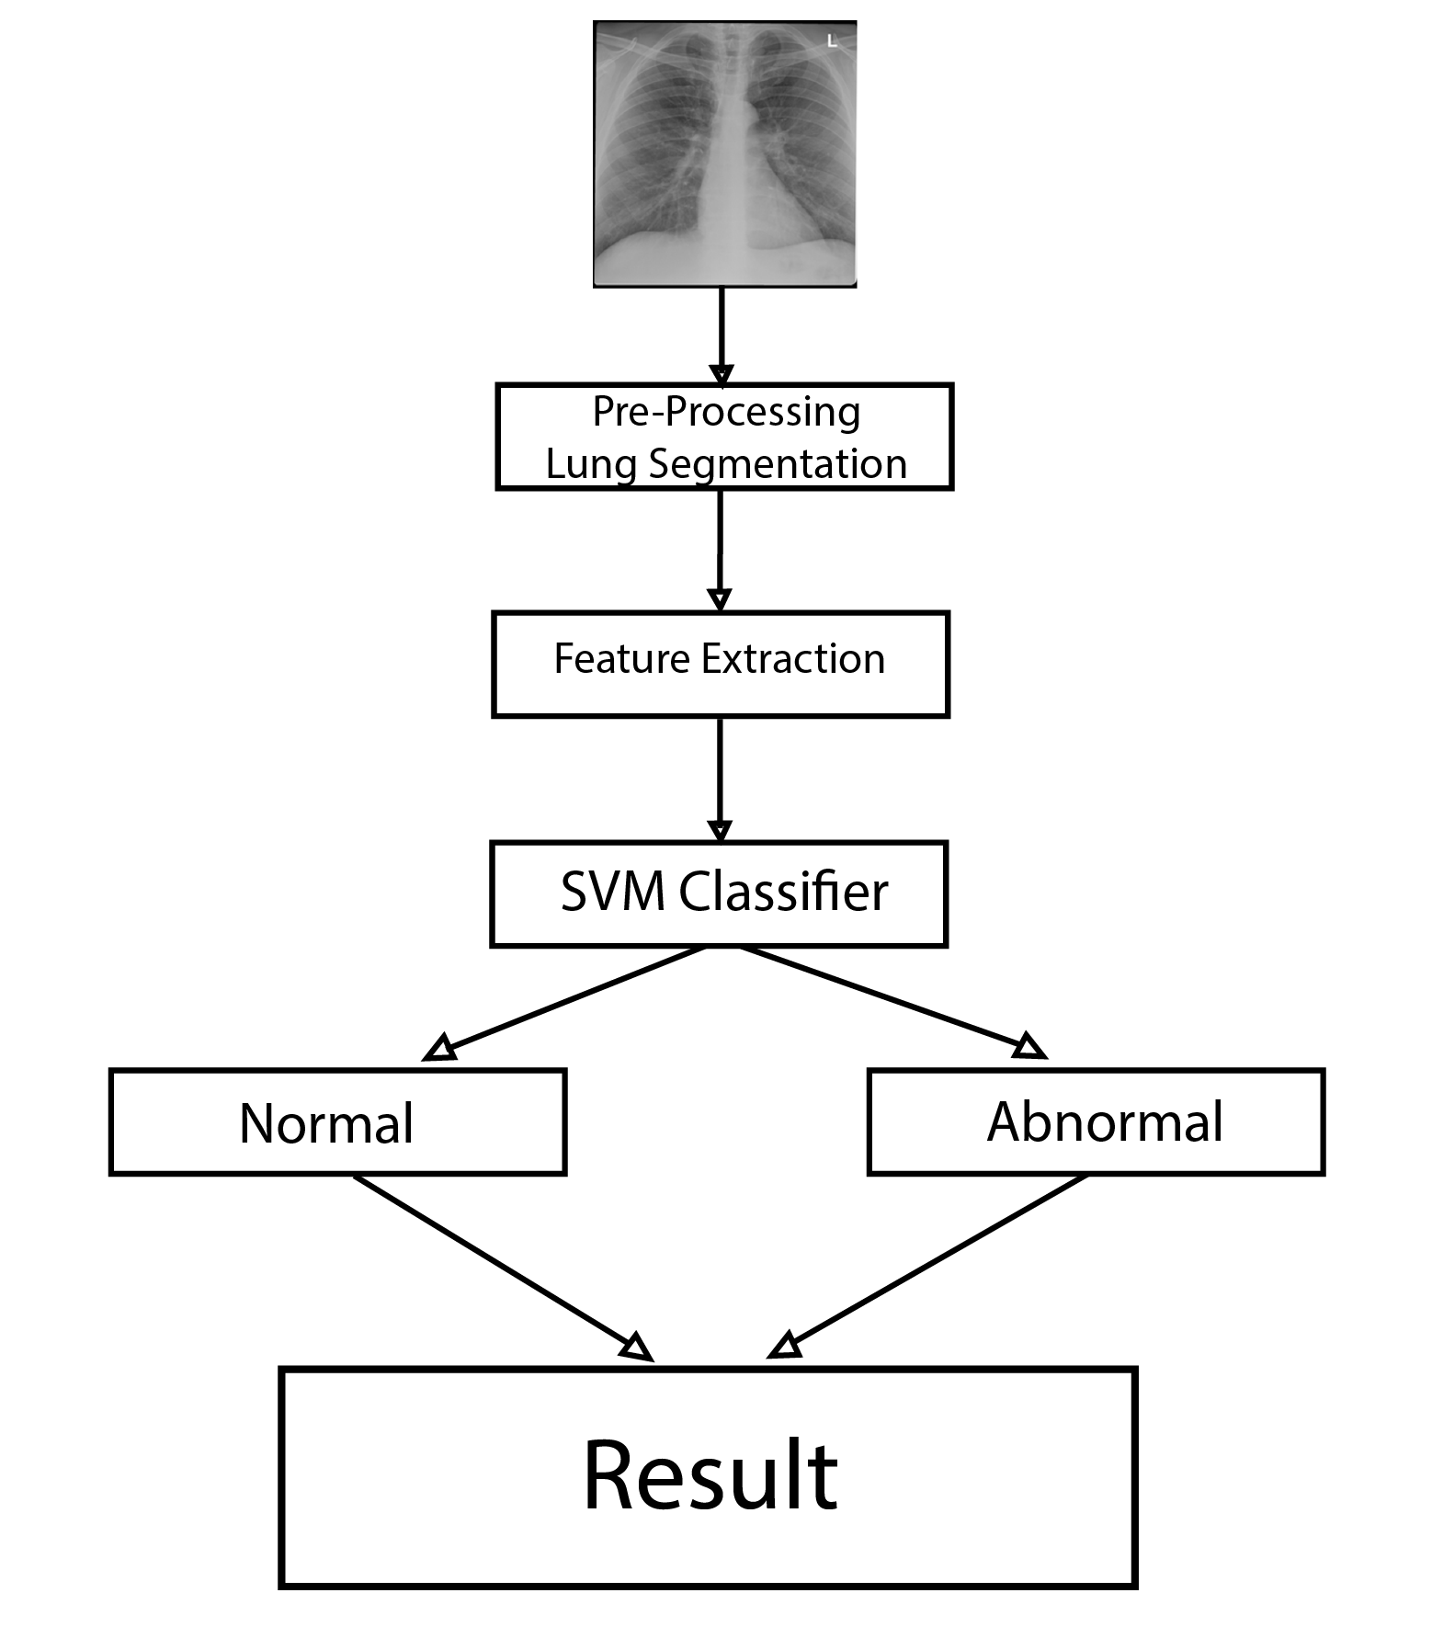
Proposed Solutions
We will pre-process CXR images and segment the lungs from the whole X-ray images.
From the segmented lungs, we will extract the features using convolutional neural network (CNN).
The SVM classifier will classify whether the lung is normal or abnormal.

Slide 7
Dataset
https://www.kaggle.com/tawsifurrahman/tuberculosis-tb-chest-xray-dataset
The dataset available at the above link contains 3,500 normal CXR images and 700 tuberculosis CXR images. An additional 2,800 tuberculosis images are also accessible from a link provided there.
We will use 90% of the available CXR images for the training purpose, and 10% of them for the test purpose.

Slide 8
Importance of the Project
Financial reason and lack of awareness, People tend to neglect the reason of TB. Some times mistook for other disease. Our goal is to make TB screening hassle free.

Slide 9
Communal Impact
TB screening will be much faster. People will know the difference between TB and other diseases. Patients will know the effect of TB and what could happen in the further future, They will be provided with a proper guideline.

