Slide 1
ECE 313 • Course Project
Impulse Noise Interpolation for Images
Chung Yu, Zahin Zaman ECE 313 – Digital Signal Processing Fall 2021 Department of Electrical & Computer Engineering

Slide 2
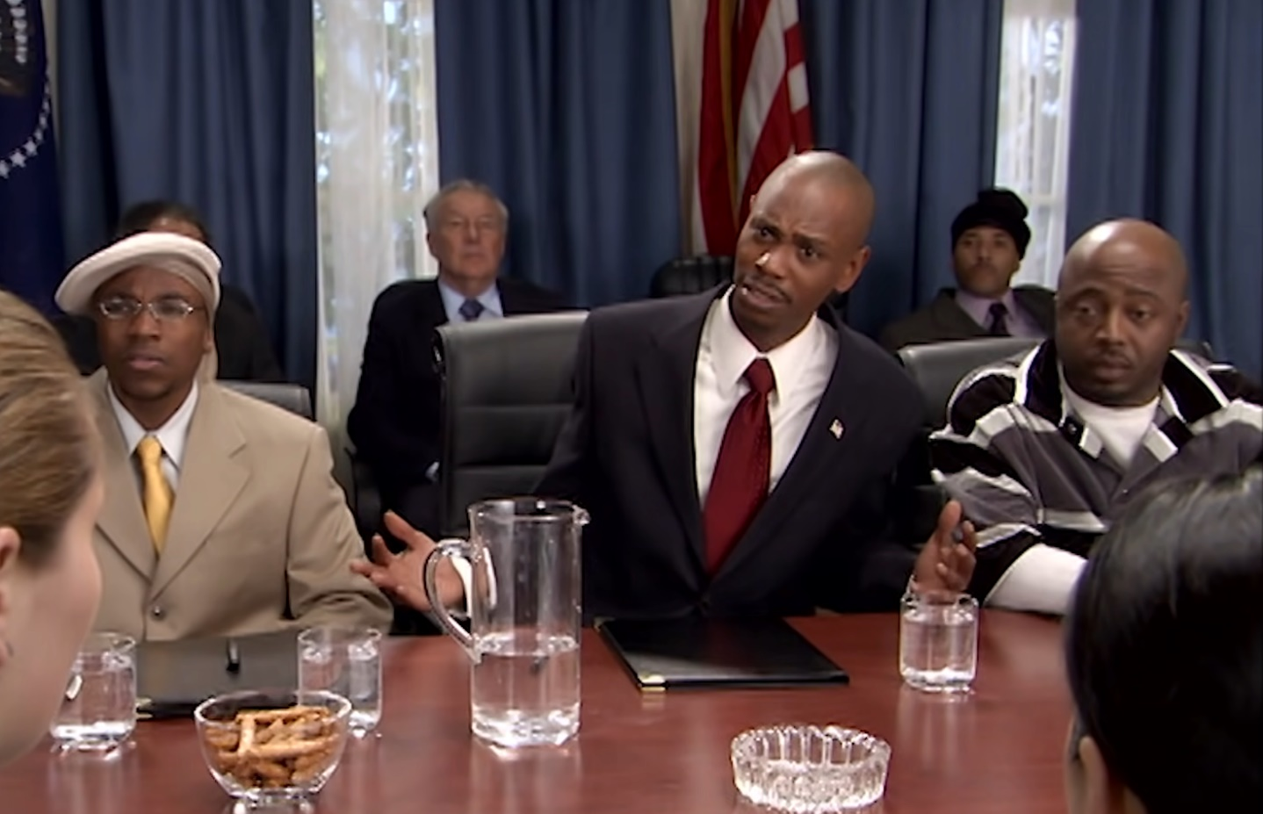
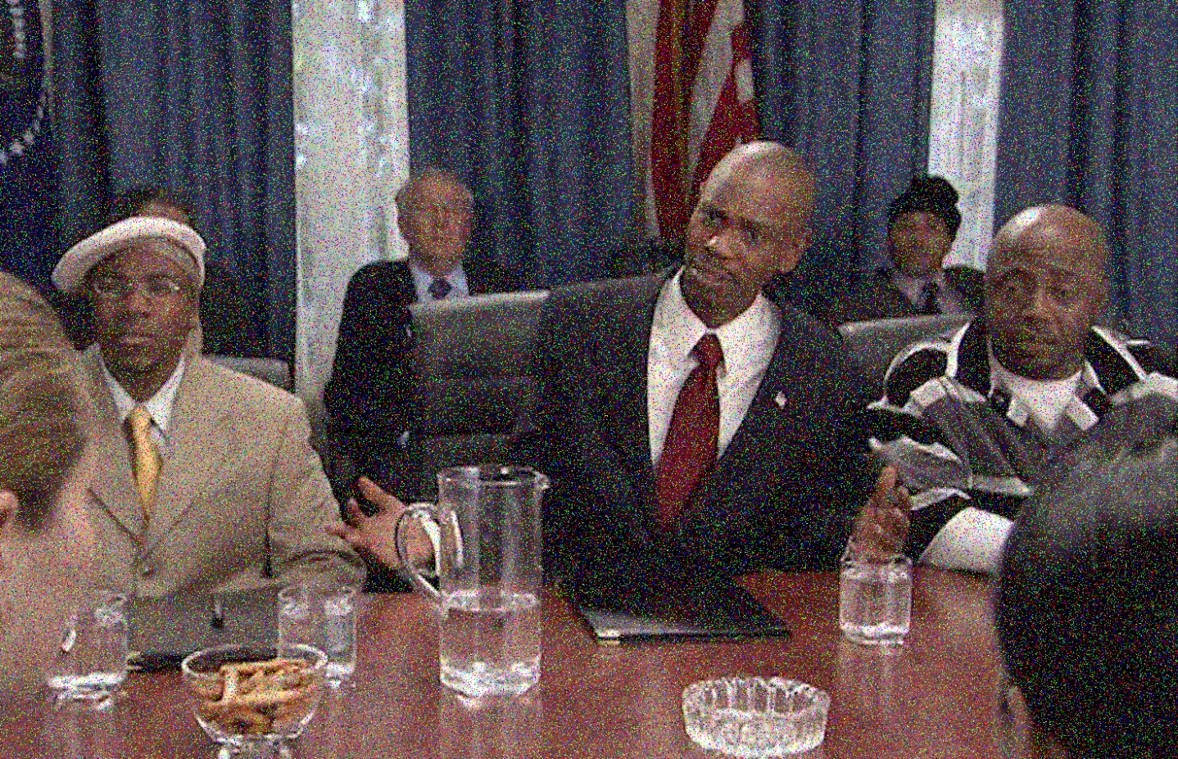
Problem Statement
What is impulse noise?
Impulse noise is described as the category of noise that is undesired and of relatively short duration, often caused by switching noise or adverse channel environments in communication.

Slide 3
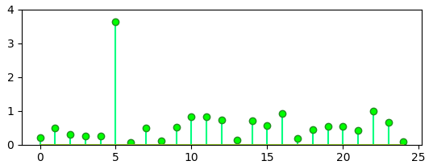
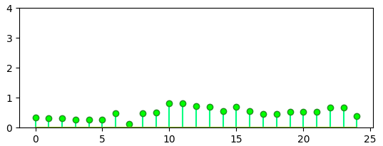
Other Solutions
Median filter
Most go-to solution for impulsive noise removal is median filtering
Involves replacing every pixel with the median of its surrounding pixels
Downside is the loss of edges and texture of the image
There is a need for a method that reduces noise while also preserving edges and details
Median filter with n = 3

Slide 4
Solution
In this project we reproduce the methods and results of research paper titled Impulsive Noise Removal Using Interpolation Technique in Color Images, authored by professors Yasuhide Wakabayashi and Akira Taguchi.
The solution outlined involves two steps:
Impulsive Noise Detection Noisy pixels are detected using an appropriate threshold value
Noise Interpolation Noisy pixels identified are replaced using interpolation of surrounding pixels in all RGB channels of image

Slide 5
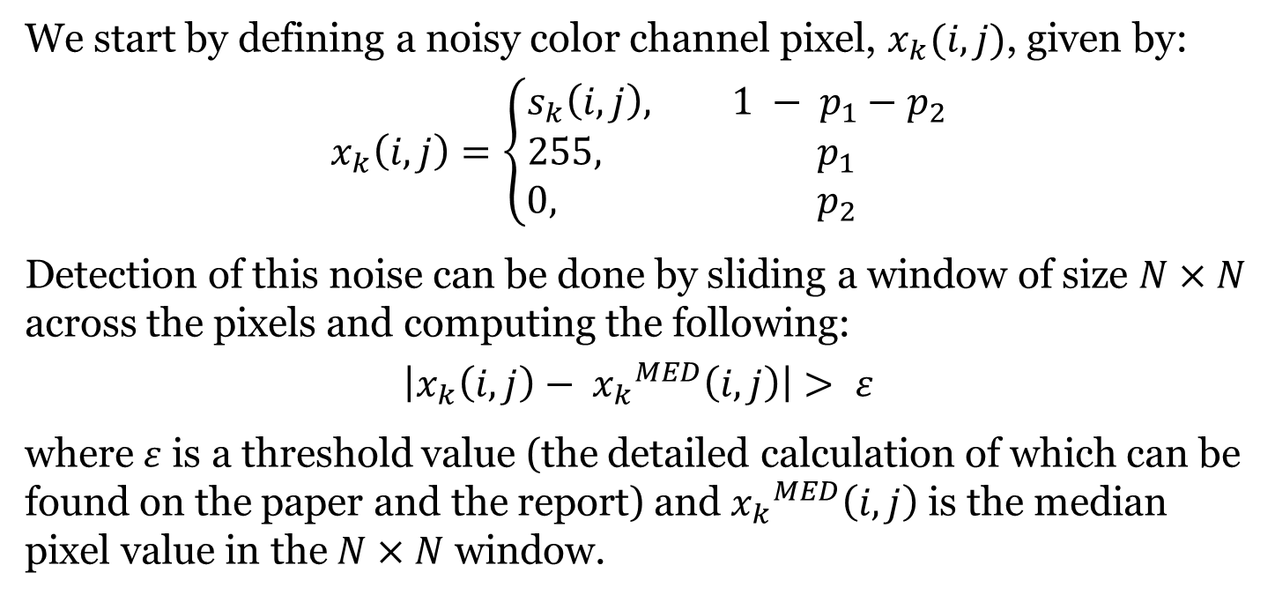
Noise Detection: Theory
We start by defining a noisy color channel pixel, $x_{k}(i, j)$, given by:
$$x_{k}\left(i, j\right)=\left\{\begin{aligned}s_{k}\left(i, j\right), 1 − p_{1}−p_{2} \\ 255, p_{1 } \\ 0, p_{2 }\end{aligned}\right.$$
Detection of this noise can be done by sliding a window of size $N×N$ across the pixels and computing the following:
$$\left|x_{k}\left(i, j\right)− {x_{k}}^{MED}\left(i, j\right)\right|> ε$$
where $ε$ is a threshold value (the detailed calculation of which can be found on the paper and the report) and ${x_{k}}^{MED}\left(i, j\right)$ is the median pixel value in the $N×N$ window.

Slide 6
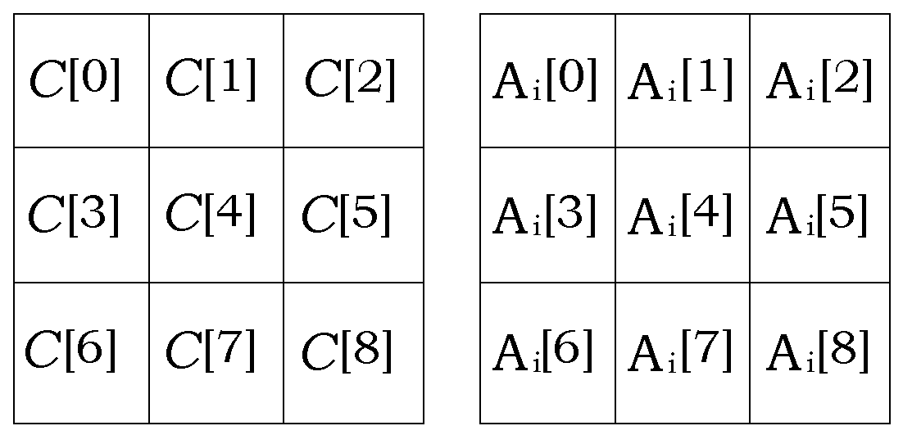
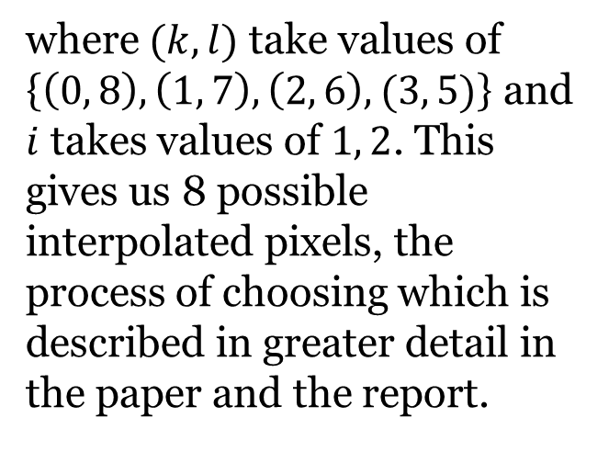
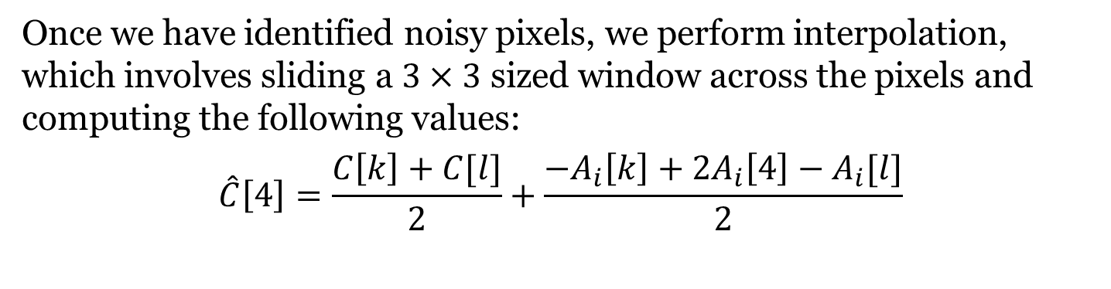
Noise Interpolation: Theory
Once we have identified noisy pixels, we perform interpolation, which involves sliding a $3×3$ sized window across the pixels and computing the following values:
$$\hat{C}\left[4\right]=\frac{C\left[k\right]+C[l]}{2}+\frac{{−A}_{i}\left[k\right]+2A_{i}\left[4\right]−A_{i}[l]}{2}$$
where $(k, l)$ take values of $\left\{\left(0, 8\right), \left(1, 7\right), \left(2, 6\right), (3, 5)\right\}$ and $i$ takes values of $1, 2$. This gives us 8 possible interpolated pixels, the process of choosing which is described in greater detail in the paper and the report.

Slide 7
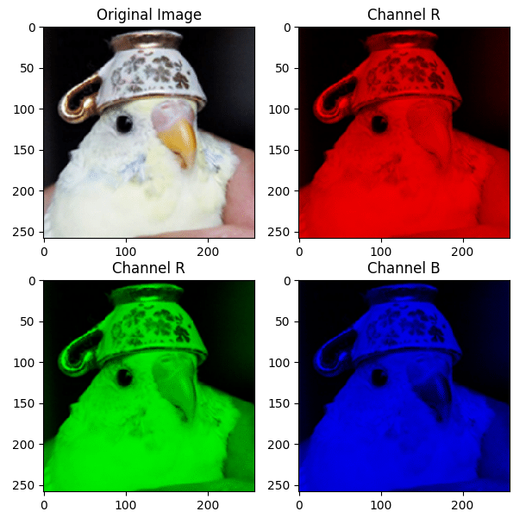

Noise Generation: Implementation

Slide 8
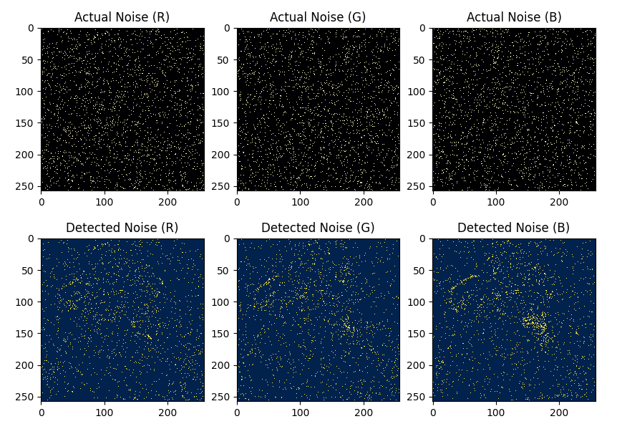
Noise Detection: Implementation

Slide 9

Noise Interpolation: Implementation

Slide 10
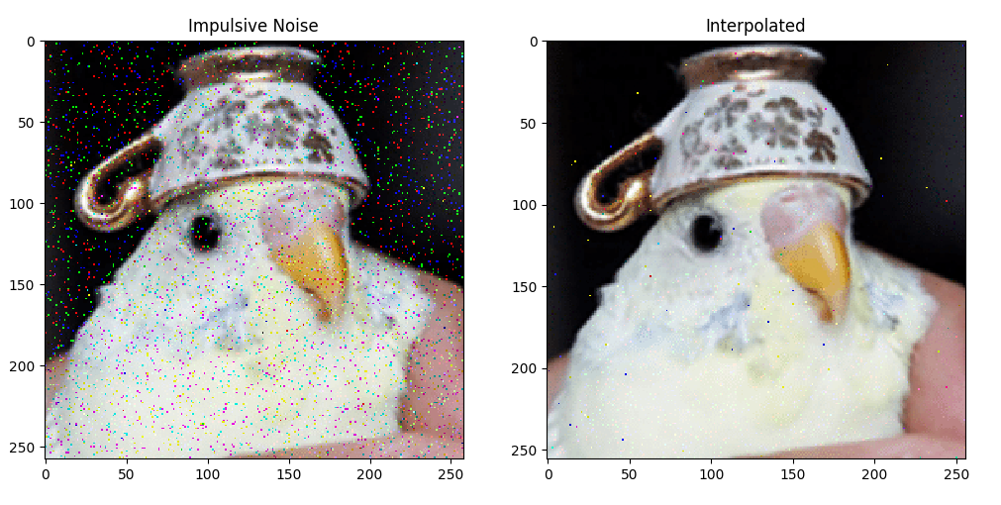
Performance
Normalized Mean-Squared Error Between Image Pixels
 | Red Channel | Green Channel | Blue Channel
Noisy & Original | 0.193763 | 0.199618 | 0.198139
Interpolated & Original | 0.040137 | 0.038811 | 0.043348

Slide 11
Limitations
It is, however, important to remember the context of these results, and identify limitations to this method:
The noise used in this project was salt-and-pepper noise, which involves noise that is sharp, and either very high or very low in value. If an image is affected by noise that can vary between a large range of values, this method may not be appropriate.
This method assumes correlation between the RGB channels of an image. If no such correlation exists for an image, this method will likely not perform well.

Slide 12
Resources
Github Repository: https://github.com/alvii147/ImageNoiseInterpolation
Source Code Documentation: https://alvii147.github.io/ImageNoiseInterpolation/build/html/utils.html
Project Report: https://alvii147.github.io/ImageNoiseInterpolation/report/ECE_313_Course_Project

Slide 13
References
Y. Wakabayashi, A. Taguchi. (2005, December). Impulsive Noise Removal Using Interpolation Technique in Color Images. Available https://ieeexplore.ieee.org/document/1595367
Fictspedia Wiki. (2012). Birb [Online]. Available https://fictspedia.fandom.com/wiki/Birb
D. Chappelle, N. Brennan. (2004, March). Chappelle’s Show (Season 2, Episode 8).

