Slide 1
GWAS Data & Sources for Mendelian Randomization

Slide 2
What is GWAS?
• Genome-Wide Association Studies (GWAS) identify SNPs associated with traits.
• Output: SNP, effect size (beta), standard error, p-value, etc.
• Key for Mendelian Randomization: genetic instruments from GWAS.

Slide 3
GWAS Output for MR
Relevant fields in summary statistics:
• SNP ID, effect allele, other allele
• Beta (effect size), SE, p-value
• Sample size, trait description

Slide 4
Requirements for MR
• Independent SNPs (IVs)
• Summary statistics for both exposure and outcome
• Harmonization potential between datasets
• Attention to: palindromic SNPs, genome build differences

Slide 5
Where to Find GWAS Data?
• GWAS Catalog (ebi.ac.uk/gwas)
• MR-Base / IEU OpenGWAS (gwas.mrcieu.ac.uk)

Slide 6
GWAS Catalog
• URL: https://www.ebi.ac.uk/gwas/
• Curated repository of published GWAS findings
• Limitation: may not provide full summary stats

Slide 7
MR-Base & IEU OpenGWAS
• URL: https://gwas.mrcieu.ac.uk/
• Contains >50,000 harmonized GWAS datasets
• API and R package support (ieugwasr)
• Integrated with TwoSampleMR for MR analysis

Slide 8
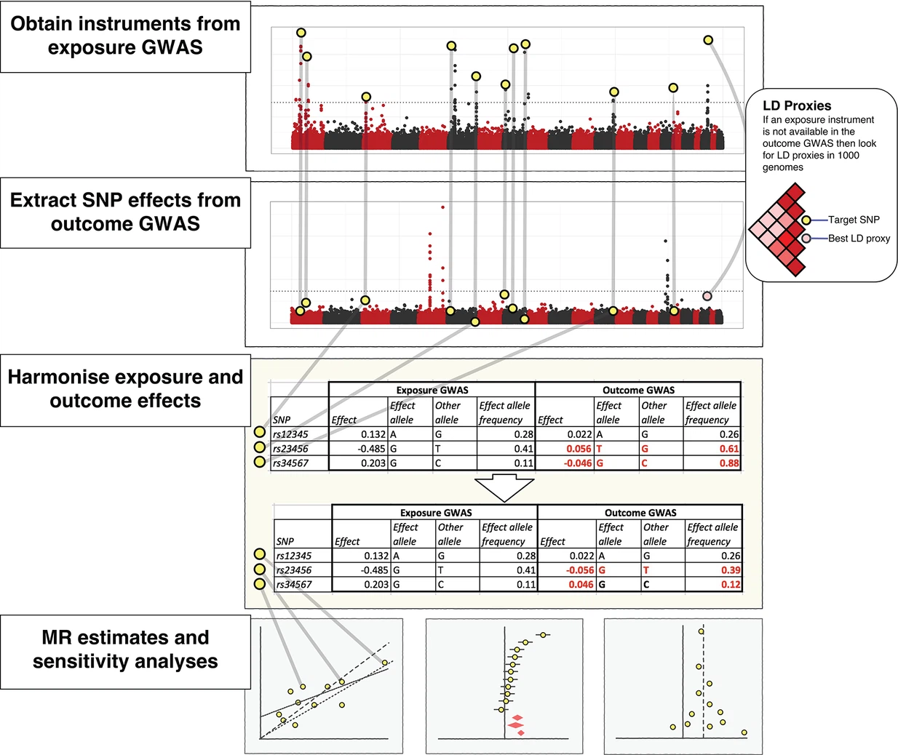

Slide 9
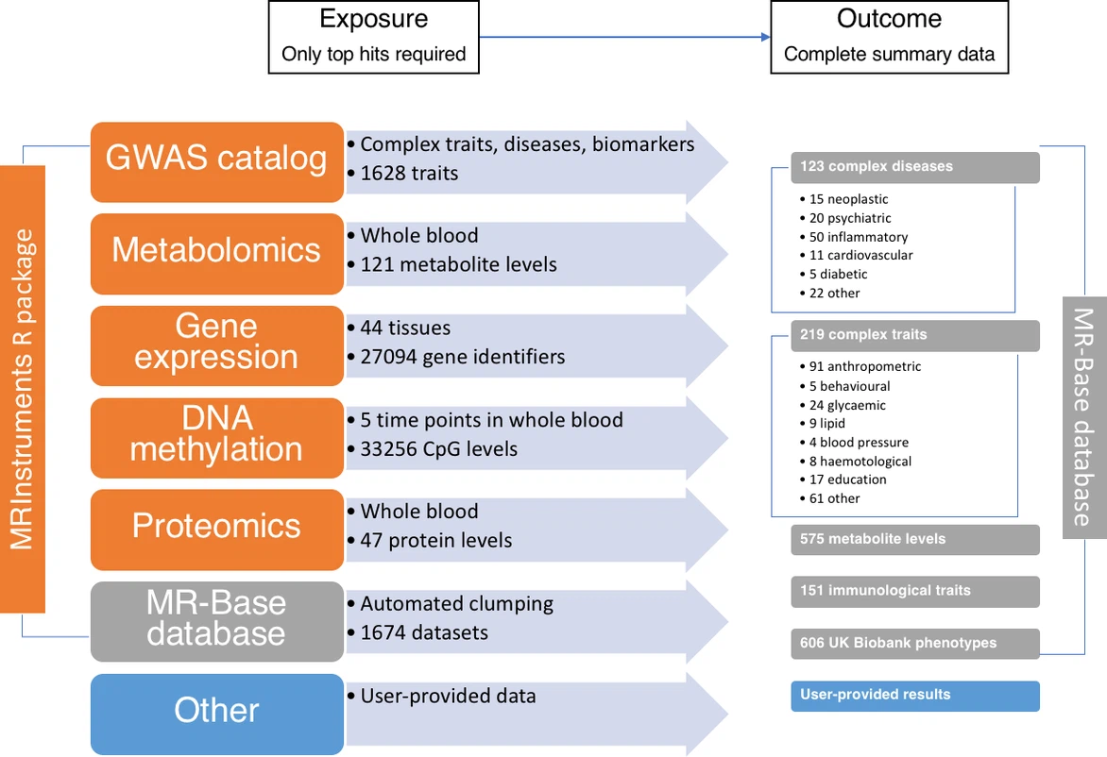

Slide 10
Choosing GWAS for MR
• Large sample size
• Clear phenotype definition
• Ancestry match with outcome
• No sample overlap (2-sample MR)
• Full summary statistics availability

Slide 11
Next: Hands-On Preview
What you’ll learn:
• Querying GWAS from different sources
• Instrument selection and clumping
• Harmonization and preparation for MR

