Slide 1

AI 2 Project
Happy Whale Species Classification
Prepared By : Team Outliers
Aman Pawar Alvin Vinod Pratik Mukherjee Ojas Kulkarni

Slide 2

Table of Contents :
1. Introduction to Dataset
2. Preprocessing Data
3. Overfitted Network
4. Regularized Network
5. Autoencoders (Compressing Data)
6. Getting Best Model
7. Model analysis using Saliency Maps and GradCAM
8. Model visualization using Tensorboard
9. Identification of individual ids (Transfer Learning using VGG16)
10. Conclusion
Mr. Hipster has organized a get together for whales and dolphins, but some mischievous whales and dolphins are there. Using your AI skills help Mr Hipster to find the mischievous whales and dolphins from the guests.

Slide 3
Introduction & Motivation to the Project :
Objectives: To classify various species of Whales and Dolphins based on their images.
Approach:
Start with overfitting a CNN model
Tune and experiment with the model architecture and add in regularization to obtain minimal loss
Visualize model's perception using Saliency maps and Grad cams
Finally, utilize pre-trained SOTA models to optimize for both performance and computation
Limitations:
Images in the dataset are naturally captured and often only portions like humps, dorsal fins, backs, heads and flanks are visible.
There are multiple images of the same individual, captured at different periods and angles.
This leaves us with minimal information for the classification task.

Slide 4
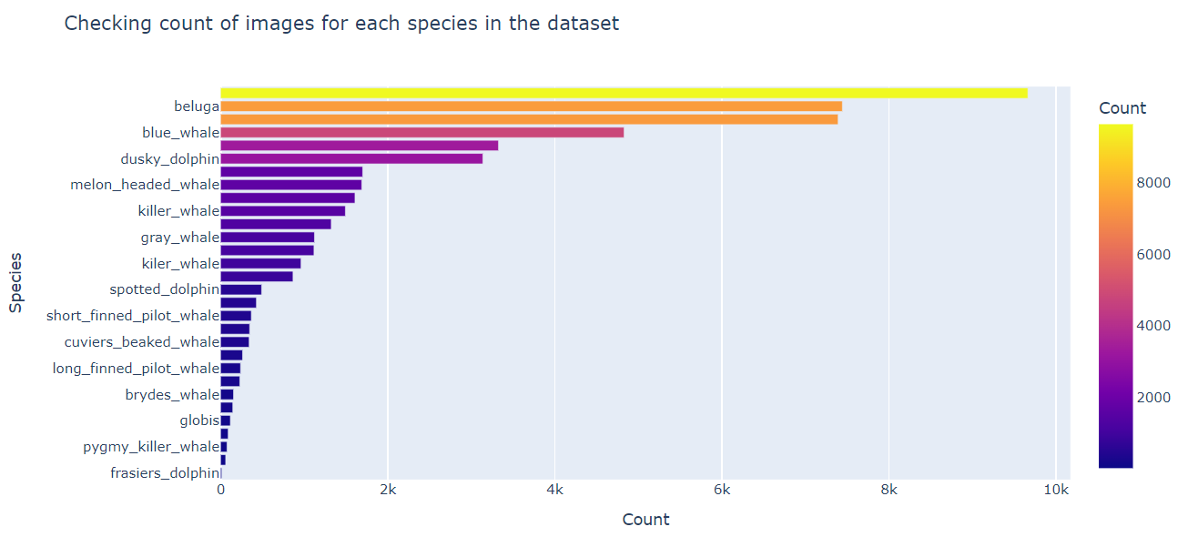
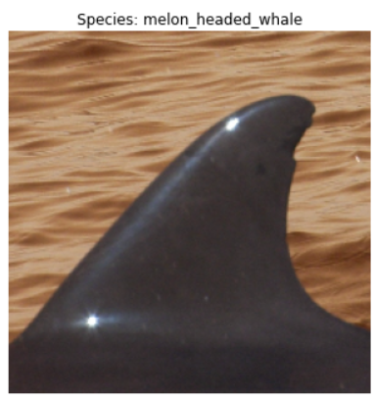
Introducing the Dataset :
Careful investigation of the dataset we come up with the following observation about the different species and their distribution in the dataset.

Slide 5
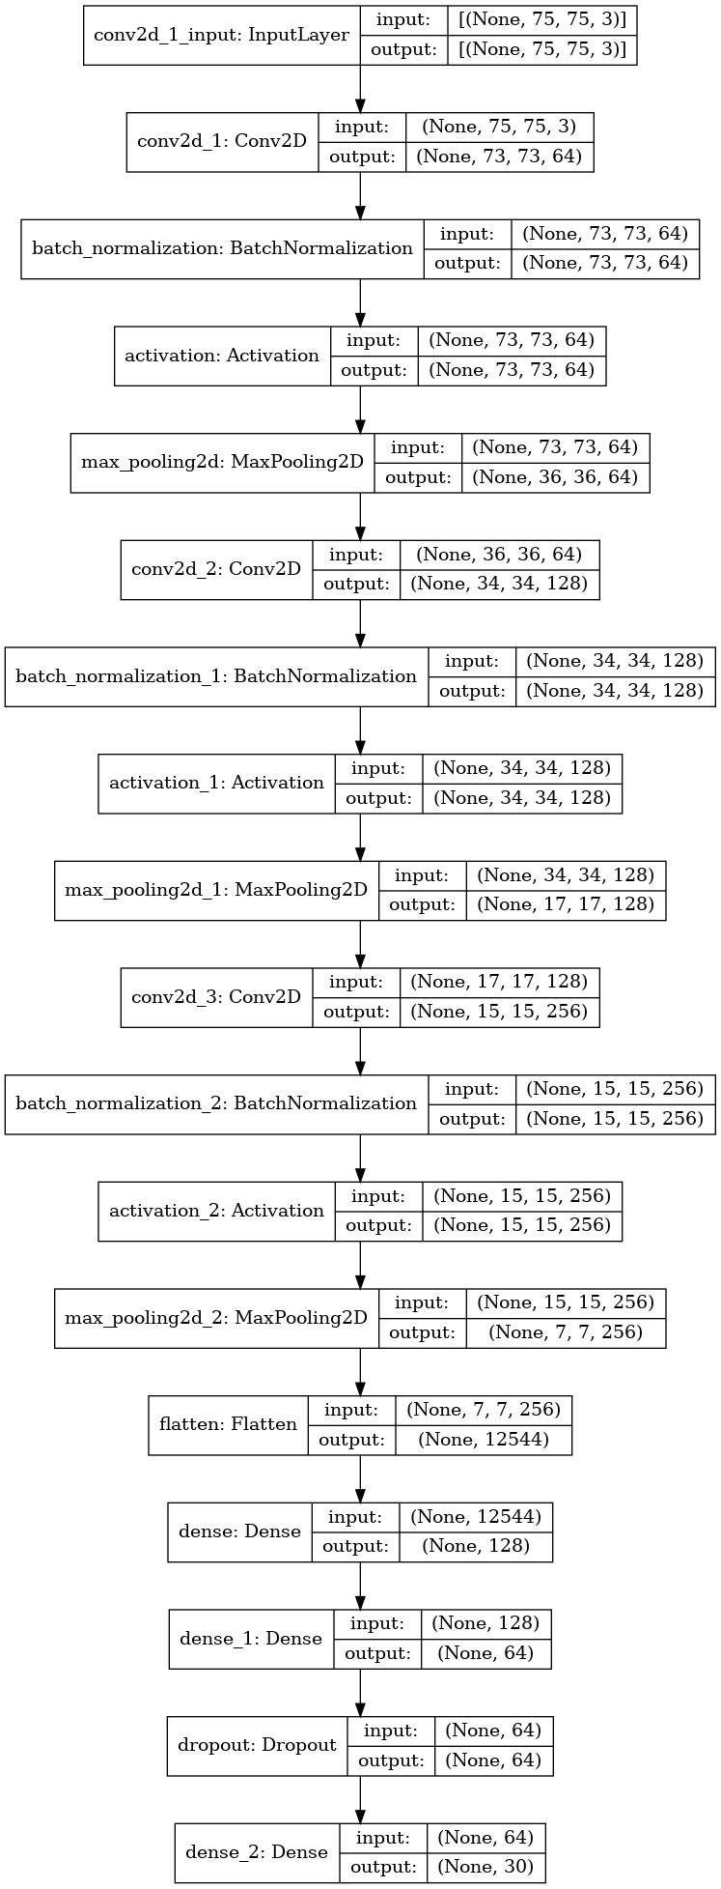
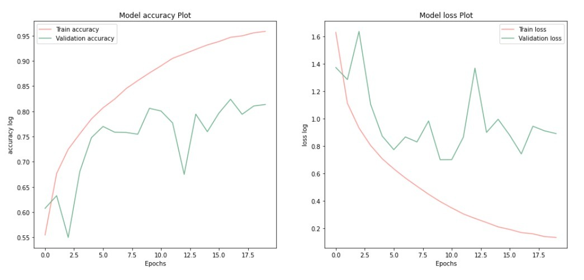
Making Neural Networks :
Best Model Architecture
Loss & Accuracy Plot
A
A

Slide 6
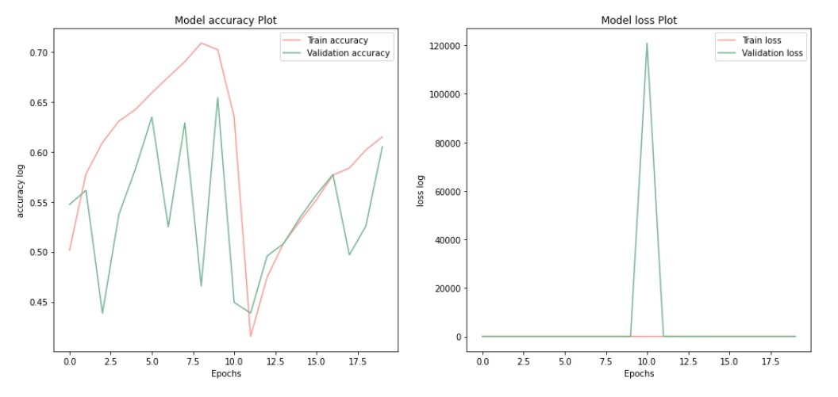
Auto Encoders :
We tried passing the image pool through an autoencoder to try and get a good latent space representation, and we then feed this representation into another CNN Model. The performance was at par with the regularized models at the end of 20 epochs of training.

Slide 7
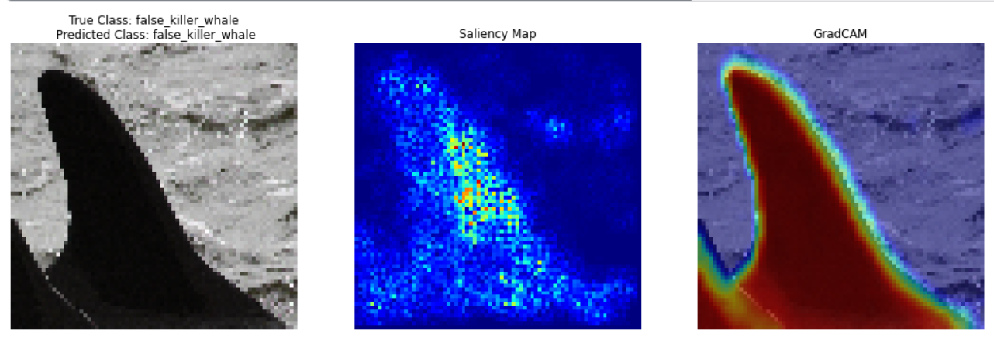
Model Visualizations using Saliency Maps, Gradcams
Based on the best model we made the necessary visualisations using saliency maps and gradcams to understand if the model is looking over the correct features and making the predictions

Slide 8
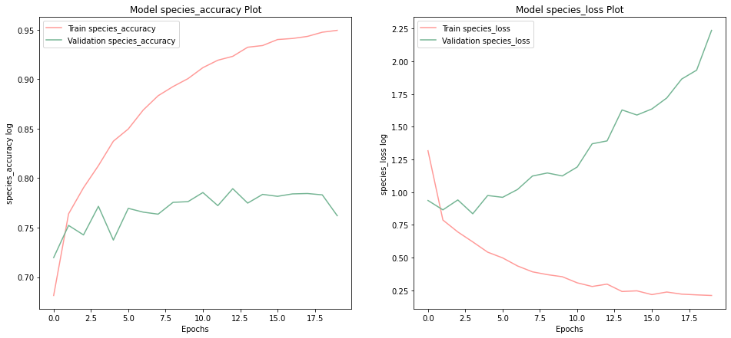
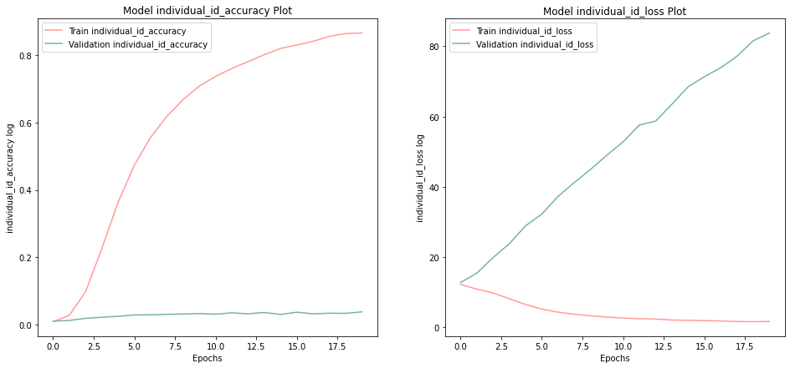
Identification of Individual Id’s using Transfer Learning:
For the purpose of Transfer Learning we have use VGG16 model, followed by dense layers having 1024 and 512 neurons The results of model prepared by Transfer Learning model was at par with other models and approaches discussed above.

Slide 9
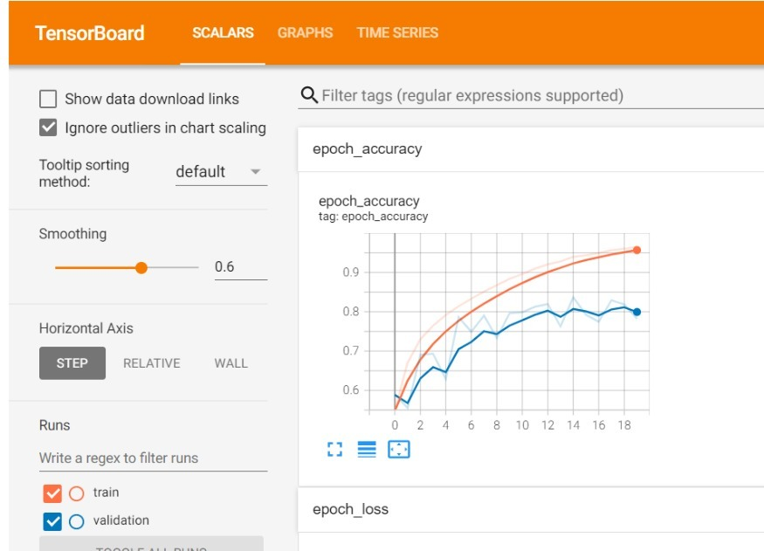
Conclusion :
Visualisation of best model accuracy
Metrics
Model | Overfitted | Regularized | Transfer Learning
Accuracy (validation) | 61% | 80% | 78%
Loss (Sparse Categorical Cross entropy) | 2.60 | 0.9 | 1.49

Slide 10

THANK-YOU
Team outliers is keen to know your feedback

