Slide 1
EESTECH Challenge 2020
Human Computer Interaction
Human Computer Interaction
09.10.2020

Slide 2
EESTECH Challenge 2020
Plant Monitoring
Plants require different care in terms of temperature, irrigation, nutrient content in the soil, etc.
“Plant Monitoring” deals with the automated monitoring and control of these and other parameters for healthy plant growth using sensor technology
Automated monitoring solutions for plants can be applicable both in the private context and in industrial environments.
Human Computer Interaction
09.10.2020

Slide 3







EESTECH Challenge 2020
Plant Monitoring
End devices with
plant monitoring application
Plant + different sensors

Slide 4
EESTECH Challenge 2020
Plant Monitoring
Develop a concept and a prototype for a product that supports the user in ideal plant care with the help of sensor technology!
Human Computer Interaction
09.10.2020

Slide 5
EESTECH Challenge 2020
Important steps to consider
Problem definition
Which problem should be solved with the help of your idea?
What is the exact context in which your product should be used?
Is your product intended for private or corporate use? …
Target group
Which target group does your product address?
What are the characteristics of this target group?
Requirements
What requirements should your product meet with regard to the user?
Prototype
Develop a prototype of your product based on the requirements that shows how the product works in detail (code required)
Human Computer Interaction
09.10.2020

Slide 6
EESTECH Challenge 2020
Hints & Tipps
On a conceptual level, think also about which sensors would be suitable for such an application
It can be helpful to draw wireframes / sketches of your idea (in Miro, Power Point etc.) before starting with the coding
For the implementation you can choose a programming language yourself
Other aspects you can consider
Do you want to make your solution scalable or is it tailored for single users?
Human Computer Interaction
09.10.2020

Slide 7
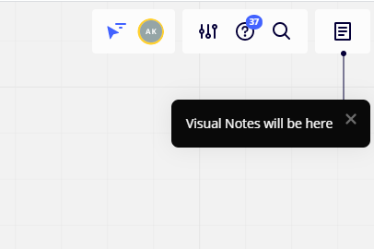
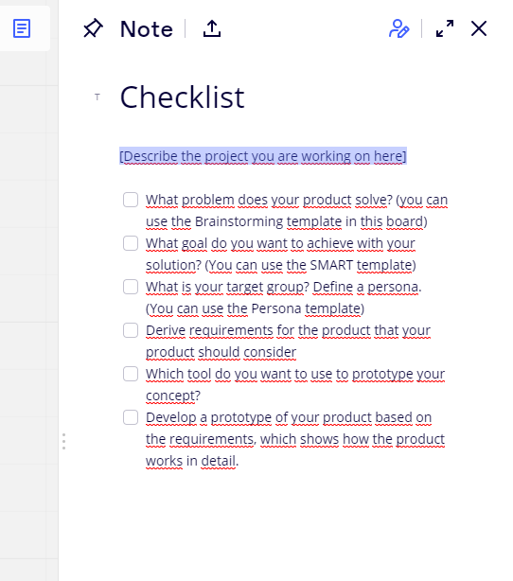
Also take a look at
Checklist in Miro
Templates in Miro
#questions-channel
#programming-tips channel

Slide 8
Question time …

Slide 9
Have fun and good luck!

