Slide 1

By Raffelberger Jungs

Slide 2
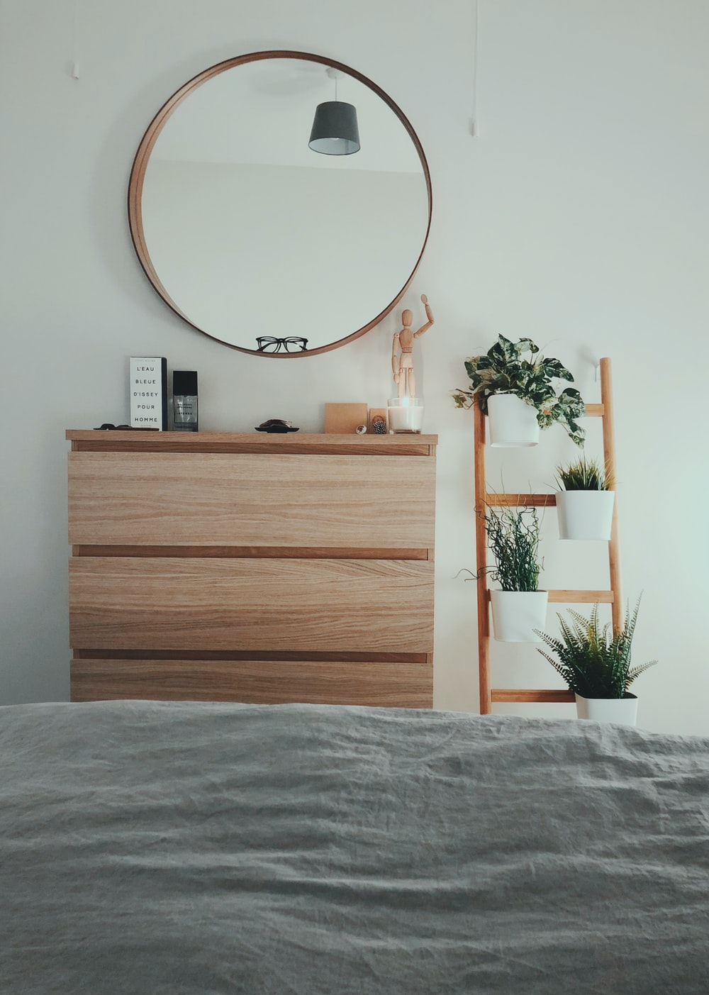


A Personal House Plant Monitoring App
For busy office workers
and students
Increase your plant healthiness
through monitoring various metrics

Slide 3



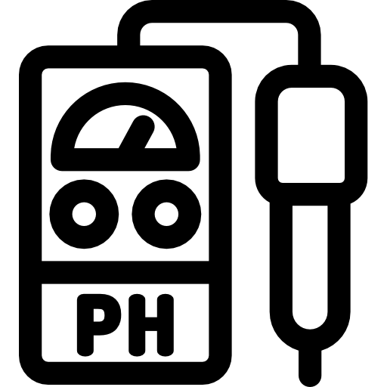
Sensors for Measurement
Soil Humidity
Luminance
Temperature
pH Level

Slide 4


Slide 5

gamification
/ˌɡeɪm.ɪ.fɪˈkeɪ.ʃən/
noun
the application of typical elements of game playing (e.g. point
scoring, competition with others, rules of play) to other
areas of activity, typically as an online marketing technique
to encourage engagement with a product or service.

Slide 6
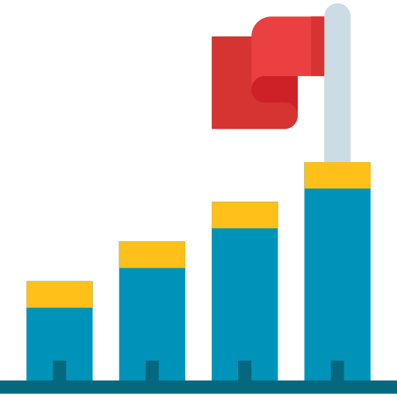


Experience Point and Level Progression
Login: +5 / day
Water Plant: +15/ plant per day
7 Days Streak: +50/ day
Sharing Pic to
Social Media: +20/ week
Not watering for 3 days: -25

Slide 7
Experience Point and Level Progression
Lvl 1: 15 exp
Lvl 5: 120 exp
Lvl X: 300 exp

Slide 8

How it works

Slide 9



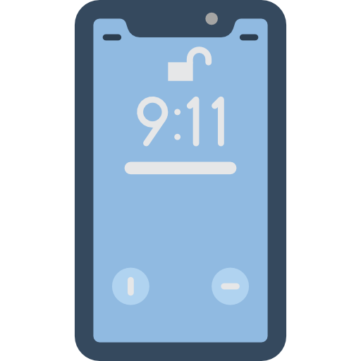
pH, Humidity,
Luminance
Request Data
Retrieve Data

Slide 10
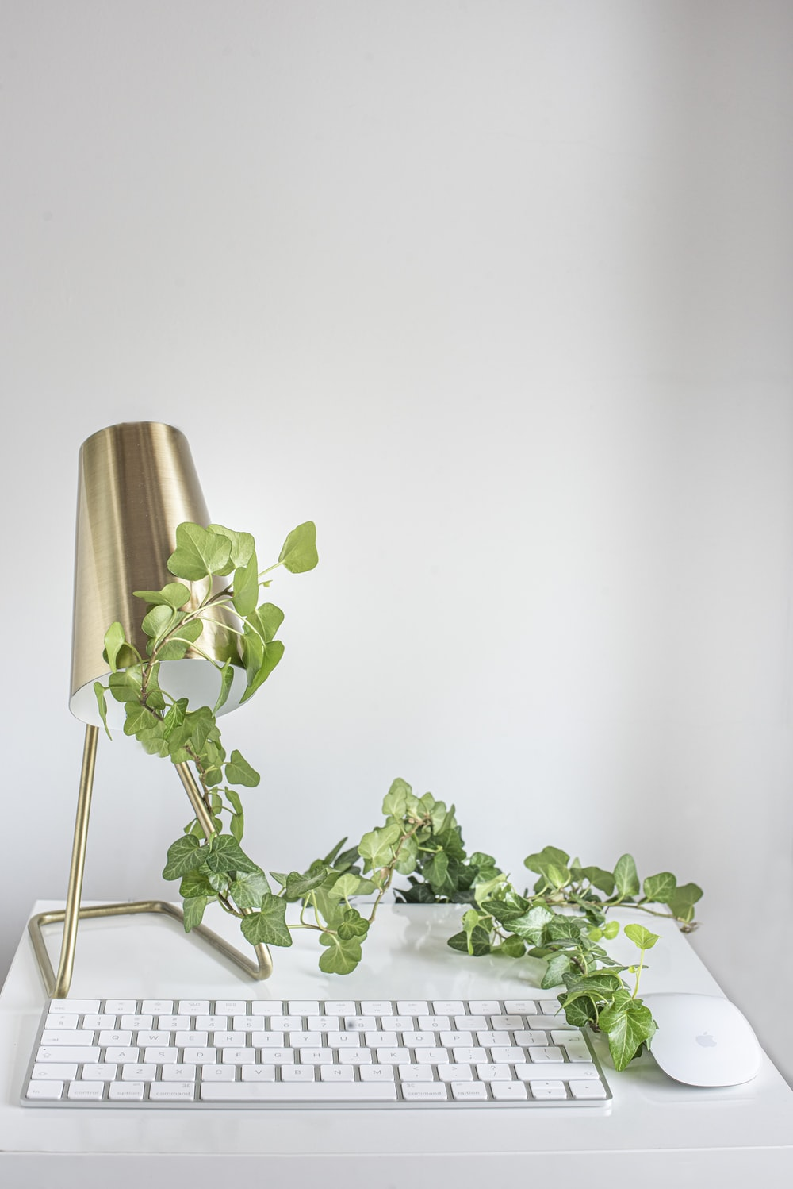
User Interface
Simple to use
Intuitive
Clean

Slide 11
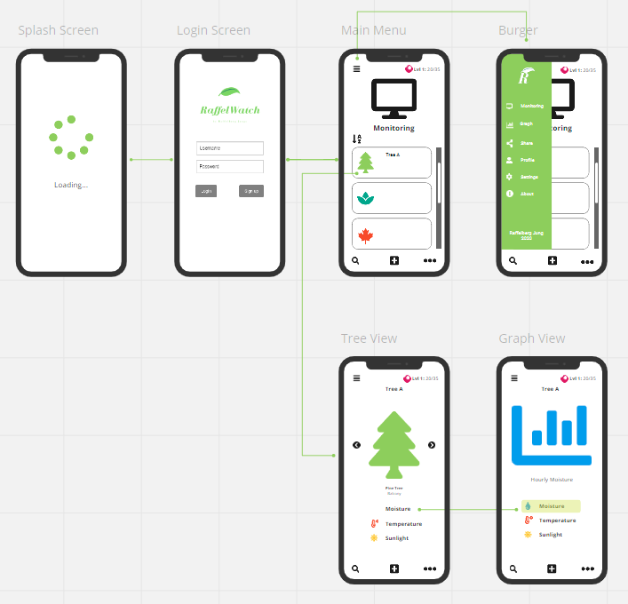
UI Workflow

Slide 12
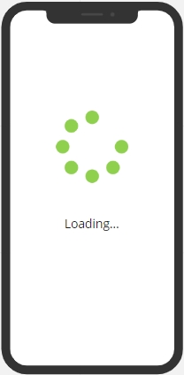
Splash Screen

Slide 13
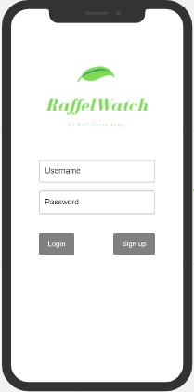
Login Screen

Slide 14
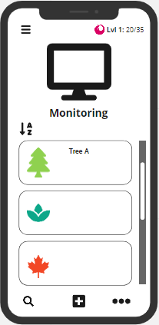
Plant Monitoring

Slide 15
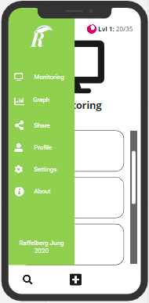
Navigation Bar

Slide 16
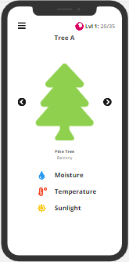
Plant View

Slide 17
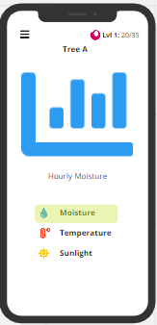
Graph View

Slide 18

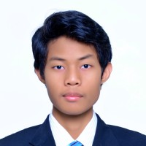
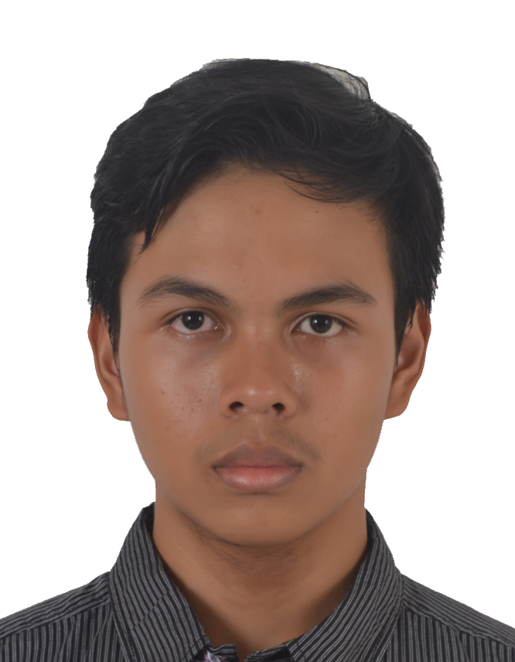
Team
Alvin Sutandar
Back End Developer
Lead Developer
Nizam Gifary
Front End Developer
Muhammad Haidar
UX/ UI Designer
Project Manager

Slide 19
