Slide 1
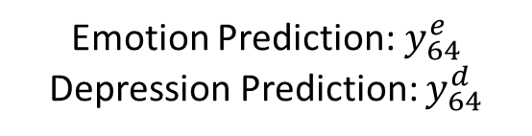
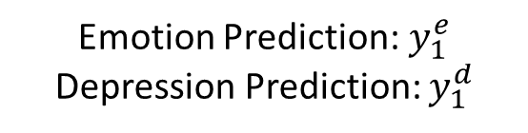


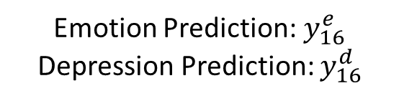

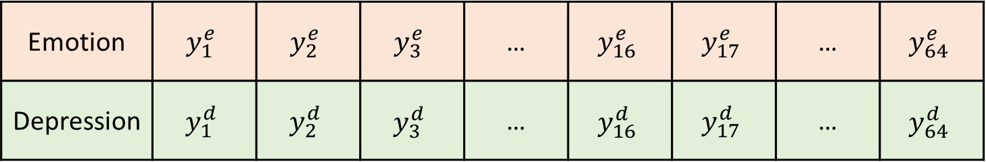
Frame 1
Frame 2
Frame 16
Frame 17
Frame 18
Frame 64
Frame 79
…
…
…
…
video clip ( $\frac{1}{2}$ s )
…
video clip ( $\frac{1}{2}$ s )
Emotion Recognition & Depression Estimation
Emotion Recognition & Depression Estimation
video clip ( $\frac{1}{2}$ s )
Emotion Prediction:$y_{1}^{e}$
Depression Prediction: $y_{1}^{d}$
Emotion Recognition & Depression Estimation
Emotion Prediction:$y_{16}^{e}$
Depression Prediction: $y_{16}^{d}$
Insert into Queue
Emotion Prediction:$y_{64}^{e}$
Depression Prediction: $y_{64}^{d}$
…
Insert into Queue
…
Insert into Queue
Emotion | $$y_{1}^{e}$$ | $$y_{2}^{e}$$ | $$y_{3}^{e}$$ | … | $$y_{16}^{e}$$ | $$y_{17}^{e}$$ | … | $$y_{64}^{e}$$
Depression | $$y_{1}^{d}$$ | $$y_{2}^{d}$$ | $$y_{3}^{d}$$ | … | $$y_{16}^{d}$$ | $$y_{17}^{d}$$ | … | $$y_{64}^{d}$$
Prediction Queue:
Analyze Pattern

Slide 2
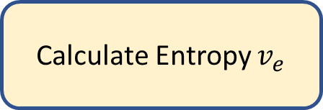

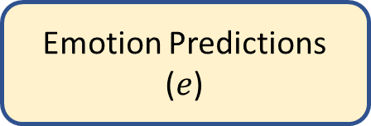
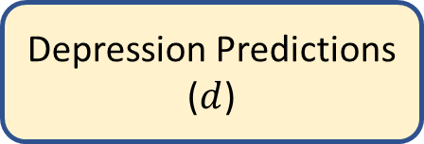


Depression Predictions
($d$)
Emotion Predictions
($e$)
If $d≥20$
Calculate Entropy $v_{e}$
Depression Disorder
If $v_{e}$ < $τ$
Bipolar Disorder
Stable Emotion
If $e∈negative$
Depression Disorder

