Slide 1
Lab 2 : RSA and DES
ECE 371: Intro to Security Engineering

Slide 2
Objectives
Learn how to use Linux on the ARM processor of the FPGA
Implementing RSA
Performing key exchange
Implementing DES encryption and decryption
Important: Make sure you read all the instructions; we have tried to make sure we cover all possible hurdles in this lab.

Slide 3
Software Tools
Python3 : Already installed on the Ubuntu version that comes with the board. You can run scripts with python3 script.py
Make sure you do not use python script.py as it will use Python2 that is incompatible with the code.
Putty: for serial communication between the board and your PC

Slide 4
Lab Overview
Download project files from Moodle/sources
Read over references, get familiar with Linux commands
Set up Linux on the DE1-SoC board, connect to your PC using the USB cable (No GUI)
Implement RSA key generation, encryption, and decryption
Implement DES as the image encryption scheme
Encrypt image with DES, encrypt DES key with RSA, recover the key by RSA decryption, decrypt image with DES

Slide 5
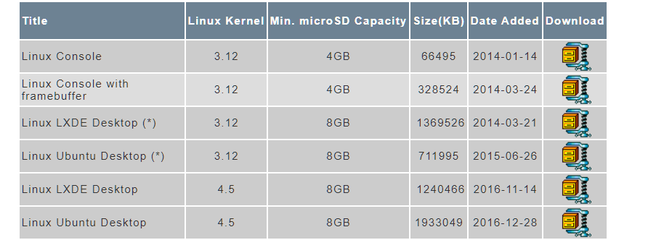
Part 1 - Download Linux Image
Download the Linux Image from this Address:
https://www.terasic.com.tw/cgi-bin/page/archive.pl?Language=English&CategoryNo=205&No=836&PartNo=4
Download Linux Ubuntu Desktop with kernel version 4.5

Slide 6
Part 1 – Write to Micro SD, Setup Linux
Go through pages 1-3 of this document on how to write the Linux Image on the SD-CARD using win32 disk imager
https://people.ece.cornell.edu/land/courses/ece5760/DE1_SOC/DE1-SoC-UP-Linux/Linux.pdf
In short:
Unzip the Linux image, write it on the SD card using Win32DiskImager.exe, insert the SD card in the corresponding slot on DE1
Make sure all the MSEL switches on the back of the board are set to ‘0’, take a picture before changing the switches so you can restore them after the lab is finished
We will be using a Linux image that contains a graphical user interface, however, most of the students do not have access to a Monitor with VGA port. The alternative is to connect to the board through serial (next slide)

Slide 7
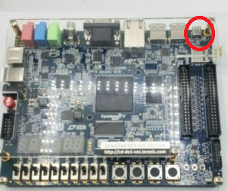
Communicating with the Linux on DE1-SoC
We communicate with the DE1-SoC Linux using serial communication
Use the USB cable (provided in DE1 box) to the connect the board (picture below) to your PC.

Slide 8
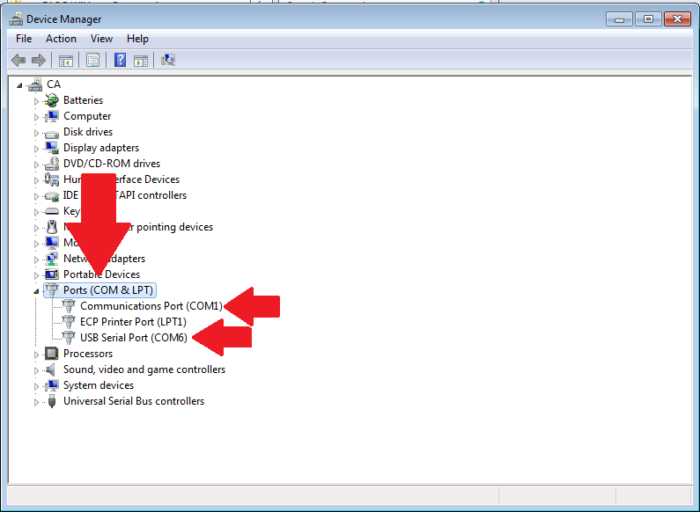
Communicating with the Linux on DE1-SoC
Once connected, the necessary USB-to-Serial drivers will be automatically installed (Windows) and it will show up on your control panel.
You need to find out the COM number of the serial
You can do that by going to control panel > device manager > COMS & ports (in the image below it is COM6, it is different for your PC)

Slide 9
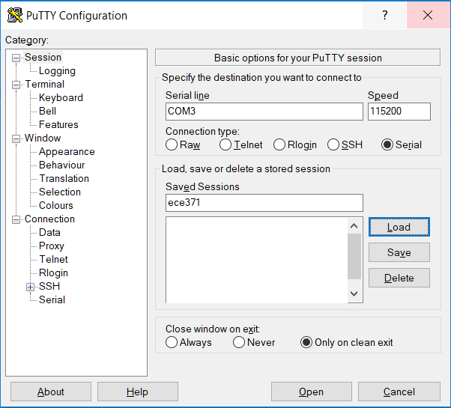
Communicating with the Linux on DE1-SoC
You can communicate with the board using a myriad of serial programs
My personal favorite is PUTTY (https://www.chiark.greenend.org.uk/~sgtatham/putty/latest.html)
A quick PUTTY tutorial:
https://www.ssh.com/ssh/putty/windows/
Long story short, your PUTTY settings will look like this figure ->
COM# (from control panel)
Communication type: Serial
Baud rate: 115200
Do not change other options

Slide 10
Part 1 (continued)
Now you have a separate Linux computer!
To transfer files to the board, you can use USB thumb drive
Use a USB thumb drive to copy the code folder from Moodle to the board
Do not modify the name of the files in the code folder, because they are used in loading python modules
The login username is ubuntu. The password is temppwd, do not modify!
You will write python3 code and perform experiments in this board
If you have not had previous exposure to Linux command line, the first few lessons of https://ubuntu.com/tutorials/command-line-for-beginners can help you quickly

Slide 11
How to read and write files to the DE1-SoC
You can use a USB flash drives (stick) to transfer files between the board Linux and your PC
Once the flash drive is connected to the board you need to mount it to the file system
Use the lsblk command to find the /dev name of your flash memory (e.g. /dev/sdb1)
Create a folder in the /mnt directory: mkdir /mnt/external
Mount the usb memory to the folder: mount /dev/sdb1 /mnt/external
You can access all the USB drive files in /mnt/external, you need to remount every time you disconnect the USB flash drive
Once all the operations are finished, make sure you use the ‘sync’ command before removing the flash memory stick from the board. This will ensure the cache is empty and all the files are written in the memory
Sometimes the flash drive is automatically mounted, in that case, you can find the folder name using lsblk and looking at the MOUNTPOINT column

Slide 12
Part 2 – Setup RSA code
In the code folder, open RSA.py
Complete the following functions using Python3 (not Python or Python2)
get_d(): this function calculates the d value using the Extended Euclidean algorithm
generate_keypair(): this function accepts the p and q values and returns the public and private keypairs, uses get_d() and gcd functions
encrypt(): this function accepts one character and the keypair and performs encryption
decrypt(): this function accepts one character and performs decryption

Slide 13
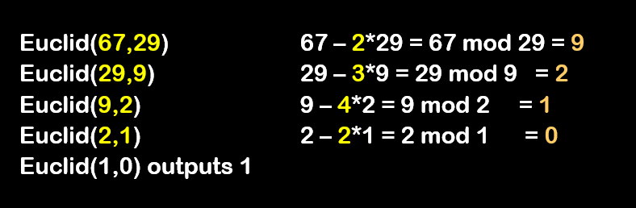
Euclidean Algorithm
A recursive algorithm used to find the GCD of two numbers
Euclid(A,B)
If B=0 then return A
else return Euclid(B, A mod B)

Slide 14
Euclidean Algorithm
gcd(98,20)=?
Euclid(98,20) 98 – 4*20 = 98 mod 20 = 18
Euclid(20,18) 20 – 1*18 = 20 mod 18 = 2
Euclid(18,2) 18 – 9*2 = 18 mod 2 = 0
Euclid(2,0) outputs 2
gcd(98,20) = 2

Slide 15
Extended Euclidean Algorithm
Remember our goal was to calculate the d value in RSA
We have p, q, n=p*q, z=(p-1)*(q-1), e mod z =1
We choose d such that ed-1 is exactly divisible by z (ed-1=x*t)
Or ed +x*t = 1
There is no unique d value, how to calculate d?
Extended Euclidean algorithm can be used

Slide 16
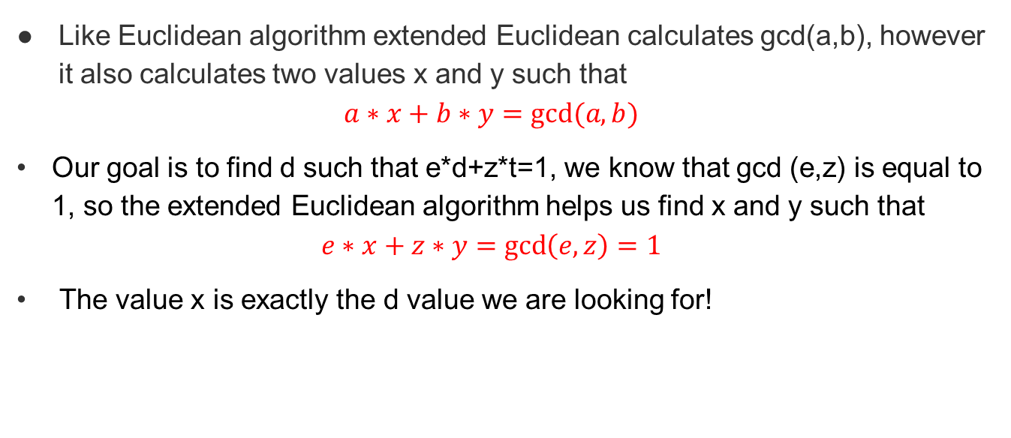
Extended Euclidean Algorithm
Like Euclidean algorithm extended Euclidean calculates gcd(a,b), however it also calculates two values x and y such that
$$a∗x+b∗y=gcd⁡(a,b)$$
Our goal is to find d such that e*d+z*t=1, we know that gcd (e,z) is equal to 1, so the extended Euclidean algorithm helps us find x and y such that
$$e∗x+z∗y=\gcd\left(e,z\right)=1$$
The value x is exactly the d value we are looking for!

Slide 17
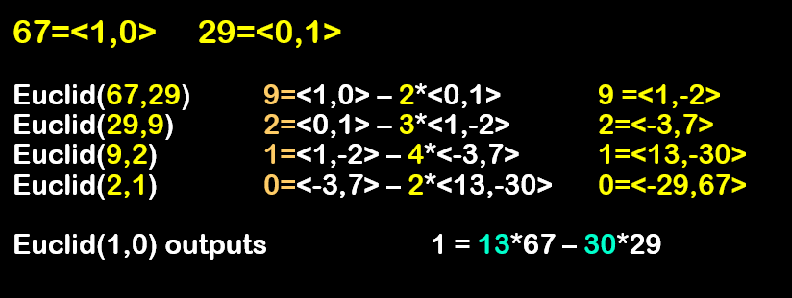
Extended Euclidean Algorithm
Let <r,s> denote the number r*67 + s*29. Calculate all intermediate values in this representation.

Slide 18
Extended Euclidean Algorithm
Example for RSA, p=11, q=7, n=77, z=60, e=37
Apply extended Euclidean algorithm to e, z to find d, e*d+z*t=1
<r,s>= r * 60 + s * 37
60=<1,0> 37=<0,1>
Euclid(60,37) 23= 60 mod 37 = 60 – 37 = <1,0> – <0,1> 23 =<1,-1>
Euclid(37,23) 14= 37 mod 23 = 37 – 23 = <0,1> – <1,-1> 14=<-1,2>
Euclid(23,14) 9= 23 mod 14 = 23 – 14 = <1,-1> – <-1,2> 9=<2,-3>
Euclid(14,9) 5= 14 mod 9 = 14 – 9 = <-1,2> – <2,-3> 5=<-3,5>
Euclid(9,5) 4= 9 mod 5 = 9 – 5 = <2,-3> – <-3,5> 4=<5,-8>
Euclid(5,4) 1= 5 mod 4 = 5 – 4 = <-3,5> – <5,-8> 1=<-8,13>
Euclid(4,1)=0, algorithm stops
gcd (60,37) = 1, and 60*(-8)+37*(13)=1
So d = 13
Euclid(1,0) outputs 1 = 13*67 – 30*29

Slide 19
Extended Euclidean Algorithm
Sometimes the output of extended Euclidean algorithm for d is a negative number, in that case you have to keep adding d with z until you get to a positive number.
In fact for the previous problem we got d =13, we can also find other values for d
d = 13+z = 73, d= 13+2*z = 133, …
You must implement extended Euclidean algorithm in the get_d() function in RSA.py

Slide 20
Fix hostname (important)
You need to run some commands with sudo privilege
You will get error when trying to do that (sudo command)
You need to modify some of the host names
On the board Linux terminal run sudo nano /etc/hosts
One of the lines looks like this : 127.0.1.1 arm.localdomain arm
Change it to this: 127.0.0.1 DE1_SoC
Then save it
After that, you will be able to run sudo commands

Slide 21
Part 2 – Implement DES
In this part, you will implement the DES encryption algorithm.
You can start by reviewing DES
This link gives a practical step-by-step explanation of DES
http://page.math.tu-berlin.de/~kant/teaching/hess/krypto-ws2006/des.htm
Remember that the board Linux does not have NumPy installed so you need to implement every function with basic data structures (e.g. list)
Sufficient explanation is given in the accompanied Python files to help you complete the implementation

Slide 22
Part 2 – Implement DES
Go to the des.py file in the code folder, it is implemented as a class. Implement the following functions in des.py
Implement compute_s_box() function which returns the binary value for the 4-bit output of the S-box based on the 6-bit input block. This function returns a string, for example the input is ‘101010’ and the output is ‘1100’ (you can use binvalue() function from des.py!)
Implement substitute() function which accepts d_e, a string of 48 bits and returns another list which is substituted using the S_BOX

Slide 23
Part 3 – The main code
This is the main code that you will run during the demo. No need to write any function here
There are two variables p and q. Each group will need to find their corresponding p and q values from the Prime_numbes.xlsx project file
group numbers can be found in the online spreadsheet (here)
Again! Use python3 and not python or python2
The main code will ask for an 8-character DES key from you, perform RSA encryption and decryption on the key, and will also perform DES encryption and decryption on the penguin.jpg image (project file)
Successful implementation of RSA will result in correct key in the command line.
Successful implementation of DES will result in a penguin_decrypted.jpg image that can be opened in your PC as a JPEG image similar to penguin.jpg

Slide 24
Important points
There are placeholders for each piece of code to make sure the code runs without error, but they generate the wrong value!
The code can be overwhelming at first. We suggest you go through it all in the beginning to get familiar with the process.
Developing code on the Linux command line can be difficult, I suggest you do all your development on your local computer (Python 3.5) and transfer the final code to the board for testing.
This lab has changed from last year (GUI is turned into command line), a lot of questions or confusions may rise. We will try to answer all your questions during office hours (preferably) and through Piazza.

Slide 25
Deliverables
You will write a report, giving a general description for each code snippet that you wrote as well as a screenshot of the monitor screen with the main code working, and your penguin_decrypted.jpeg image
Please also add the answers to the questions to (next slide) to the report
Upload all your code python files (RSA.py, DES.py, main.py) as well as the penguin encrypted and decrypted files to Moodle with the report
Each code description does not need to be more than a few lines of explanation

Slide 26
Questions for report
Question1 (5 points): Give a short description for each of the 5 network security principles: Confidentiality, Integrity, Authentication, Accessibility, and Availability
Question2 (3 points): Explain playback attack in the network with an example. How does the use of a random Nonce prevent such an attack?
Question3 (2 points): What is the difference between public key encryption and private key encryption?
Question 4 (2 ponts): Why did we use RSA for encrypting the key and not the whole image and instead used DES for image?

Slide 27
What to expect during the demo?
You will be presenting a demo of your code on the board by connecting it to PUTTY in your laptop/PC and sharing the screen through Zoom.
You need to show that the code can generate the penguin_decrypted.jpg file correctly (it can open as an image in the PC, and the success message is printed in the end)
We will randomly ask you to describe different parts of your code
We will ask some questions about the platform you have used (you will be able to answer these questions if you have spent reasonable time working on this lab!)
The goal of the questions is to make sure all the group members have contributed to the lab

Slide 28
Best of luck!

