Slide 1

Fast Focus: Explore Windows AI Development w/ AI Dev Gallery
Alvin Ashcraft
Sr. Content Developer
Microsoft
Level: Beginner

Slide 2

Session Survey
Your feedback is very important to us
Please take a moment to complete the session survey found in the mobile app
Use the QR code or search for “Converge360 Events” in your app store
Find this session on the Agenda tab
Click “Session Evaluation”
Thank you!

Slide 3
About me
Microsoft Learn Content Developer
Azure Open AI docs on Microsoft Foundry
30+ years industry experience
Link blog – The Morning Dew (alvinashcraft.com)
Three books for Packt Publishing

Slide 4
Agenda
What is AI Dev Gallery?
Key features
Demos 🎉

Slide 5
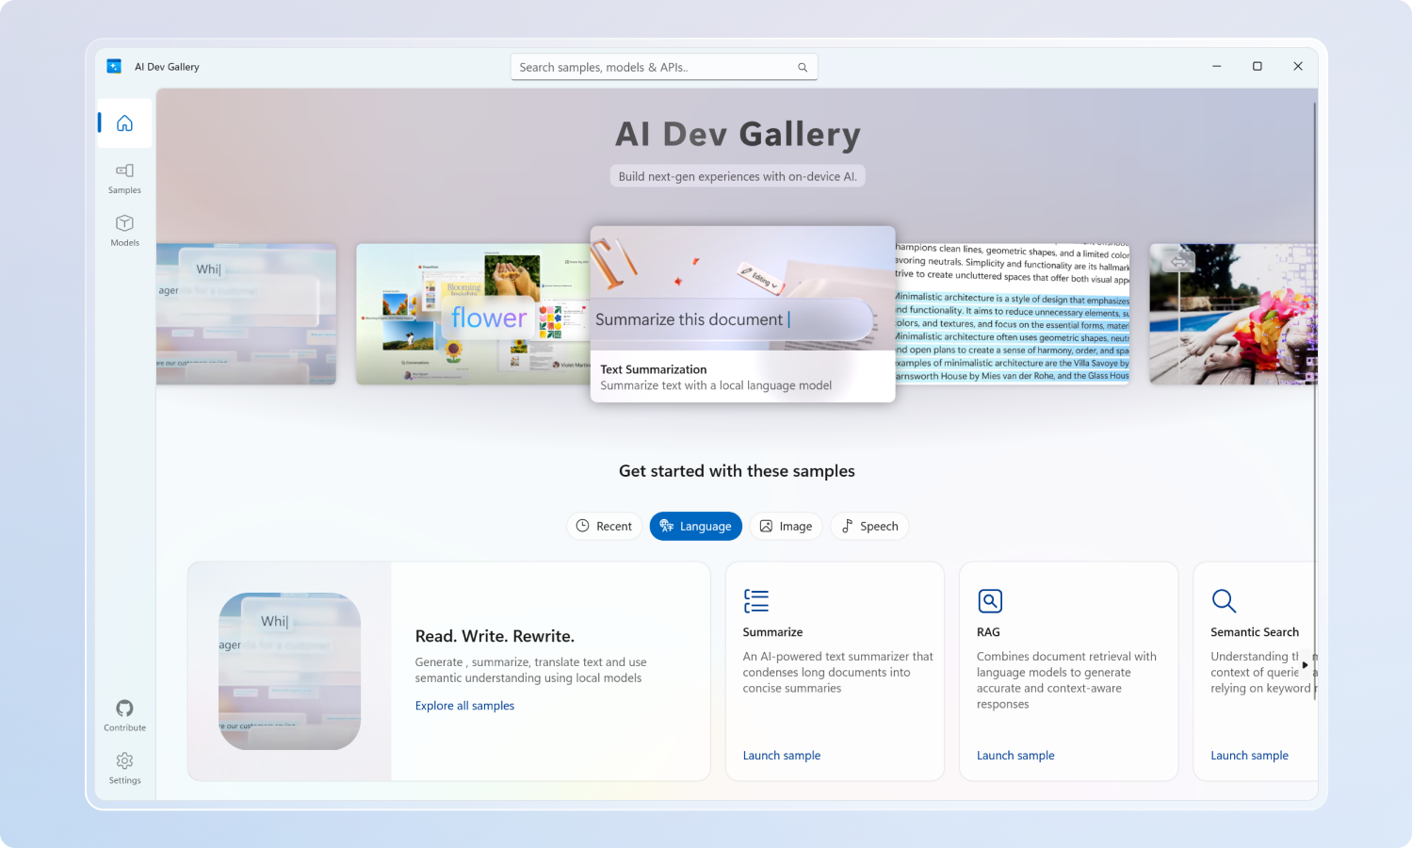
What is AI Dev Gallery?
Open-source Windows app from Microsoft
Available free in Microsoft Store
Integrate AI capabilities in your native apps
Discover AI scenarios & models
Built with WinUI & Windows App SDK

Slide 6
Key Features
🧠 Models & Samples
25+ interactive samples
Browse & download models
Supports Phi Silica on Copilot+ PCs
🛠️ Developer Experience
View C# source code for every sample
Export Visual Studio projects
Works offline with downloaded models
Supports x64 and Arm64 PCs

Slide 7
🚀 Demo TIme
Let’s explore AI Dev Gallery

Slide 8
Resources
Microsoft Store: http://aka.ms/ai-dev-gallery-store
GitHub repo: https://github.com/microsoft/ai-dev-gallery/
Windows AI docs: https://learn.microsoft.com/windows/ai/overview

Slide 9
Thank you!
Questions?
Blog: https://alvinashcraft.com
BlueSky: https://bsky.app/profile/alvinashcraft.com
Demos: https://github.com/alvinashcraft/speaking

Slide 10
Session Survey
Your feedback is very important to us
Please take a moment to complete the session survey found in the mobile app
Use the QR code or search for “Converge360 Events” in your app store
Find this session on the Agenda tab
Click “Session Evaluation”
Thank you!

