Slide 1

Build Intelligent Apps w/ WinUI, Phi Silica & Microsoft Foundry
Alvin Ashcraft
Sr. Content Developer
Microsoft
Level: Intermediate

Slide 2

Session Survey
Your feedback is very important to us
Please take a moment to complete the session survey found in the mobile app
Use the QR code or search for “Converge360 Events” in your app store
Find this session on the Agenda tab
Click “Session Evaluation”
Thank you!

Slide 3
About me
Sr. Content Developer on Microsoft Learn
Azure OpenAI docs on Microsoft Foundry
Software industry for 30+ years
Morning Dew link blog (alvinashcraft.com)
Three books for Packt Publishing
TechBash dev conference organizer since 2016

Slide 4
Agenda
AI Options for .NET Developers on Windows
WinUI and Windows App SDK
Copilot+ PCs, Foundry Local & Phi Silica (and Aion)
Windows AI APIs in Windows App SDK
Text Recognition APIs
Recall on Windows – Where does my app tie in?
The AI Dev Gallery app for Windows
My AI Apps for Windows – AIvin & Model Buddy
Q&A

Slide 5
AI Options for .NET Developers
Microsoft.Extensions.AI library (MEAI)
Microsoft Agent Framework
Build agents and consume models with C# or Python or use Copilot SDK for a ready-made harness.
C# SDK for Model Context Protocol (MCP)
Foundry Toolkit for VS Code
GitHub Copilot in Visual Studio, VS Code, Copilot app & Copilot CLI
Microsoft Foundry & Foundry Local
Windows AI APIs

Slide 6
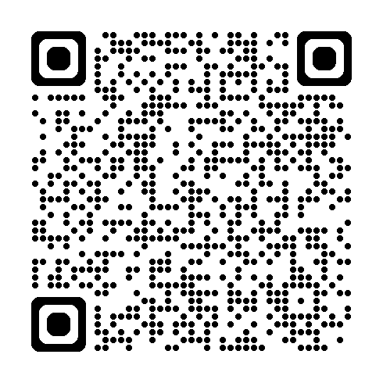
WinUI & Windows App SDK Overview
Understand the benefits of WinUI for modern applications.
Learn how Windows App SDK enhances app development.
Access .NET 10, WinRT APIs, and Windows App SDK APIs in WinUI apps.
Get started on Microsoft Learn:

Slide 7
Copilot+ PCs and Phi Silica
Introducing Copilot+ PCs & integration w/ Windows dev tools
What’s the role of Phi Silica on Windows Copilot+ PCs?
NPU-tuned local model
Aion coming this fall! (next-gen local model)
Practical applications of Windows AI Foundry and Windows AI APIs
Local models
OCR
Imaging
Content moderation

Slide 8
Windows AI APIs in Windows App SDK
Overview of the Windows AI APIs.
Use these APIs in your Windows apps: WinUI, WPF, Windows Forms, and even C# console apps
Demo
WinUI app
Query local model
Moderation filters
Console app AI

Slide 9
Text Recognition APIs
Text recognition capabilities
Image Super Resolution (smart scaling) & Segmentation
Demo
WPF app w/ scaling & text recognition (WinUI backup app)
Load image (supports file picker or paste)
OCR to produce text
Use local model to explain the text

Slide 10
Recall in Windows & Integration w/ Your Apps
Windows Recall integration options in Windows apps
Opt-in feature only available on Copilot+ PCs
Enhance user experience in Recall
Launch Click to Do – Use URI ms-clicktodo://
Search Recall for images related to your app
Use UserActivity APIs to record specific app data related to saved snapshots.
APIs still in experimental state and evolving

Slide 11
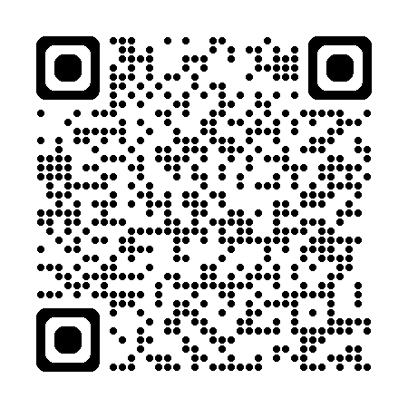
AI Dev Gallery on Microsoft Store
AI Dev Gallery – Get it in the Microsoft Store
Over 30 interactive local AI sample apps
Discover and download local models
Download Visual Studio projects
Open source on GitHub →

Slide 12
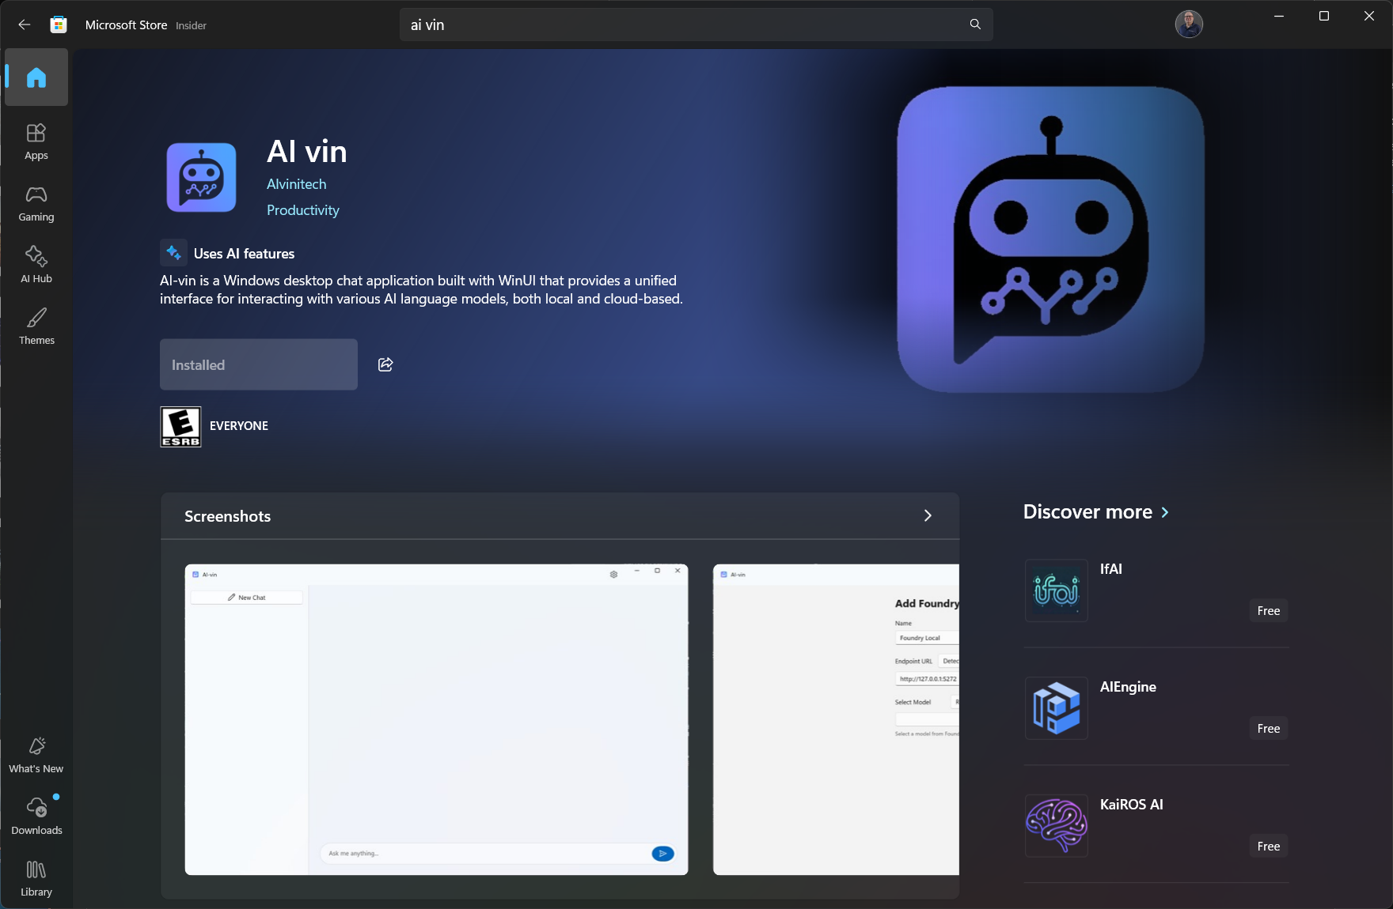
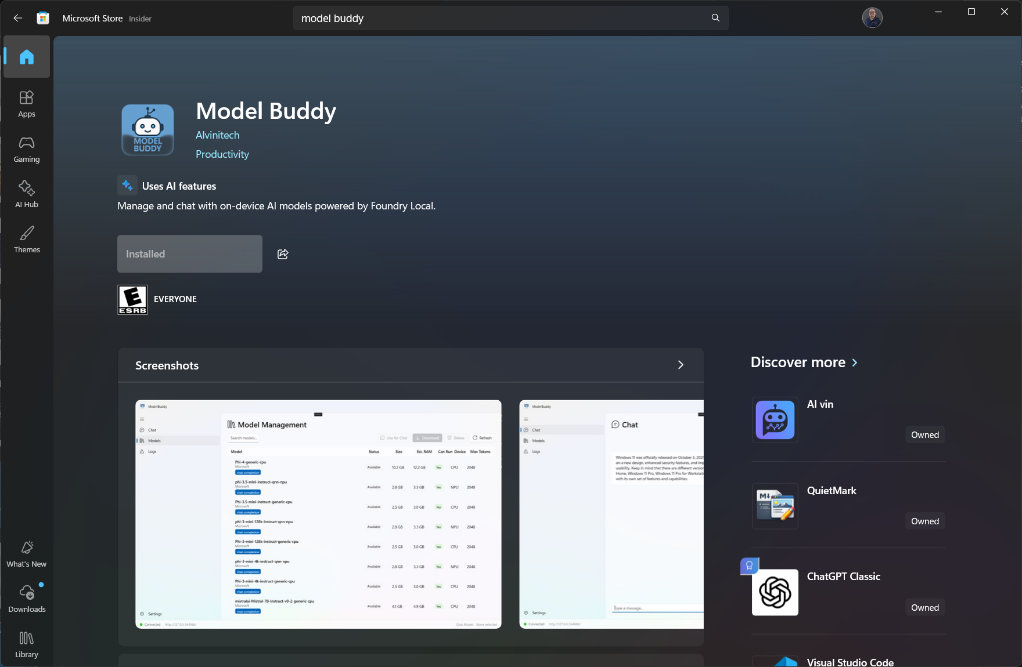
My WinUI apps w/ Windows AI

Slide 13
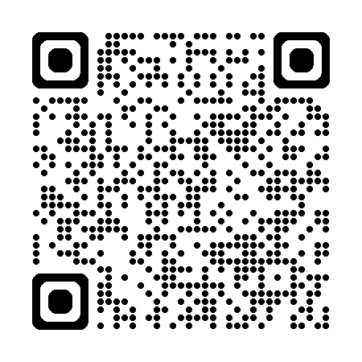
Thank you!
Any questions?
Contact me: alashcraft@gmail.com
Learn more in the Windows AI docs on Microsoft Learn:

Slide 14
Session Survey
Your feedback is very important to us
Please take a moment to complete the session survey found in the mobile app
Use the QR code or search for “Converge360 Events” in your app store
Find this session on the Agenda tab
Click “Session Evaluation”
Thank you!

