Slide 1

Build Intelligent Apps w/ WinUI, Phi Silica & Microsoft Foundry
Alvin Ashcraft
Sr. Content Developer
Microsoft
Level: Intermediate
Notes:
Welcome to the last main session day at VSLive and my session on building native Windows apps with WinUI, Foundry Local, and the Windows AI APIs in the Windows App SDK.

Slide 2

Session Survey
Your feedback is very important to us
Please take a moment to complete the session survey found in the mobile app
Use the QR code or search for “Converge360 Events” in your app store
Find this session on the Agenda tab
Click “Session Evaluation”
Thank you!
Notes:
This is the most important slide of the deck. Make sure you complete your session survey and provide feedback for the sessions you attended this week. Your feedback helps the organizers select future sessions and help speakers like me improve our talks.

Slide 3
About me
Sr. Content Developer on Microsoft Learn
  Azure OpenAI docs on Microsoft Foundry
Software industry for 30+ years
Morning Dew link blog (alvinashcraft.com)
Three books for Packt Publishing
TechBash dev conference organizer since 2016
Notes:
A little background about me…
For those who don’t know me, I’ve been in the software industry since 1995, with most of that time (over 25) years spent as a developer and architect using various Microsoft technologies.
Some of you may also be familiar with my blog, the Morning Dew, where I’ve been posting daily links for .NET developers since 2007.
I also have three books from Packt Publishing with a fourth on the way. You can check those out on Packt’s website or on Amazon. Just search for my name.
Writing those books led me to pivot my career to technical writing. I joined Microsoft about four and a half years ago as a content developer. I write documentation and code samples on Microsoft Learn. I used to work on the Windows developer docs team, but I moved over to the Foundry docs team late last year. I have another talk I give about my work as a content developer and how anyone can contribute to content on Learn through GitHub issues and PRs.
Finally, I’m one of the founding organizers of the TechBash developer conference. We’ve been running the event right here in the Poconos since 2016.

Slide 4
Agenda
AI Options for .NET Developers on Windows
WinUI and Windows App SDK
Copilot+ PCs, Foundry Local & Phi Silica (and Aion)
Windows AI APIs in Windows App SDK
Text Recognition APIs
Recall on Windows – Where does my app tie in?
The AI Dev Gallery app for Windows
My AI Apps for Windows – AIvin & Model Buddy
Q&A
Notes:
Here’s what we’re going to cover today. We’ll go a little deeper in some areas than others.
We’ll briefly touch on WinUI and Windows App SDK, just to level-set and make sure everyone understands what they are.
Then we’ll try to untangle somethings that were announced and updated over the last year and a half:
Copilot+ PCs are devices optimized for local AI workloads with an NPU and Phi Silica is the local model on those PCs. The first models had Arm processors, but Intel and AMD have their own NPU-based models across multiple manufacturers now too.
Microsoft Foundry on Windows encompasses the local Windows AI features and Foundry Local hosts local AI models (similar to Ollama).
The Windows AI APIs are a set of APIs in the Windows App SDK that leverage the local Phi Silica model and other local models found on Copilot+ PCs – coming soon to all modern Windows devices. They’re working on enabling these APIs for models that use the GPU and CPU too.
Windows ML is another set of APIs and features in the Windows App SDK for accessing other types of local AI models in Windows AI Foundry. Machines without an NPU can also use these APIs.
After demoing the APIs for using Phi Silica in your apps, we’ll look at the text recognition APIs in Windows App SDK and how you can use those in WinUI, WPF, or even a .NET command line app.
Next, we’ll talk briefly about Microsoft Recall and how you can opt your apps in to provide more detail in Recall snapshots.
We’ll wrap up by looking at the open-source AI Dev Gallery app that you can download from the Store. It’s got WinUI and other .NET sample apps and tools to help download local models. The team has worked hard to make it easy to use and an example of how to build a great-looking WinUI app for Windows 11.
And if we have time, I’ll show you a couple of native WinUI apps I published to the Store that leverage Windows AI. We’ll peek into the source code for those apps, which aren’t open-source on GitHub yet, but I do intend to open them up when I get a chance to finish polishing the code.

Slide 5
AI Options for .NET Developers
Microsoft.Extensions.AI library (MEAI)
Microsoft Agent Framework
  Build agents and consume models with C# or Python or use Copilot SDK for a ready-made harness.
C# SDK for Model Context Protocol (MCP)
Foundry Toolkit for VS Code
GitHub Copilot in Visual Studio, VS Code, Copilot app & Copilot CLI
Microsoft Foundry & Foundry Local
Windows AI APIs
Notes:
In this section, we'll explore various AI options that are specifically designed for .NET developers. This includes tools, frameworks, and best practices that can streamline the integration of AI into your existing applications.
The Microsoft.Extensions.AI libraries were created to help .NET developers consume AI services. We won’t get into details, as this isn’t the focus of my talk, but they include libraries for:
Requesting or streaming chat responses.
Calling tools (functions or APIs) as part of a chat request (like providing a specific weather call to use in a prompt request).
Caching responses
Using telemetry
Chat options
Functionality Pipelines (builder pattern familiar to ASP.NET devs – ChatClientBuilder)
Middleware – composition with sub client for things like rate limiting
Dependency injection for easily swapping out AI services in config
Security and content safety
Evaluation APIs for determining the accuracy and quality of responses from AI services and models
We also won’t be exploring Microsoft Agent Framework today, but it’s got libraries for .NET and Python developers to simplify building AI agents and consume models.
The C# SDK for MCP is new and evolving quickly. Use it to build your own MCP servers and clients that consume them.
The Foundry Toolkit is a plugin for VS Code a growing feature set.
Model catalog (GitHub, ONNX, OpenAI, Anthropic, Google, and more)
Bring your own model (local or cloud)
A Playground for model inference or testing with a chat UI
Attachment support for working in multi-model scenarios
Running prompts in batches
Evaluate or fine tune a model with your own datasets
Agent Builder generate C# or Python code from your prompts
Convert models to ONNX format. Local models in AI Toolkit must be in ONNX format. AI Toolkit can convert models it downloads from Azure AI Foundry, Hugging Face, and other sources.
There are tons of AI productivity tools like GitHub Copilot in Visual Studio and VS Code, the Copilot CLI, and the new GitHub Copilot app.
There are cloud platforms like Microsoft Foundry and now local platforms like Foundry Local.
And finally, the Windows AI APIs, formerly known as the Windows Copilot Runtime APIs that are included in the latest Windows App SDK releases.
Let’s talk about Windows App SDK and WinUI in some more detail.

Slide 6
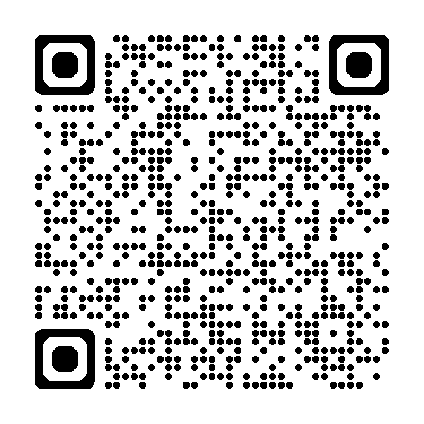
WinUI & Windows App SDK Overview
Understand the benefits of WinUI for modern applications.
Learn how Windows App SDK enhances app development.
Access .NET 10, WinRT APIs, and Windows App SDK APIs in WinUI apps.
Demo: WinUI ShoppingList app.
Get started on Microsoft Learn:
Notes:
We’ll cover the advantages of using WinUI in your application development. We will also discuss how the Windows App SDK can enhance the overall development experience and what features are available when using Windows App SDK for building apps with AI features.
If you haven’t created apps with WinUI before, it’s the same XAML schema as UWP apps. It’s similar enough to WPF or .NET MAUI to pick make the adjustment easily. In fact, if you’ve deployed a .NET MAUI app to Windows, that’s a WinUI app under the covers. It’s Microsoft’s recommended UI framework when you’re building native apps for Windows, assuming the current feature set meets your requirements. It hasn’t been around as long as WPF and WinForms, so there are still a few areas where they excel.
WinUI is part of the Windows App SDK and receives updates with its releases. In addition to containing the WinUI UI components, the SDK contains an API set similar (but not as extensive as) the Windows Runtime (or WinRT) APIs that UWP uses.
Many of those WinRT APIs are still accessible to packaged WinUI apps (or any packaged desktop app for that matter). It’s a topic for another talk, but WPF and WinForms apps packed with MSIX can use most of the non-UI APIs in both Windows App SDK and WinRT. There are articles in the Windows developer docs on Microsoft Learn about how to configure your apps to use these different SDKs.
As far as WinUI is concerned, your apps out of the box can use .NET 10 APIs, Windows App SDK APIs, and most of the WinRT APIs. Keep in mind that when using the WinRT APIs, you have the same constraints as UWP apps and Windows versions. You must specify a minimum Windows SDK version and target version to determine the set of APIs your app can use.
Each release of Windows App SDK is closing the gap with WinRT, so there are fewer reasons than ever for WinUI developers to dip into the Windows SDK.
We’ll take a very brief look at a WinUI sample app I use in some of my other talks so you can see the kind of Windows native look-and-feel you get out of the box.
The QR code here will take you to the docs on getting started with WinUI. We’ll see some code shortly when we open our first WinUI project that uses the Windows AI APIs.

Slide 7
Copilot+ PCs and Phi Silica
Introducing Copilot+ PCs & integration w/ Windows dev tools
What’s the role of Phi Silica on Windows Copilot+ PCs?
  NPU-tuned local model
  Aion coming this fall! (next-gen local model)
Practical applications of Windows AI Foundry and Windows AI APIs
  Local models
  OCR
  Imaging
  Content moderation
Notes:
Here, we will provide an overview of Windows Copilot+ PCs and their significance in development environments. Additionally, we will explore how Phi Silica contributes to performance improvements and what that means for developers.
Copilot+ PCs are Windows PCs that include a neural processing unit (NPU) for power-friendly, AI processing performance. The first Copilot+ PCs all had Arm-based CPUs (Qualcomm Snapdragon X Elite and X Plus models), but additional models with Intel Core Ultra 200V and AMD Ryzen AI 300 series CPUs were announced later in the year and released shortly thereafter.
These PCs include but aren’t limited to Surface Pro and Surface Laptop devices. Dell, Lenovo, and other manufacturers have their own Copilot+ PCs available in different form factors.
These PCs provide the ability to run apps and features with local AI models while maintaining exceptional battery life. The Phi Silica local language model is Microsoft’s model that ships with the OS and integrates with features like Recall and the AI features being built into Notepad, Microsoft Paint, and AI powered search in Windows, File Explorer and the Photos app.
With the Windows AI APIs in Windows App SDK, your apps can query the Phi Silica model and leverage other features like OCR, imaging and content moderation/safety. Third party apps can also use Search APIs to opt-in to providing results in Windows Search.
Let’s talk about some more API specifics next.

Slide 8
Windows AI APIs in Windows App SDK
Overview of the Windows AI APIs.
Use these APIs in your Windows apps: WinUI, WPF, Windows Forms, and even C# console apps
Demos
  Windows AI docs on Microsoft Learn
  WinUI app
    Query local model (Basic chat / Summarize Text)
    Moderation filters
  C# Console app referencing Windows App SDK
Notes:
Let’s talk about the Windows AI APIs available through the Windows App SDK. We’ll cover how to consume these APIs in your native Windows projects and show some examples of their use in a simple project I created for this demo.
You can use these AI APIs in any packaged desktop app that includes the Windows App SDK package reference. Right now, you need to use an experimental release to build and debug locally. To build release mode apps or deploy to the Store, you need to get a token from the Windows dev team to enable your app to use a stable Windows App SDK release with the AI APIs. The Learn documentation has details on how to request the production token, but it’s simple to do, and the team is quick to respond to requests.
Let’s get to the demos.
First, we’ll see code in a WinUI app to query the Phi Silica local model on my Copilot+ PC with a basic chat interface. Then we’ll use the same UI to summarize some long text. I’ll also show you the moderation filters that are available to restrict different types of risky input or output.
Finally, I’ll use the same chat APIs from a C# console app. You can reference Windows App SDK from WPF, WinForms, or even console apps by adding a Packaging project to the solution to provide the package identity that Windows needs to give access to these APIs. Pretty much any Windows App SDK APIs that don’t involve UI elements, can be used from other .NET projects this way. I’ve used it to access the Windows Notifications APIs in my WPF apps.
Let’s get to some Windows AI demo code.

Slide 9
Text Recognition APIs
Text recognition capabilities
Image Super Resolution (smart scaling) & Segmentation
Demo
  WPF app w/ scaling & text recognition (WinUI backup app)
    Load image (supports file picker or paste)
    OCR to produce text
    Use local model to explain the text
Notes:
Now we’ll focus on text recognition APIs, their functionalities, and potential applications. We will also go over coding examples to illustrate how these APIs can be incorporated into your Windows desktop apps.
So, the text recognition APIs used in the app we’ll see can OCR text from an image we select and then use the local model to analyze the detected text to summarize what’s there.
This time, we’re using a WPF project that’s referencing Windows App SDK. I also have a WinUI version of the project in case we have issues. The imaging project loads an image, runs an OCR scan on it to get the text and then uses the AI APIs to analyze and summarize the text.
Let’s go…

Slide 10
Recall in Windows & Integration w/ Your Apps
Windows Recall integration options in Windows apps
Opt-in feature only available on Copilot+ PCs
Enhance user experience in Recall
  Launch Click to Do – Use URI ms-clicktodo://
  Search Recall for images related to your app
  Use UserActivity APIs to record specific app data related to saved snapshots.
APIs still in experimental state and evolving
Notes:
Let’s talk about Windows Recall and your Windows apps. We'll discuss the importance of the principles of responsible AI and share best practices to enhance the overall user experience in your apps.
Since it’s initial introduction, Microsoft has updated Recall quite a bit. One of the biggest changes is making it an opt-in feature. It’s not enabled by default on supported PCs. Users can also use the Recall settings to exclude apps and sites from being included in Recall’s screenshots.
Part of Recall is a feature called Click to Do. This feature presents an overlay on your screen with options to:
Copy text
Open selected text with the app of your choice
Search the web with the selected text
Open a URL from the selected area
Email an email address from the selected area
Copy/save/share/open a selected image
Perform a visual search on Bing with the image
Blur or remove a background
Erase objects in the selected image
Any app can launch Click to Do with the clicktodo URI. You can even put the URI into your browser to launch it.
In the future you’ll be able to allow users search the Recall snapshots for any information recorded for your app.
You can also use the UserActivity class to record additional information along with the screenshots captured while your app has focus. This extra metadata can make it easier to either search or provide more data back to your app’s users later when they view the snapshots.

Slide 11
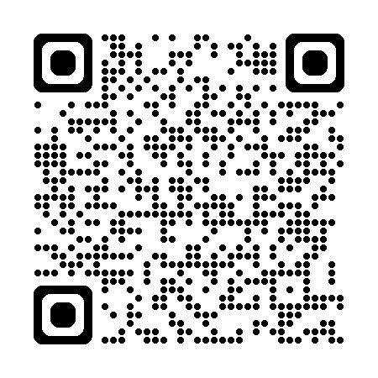
AI Dev Gallery on Microsoft Store
AI Dev Gallery – Get it in the Microsoft Store
Over 30 interactive local AI sample apps
Discover and download local models
Download Visual Studio projects
Open source on GitHub →
Notes:
Here we'll introduce the AI Dev Gallery app for Windows, highlighting its features and available resources. Look at how to provide feedback and contribute to the app on GitHub.
The app is available on the Microsoft Store, and the code is open source on GitHub. Use the QR code on screen to check out the repo and run it from source locally.
It now has over 30 sample apps that you can explore and run on your machine. Some are apps that use the Windows AI local models with NPUs, but many others can run on any Windows PCs. The samples that require a Copilot+ PC are easily identified on each sample page.
You can also use the gallery to download and use different local AI models.
Let’s open the app can explore a bit and even try running it from source code.

Slide 12
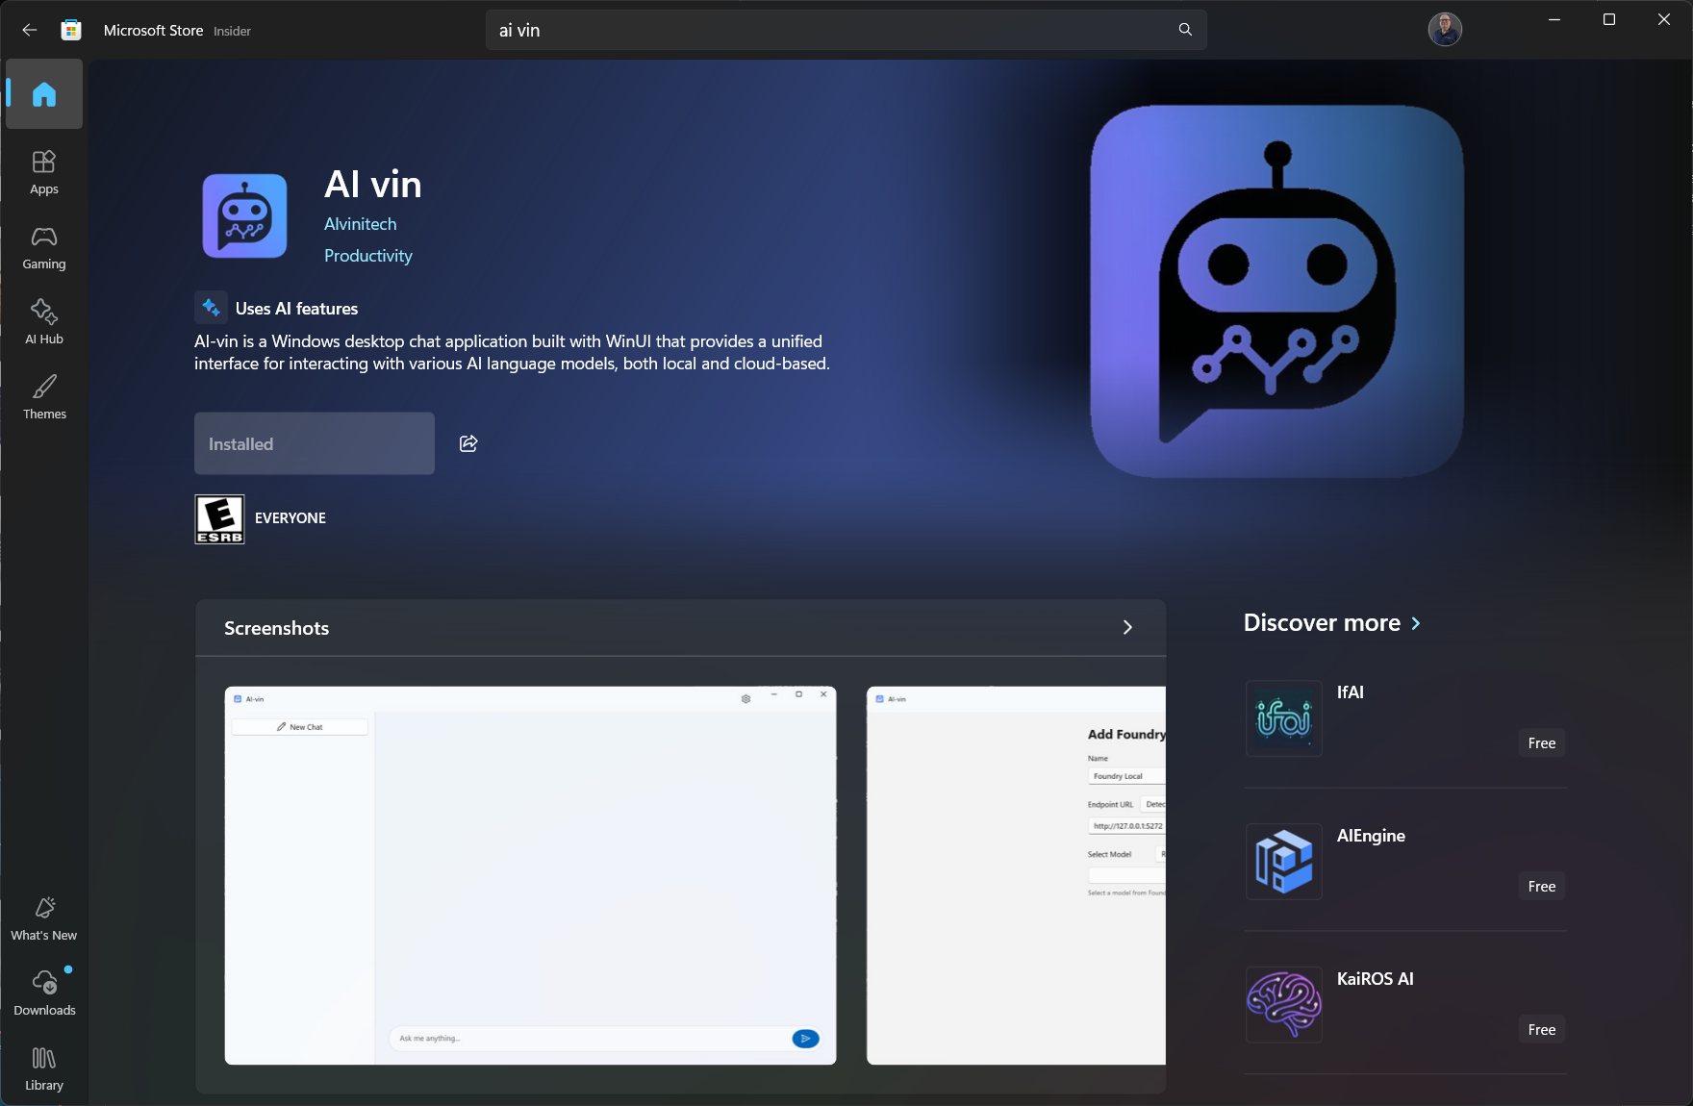
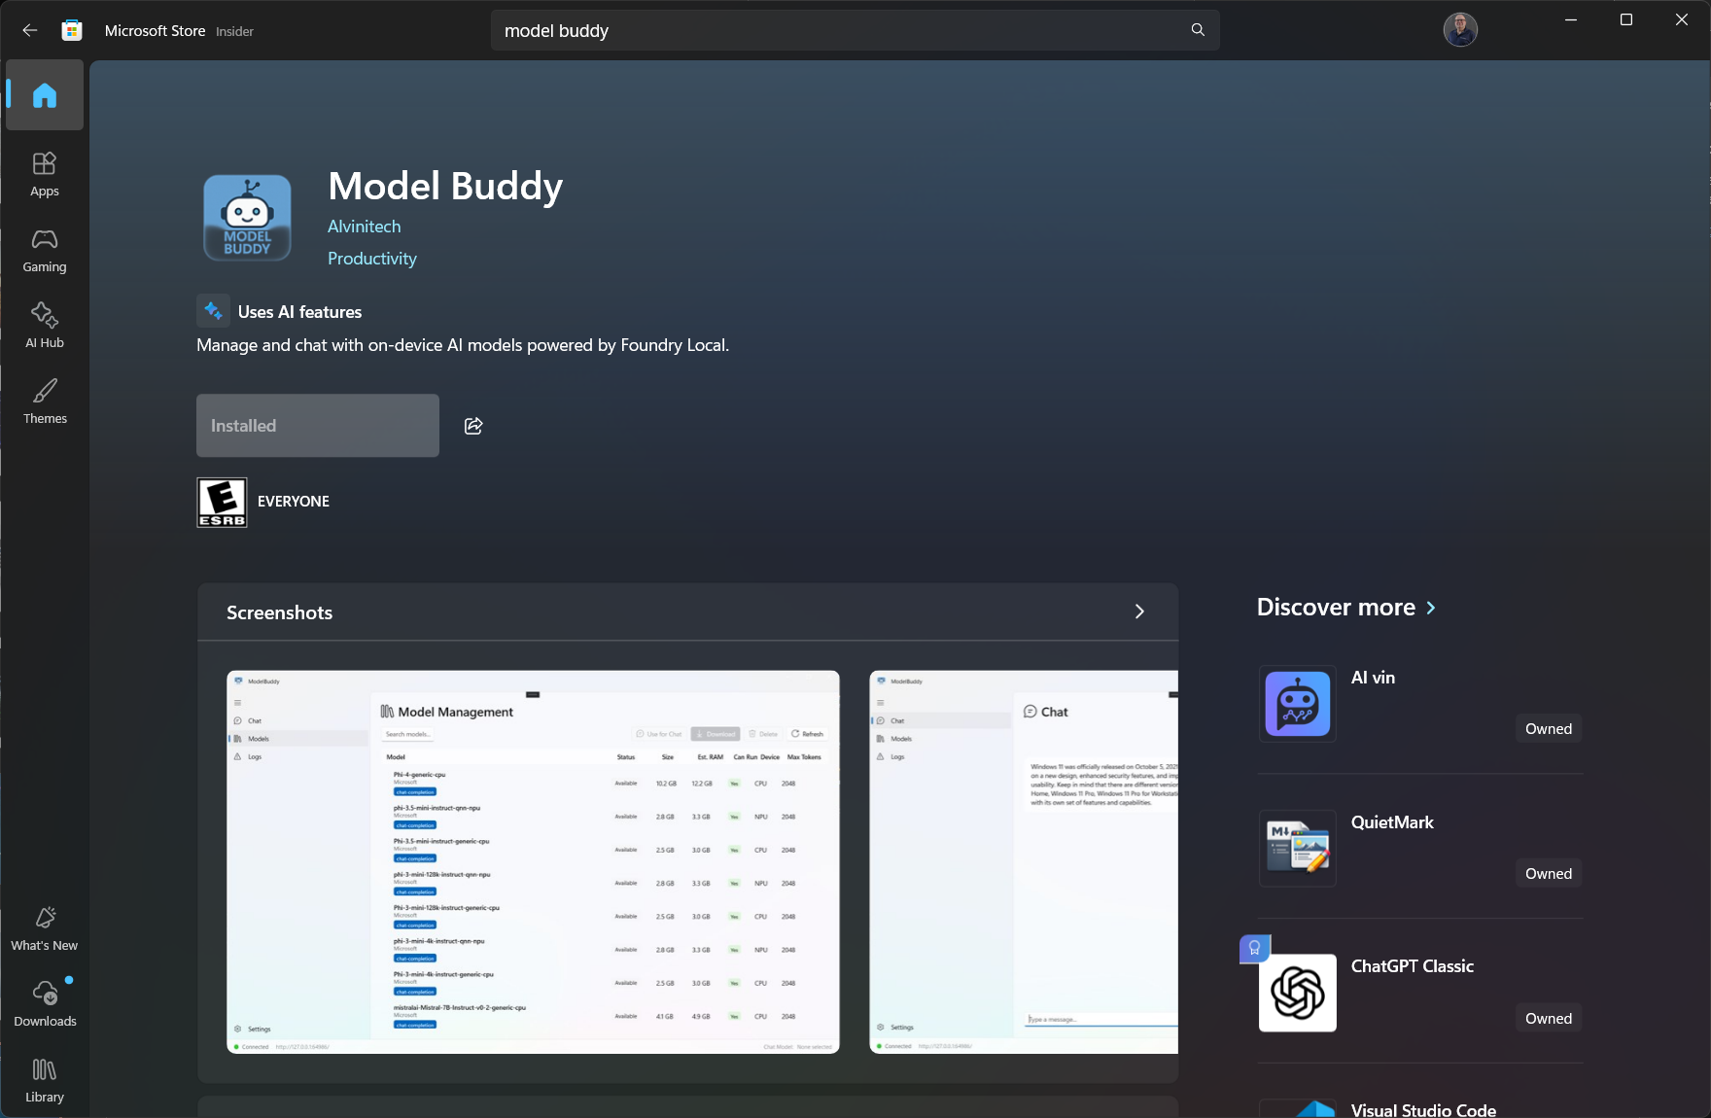
My WinUI apps w/ Windows AI
Notes:
This year, I’ve published a few apps to the Microsoft Store. Two of them are created with WinUI and consume AI APIs.
AI-vin is a WinUI AI chat app that can use local models in Microsoft Foundry Local or Ollama or you can use your OpenAI key to use one of their cloud models.
Model Buddy is an app for managing your Foundry Local models. You can download or remove models from your Foundry Local instance. It also has a chat interface, although not as feature-rich as AI-vin’s.
Let’s take a quick look.

Slide 13
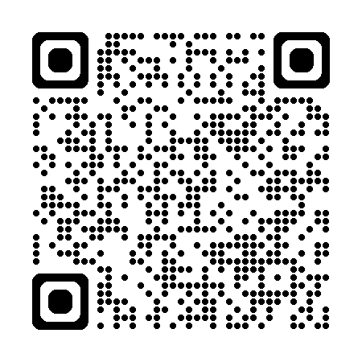
Thank you!
Any questions?
Contact me: alashcraft@gmail.com
Learn more in the Windows AI docs on Microsoft Learn:
Notes:
Thank you! Any questions?
If not, you can use the QR code here to get to the Windows AI docs on Learn.

Slide 14
Session Survey
Your feedback is very important to us
Please take a moment to complete the session survey found in the mobile app
Use the QR code or search for “Converge360 Events” in your app store
Find this session on the Agenda tab
Click “Session Evaluation”
Thank you!
Notes:
And don’t forget to do your evals!

