Slide 1

Supercharge Your Agents: Custom Tools, MCP, and Microsoft Foundry
Alvin Ashcraft
Sr. Content Developer - Microsoft
Notes:
Welcome! This session will provide a practical tour of Foundry agent services capabilities beyond the basic chat prompt.
The three anchors are custom tools, MCP, and Microsoft Foundry as the management and hosting layer.
We’ll see two concrete demos: deploy & call a hosted agent and compose & leverage a reusable toolbox.

Slide 2
About me
Software industry over 30 years
Morning Dew link blog
Authored three books – Packt Publishing
Content developer at Microsoft since 2022
TechBash dev conference organizer since 2015
Notes:
A little bit about me:
I’ve been building or writing about software for over 30 years
I spent the first 25 years as a developer and architect
Joined Microsoft in 2022 – currently working on the Azure OpenAI docs in Microsoft Foundry
May know my Dew Drop link blog posts that I’ve been sharing since 2007 on my blog at alvinashcraft.com
I’ve written three books for .NET developers and I’m co-authoring a new one on MCP for .NET devs
And I’m also a conference organizer. I help run the TechBash dev conference at the Kalahari Resort in Pennsylvania

Slide 3

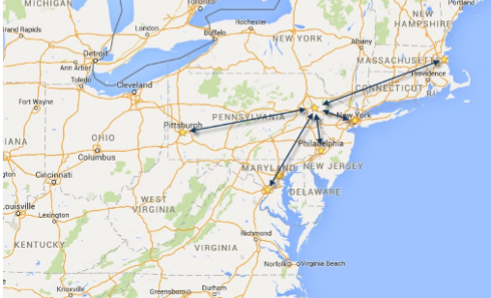

October 13-16, 2026 | Pocono Manor, PA
Great speakers with top content
A fraction of the cost of the more crowded conferences
- 3-day conference plus lodging for ~$1000
Full-day deep dive preconference sessions available
Easy travel from almost anywhere
World-class keynotes
In addition to the sessions, you get a great hallway
Track, amazing food, attendee Welcome Reception, Game Night & more
Family Day Friday - full day of kids' sessions, free for attendees' families
Discounted Kalahari Resort rooms with water park access: stay, learn & play all week
https://techbash.com or @techbash
Notes:
If you happen to be in the states in October, come join us at TechBash!
We have three days of sessions, and an optional workshop day.

Slide 4
Agenda
What is Microsoft Foundry?
Overview of Foundry Agent Services
Hosted Agents in Foundry
Agent Tools
Toolboxes in Foundry
Manage agents at scale
Q&A
Notes:
The Foundry Agents arc:
Platform
Agent-service choices
Hosted-agent demo
Tools and MCP
Toolbox demo
Operations and management
Along the way, we’ll watch for the boundary between code you own and capabilities Foundry manages.

Slide 5
What is Microsoft Foundry?
AI services
Agents/models/tools
Enterprise capabilities and configurations
Unified role-based access control (RBAC) and policies
Networking services
https://ai.azure.com/
Notes:
Microsoft Foundry is the Azure platform for building and operating AI applications and agents.
It brings together projects, model deployments, agent authoring, tools, evaluation, tracing, and governance.
It’s important to remember that Foundry is more than a model endpoint: the surrounding lifecycle is the point.

Slide 6

What can you build in Foundry?
Agents
Prompt agents
Hosted agents
Models
Nearly 2000 models
Microsoft, OpenAI, Anthropic, Meta, Grok, and more
Tools/knowledge
Built-in or custom tools
Notes:
At a high level, the models provide reasoning, agents provide behavior, and tools connect behavior to data and actions.
Types of agents in Foundry:
Prompt agents are configuration-based
Hosted agents are code-backed
Both can use tools
The model catalog is broad, but model availability, quotas, region, and tool support still matter.

Slide 7
Agent Services
Agent Runtime
Responses API
Publishing
Models
Identity
Security
Observability
Tools
Notes:
1:50pm
Agent Services in Foundry is the execution layer for agents.
Think about where your agent code should run and where state, identity, and telemetry should live.

Slide 8
Agent Services Options
Prompt Agents
Hosted Agents
Author in portal or SDKs
Foundry runs it for you
No compute, containers, or packages
Code your agent
Package in container
Run in Foundry
Managed endpoint
Scaling
Identity
Observability
Notes:
Prompt agents
Author in the portal or SDKs
Foundry runs the service for you
Hosted agents
Bring your code, packages, protocols, and runtime assumptions
Foundry supplies a managed endpoint and hosting lifecycle
Decide what suits your needs
Start with prompt agents for speed and managed execution. Think of it as an agent.md in the cloud.
Move to hosted agents when application code or runtime control is the requirement.

Slide 9
Building Hosted Agents
Bring your own code
SDK Options
C#, Python, Java, JS/TS, REST APIs
Protocol options
Control your compute resources in Foundry
Persist files and state
Demo – Create a hosted agent
Notes:
1:55pm
A hosted agent looks like other C# software development
Local loop (code, build, test locally)
Dependency management
Deployment, versions, and logs
The platform boundary removes infrastructure work without hiding the application boundary.
Let’s get into Demo 1:
We’ll see the project, discuss running locally, deployment, invoke the hosted agent, and inspect the result.

Slide 10
Extend agents with tools
Built-in tools
Web Search
Code Interpreter
File Search
Function Calling
Custom tools
Model-Context-Protocol (MCP)
Agent2Agent (A2A)
OpenAPI
Notes:
2:05pm
A tool lets the agent do something the model cannot otherwise reliably do:
Retrieve current information
Query data
Calculate, or take an action.
Function tools are a good fit for application-owned logic.
MCP is a good fit for reusable server-hosted capabilities.
Tool descriptions, authentication, approval, and data boundaries are part of the design.

Slide 11
Toolboxes in Foundry
Build
Select, configure and deploy tools in a toolbox
Build once, reuse across agents
Consume
Connect your agent to an MCP endpoint
Access all tools in the toolbox
Notes:
A toolbox bundles tools behind one MCP-compatible endpoint.
This centralizes reuse, credentials, policy, and versioning.
The agent consumes the contract rather than knowing every implementation detail.
We’ll use the Microsoft Learn MCP server in this demo
You’ll see current documentation retrieval with citations

Slide 12

Demo
Create and deploy a toolbox in Foundry
Notes:
2:10pm
Demo 2: create the connection, define the toolbox, add Web Search and Microsoft Learn MCP, attach the version to an agent, and ask a documentation question.
Pause on the tool call and the cited answer. That is the visible proof of grounding.
Show the version boundary: changing the bundle should not require changing the agent's core code.

Slide 13
Manage agents at scale
Microsoft Foundry Control Plane
Inventory
Observability
Tracing
Manage lifecycle events
Notes:
2:20pm
A single successful demo says little about production health.
The Foundry Control Plane provides inventory and lifecycle views across agents and projects
Application Insights-backed tracing exposes runs, errors, usage, and cost signals.
We’ll look at a trace if there’s time:
It contains the request, model spans, tool calls, latency, and conversation correlation.
Remember that traces can contain sensitive inputs and tool arguments.
It’s important to leverage access controls and redact sensitive content.

Slide 14
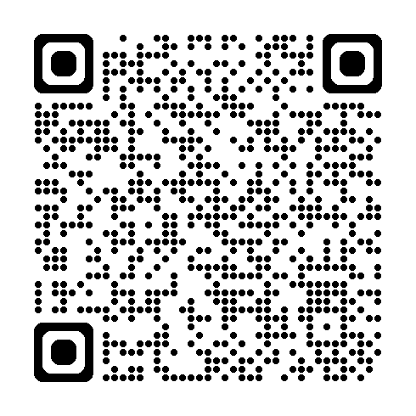
Additional Resources
Foundry docs on Microsoft Learn
Agent Services docs
Azure SDKs
REST API reference
Slides and demo code
Notes:
2:23pm
Get everything from the links file in my speaking repo, especially Foundry overview, hosted agents, MCP, toolboxes, and tracing.
Start with a small prompt agent or hosted sample, then add one tool with a clear contract.
Remember that preview labels, regional support, and SDK versions should be checked before production use.

Slide 15

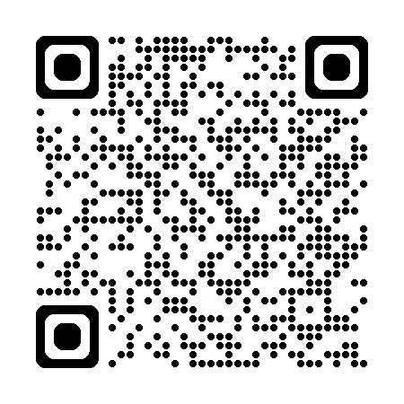
Thank you / Q&A
Any questions?
Contact me – alvin@alvinashcraft.com
Bluesky - https://bsky.app/profile/alvinashcraft.com
Notes:
2:25pm
Any questions about choosing the hosting model, connecting MCP servers, identity, and deployment workflows?
A practical summary of Foundry Agents:
Agents become useful when they can access the right tools, and maintainable when those tools and runtimes are managed deliberately.

