Slide 1

Explore Windows AI Development with the AI Dev Gallery
Alvin Ashcraft
Sr. Content Developer - Microsoft

Slide 2

Explore Windows AI Dev Options with the AI Dev Gallery
About Me
Alvin Ashcraft
Sr. Content Developer — Microsoft Learn
Microsoft Foundry documentation (Agent services & OpenAI)
github.com/alvinashcraft/speaking
alvinashcraft.com
bsky.app/profile/alvinashcraft.com
AI Agents Conference 2026

Slide 3
Explore Windows AI Dev Options with the AI Dev Gallery
Agenda
What is the AI Dev Gallery?
Key Features
Demos🎉
AI Agents Conference 2026

Slide 4
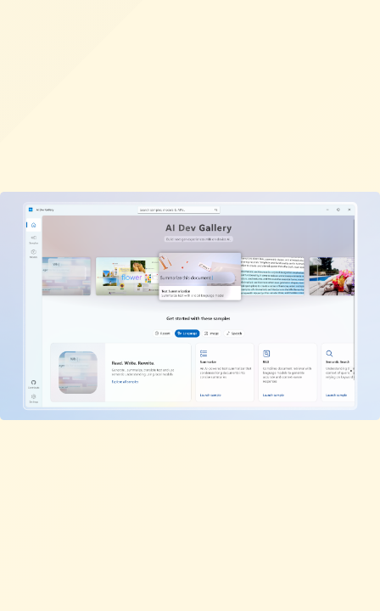
Explore Windows AI Dev Options with the AI Dev Gallery
What is the AI Dev Gallery?
Open-source Windows app from Microsoft
Build and run from GitHub source
Available free in the Microsoft Store
Integrate AI capabilities into your native Windows apps
Discover AI scenarios, projects, & models
Built with WinUI & Windows App SDK
AI Agents Conference 2026

Slide 5
Explore Windows AI Dev Options with the AI Dev Gallery
Key Features
🧠 Models & Samples
🛠️ Developer Experience
25+ interactive samples powered by local AI models
Browse and download models from Hugging Face and GitHub
Supports Phi Silica on Copilot+ PCs
View C# source code for every sample
Export standalone Visual Studio projects with a single click
Works offline — models run locally
Supports x64 and Arm64 PCs
AI Agents Conference 2026

Slide 6
🚀 Demo Time
Let's explore the AI Dev Gallery

Slide 7
Explore Windows AI Dev Options with the AI Dev Gallery
Resources
Microsoft Store — aka.ms/ai-dev-gallery-store
GitHub — github.com/microsoft/ai-dev-gallery
Windows AI Docs — learn.microsoft.com/windows/ai
AI Agents Conference 2026

Slide 8
Thank You!
Questions?
alvinashcraft.com · bsky.app/profile/alvinashcraft.com

