Slide 1

WDI: Project 1
Music Album Matching Memory Game
Alvin Chun

Slide 2
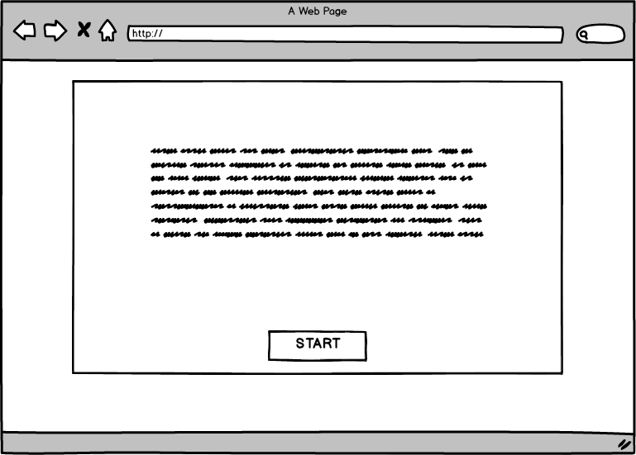
Instruction
Start Button

Slide 3
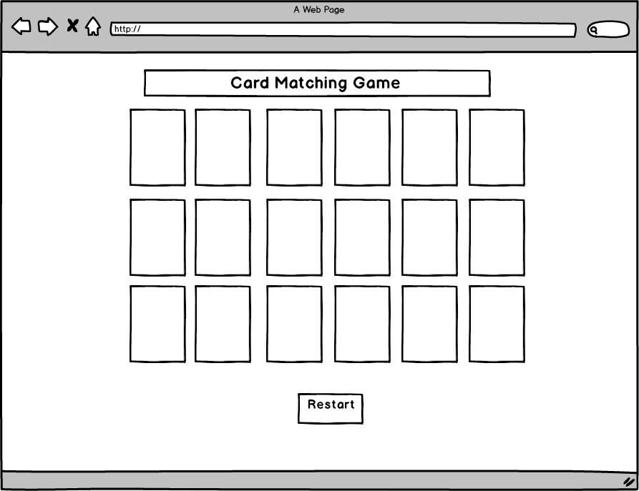
Matching 18 Music Album Jacket Cards
Restart Button
Background Music Playing

Slide 4
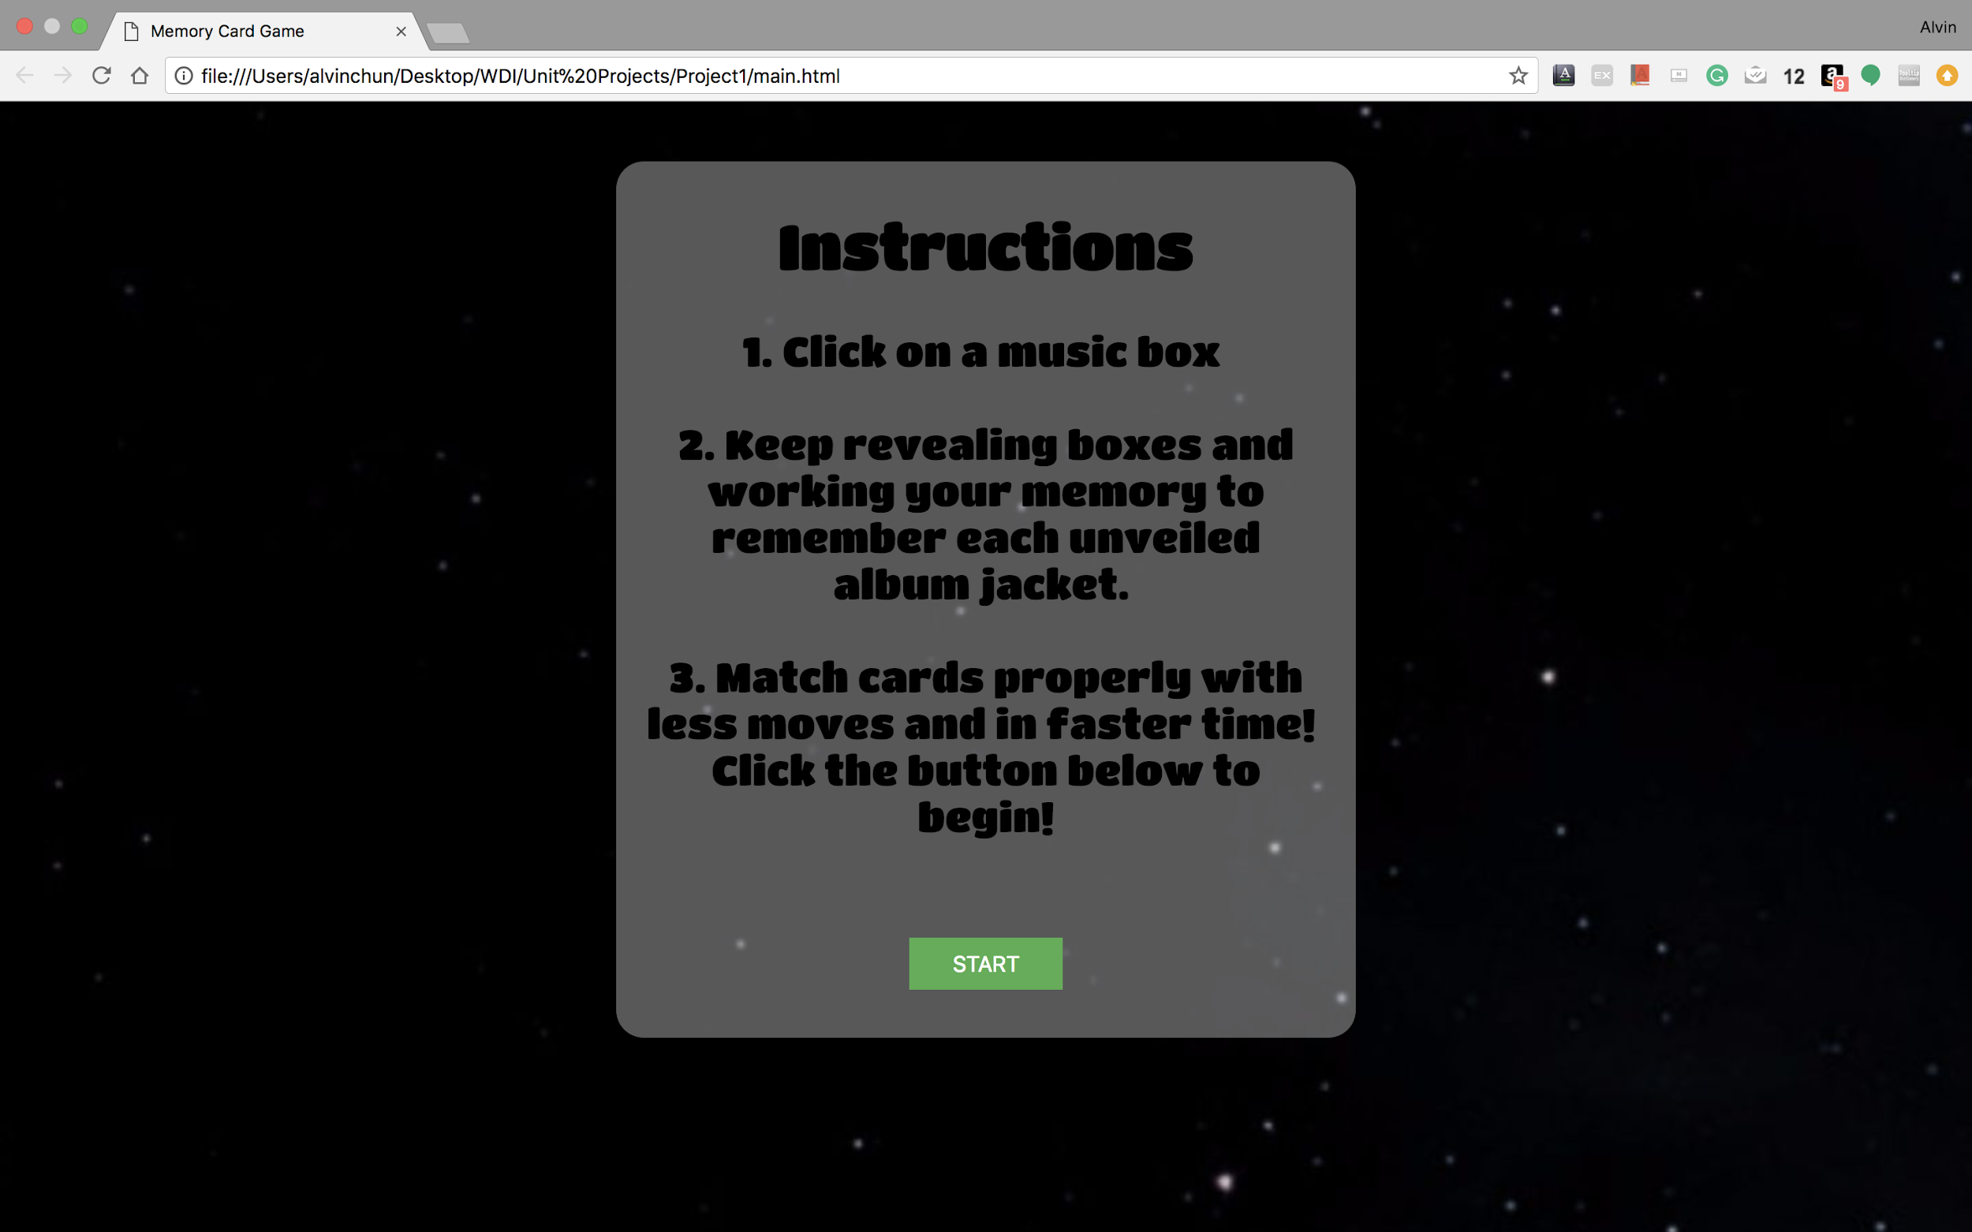

Slide 5
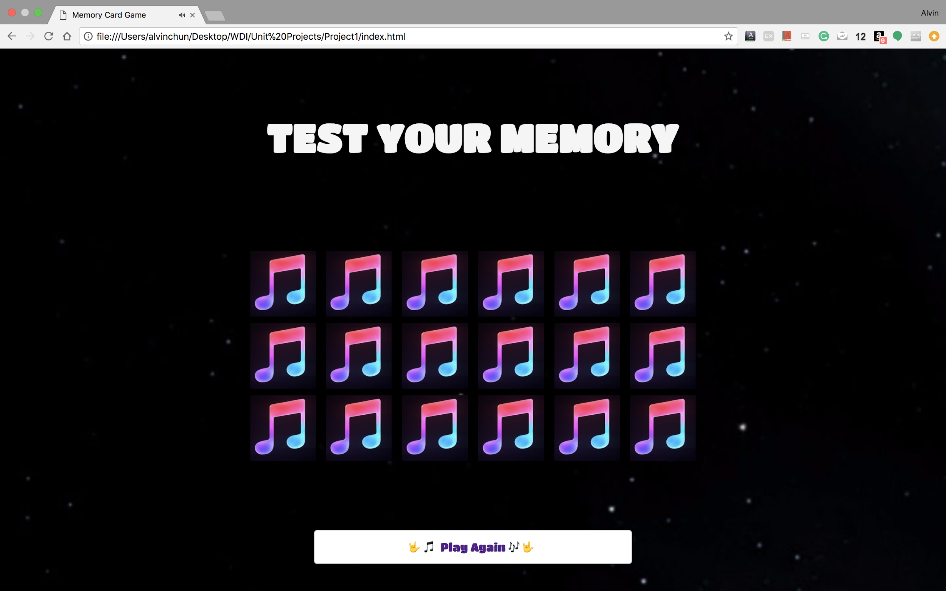

Slide 6
