Slide 1
Good Morning
Notes:
Before we dive into the software, just a brief introduction on why this software was created
And it starts with the title of my FYP

Slide 2
Title of my FYP
Saving victims’ lives by empowering
Emergency Response Service
using voice recognition and natural language processing technology
Notes:
It’s a long title, really reflects what the software is trying to achieve

Slide 3
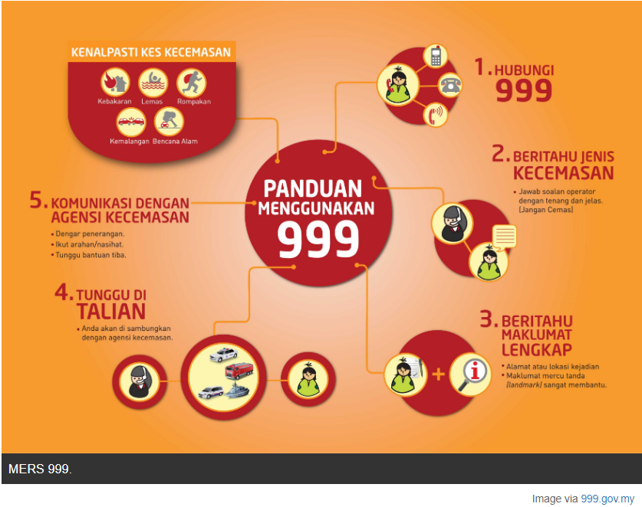
Notes:
The process that we are all familiar, so take calling for ambulance help as an example,
to visualize it in a flowchart

Slide 4
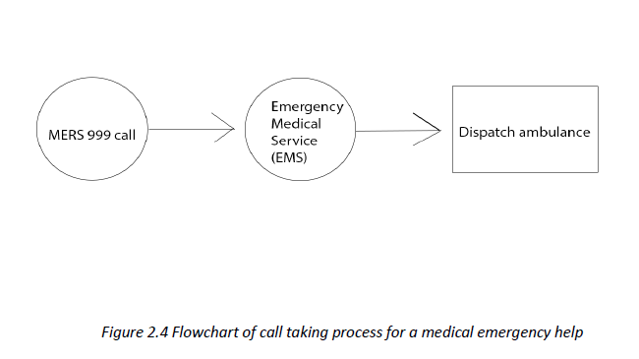

Slide 5
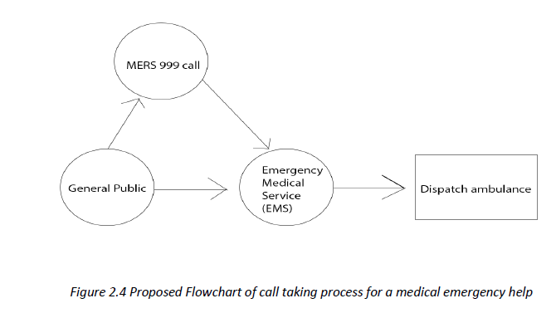
Notes:
This is the newly designed flow,
Having mers 999 as an operator
So how do we contact EMS directly??

Slide 6
Title of my FYP
Saving victims’ lives by empowering
Emergency Response Service
using voice recognition and natural language processing technology
Notes:
Use voice recognition in what sense?
Use it during the emergency
Since most of the time, we are telling the same problems and

Slide 7
DEMO
Notes:
Use voice recognition in what sense?
Use it during the emergency
Since most of the time, we are telling the same problems and

Slide 8


Slide 9

Thank you

Slide 10
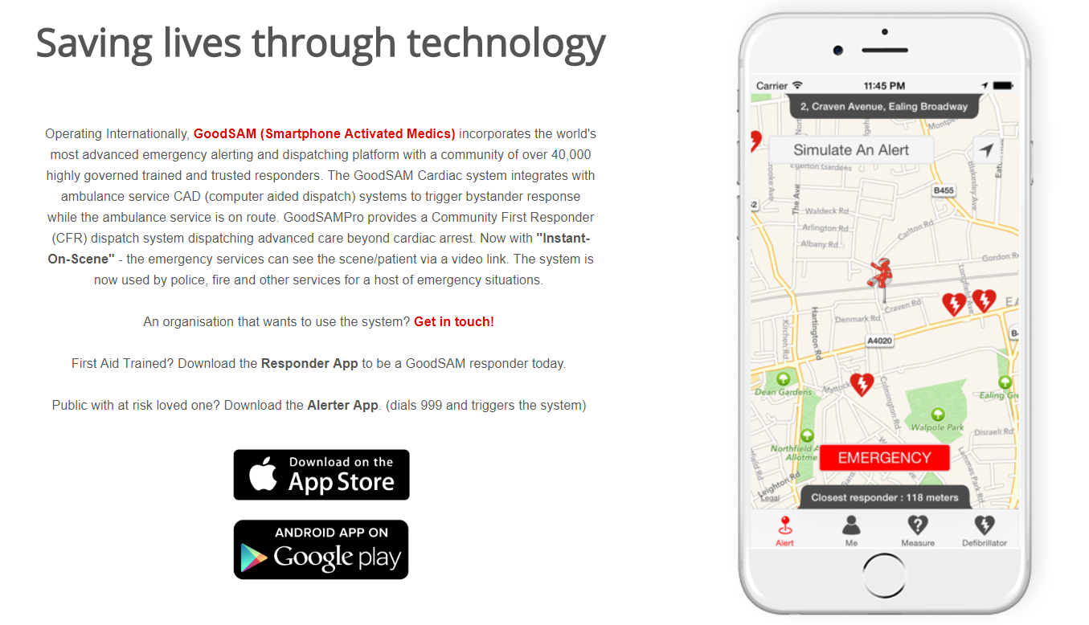

Slide 11
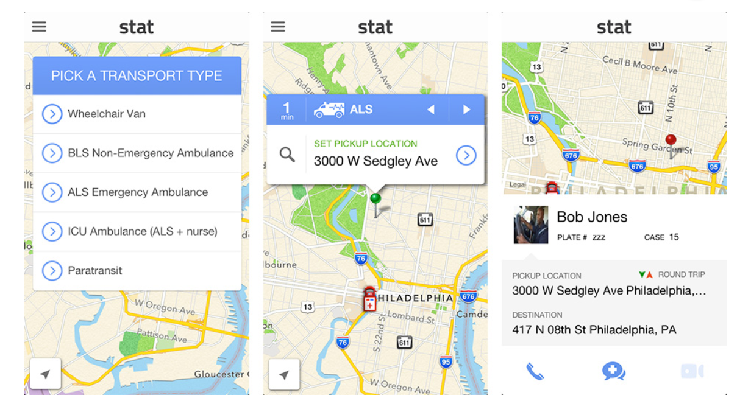

Slide 12
Computer Telephony Interface (CTI)
• Cutting-edge computer telephone technology delivers the latest tech in call processing to filter spam calls
• CTI integrates with the emergency lines allowing to delimit safety parameter from an address and instantaneously produce an exhausting list of addresses
Computer Aided Dispatching (CAD) system
• A powerful real-time command & control process, that tracks information relating to all calls and field unit activities
• Captures incident related information, resource availability, resource status & resource recommendation
Geographical Information System (GIS).
• Integrated to the CAD System as a tool in visualizing the overall situation
• Can visualize the location of calls, incident, vehicles & resources tracking through GPS & Automated Vehicle Location System (AVLS)

Slide 13
Difficulties to determine the precise incident location (5km or more radius)
Data accuracy from the cellular provider (Longitude and Latitude) and profile of the caller might be different
The geocoding process must be improved continuously due to the dynamic movement of the telephone subscribers and new development of residential areas
Geographical Map in the system need to be updated due to the changing landscape from constant new developments in the area
Sharing of common information among all different emergency departments must be consistent

