Slide 1
CA1
Alvin Lim

Slide 2
Step 3: Impute missing values and transforming of variables
Step 1: Import data using CSV format
Step 5: Briefly summaries the model findings and insights
Import data
Descriptive data
Data Transformation
Selecting predictors and models
Analyze different predictive models
Step 2: Understanding the data structure and variable type
Step 4: Select model(s) that is most appropriate for the dataset.
Notes:
1. Import csv
2. Understanding the data structure and also the variable type through the use of descriptive statistics.
3. If there are missing variables I would impute missing, for the king county housing I did not have to impute as there were no missing values. This is step include feature engineering
4. After ensuring that my dataset is ready, I will divide my dataset into train and test data. Both of the datasets I used a 80% train and a 20% test split. I will select the most appropriate model.
5. Lastly, summaries the model performance

Slide 3
Predictors and model (factory dataset)
Baseline Linear Regression
Xgboost
Variables
Quality, Ambient T, Process T C, Rotation Speed rpm, Torque Nm, Tool Wear min, Machine Status
Dummy variables
Model type S, Model type T, Model type Z
Feature engineering
Power (Rotation Speed * Torque Nm), TorqueMean, ToolWearMax, TorqueRollingMean
Notes:
For e.g. in the factory.csv I used Xgboost to handle the imbalance classes

Slide 4
Factory dataset – Classification
Baseline Linear Regression | Precision | Recall | F1-score | Support
Normal | 0.97 | 1.00 | 0.98 | 3863
Abnormal | 0.66 | 0.14 | 0.23 | 137
AUC (Area Under Curve): 0.568 (3.d.p)
XGboost | Precision | Recall | F1-score | Support
Normal | 1.00 | 1.00 | 1.00 | 3863
Abnormal | 0.93 | 0.90 | 0.91 | 137
AUC (Area Under Curve): 0.994 (3.d.p)
Notes:
The baseline model AUC suggest that the features are no better than chance at categorising the machine into normal or abnormal
The features created and the nonlinear model help to predict the machine status better

Slide 5
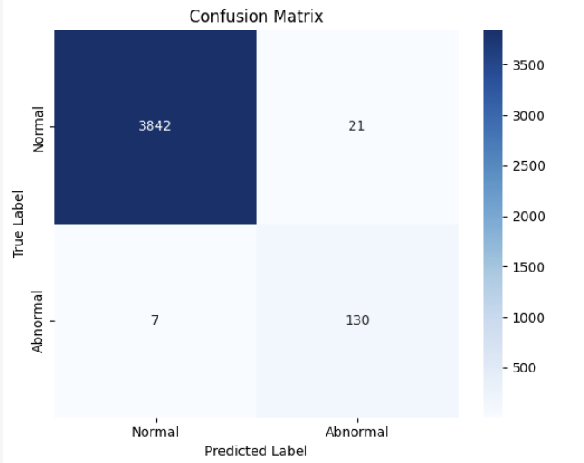
Confusion matrix (Xgboost)
Notes:
As shown by the accuracy, the model seems to be doing well in categorising the true positive and true negatives.

Slide 6
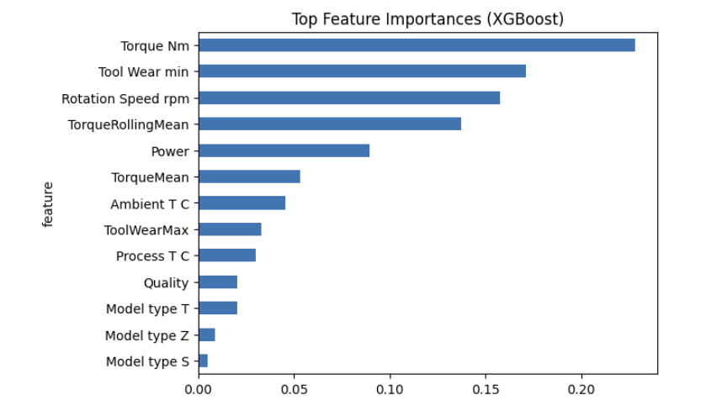
Feature importance

Slide 7
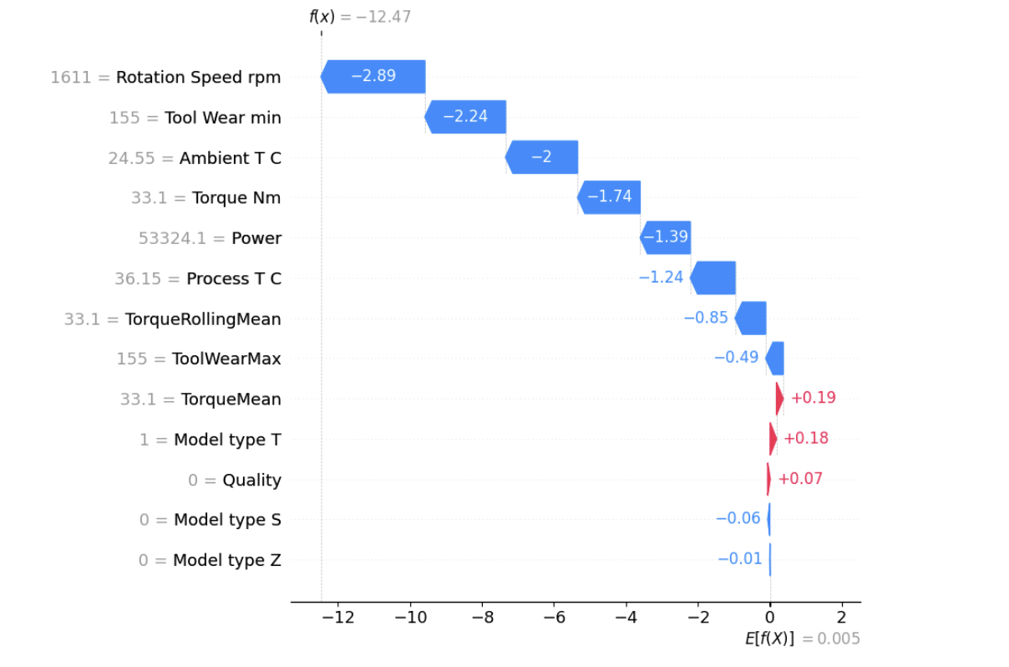
Shap Waterfall plot
Notes:
# Gives the contribution of each feature to the model's output for a specific prediction. # The output is sequential view of how features influence the model's prediction# Features pushing the prediction higher are shown in red, while those pushing it lower are in blue.# Machine Status: 0 means normal, 1 means abnormal
Rotation Speed rpm = 1611 ➜ pushed the prediction down by -2.89 → likely a normal behavior.
Tool Wear min = 155 ➜ also pushed it down by -2.24.

Slide 8
Summary
XGBoost significantly outperformed Logistic Regression, highlighting the importance of capturing nonlinear relationships

Slide 9
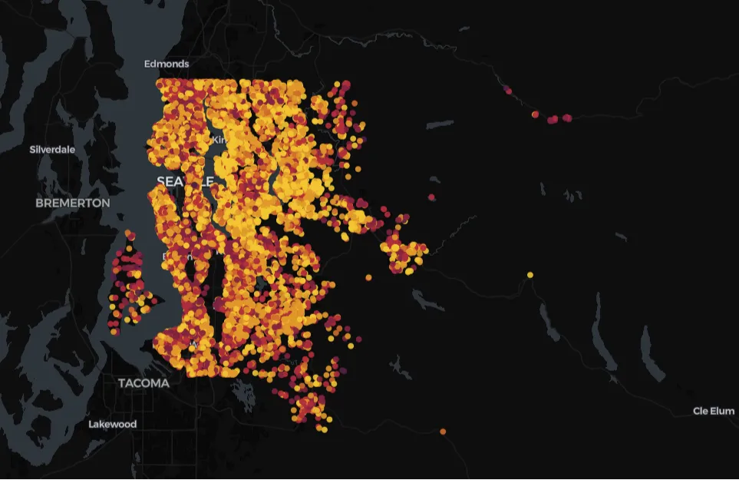
King County - Regression
Notes:
First. I plot these datapoints into a geospatial application. I notice there are some datapoints that don’t really fall into the distinct clusters. So I removed them. There were total of 21 datapoints. I felt that if I wouldn’t want to be purchasing those houses in real life therefore they are the outliers.

Slide 10
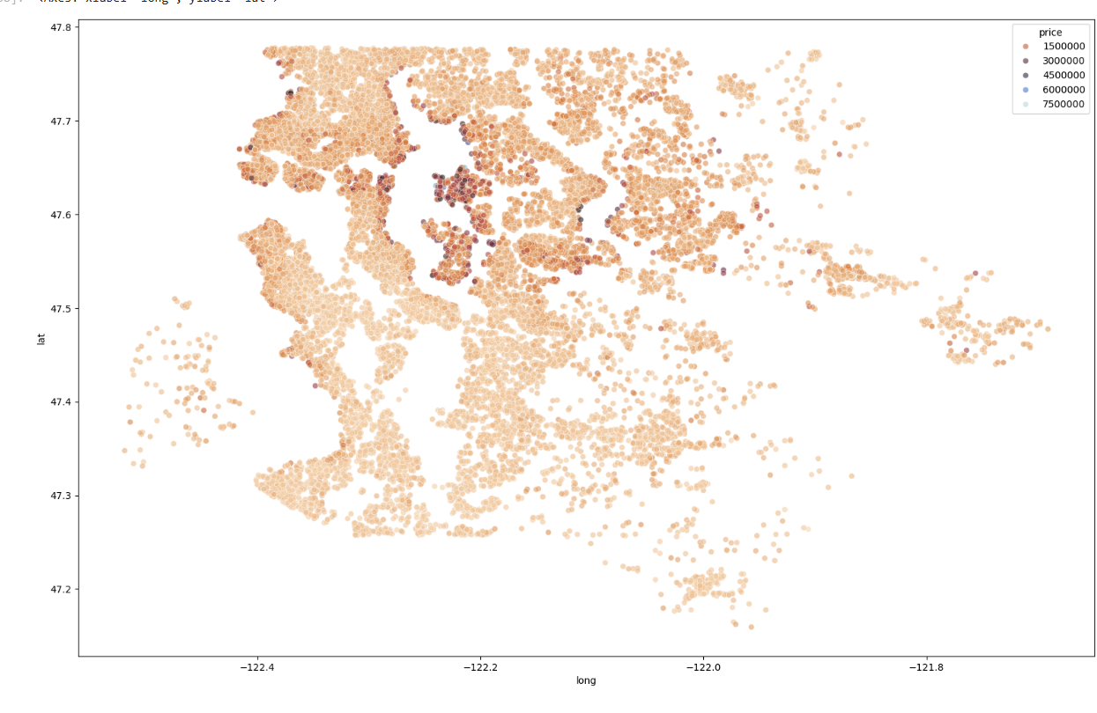
Price – Lat/Long scatterplot
Notes:
The data suggest that there are various hotpoints where the residents of king county stays, suggesting that they have some sort of district. It also appears that the waterfront location seem to command higher prices.

Slide 11
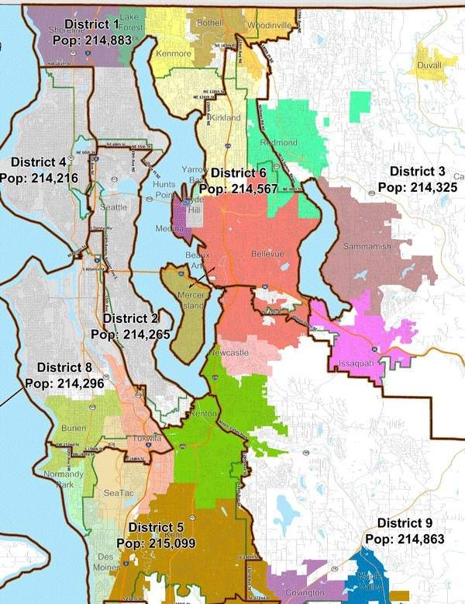
Dividing the dataset into various districts
Notes:
Dividing the datasets into various districts. Given that there are total of 70 zipcodes I did not want to have a overfitting model

Slide 12
Feature engineering
Variable Name | How the variable is calucated
zip_to_district | 70 zip codes into their 9 districts
distance_to_seattle_km | Calculates distance between Seattle and the latitude and longitude of each house. (Haversine formula)
seasons | Categorise each sale into their respective seasons
renovation_status | 1 represents renovated, 0 represents not renovated
basement_presence | 1 represents basement present, 0 represents basement not present.
Notes:
Given that there is evidence to support that certain months have higher sales. 3 <= month <= 5: return 'Spring'

Slide 13
Models used
Model used | Features added | Features Dropped
Baseline Linear Regression without features |  | 'id', 'lat', 'long', 'date','zipcode'
Linear Regression with features | zip_to_district, distance_to_seattle_km, seasons | 'id', 'lat', 'long', 'date','zipcode’ 'sqft_living15', 'sqft_living15’, 'sqft_lot15, 'yr_renovated'
Polynomial Regression with features | zip_to_district, distance_to_seattle_km, seasons | 'id', 'lat', 'long', 'date','zipcode’ 'sqft_living15', 'sqft_living15’, 'sqft_lot15, 'yr_renovated'
Notes:
corerlation

Slide 14
Models performance
Model | R2 Score | Root Mean Squared Error (RMSE)
Polynomial Regression with features | 0.8606 | 135101.194
Linear Regression with features | 0.7486 | 181407.804
Baseline Linear Regression without features | 0.6553 | 212413.289

Slide 15
Understanding of the model (coefficients)
Model | Top 3 Positive coefficients | Top 3 Negative coefficients
Polynomial Regression with features | sqft_lot zipcodemapping_4 distance_to_seattle_km zipcodemapping_4 sqft_lot | distance_to_seattle_km , distance_to_seattle_km zipcodemapping_3, distance_to_seattle_km zipcodemapping_1
Linear Regression with features | sqft_living , sqft_above , grade | distance_to_seattle_km , zipcodemapping_5, yr_built
Baseline Linear Regression without features | sqft_living , sqft_above, grade | distance_to_seattle_km , zipcodemapping_5 , yr_built
Notes:
Polynomial Regression with features – pairwise combination suggests that

Slide 16
Summary
Polynomial regression improved performance by modelling feature interactions.
Locations and the presence of waterfront strongly affect the housing price

