Slide 1
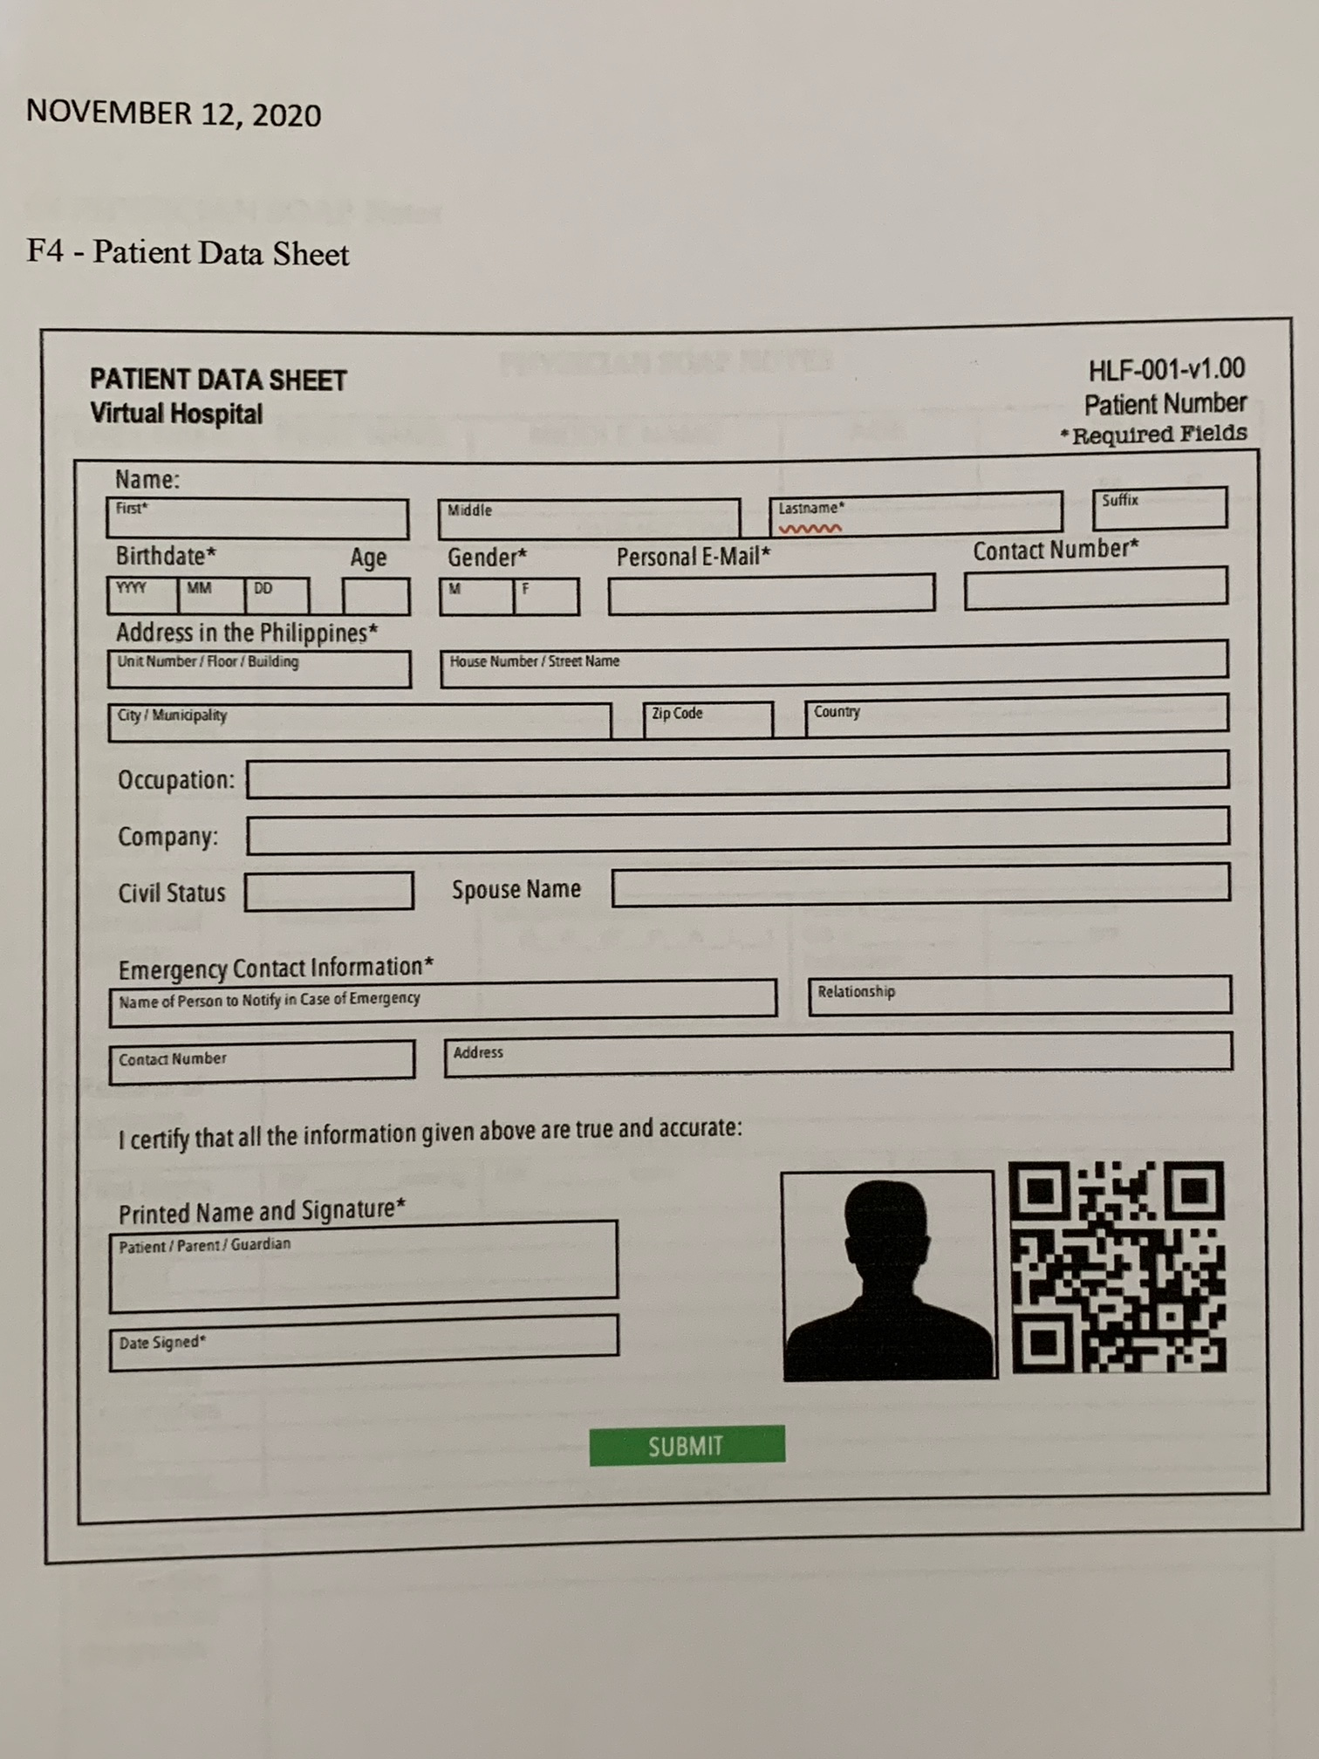
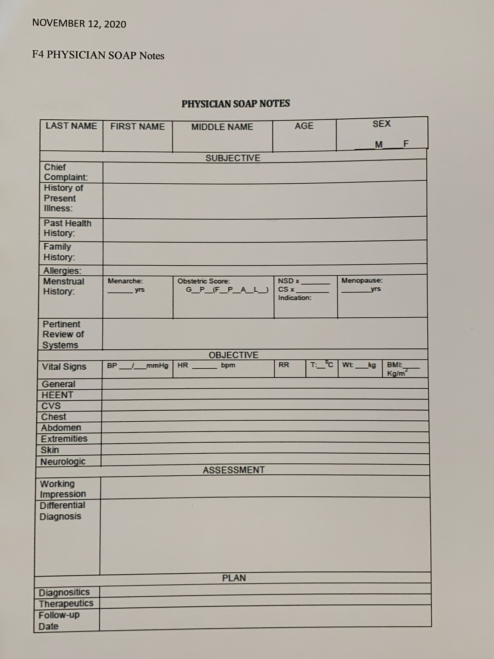
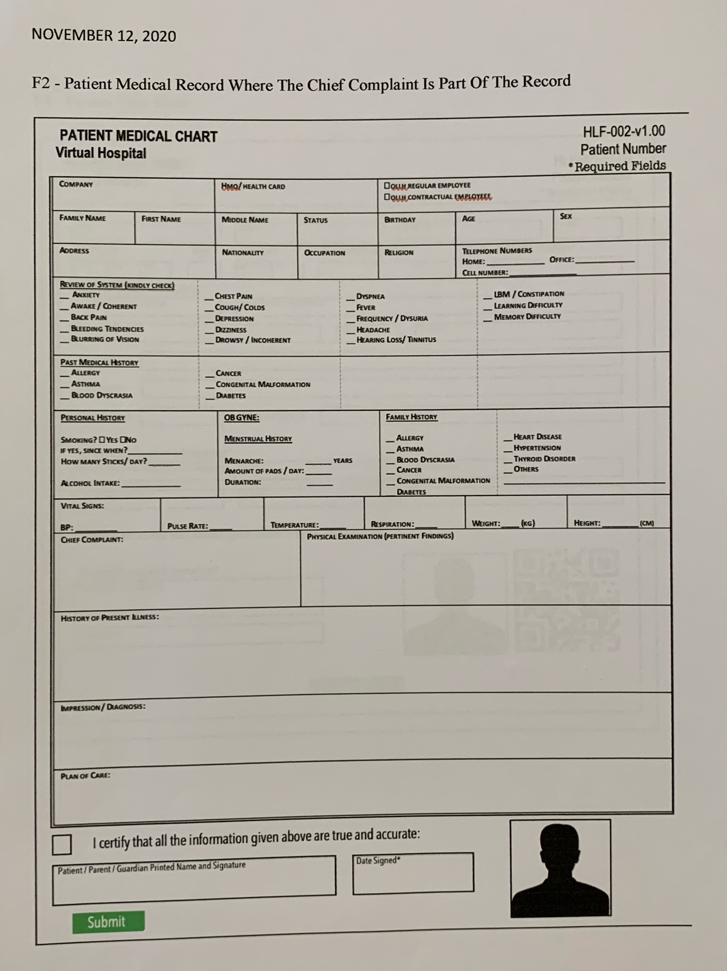
COMPLETE VIEW OF FORMS
PATIENT DATA SHEET
PHYSICIAN SOAP
PATIENT MEDICAL RECORDS

Slide 2
PATIENT DATA SHEET

Slide 3
PATIENT MINIMUM
DATA SHEET. This should be included in the different views, not necessarily filled up everytime.

Slide 4
PATIENT MEDICAL HISTORY

Slide 5
CHIEF COMPLAINT FORM

Slide 6
PHYSICIAL NOTES/SOAP
WHICH INCLUDES THE CHIEF COMPLAINT FORM

Slide 7
PHYSICIAL NOTES/SOAP
WITHOUT THE CHIEF COMPLAINT FORM

