Slide 1
Images For Introducing
New BCD Instructions

Slide 2
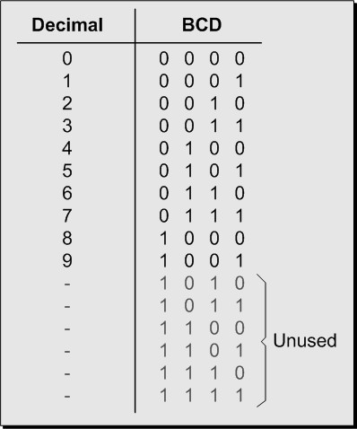
Decimal to BCD mapping

Slide 3
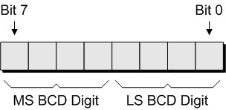
Two BCD digits packed into an 8-bit byte

Slide 4
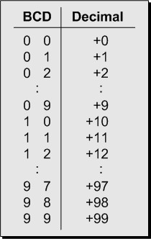
Unsigned BCD: A single byte with two BCD digits
can represent numbers in the range 0 to +99

Slide 5
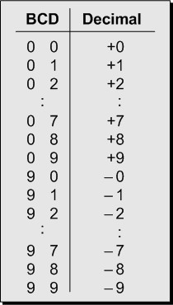
Sign-magnitude BCD: A single byte with two BCD digits can
represent numbers in the range -9 to +9 (with -0 and +0)

Slide 6
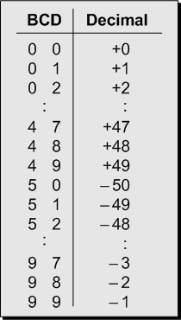
Signed (tens complement) BCD: A single byte with two BCD
digits can represent numbers in the range -50 to +49

Slide 7
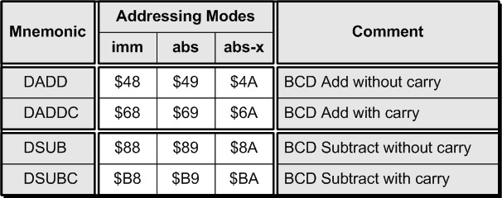
New BCD instructions and associated opcodes

Slide 8
$27 + $15 = $3C in binary using the ADD instruction
$27 + $15 = $42 in BCD using the DADD instruction
Comparison of binary and BCD additions

Slide 9
1362 + 2257 = 3619
Load the accumulator with $62.
Use a DADD instruction to add $57 with a
carry-in of 0.
Store this LS byte of the result.
Load the accumulator with $13.
Use a DADDC instruction to add $22 along
with the current contents of the carry flag.
Store this MS byte of the result.
Addition example

Slide 10
6735 - 2352 = 4383
Load the accumulator with $35.
Use a DSUB instruction to subtract $52 with a carry-in of 1.
Store this LS byte of the result.
Load the accumulator with $67.
Use a DSUBC instruction to subtract $23 along with the current contents of the carry flag.
Store this MS byte of the result.
Subtraction example

Slide 11
Remember that 6,735 – 2,352 is the same as saying 6,735 + (–2,352), and that this is the same as saying 6,735 + (the tens complement of 2,352).
Also remember that we can generate the nines complement of a decimal value by subtracting it from a value of all nines; thus, the nines complement of 2,352 is 9,999 – 2,352 = 7,647.
Furthermore, the tens complement of a decimal value is its nines complement + 1; thus, the tens complement of 2,352 = 7,647 + 1 = 7,648.
Subtraction example (continued)

Slide 12
So now we have the following progression:
6.735 – 2,352
= 6.735 + (–2,352)
= 6.735 + (the tens complement of 2,352)
= 6,753 + (the nines complement of 2,352 + 1)
= 6.735 + 7647 + 1
= 14,383
= 4,383 (when we drop the final carry)
Keeping this in mind, the way the CPU actually performs the above operations is as follows
Subtraction example (continued)

Slide 13
Load the accumulator with $35.
Use a DSUB instruction to subtract $52 with a
carry-in of 1.
  Internally, the CPU subtracts $52 from $99 to give $47, which is the nines complement of $52. The CPU then adds this value to the accumulator (using a BCD add of course) along with a carry-in set to 1 (where this carry-in of 1 is what gives us the tens complement of the number to be subtracted).
Store this LS byte of the result.
Load the accumulator with $67.
Use a DSUBC instruction to subtract $23 along with the current contents of the carry flag.
  Internally, the CPU subtracts $23 from $99 to give $76, which is the nines complement of $23. The CPU then adds this value to the accumulator (using a BCD add of course) along with the current contents of the carry flag.
Store this MS byte of the result.
Subtraction example (continued)

