Slide 1
Images From the Workbench 101
Topic On the “Demos” Page

Slide 2
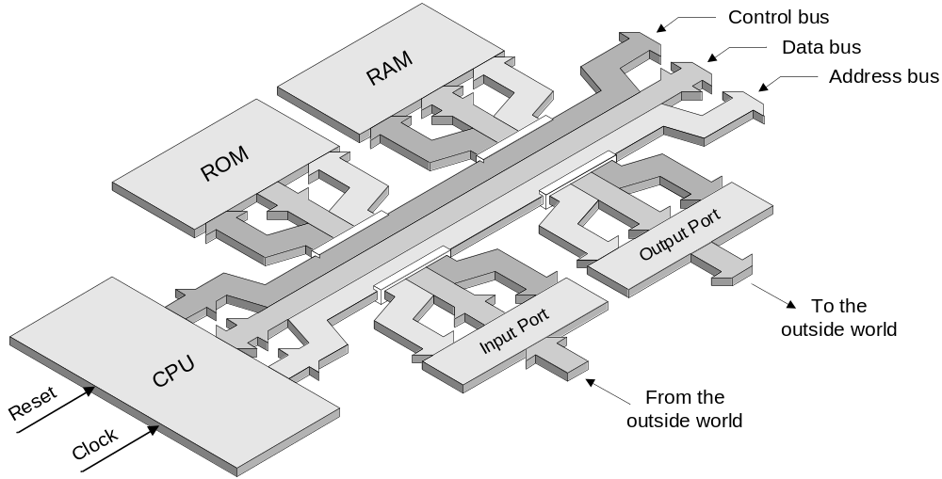
The main elements forming a computer

Slide 3
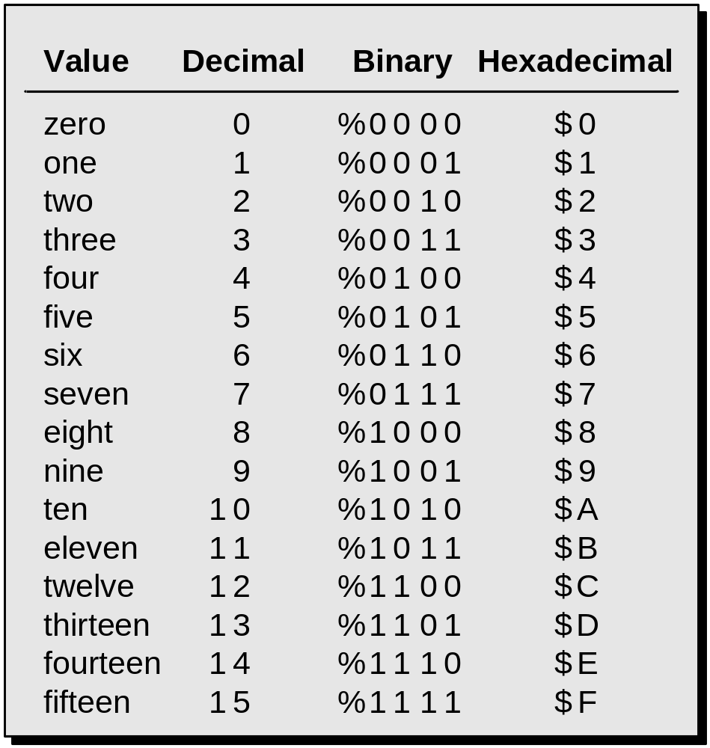
Binary and hexadecimal

Slide 4
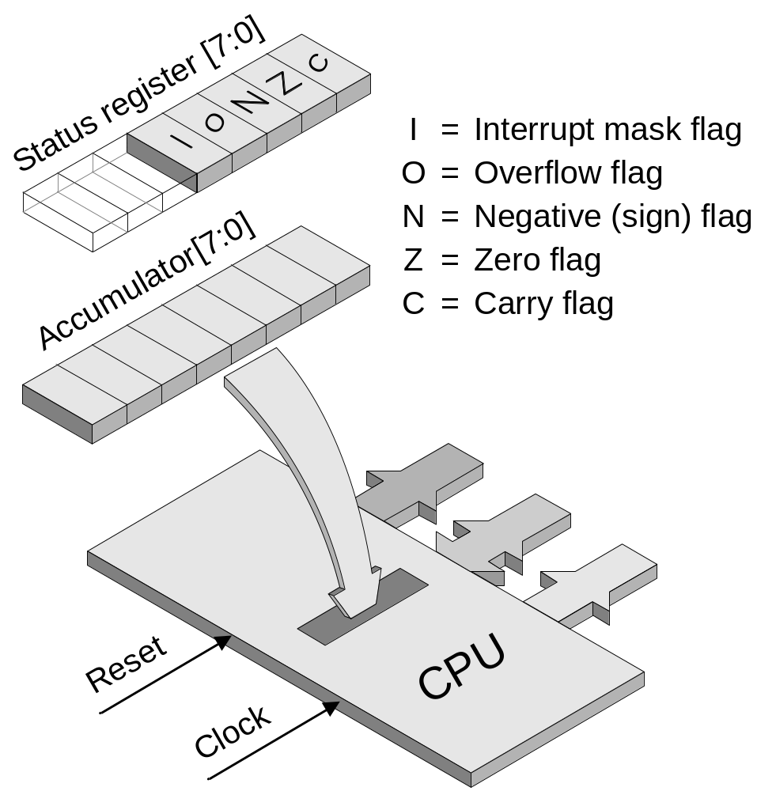
The accumulator (ACC) and status register (SR)

Slide 5
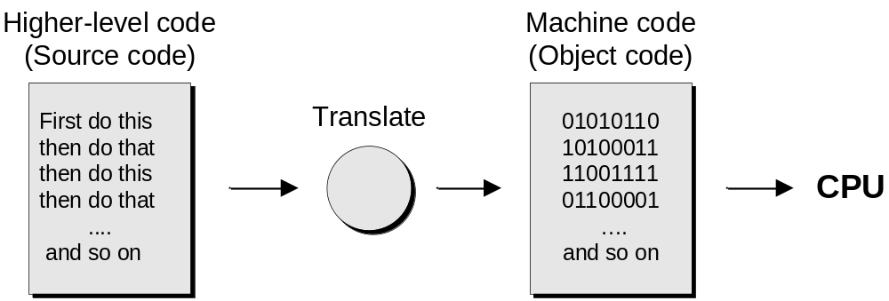
If we wished, we could feed programs and data values into a computer as machine code; that is, as a series of numerical values; for example:
$90 $10 $99 $F0 $31 $A0 $00 $00
$92 $40 $15 $D1 $00 $00 $99 $F0
Given a choice, however, we prefer to work at a higher level…
Working at a higher level than machine code

Slide 6
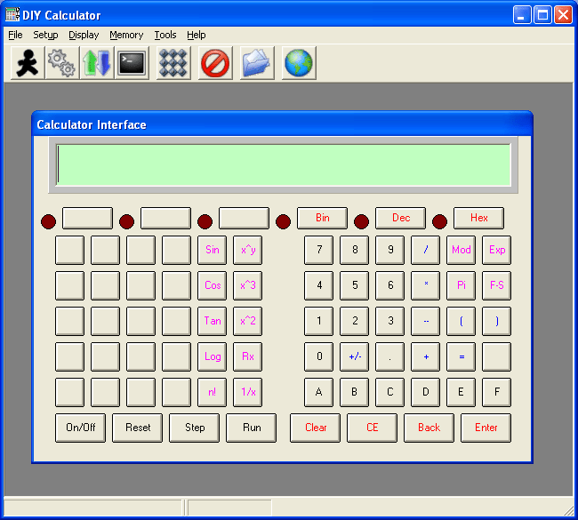
Screenshot of the DIY Calculator’s primary interface

Slide 7
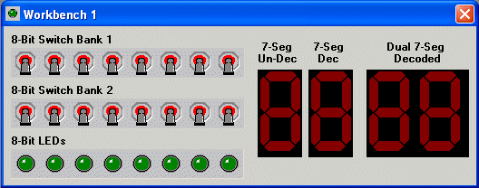
The Tools > Workbench #1 interface

Slide 8
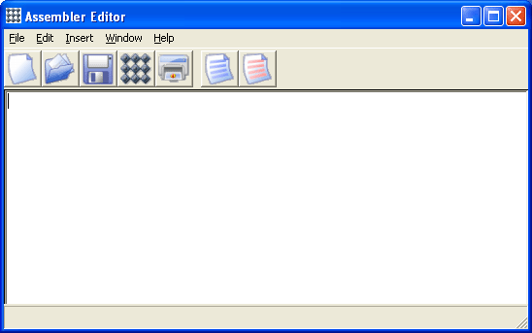
The DIY Calculator’s assembler

Slide 9
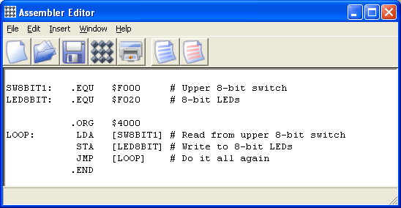
The program for Lab 1

Slide 10
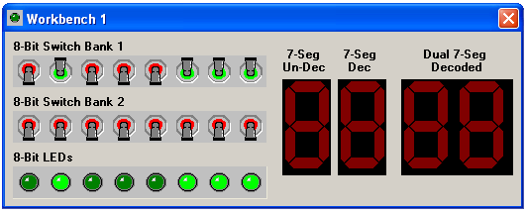
Reading from the 8-bit switches, writing to the 8-bit LEDs

Slide 11
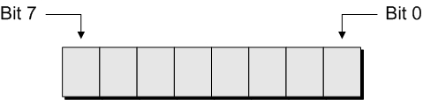
The CPU’s 8-bit accumulator (bits are numbered right-to-left from 0 to 7)

Slide 12
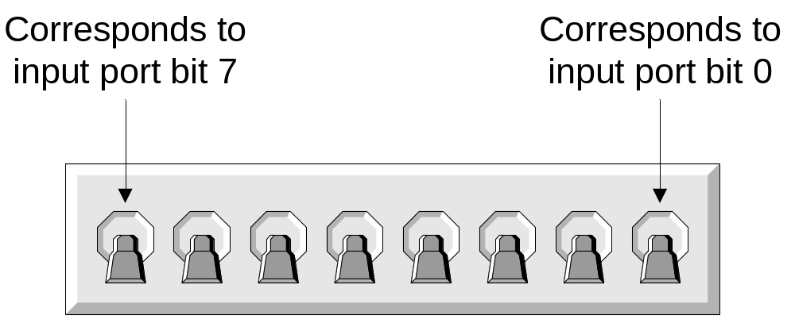
The upper bank of 8-bit switches (logical view)

Slide 13
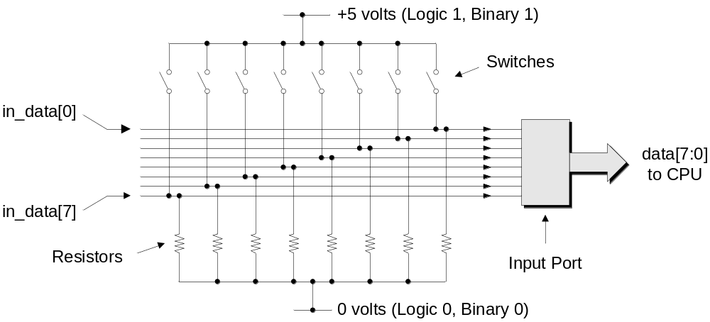
Circuit diagram of upper bank of 8-bit switches (all switches are open)

Slide 14
Upper bank switches 6, 2, 1, and 0 are Up / Closed / On

Slide 15

Circuit diagram, switches 6, 2, 1, and 0 are Closed / On

Slide 16
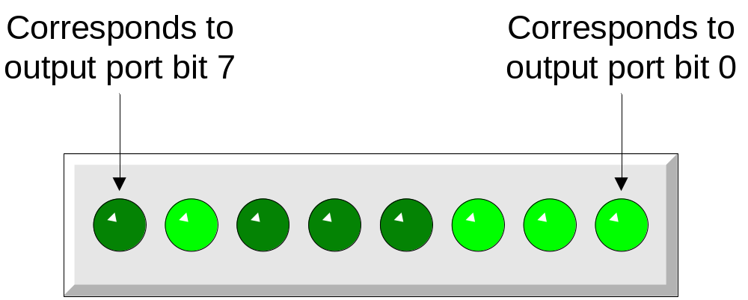
The 8-bit bank of LEDs (logical view)

Slide 17
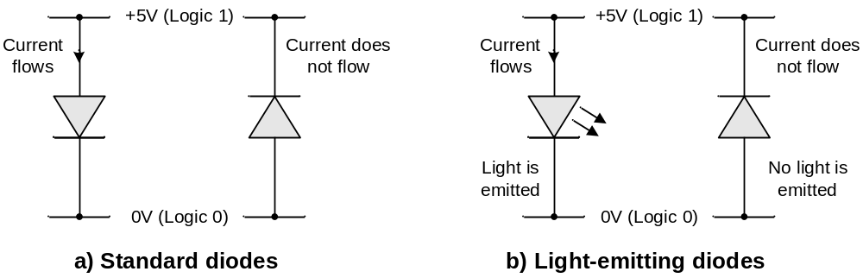
Standard semiconductor diodes versus light-emitting diodes (LEDs)

Slide 18
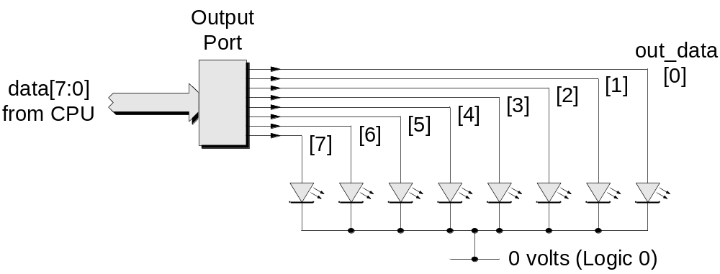
Circuit diagram for the bank of 8-bit LEDs

Slide 19
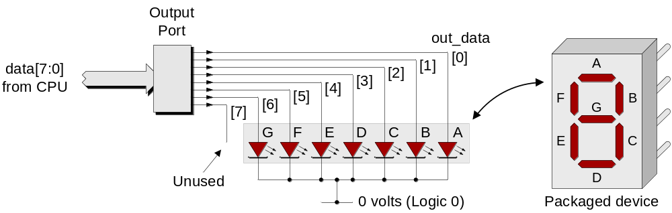
Single un-decoded 7-segment display

Slide 20
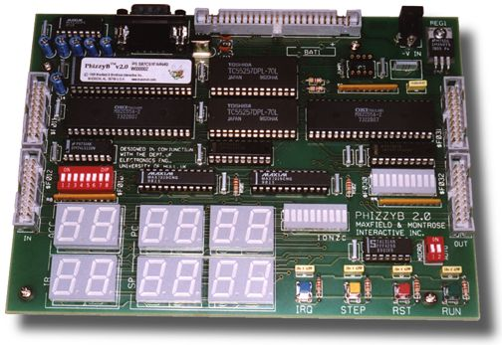
Real-world circuit board featuring a number of 7-segment displays

Slide 21
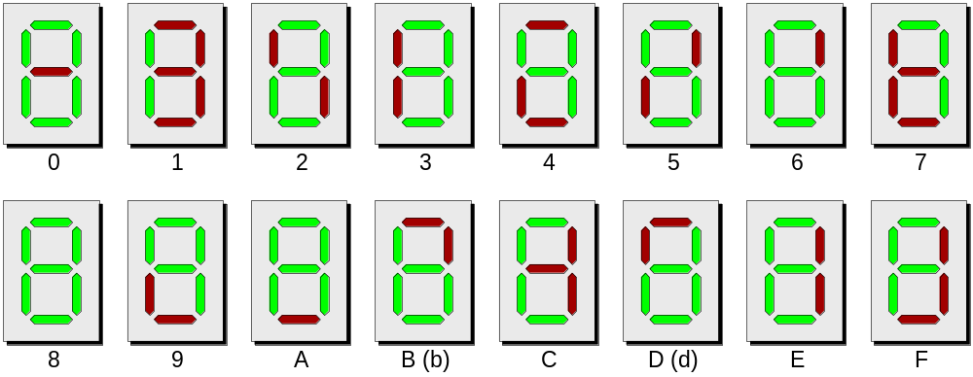
Representing the hexadecimal characters ‘0’ – ‘9’ and ‘A’ – ‘F’

Slide 22
SW8BIT1: .EQU $F000 # Upper 8-bit switches
LED8BIT: .EQU $F020 # 8-bit LEDs
SUD7SEG: .EQU $F021 # Single un-decoded 7-segment
.ORG $4000 # Set program origin
LOOP: LDA [SW8BIT1] # Read from upper 8-bit switches
STA [LED8BIT] # Write to 8-bit LED Display
STA [SUD7SEG] # Write to single un-dec 7-seg
JMP [LOOP] # Do it all again
.END
Modify program to write to single un-decoded 7-segment display

Slide 23
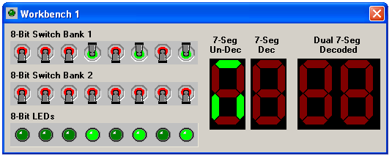
Writing to the single un-decoded 7-segment display

Slide 24
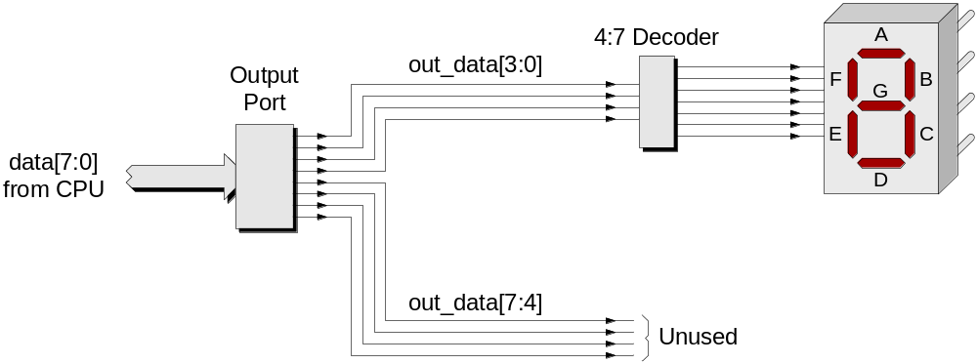
Single decoded 7-segment display

Slide 25
SW8BIT1: .EQU $F000 # Upper 8-bit switches
LED8BIT: .EQU $F020 # 8-bit LEDs
SUD7SEG: .EQU $F021 # Single un-decoded 7-segment
SD7SEG: .EQU $F022 # Single decoded 7-segment
.ORG $4000 # Set program origin
LOOP: LDA [SW8BIT1] # Read from upper 8-bit switches
STA [LED8BIT] # Write to 8-bit LED Display
STA [SD7SEG] # Single decoded 7-segment
STA [SUD7SEG] # Single un-decoded 7-segment
JMP [LOOP] # Do it all again
.END
Modify program to write to single decoded 7-segment display

Slide 26
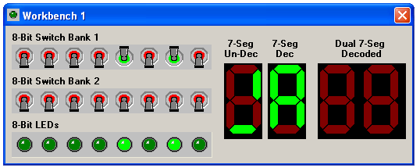
Writing to the single un-decoded and decoded 7-segment displays

Slide 27
SW8BIT1: .EQU $F000 # Upper 8-bit switches
LED8BIT: .EQU $F020 # 8-bit LEDs
SUD7SEG: .EQU $F021 # Single un-decoded 7-segment
SD7SEG: .EQU $F022 # Single decoded 7-segment
.ORG $4000 # Set program origin
LOOP: LDA [SW8BIT1] # Read from 8-bit switches
STA [LED8BIT] # Write to 8-bit LED Display
STA [SD7SEG] # Single decoded 7-seg display
GETPAT: AND %00001111 # Mask out the MS four bits
STA [TEMPX+1] # Store ACC to LS of temp X
BLDX [TEMPX] # Load the index register
LDA [NUM_0_3,X] # Load ACC with correct pattern
STA [SUD7SEG] # Single un-decoded 7-seg
JMP [LOOP] # Do it all again
TEMPX: .2BYTE $0000
NUM_0_3: .BYTE %00111111, %00110000, %01011011, %01001111
NUM_4_7: .BYTE %01100110, %01101101, %01111101, %00000111
NUM_8_B: .BYTE %01111111, %01100111, %01110111, %01111100
NUM_C_F: .BYTE %00111001, %01011110, %01111001, %01110001
.END
Modify program to decode for un-decoded 7-seg display in software

Slide 28
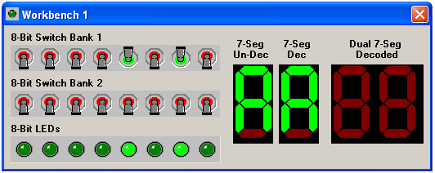
Performing decoding for the un-decoded 7-segment display in software

Slide 29
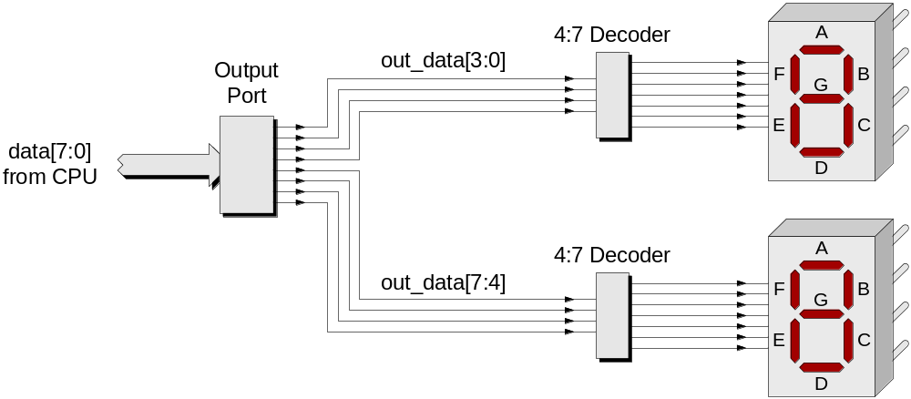
Dual decoded 7-segment display

Slide 30
SW8BIT1: .EQU $F000 # Upper 8-bit switches
LED8BIT: .EQU $F020 # 8-bit LEDs
SUD7SEG: .EQU $F021 # Single un-decoded 7-segment
SD7SEG: .EQU $F022 # Dingle decoded 7-segment
DD7SEG: .EQU $F023 # Dual decoded 7-segment
.ORG $4000 # Set program origin
LOOP: LDA [SW8BIT1] # Read from upper 8-bit switches
STA [LED8BIT] # Write to 8-bit LED Display
STA [SD7SEG] # Single decoded 7-segment
STA [DD7SEG] # Dual decoded 7-segment display
STA [SUD7SEG] # Single un-decoded 7-segment
JMP [LOOP] # Do it all again
.END
Modify program to write to dual decoded 7-segment display

Slide 31
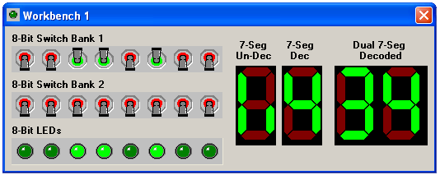
Writing to all of the displays

